Slide 1

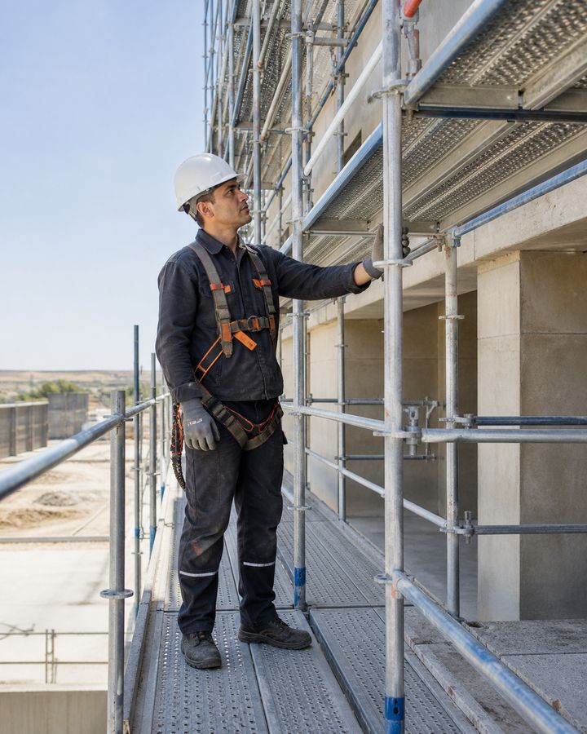
TRAINING COURSE
Scaffolding erection work
Safe installation, operation and dismantling of scaffolding
Training course for workers and line personnel
Scaffolding erection work
01
Notes:
[Sources]
- SafetyHub canonical RU slide source: content/source-materials/derived/lesomontazhnye-raboty/presentation.pptx
- Reviewed EN text map: content/localizations/staged-2026-09-01/presentations/lesomontazhnye-raboty/en/text-map.json

Slide 2
After the course worker will be able to
01
Before erection, check the authorization, design, base and hazard zone.
The safety of scaffolding is determined by the system as a whole, and not by one strong element.
02
Recognize the basic elements of scaffolding and the purpose of ties, decking and fencing.
03
Use scaffolds safely and understand their approval status.
04
Stop operation if deformed, subsidence, overloaded or hazardous weather occurs.
Scaffolding erection work
02
Notes:
[Sources]
- SafetyHub canonical RU slide source: content/source-materials/derived/lesomontazhnye-raboty/presentation.pptx
- Reviewed EN text map: content/localizations/staged-2026-09-01/presentations/lesomontazhnye-raboty/en/text-map.json

Slide 3
Course logic
01
Admission, roles and planning.
COURSE
02
Elements, foundation and stability.
5
03
Flooring, access and fall protection.
04
Inspection, use and dismantling.
semantic blocks
05
Work stoppage and emergency actions.
Scaffolding erection work
03
Notes:
[Sources]
- SafetyHub canonical RU slide source: content/source-materials/derived/lesomontazhnye-raboty/presentation.pptx
- Reviewed EN text map: content/localizations/staged-2026-09-01/presentations/lesomontazhnye-raboty/en/text-map.json

Slide 4
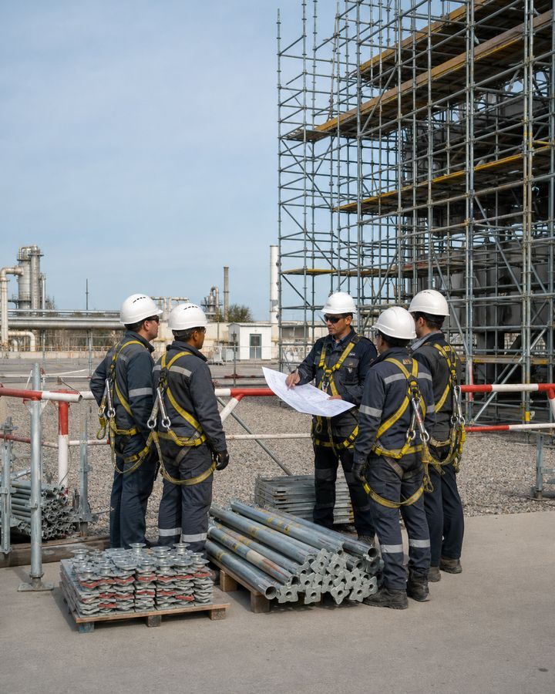
01
Admission and planning
Installation begins with the appointment of responsible persons, design and assessment of site conditions.
Scaffolding erection work
04
Notes:
[Sources]
- SafetyHub canonical RU slide source: content/source-materials/derived/lesomontazhnye-raboty/presentation.pptx
- Reviewed EN text map: content/localizations/staged-2026-09-01/presentations/lesomontazhnye-raboty/en/text-map.json

Slide 5
Installation is carried out by a trained team
• Erection, alteration and dismantling are assigned to trained workers under designated supervision.
• Inspection and authorization for use are performed by a person assigned that function who knows the scaffolding system.
• A user must not alter the working platform, ties, fastenings or guardrails without authorization.
• Authorizations for work at height, in electrical hazard zones and for lifting operations are checked separately.
Authorization to use scaffolding does not authorize the user to alter it.
Standard: Work at Height — Order No. 109
Scaffolding erection work
05
Notes:
[Sources]
- SafetyHub canonical RU slide source: content/source-materials/derived/lesomontazhnye-raboty/presentation.pptx
- Reviewed EN text map: content/localizations/staged-2026-09-01/presentations/lesomontazhnye-raboty/en/text-map.json

Slide 6
Roles share responsibilities
• The work supervisor plans the sequence, resources and safe conditions.
• The erector follows the erection scheme, checks each component before installation and reports deviations.
• The designated competent person inspects the system and records its authorization-for-use status.
• The user performs a visual pre-use check and observes the restrictions.
Everyone is responsible for their own verification, but changes are permitted only by an authorized person.
Scaffolding erection work
06
Notes:
[Sources]
- SafetyHub canonical RU slide source: content/source-materials/derived/lesomontazhnye-raboty/presentation.pptx
- Reviewed EN text map: content/localizations/staged-2026-09-01/presentations/lesomontazhnye-raboty/en/text-map.json

Slide 7
Work at height starts from 1.3 meters
• Work at height includes work at a height or depth of 1.3 m or more.
• A distance of less than 2 m from the unfenced boundary of the drop is also taken into account.
• Safety is ensured by collective protection, access and, if necessary, a safety net.
• Specific measures are recorded in the work project and work permit.
Height is assessed along with drop edge and actual access.
Standard: Work at Height — Order No. 109
Scaffolding erection work
07
Notes:
[Sources]
- SafetyHub canonical RU slide source: content/source-materials/derived/lesomontazhnye-raboty/presentation.pptx
- Reviewed EN text map: content/localizations/staged-2026-09-01/presentations/lesomontazhnye-raboty/en/text-map.json

Slide 8
Planning precedes installation
1
2
3
4
Explore
Inspect
Organize
Instruct
The design, system technical manual, erection scheme, permit-to-work and restrictions.
Base, facade, openings, communications, traffic and weather.
Danger zone, storage, lifting, access and rescue operations.
Distribute roles, signals, installation order and stopping conditions.
An unknown type of scaffolding or a missing diagram is a reason not to start installation.
Standard: Work at Height — Order No. 109
Scaffolding erection work
08
Notes:
[Sources]
- SafetyHub canonical RU slide source: content/source-materials/derived/lesomontazhnye-raboty/presentation.pptx
- Reviewed EN text map: content/localizations/staged-2026-09-01/presentations/lesomontazhnye-raboty/en/text-map.json

Slide 9
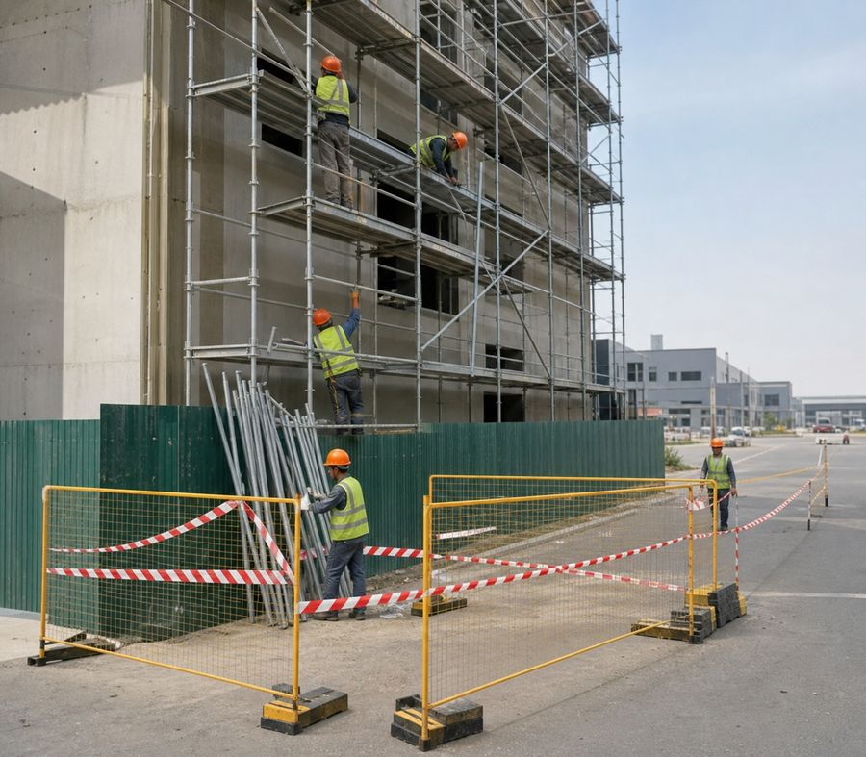
The danger zone is fenced off before work begins
• The boundary is defined according to the height, nature of the work and possible trajectory of falling objects.
• Barriers and signs must be visible, stable and must not create a new risk.
• Pedestrian and vehicle movement through the zone is coordinated or stopped.
• Materials must not be placed beyond the zone boundary where they could obstruct evacuation routes.
The fence protects people below even before the first element appears above.
Standard: Work at Height — Order No. 109
Scaffolding erection work
09
Notes:
[Sources]
- SafetyHub canonical RU slide source: content/source-materials/derived/lesomontazhnye-raboty/presentation.pptx
- Reviewed EN text map: content/localizations/staged-2026-09-01/presentations/lesomontazhnye-raboty/en/text-map.json

Slide 10
02
Scaffolding system and stability
Dimensions, spacing and fastenings are determined only from the design, technical manual and scheme for the specific system.
Scaffolding erection work
10
Notes:
[Sources]
- SafetyHub canonical RU slide source: content/source-materials/derived/lesomontazhnye-raboty/presentation.pptx
- Reviewed EN text map: content/localizations/staged-2026-09-01/presentations/lesomontazhnye-raboty/en/text-map.json

Slide 11
Scaffold Type Determines Assembly Method
• Frame, clamp, wedge and other systems have different components and limitations.
• Elements of different systems are not mixed without confirmed compatibility.
• The diagram specifies the sequence, height of tiers, connections, fastenings and access.
• Damaged or unknown item is not used as a universal replacement.
There is no universal installation scheme for all scaffolding.
Scaffolding erection work
11
Notes:
[Sources]
- SafetyHub canonical RU slide source: content/source-materials/derived/lesomontazhnye-raboty/presentation.pptx
- Reviewed EN text map: content/localizations/staged-2026-09-01/presentations/lesomontazhnye-raboty/en/text-map.json

Slide 12
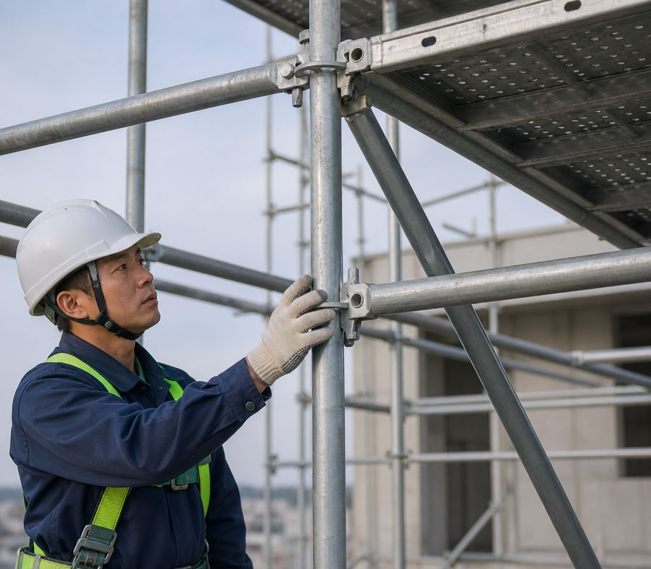
Each element performs its own function
• Standards transfer vertical loads to the base.
• Ledgers and transoms form the tiers and support the working platform.
• Ties and diagonal braces provide spatial rigidity.
• Clamps, wedges, locks and fastenings connect the system in accordance with the manufacturer's diagram.
Removing one element can change the stability of the entire section.
Scaffolding erection work
12
Notes:
[Sources]
- SafetyHub canonical RU slide source: content/source-materials/derived/lesomontazhnye-raboty/presentation.pptx
- Reviewed EN text map: content/localizations/staged-2026-09-01/presentations/lesomontazhnye-raboty/en/text-map.json

Slide 13
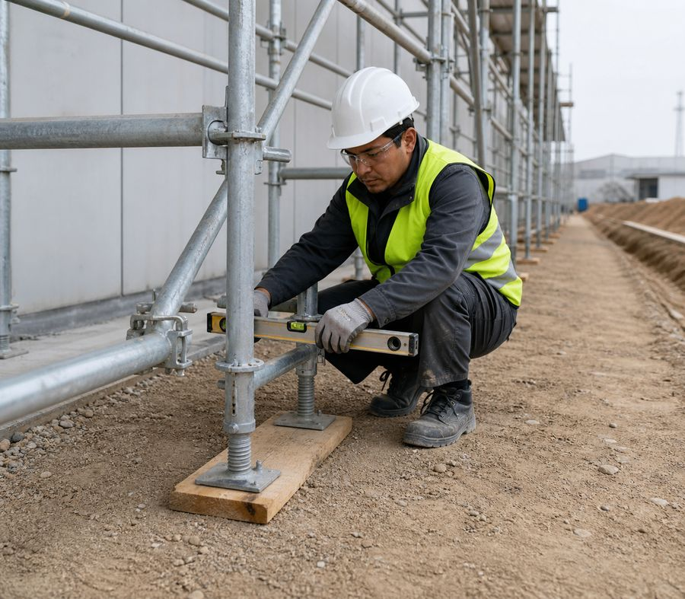
The base safely transfers the load
• Assess load-bearing capacity, levelness, drainage, voids, trenches and possible settlement.
• Ice, loose soil, debris and random pads are not a reliable foundation.
• The load is distributed by the provided support elements.
• The condition of the foundation is monitored during operation, especially after precipitation and excavation work.
Vertical scaffolding does not compensate for a weak foundation.
Scaffolding erection work
13
Notes:
[Sources]
- SafetyHub canonical RU slide source: content/source-materials/derived/lesomontazhnye-raboty/presentation.pptx
- Reviewed EN text map: content/localizations/staged-2026-09-01/presentations/lesomontazhnye-raboty/en/text-map.json

Slide 14
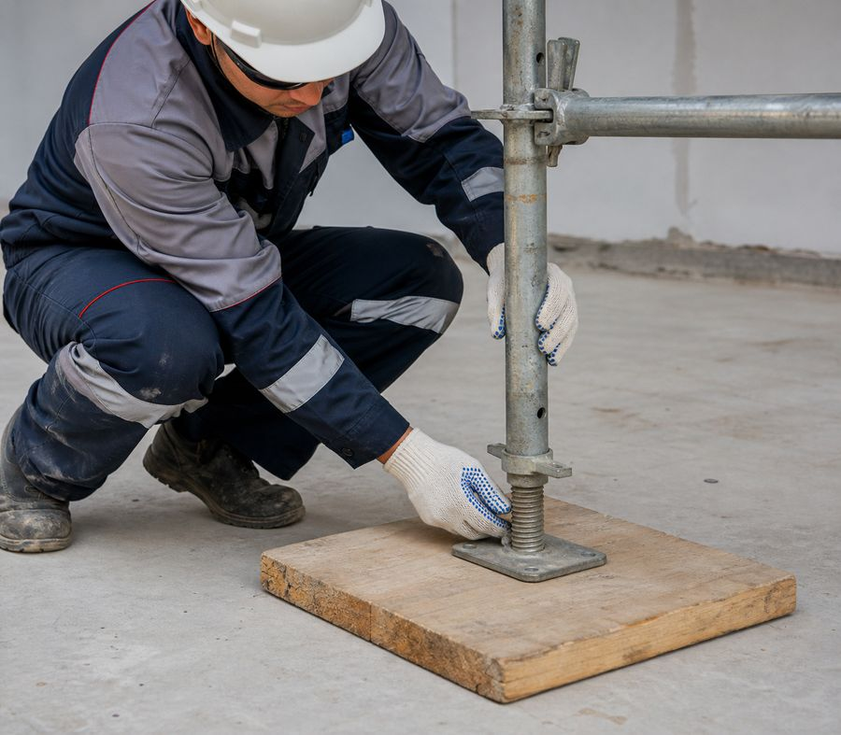
Support boards and bases work together
• The size and material of the support board are taken according to the design and load calculation.
• The base plate rests entirely on the pad and does not hang over the edge.
• The screw jack is used only within the manufacturer's permissible range.
• Bricks, scraps and loose packages of material are not used as linings.
Do not carry over questionable old dimensions: the design for the specific scaffolding applies.
Scaffolding erection work
14
Notes:
[Sources]
- SafetyHub canonical RU slide source: content/source-materials/derived/lesomontazhnye-raboty/presentation.pptx
- Reviewed EN text map: content/localizations/staged-2026-09-01/presentations/lesomontazhnye-raboty/en/text-map.json

Slide 15
Geometry is checked during installation
• Check verticality, horizontality and distances after each section.
• Set spacing of standards, tiers and fastenings from the design and the system technical manual.
• Do not correct a deviation by forced bending or improvised bracing.
• Remove the cause of misalignment or settlement before erection continues.
The accumulated small error turns into a dangerous misalignment at height.
Scaffolding erection work
15
Notes:
[Sources]
- SafetyHub canonical RU slide source: content/source-materials/derived/lesomontazhnye-raboty/presentation.pptx
- Reviewed EN text map: content/localizations/staged-2026-09-01/presentations/lesomontazhnye-raboty/en/text-map.json

Slide 16
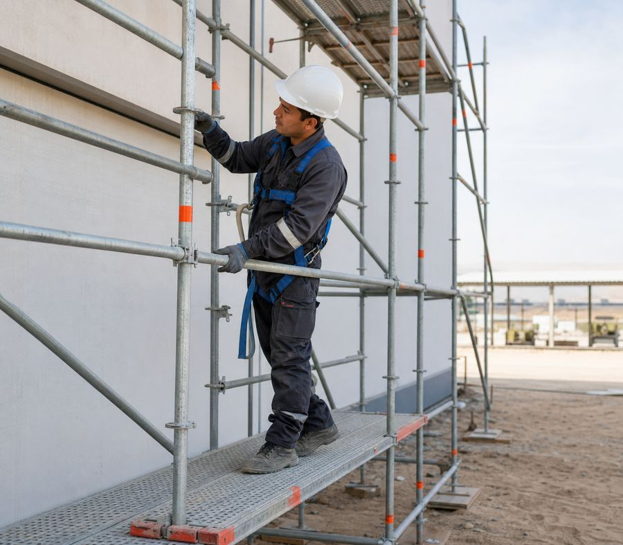
Connections ensure system rigidity
• Longitudinal and transverse connections are installed in the places and sequence specified by the diagram.
• The connection must be properly secured to the designated nodes.
• Temporary withdrawal is permitted only through an authorized procedure with a replacement measure.
• After impact, movement or reconfiguration, connections are rechecked.
The connection cannot be considered “superfluous”, even if working platform is not loaded yet.
Scaffolding erection work
16
Notes:
[Sources]
- SafetyHub canonical RU slide source: content/source-materials/derived/lesomontazhnye-raboty/presentation.pptx
- Reviewed EN text map: content/localizations/staged-2026-09-01/presentations/lesomontazhnye-raboty/en/text-map.json

Slide 17
Braces stabilize the plane
• Install diagonal braces from the start of erection, not after full height has been reached.
• Their direction, number and fastening points are specified by the scheme for the particular system.
• Remove any bent, cracked or unsecured brace from service.
• Unauthorized removal to create access or transfer material is prohibited.
A missing brace may cause the section to collapse.
Scaffolding erection work
17
Notes:
[Sources]
- SafetyHub canonical RU slide source: content/source-materials/derived/lesomontazhnye-raboty/presentation.pptx
- Reviewed EN text map: content/localizations/staged-2026-09-01/presentations/lesomontazhnye-raboty/en/text-map.json

Slide 18
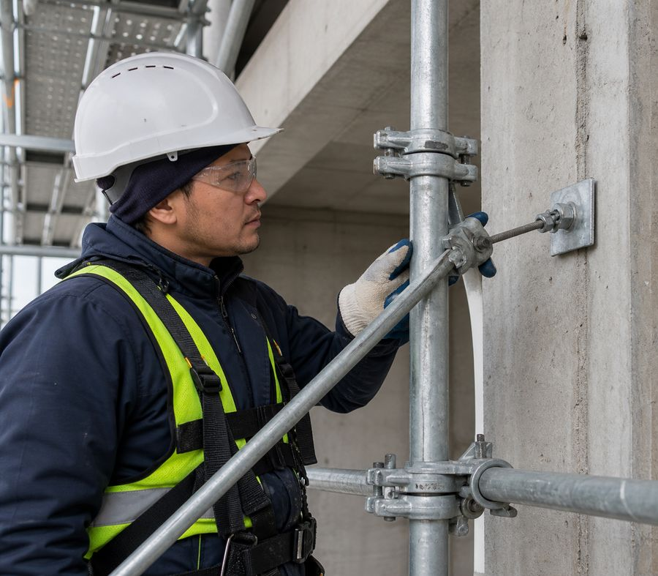
Structure Fastening Follows the Diagram
• Anchor type, base, assembly and location are determined by design and calculation.
• The fastener is not installed in weak or unknown material without confirmation.
• Anchors are installed sequentially, maintaining the stability of the free area.
• Removal of fastenings during dismantling is carried out in the reverse order and only after the tiers are freed.
The strength of an anchor is demonstrated by the design and foundation, not by its appearance.
Scaffolding erection work
18
Notes:
[Sources]
- SafetyHub canonical RU slide source: content/source-materials/derived/lesomontazhnye-raboty/presentation.pptx
- Reviewed EN text map: content/localizations/staged-2026-09-01/presentations/lesomontazhnye-raboty/en/text-map.json

Slide 19
Load limited by scaffold class
• The permitted load is stated in the design, system technical manual or system marking.
• Account for people, materials, tools, pallets, temporary devices and dynamic effects during material delivery.
• Distribute material evenly and do not store it at an unprotected edge.
• An unknown or exceeded load requires unloading and inspection.
Old load values ​​are not applied without confirmation for this system.
Scaffolding erection work
19
Notes:
[Sources]
- SafetyHub canonical RU slide source: content/source-materials/derived/lesomontazhnye-raboty/presentation.pptx
- Reviewed EN text map: content/localizations/staged-2026-09-01/presentations/lesomontazhnye-raboty/en/text-map.json

Slide 20
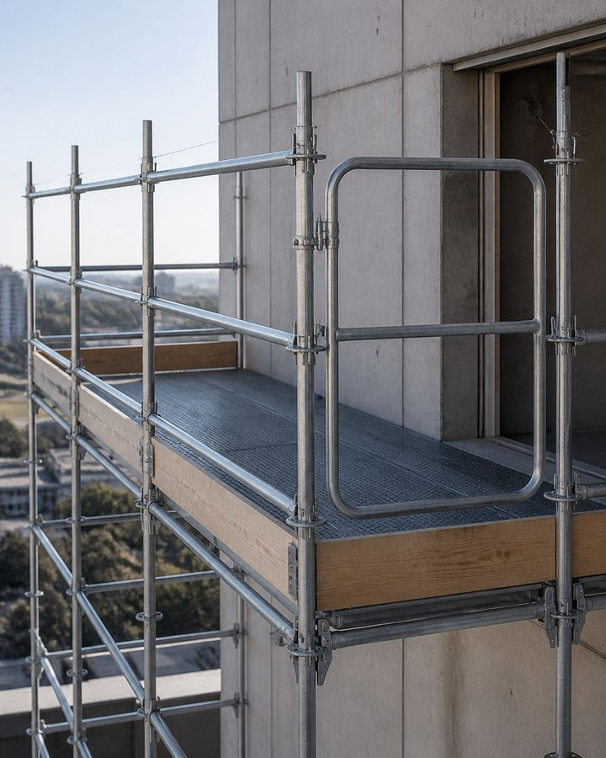
03
working platform, access and security
The work area must be continuous, fenced and accessible without climbing the structure.
Scaffolding erection work
20
Notes:
[Sources]
- SafetyHub canonical RU slide source: content/source-materials/derived/lesomontazhnye-raboty/presentation.pptx
- Reviewed EN text map: content/localizations/staged-2026-09-01/presentations/lesomontazhnye-raboty/en/text-map.json

Slide 21
working platform is selected as a system element
• Plank and metal decks must be suitable for the system, span and load.
• Damaged boards, deformed panels and elements with loose locks are rejected.
• working platform are laid in the prescribed direction and on standard supports.
• Random boards and materials are not used instead of working flooring.
working platform is a load-bearing element, and not just a surface for walking.
Scaffolding erection work
21
Notes:
[Sources]
- SafetyHub canonical RU slide source: content/source-materials/derived/lesomontazhnye-raboty/presentation.pptx
- Reviewed EN text map: content/localizations/staged-2026-09-01/presentations/lesomontazhnye-raboty/en/text-map.json

Slide 22
working platform secured against displacement
• Secure panels and boards with the specified locks, stops or prescribed method.
• Set gaps and overlaps according to the technical manual and erection scheme.
• Guard openings and temporarily removed sections immediately.
• After moving material, check that the working platform and guardrails have not shifted.
The immobility of the flooring is checked before people are admitted.
Scaffolding erection work
22
Notes:
[Sources]
- SafetyHub canonical RU slide source: content/source-materials/derived/lesomontazhnye-raboty/presentation.pptx
- Reviewed EN text map: content/localizations/staged-2026-09-01/presentations/lesomontazhnye-raboty/en/text-map.json

Slide 23
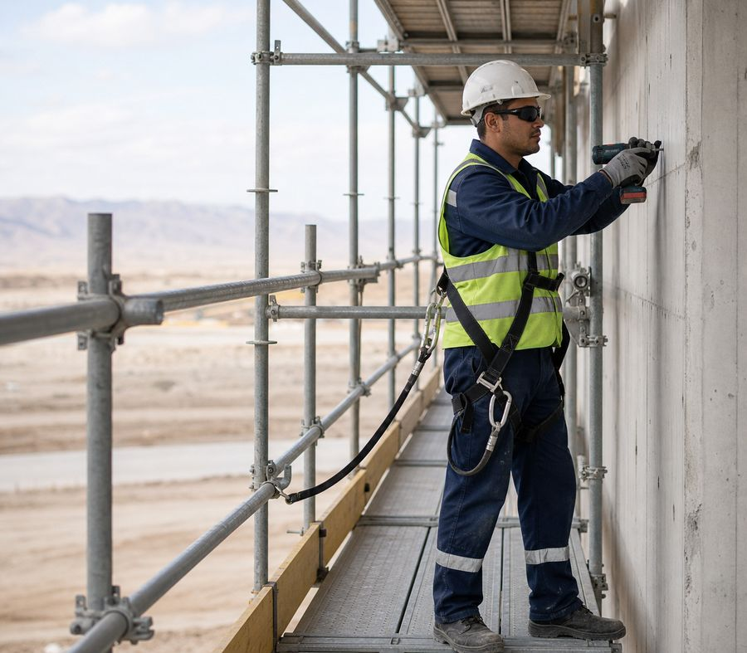
Guardrail protects against falling off the edge
• Handrails, intermediate elements and side protection are installed according to the system and design.
• The fencing must be continuous on the working level and at the ends.
• The removed fencing element is immediately replaced with an equivalent measure and restored.
• It is prohibited to stand on the handrail or use it as a support for climbing.
Collective protection applies to all workers at the same time.
Standard: Work at Height — Order No. 109
Scaffolding erection work
23
Notes:
[Sources]
- SafetyHub canonical RU slide source: content/source-materials/derived/lesomontazhnye-raboty/presentation.pptx
- Reviewed EN text map: content/localizations/staged-2026-09-01/presentations/lesomontazhnye-raboty/en/text-map.json

Slide 24
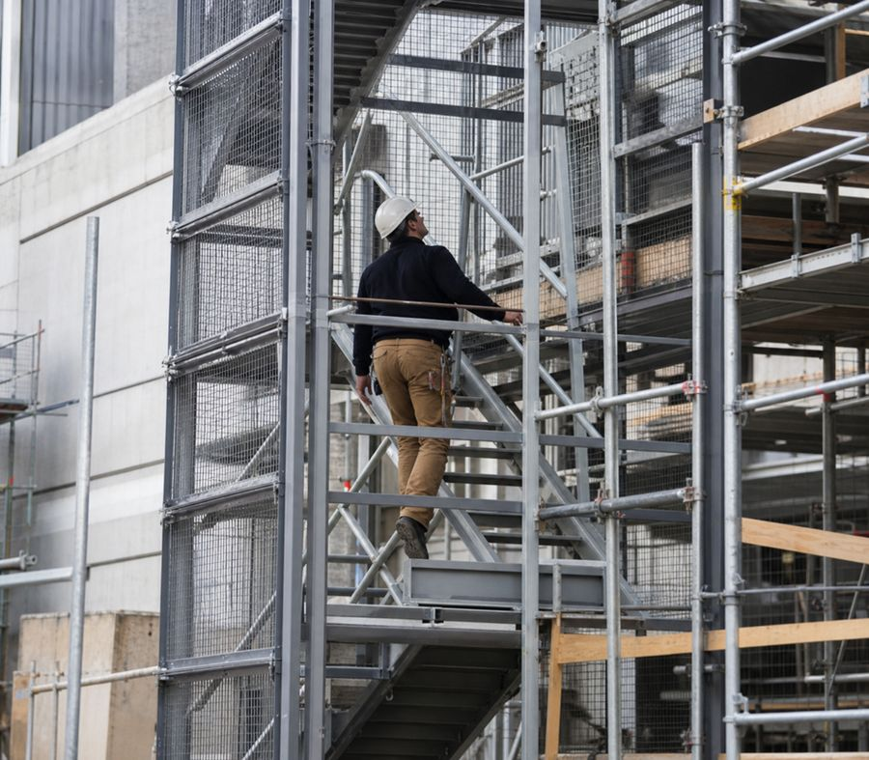
Access is organized separately from the structure
• The tiers are climbed using provided stairs, flights of stairs or towers.
• Do not climb on braces, posts, exteriors or loose elements.
• Entry and exit should not require climbing over a fence without a protected opening.
• Hatches and platforms are kept free of materials.
Safe working platform is useless if there is a dangerous climb leading to it.
Scaffolding erection work
24
Notes:
[Sources]
- SafetyHub canonical RU slide source: content/source-materials/derived/lesomontazhnye-raboty/presentation.pptx
- Reviewed EN text map: content/localizations/staged-2026-09-01/presentations/lesomontazhnye-raboty/en/text-map.json

Slide 25
Stairs must be part of the solution
• The ladder type, angle, fastening and exit are defined by the design and scaffolding documentation.
• Steps, side rails, landings and locking components are checked before use.
• The ladder is kept clear and is not used while a long load is being raised through the same access.
• Defective access is closed until it is restored.
Conflicting old step intervals are not carried forward as a universal norm.
Scaffolding erection work
25
Notes:
[Sources]
- SafetyHub canonical RU slide source: content/source-materials/derived/lesomontazhnye-raboty/presentation.pptx
- Reviewed EN text map: content/localizations/staged-2026-09-01/presentations/lesomontazhnye-raboty/en/text-map.json

Slide 26
Materials are lifted separately from people
• Use the specified lifting aids, containers and load-receiving points.
• Clear the load route and the area below, and agree the handling command in advance.
• Secure tools and small parts against falling.
• A load may be carried on a ladder only if a safe grip and support can be maintained.
The worker’s hands on the ladder are primarily intended for safe ascent.
Scaffolding erection work
26
Notes:
[Sources]
- SafetyHub canonical RU slide source: content/source-materials/derived/lesomontazhnye-raboty/presentation.pptx
- Reviewed EN text map: content/localizations/staged-2026-09-01/presentations/lesomontazhnye-raboty/en/text-map.json

Slide 27
Collective protection applied first
• Installation is planned so that fences and protected areas appear as early as possible.
• fall-arrest system is used where risk cannot be eliminated by collective action.
• The installation method must protect the worker when installing the next tier.
• Removal of protection is permitted only with a controlled alternative.
The priority is to prevent the fall, not just stop it.
Standard: Work at Height — Order No. 109
Scaffolding erection work
27
Notes:
[Sources]
- SafetyHub canonical RU slide source: content/source-materials/derived/lesomontazhnye-raboty/presentation.pptx
- Reviewed EN text map: content/localizations/staged-2026-09-01/presentations/lesomontazhnye-raboty/en/text-map.json

Slide 28
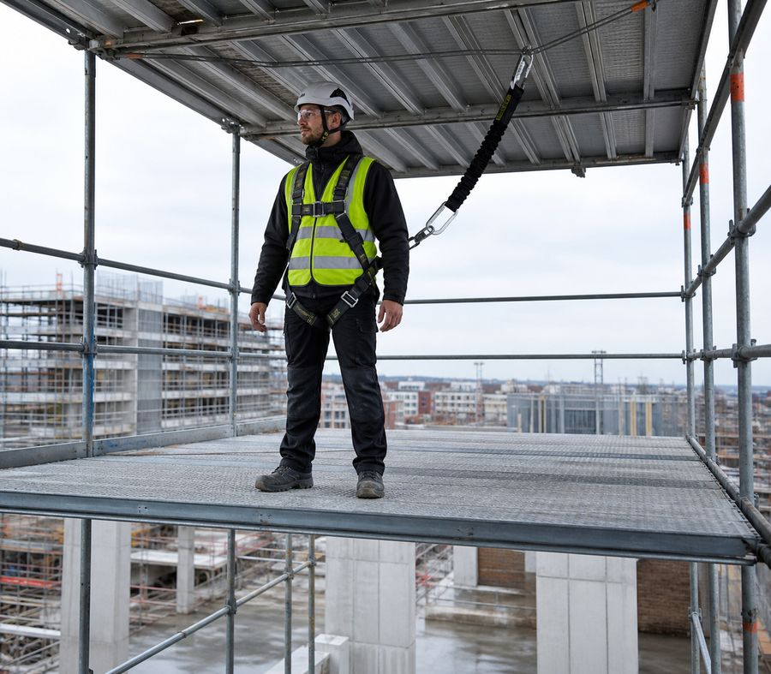
Fall Arrest Needs Adequate Clearance
• Use a compatible system suitable for the task and workplace conditions.
• The anchor point is selected by the responsible person with confirmation of suitability.
• Take into account the length of the connecting subsystem, shock absorber opening and headroom.
• Components are inspected before use; damaged ones are taken out of service.
Hooking onto the nearest member does not provide safe fall protection.
Standard: Work at Height — Order No. 109
Scaffolding erection work
28
Notes:
[Sources]
- SafetyHub canonical RU slide source: content/source-materials/derived/lesomontazhnye-raboty/presentation.pptx
- Reviewed EN text map: content/localizations/staged-2026-09-01/presentations/lesomontazhnye-raboty/en/text-map.json

Slide 29
Objects protect against falling
• Install side elements, protective nets or other prescribed measures.
• The tool is secured, small parts are stored in a closed container.
• Material is not folded at the edge or thrown down.
• The danger zone below is maintained until work and cleaning are completed.
A hard hat reduces the severity of injury but is not a substitute for preventing falling objects.
Scaffolding erection work
29
Notes:
[Sources]
- SafetyHub canonical RU slide source: content/source-materials/derived/lesomontazhnye-raboty/presentation.pptx
- Reviewed EN text map: content/localizations/staged-2026-09-01/presentations/lesomontazhnye-raboty/en/text-map.json

Slide 30
Electrical Systems Change Erection Conditions
• Before work, lines, cables, live parts and possible induced voltage are identified.
• Dangerous distances and protective measures are determined by the permit and responsible persons.
• Metal elements are not moved toward wires without a controlled pattern.
• If the position of the line or scaffolding changes, the assessment is repeated.
The safe distance to eye strain cannot be determined.
Standard: Work at Height — Order No. 109
Scaffolding erection work
30
Notes:
[Sources]
- SafetyHub canonical RU slide source: content/source-materials/derived/lesomontazhnye-raboty/presentation.pptx
- Reviewed EN text map: content/localizations/staged-2026-09-01/presentations/lesomontazhnye-raboty/en/text-map.json

Slide 31
Weather may require a stop
• Wind, thunderstorms, precipitation, ice, heat and poor visibility affect human stability and performance.
• Limit conditions are accepted according to the project, system passport and local instructions.
• After unfavorable weather, check the base, fastenings, working platform and protective elements.
• Work does not resume just because the rainfall has ended.
STOP
Unvalidated universal wind speed does not replace the requirements of a specific system.
Scaffolding erection work
31
Notes:
[Sources]
- SafetyHub canonical RU slide source: content/source-materials/derived/lesomontazhnye-raboty/presentation.pptx
- Reviewed EN text map: content/localizations/staged-2026-09-01/presentations/lesomontazhnye-raboty/en/text-map.json

Slide 32
04
Inspection and operation
Scaffolding is allowed to work only after inspection, and changes require a new inspection.
Scaffolding erection work
32
Notes:
[Sources]
- SafetyHub canonical RU slide source: content/source-materials/derived/lesomontazhnye-raboty/presentation.pptx
- Reviewed EN text map: content/localizations/staged-2026-09-01/presentations/lesomontazhnye-raboty/en/text-map.json

Slide 33
The test covers the entire system
1
2
3
4
Base
Design
Working tier
Status
Subsidence, pads, bases, water and soil conditions.
Standards, ledgers, ties, diagonal braces, locks and anchors.
working platform, barriers, access, hatches and object protection.
Loading, restrictions, marking and recording of inspection results.
Testing one tier does not confirm the safety of the entire system.
Scaffolding erection work
33
Notes:
[Sources]
- SafetyHub canonical RU slide source: content/source-materials/derived/lesomontazhnye-raboty/presentation.pptx
- Reviewed EN text map: content/localizations/staged-2026-09-01/presentations/lesomontazhnye-raboty/en/text-map.json

Slide 34
Re-inspection required after change
• Checked after installation and before first permission to operate.
• Re-inspection is required after configuration changes, damage or shock.
• Adverse weather, subsidence and long breaks also require inspection.
• Access is restricted until security is confirmed.
The previous authorization-for-use status is no longer valid after a material change in conditions.
Scaffolding erection work
34
Notes:
[Sources]
- SafetyHub canonical RU slide source: content/source-materials/derived/lesomontazhnye-raboty/presentation.pptx
- Reviewed EN text map: content/localizations/staged-2026-09-01/presentations/lesomontazhnye-raboty/en/text-map.json

Slide 35
Marking shows current status
• A clear status is placed at the entrance: allowed, restricted or prohibited for use.
• Indicate the person responsible, the date of the inspection and significant restrictions, if provided for by the procedure.
• Missing or expired labeling means the status needs to be clarified.
• The user does not change the marking independently.
Label color without a local legend is not sufficient instruction.
Scaffolding erection work
35
Notes:
[Sources]
- SafetyHub canonical RU slide source: content/source-materials/derived/lesomontazhnye-raboty/presentation.pptx
- Reviewed EN text map: content/localizations/staged-2026-09-01/presentations/lesomontazhnye-raboty/en/text-map.json

Slide 36
User checks scaffolding before work
• Ensure that the clearance status is valid and applies to the correct area.
• Inspect access, working platform, fencing, cleanliness and visible damage.
• Observe load limits and tier purpose.
• Report any removed item, subsidence, wobble or tampering immediately.
The daily user review complements, but does not replace, formal review.
Scaffolding erection work
36
Notes:
[Sources]
- SafetyHub canonical RU slide source: content/source-materials/derived/lesomontazhnye-raboty/presentation.pptx
- Reviewed EN text map: content/localizations/staged-2026-09-01/presentations/lesomontazhnye-raboty/en/text-map.json

Slide 37
Unauthorized changes are prohibited
• Do not remove ties, braces, anchors, decking or guardrails for convenience.
• Do not overload a tier or place a hop-up scaffold or ladder on the working platform without a design solution.
• Do not attach hoists, hoses, banners or equipment to the scaffolding without confirmation.
• Do not use scaffolding whose status is unknown or that has visible damage.
STOP
Any load or configuration change requires approval and verification.
Scaffolding erection work
37
Notes:
[Sources]
- SafetyHub canonical RU slide source: content/source-materials/derived/lesomontazhnye-raboty/presentation.pptx
- Reviewed EN text map: content/localizations/staged-2026-09-01/presentations/lesomontazhnye-raboty/en/text-map.json

Slide 38
Dismantling is done from top to bottom
1
2
3
4
Release
Fence
Disassemble
Send
Remove people, materials, debris and foreign fixtures.
Restore the danger zone, signals and order of transmission of elements.
Remove from top to bottom, maintaining connections and anchors until the permitted stage.
Do not throw items; inspect, sort and store sustainably.
Premature removal of a tie or anchor may cause the remaining part to collapse.
Scaffolding erection work
38
Notes:
[Sources]
- SafetyHub canonical RU slide source: content/source-materials/derived/lesomontazhnye-raboty/presentation.pptx
- Reviewed EN text map: content/localizations/staged-2026-09-01/presentations/lesomontazhnye-raboty/en/text-map.json

Slide 39
After dismantling, the elements are sorted
• Clean elements in a way that does not damage locks, coating and geometry.
• Check for deformation, cracks, corrosion, welds and completeness.
• Suitable elements are stored by type on a stable site.
• Rejects are marked and physically separated from usable material.
The damaged item is not returned to circulation “until the next repair”.
Scaffolding erection work
39
Notes:
[Sources]
- SafetyHub canonical RU slide source: content/source-materials/derived/lesomontazhnye-raboty/presentation.pptx
- Reviewed EN text map: content/localizations/staged-2026-09-01/presentations/lesomontazhnye-raboty/en/text-map.json

Slide 40
Wooden elements: fire risk
• Remove flammable waste and avoid accumulation of dry wood and packaging.
• hot work nearby is carried out only with the provided measures and controls.
• Evacuation routes and access to fire extinguishing equipment are kept clear.
• Impregnation or coating is only taken into account if the condition and purpose are confirmed.
Wooden working platform does not become non-flammable due to old coating alone.
Standard: Fire safety rules
Scaffolding erection work
40
Notes:
[Sources]
- SafetyHub canonical RU slide source: content/source-materials/derived/lesomontazhnye-raboty/presentation.pptx
- Reviewed EN text map: content/localizations/staged-2026-09-01/presentations/lesomontazhnye-raboty/en/text-map.json

Slide 41
Deformation or subsidence requires evacuation
• Stop work, warn people and leave the dangerous area in an orderly manner.
• Protect access and do not attempt to straighten a loaded structure yourself.
• Notify supervisor and designee, describe location and signs of change.
• Resume work only after inspection, elimination of the cause and new approval.
STOP
Rocking, loosening of the lock, crackling or subsidence is not normal “shrinkage” of scaffolding.
Standard: Work at Height — Order No. 109
Scaffolding erection work
41
Notes:
[Sources]
- SafetyHub canonical RU slide source: content/source-materials/derived/lesomontazhnye-raboty/presentation.pptx
- Reviewed EN text map: content/localizations/staged-2026-09-01/presentations/lesomontazhnye-raboty/en/text-map.json

Slide 42
Final scaffolder checklist
✓
Design documentation, the system technical manual, assigned roles and a safe zone are in place.
✓
The base, bases, geometry, connections and fastenings correspond to the diagram.
✓
working platform, fencing, access and object protection complete.
✓
The authorization-for-use status is valid; load and weather are monitored.
✓
If changed, damaged or in doubt, work is stopped.
Click “Start Test”
Updated: 08/21/2026
Notes:
[Sources]
- SafetyHub canonical RU slide source: content/source-materials/derived/lesomontazhnye-raboty/presentation.pptx
- Reviewed EN text map: content/localizations/staged-2026-09-01/presentations/lesomontazhnye-raboty/en/text-map.json

