Slide 1

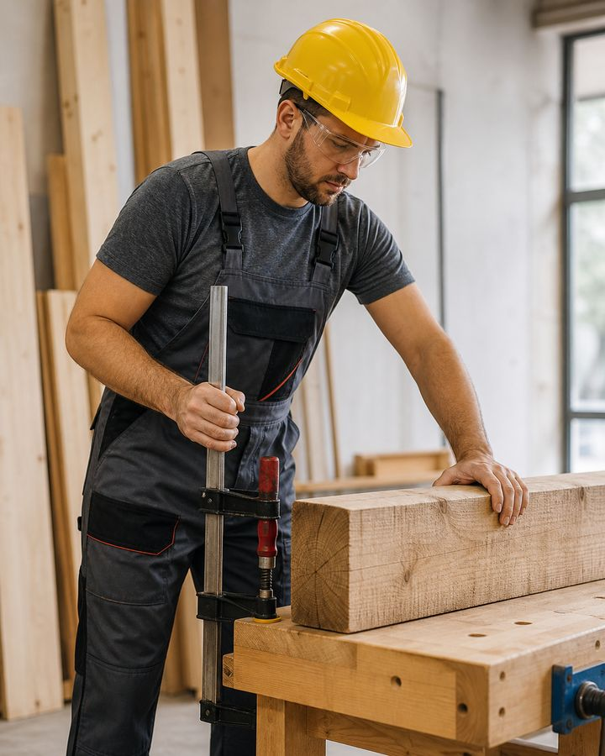
TRAINING COURSE
Carpenter
Safe organization and execution of carpentry work
Training course for workers and line personnel
Carpenter
01
Notes:
[Sources]
- SafetyHub canonical RU slide source: content/source-materials/derived/plotnik/presentation.pptx
- Reviewed EN text map: content/localizations/staged-2026-09-01/presentations/plotnik/en/text-map.json

Slide 2
After the course worker will be able to
01
Prepare the workplace, workpiece and tools before starting the operation.
Safe operation begins before the tool is turned on.
02
Choose a safe method of manual and mechanized wood processing.
03
Recognize malfunction, hazardous action and immediate stop condition.
04
Apply protective measures against dust, noise, chips, electrical and fire risks.
Carpenter
02
Notes:
[Sources]
- SafetyHub canonical RU slide source: content/source-materials/derived/plotnik/presentation.pptx
- Reviewed EN text map: content/localizations/staged-2026-09-01/presentations/plotnik/en/text-map.json

Slide 3
Course logic
01
Profession and boundaries of responsibility.
COURSE
02
Preparation of the workplace and workpiece.
5
03
Safe techniques for basic operations.
04
Tool, PPE and risk control.
semantic blocks
05
Actions in case of malfunction and incident.
Carpenter
03
Notes:
[Sources]
- SafetyHub canonical RU slide source: content/source-materials/derived/plotnik/presentation.pptx
- Reviewed EN text map: content/localizations/staged-2026-09-01/presentations/plotnik/en/text-map.json

Slide 4
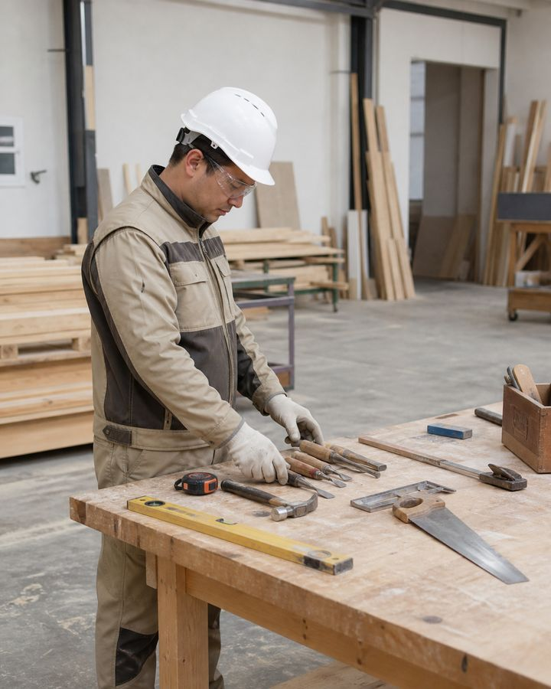
01
Profession and training
First define the task, conditions and safe way to perform it.
Carpenter
04
Notes:
[Sources]
- SafetyHub canonical RU slide source: content/source-materials/derived/plotnik/presentation.pptx
- Reviewed EN text map: content/localizations/staged-2026-09-01/presentations/plotnik/en/text-map.json

Slide 5
Carpenter Responsible for Precision and Safety
• Works with wood, sheet materials, structures and fasteners within the scope of the job.
• Reads the drawing or diagram, selects the sequence and checks the source material.
• Does not perform operations for which there is no approval, proper equipment or understandable technology.
• Coordinates changes in design and dimensions with the manager, and does not correct the project without permission.
The boundaries of a profession are determined by the task, qualifications and clearance.
Carpenter
05
Notes:
[Sources]
- SafetyHub canonical RU slide source: content/source-materials/derived/plotnik/presentation.pptx
- Reviewed EN text map: content/localizations/staged-2026-09-01/presentations/plotnik/en/text-map.json

Slide 6
Ranks Reflect Increasing Work Complexity
• 2nd–3rd categories: preparatory, simple assembly and auxiliary operations.
• 4th–5th categories: manufacturing and installation of more complex structures, precise fitting.
• 6–7th categories: particularly complex work, restoration, templates and quality control.
• A specific operation is assigned taking into account qualifications, training and local clearance.
A high level does not override the instructions and risk assessment.
Carpenter
06
Notes:
[Sources]
- SafetyHub canonical RU slide source: content/source-materials/derived/plotnik/presentation.pptx
- Reviewed EN text map: content/localizations/staged-2026-09-01/presentations/plotnik/en/text-map.json

Slide 7
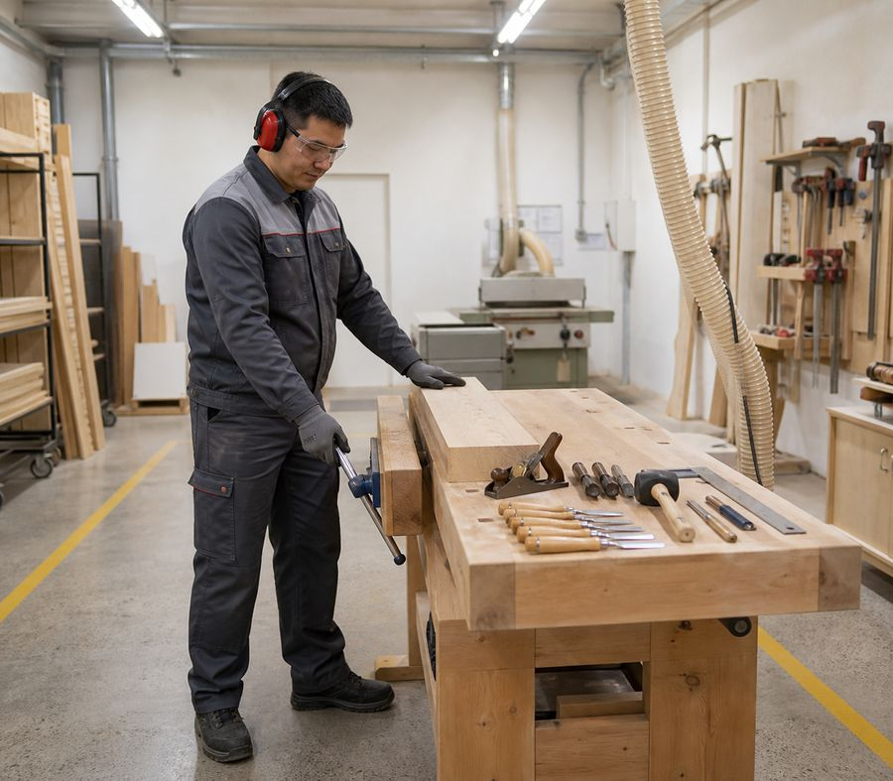
Workplace preparation reduces risk
• Remove waste and objects that interfere with stable standing and free movement.
• Provide adequate lighting, ventilation and access to emergency shutdown.
• Position the material and tool so that it does not drag across the cutting area.
• Check that walkways and escape routes are clear.
A clean place is part of technology, not cleaning after work.
Carpenter
07
Notes:
[Sources]
- SafetyHub canonical RU slide source: content/source-materials/derived/plotnik/presentation.pptx
- Reviewed EN text map: content/localizations/staged-2026-09-01/presentations/plotnik/en/text-map.json

Slide 8
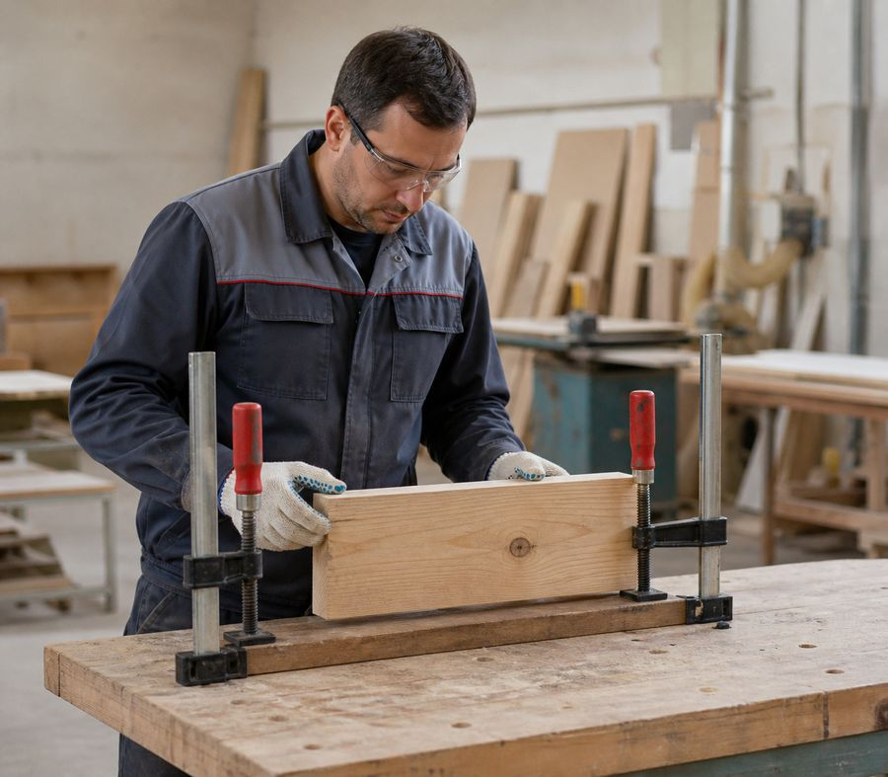
The workpiece must be inspected and secured
• Remove or mark nails, staples, stones, metal and debris.
• Check for cracks, knots, warping and grain direction.
• Secure the workpiece with stops, vices or clamps without damaging the part.
• The cutting line and tool exit must not pass through a hand, support or cable.
The hand holds the control, not the unstable workpiece.
Carpenter
08
Notes:
[Sources]
- SafetyHub canonical RU slide source: content/source-materials/derived/plotnik/presentation.pptx
- Reviewed EN text map: content/localizations/staged-2026-09-01/presentations/plotnik/en/text-map.json

Slide 9
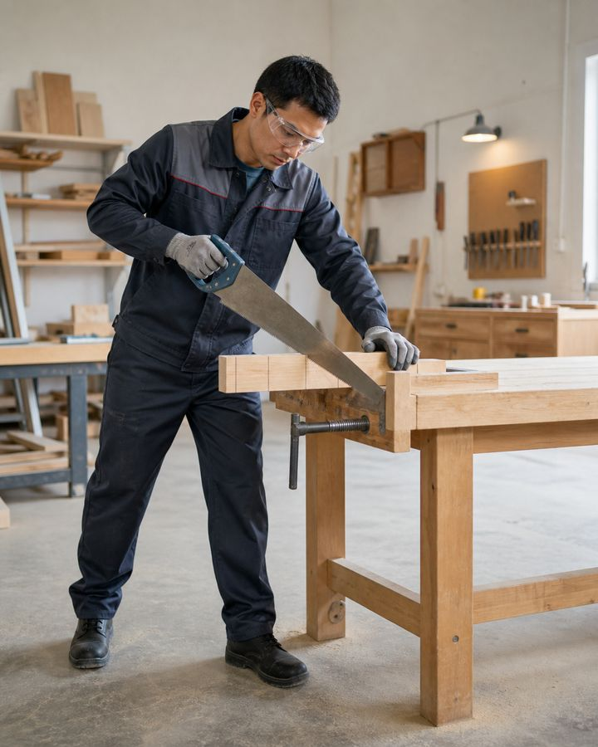
02
Safe technology
Every operation starts with a stable position and a controlled tool path.
Carpenter
09
Notes:
[Sources]
- SafetyHub canonical RU slide source: content/source-materials/derived/plotnik/presentation.pptx
- Reviewed EN text map: content/localizations/staged-2026-09-01/presentations/plotnik/en/text-map.json

Slide 10
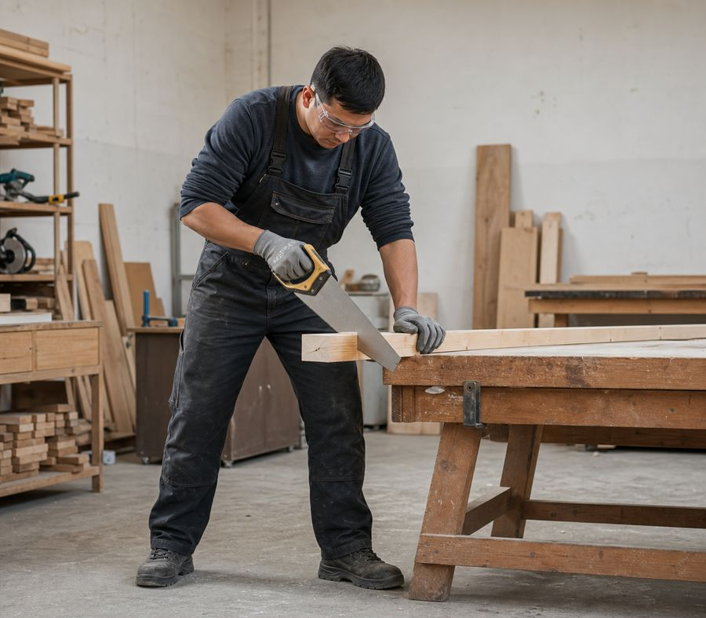
Manual sawing along a free line
• Select the saw for the material and type of cut; the blade must be serviceable and properly tensioned.
• Begin with short guiding strokes, keeping your fingers outside the blade line.
• Support the offcut so that it does not pinch the blade or break away unexpectedly.
• Do not direct the saw toward yourself or clean the teeth by hand while it is moving.
The cutting line must be clear in front of and behind the blade.
Carpenter
10
Notes:
[Sources]
- SafetyHub canonical RU slide source: content/source-materials/derived/plotnik/presentation.pptx
- Reviewed EN text map: content/localizations/staged-2026-09-01/presentations/plotnik/en/text-map.json

Slide 11
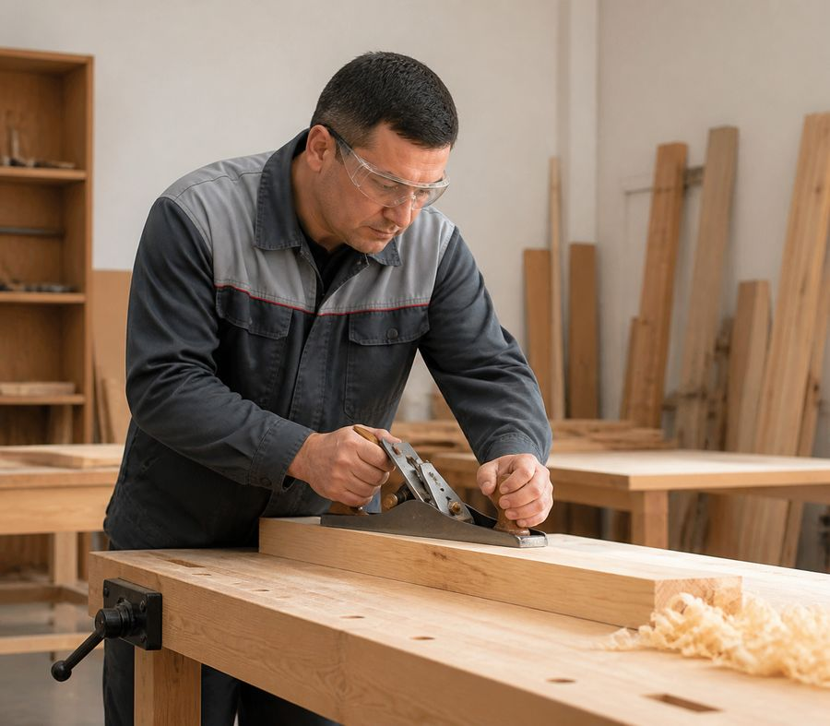
Hew and Plane Away from the Body
• Check the fastening of the ax handle and the condition of the cutting edge of the plane.
• Secure the workpiece so that it does not move when struck or passed by a tool.
• Keep your free hand out of the path of the blade and out of the area of possible slippage.
• Remove chips after stopping, using a brush or a device.
The work path does not intersect the worker’s body.
Carpenter
11
Notes:
[Sources]
- SafetyHub canonical RU slide source: content/source-materials/derived/plotnik/presentation.pptx
- Reviewed EN text map: content/localizations/staged-2026-09-01/presentations/plotnik/en/text-map.json

Slide 12
Chisel and hammer: good support
• The chisel must have a intact handle and a working ring; a dull edge can be sharpened safely.
• Do not point the cutting edge toward your palm or hold the workpiece in front of the blade.
• For the hammer, check the striker attachment, wedging and absence of cracks in the handle.
• Feed and hold fasteners in a manner that does not hit your fingers.
A properly functioning handle and proper support prevent slippage.
Carpenter
12
Notes:
[Sources]
- SafetyHub canonical RU slide source: content/source-materials/derived/plotnik/presentation.pptx
- Reviewed EN text map: content/localizations/staged-2026-09-01/presentations/plotnik/en/text-map.json

Slide 13
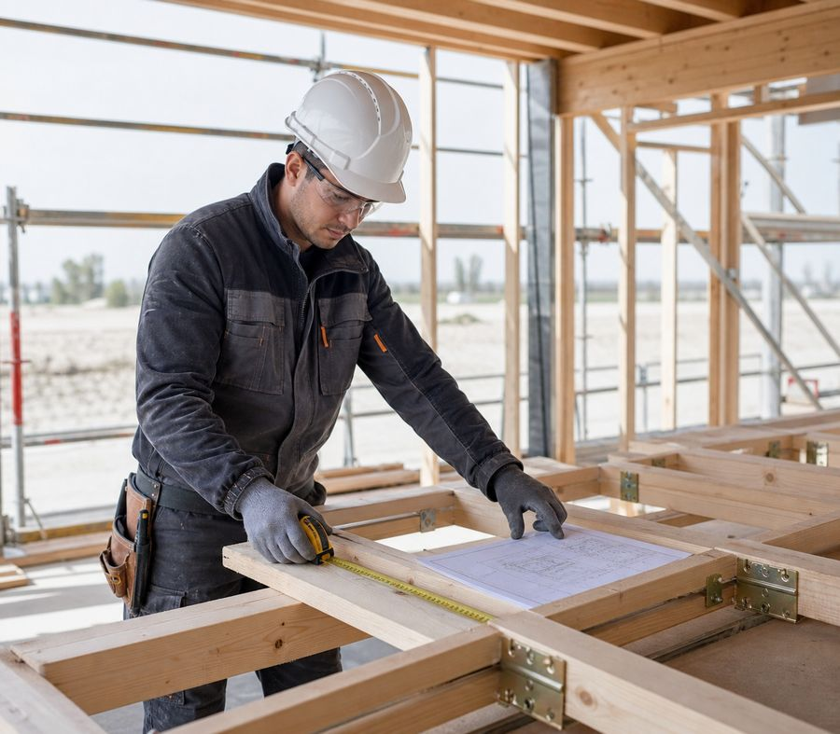
Construction Follows the Drawing
• Check the markings and components with the working documentation before cutting the material.
• Temporary supports and fastenings are not removed until the structure is stable.
• During installation, agree on the order in which the parts are supplied and ensure that there are no people under the load.
• Report deviations in size, moisture or material quality to your supervisor.
Unauthorized adjustment of the load-bearing element may change its operation.
Carpenter
13
Notes:
[Sources]
- SafetyHub canonical RU slide source: content/source-materials/derived/plotnik/presentation.pptx
- Reviewed EN text map: content/localizations/staged-2026-09-01/presentations/plotnik/en/text-map.json

Slide 14
Safe adjustment of floors and openings
• Store material stably, without blocking passages or edges of openings.
• Adjust the part at a work place with reliable fixation, and not on weight.
• When working near an opening, use the provided guards and safe access.
• Move glass, fittings and heavy elements in a coordinated manner using suitable grips.
Fitting an unclosed opening requires separate fall protection.
Standard: Work at Height — Order No. 109
Carpenter
14
Notes:
[Sources]
- SafetyHub canonical RU slide source: content/source-materials/derived/plotnik/presentation.pptx
- Reviewed EN text map: content/localizations/staged-2026-09-01/presentations/plotnik/en/text-map.json

Slide 15
Technology depends on the area of work
• Construction work: structures, formwork, decking, openings and temporary elements.
• Finishing and furniture: more precise finishing, assembly, fittings and surface quality.
• Restoration: preservation of existing material and coordinated repair technology.
• Logging operations involve a separate organization of work and risks.
The same tool does not make technologies interchangeable.
Carpenter
15
Notes:
[Sources]
- SafetyHub canonical RU slide source: content/source-materials/derived/plotnik/presentation.pptx
- Reviewed EN text map: content/localizations/staged-2026-09-01/presentations/plotnik/en/text-map.json

Slide 16
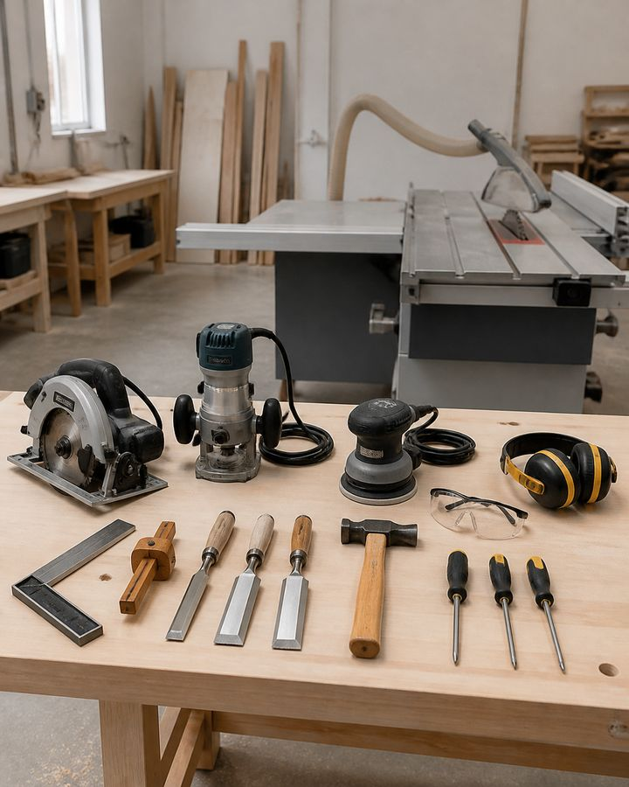
03
Tools and risks
Serviceability, suitable equipment and safety devices are more important than speed of operation.
Carpenter
16
Notes:
[Sources]
- SafetyHub canonical RU slide source: content/source-materials/derived/plotnik/presentation.pptx
- Reviewed EN text map: content/localizations/staged-2026-09-01/presentations/plotnik/en/text-map.json

Slide 17
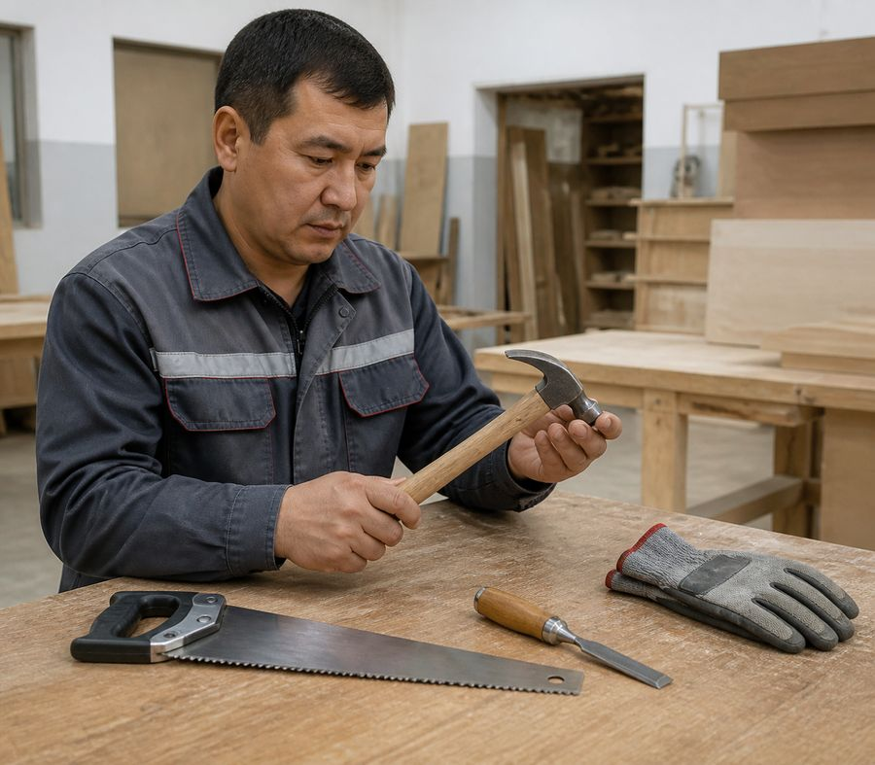
Hand tools are checked before work
• The tool matches the operation, part size and material.
• The handles are intact, dry and securely fastened; edges and teeth without cracks or chips.
• Protective covers and storage areas do not damage cutting parts.
• The faulty tool is marked and removed from use.
A handy replacement for a tool creates an unpredictable load.
Standard: Tool Safety — Order No. 204
Carpenter
17
Notes:
[Sources]
- SafetyHub canonical RU slide source: content/source-materials/derived/plotnik/presentation.pptx
- Reviewed EN text map: content/localizations/staged-2026-09-01/presentations/plotnik/en/text-map.json

Slide 18
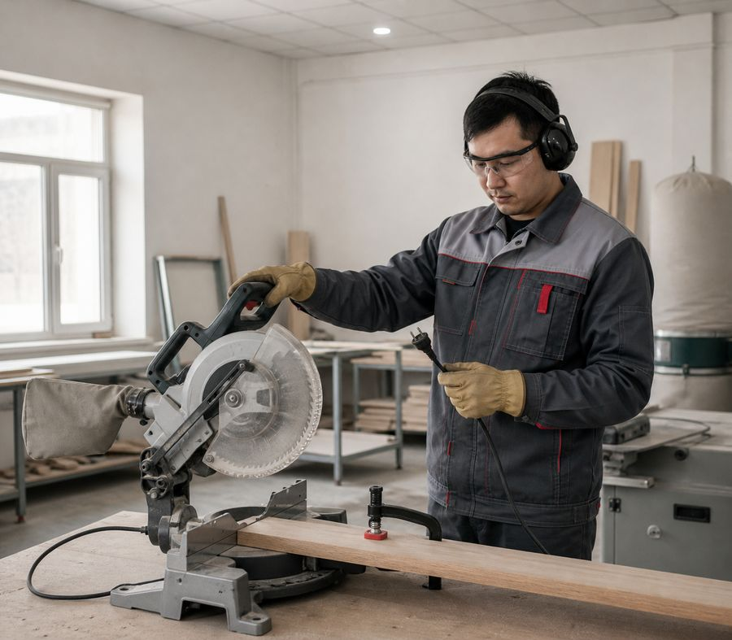
The power tool is used for its intended purpose
• Circular saw: good guard, suitable blade, stable guidance without side pressure.
• Jigsaw and router: secured workpiece, proper equipment, full stop before adjustment.
• Drill: correctly clamped drill and prevent rotation of the part.
• Sander: wheel or belt suitable for tool, material and speed allowed.
Before changing equipment, the power is turned off and accidental starting is excluded.
Standard: Tool Safety — Order No. 204
Carpenter
18
Notes:
[Sources]
- SafetyHub canonical RU slide source: content/source-materials/derived/plotnik/presentation.pptx
- Reviewed EN text map: content/localizations/staged-2026-09-01/presentations/plotnik/en/text-map.json

Slide 19
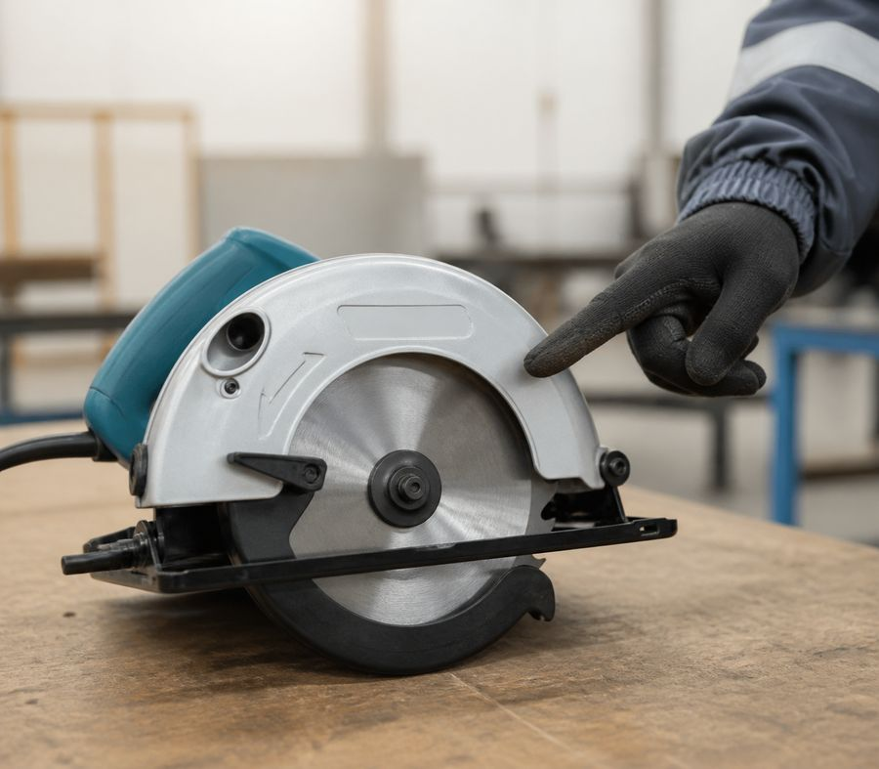
Guardrails and equipment must not be bypassed
• Covers and guards must be in place, move freely and cover the hazardous part.
• The cable, plug, switch and entry into the housing are not damaged or have any signs of overheating.
• The disc, blade, cutter or drill is the correct size and manufacturer's specifications.
• Self-made adapters, lockout switches and removal of protection are prohibited.
Protection does not interfere with work - it limits access to hazardous energy.
Standard: Tool Safety — Order No. 204
Carpenter
19
Notes:
[Sources]
- SafetyHub canonical RU slide source: content/source-materials/derived/plotnik/presentation.pptx
- Reviewed EN text map: content/localizations/staged-2026-09-01/presentations/plotnik/en/text-map.json

Slide 20
Fault means stop
• Sparking, overheating odor, unusual noise or vibration.
• Jamming, beating, crack of the disk, blade or body.
• Spontaneous starting, broken switch or protective casing.
• Damaged cable, plug, grounding or traces of moisture.
STOP
Disable - designate - report. Do not repair without authority.
Standard: Tool Safety — Order No. 204
Carpenter
20
Notes:
[Sources]
- SafetyHub canonical RU slide source: content/source-materials/derived/plotnik/presentation.pptx
- Reviewed EN text map: content/localizations/staged-2026-09-01/presentations/plotnik/en/text-map.json

Slide 21
Dust, noise and chips require control
risk / SOURCE
CONSEQUENCE
CONTROL MEASURE
Wood dust
Irritation, reduced visibility, firefighter risk
Local removal, cleaning, suitable respiratory protection
Noise
Gradual hearing loss
Functional tool, exposure limitation, hearing protection
Chips and splinters
Eye and skin injury
Guard, ejection direction, eye protection
Waste
Slipping and fire spread
Regular cleaning and safe accumulation
Dust is removed at the source rather than blown into the work area.
Standard: Fire safety rules
Carpenter
21
Notes:
[Sources]
- SafetyHub canonical RU slide source: content/source-materials/derived/plotnik/presentation.pptx
- Reviewed EN text map: content/localizations/staged-2026-09-01/presentations/plotnik/en/text-map.json

Slide 22
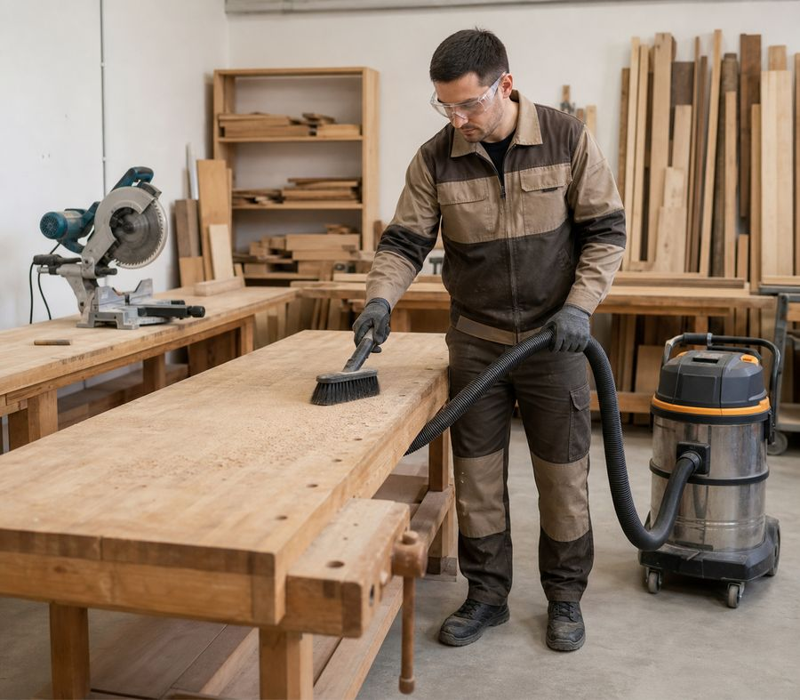
Cleaning - only after a complete stop
• Turn off the power, wait until it stops completely and prevent restarting.
• Remove chips with a brush, hook or duster, not with your hand near the cutting part.
• Check fasteners, ventilation holes and condition of equipment according to the instructions.
• Store dry tools and sharp parts in cases or designated areas.
Maintenance begins only after the hazardous energy has been removed.
Standard: Tool Safety — Order No. 204
Carpenter
22
Notes:
[Sources]
- SafetyHub canonical RU slide source: content/source-materials/derived/plotnik/presentation.pptx
- Reviewed EN text map: content/localizations/staged-2026-09-01/presentations/plotnik/en/text-map.json

Slide 23
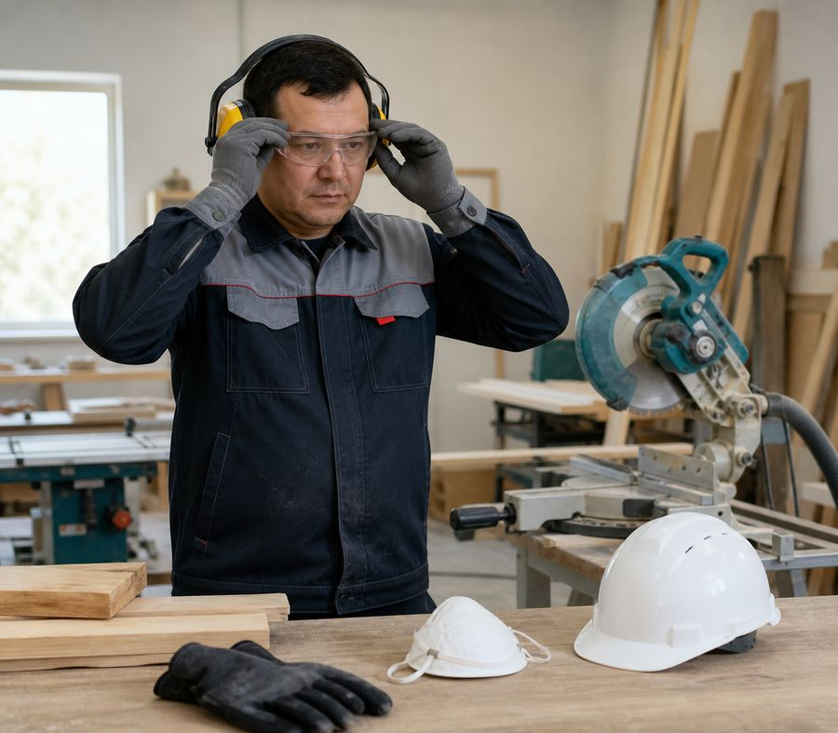
PPE selected according to actual risk
• Eye protection - in case of chips, dust and destruction of equipment; hearing protection - in case of noise.
• Respiratory protection complements, but does not replace, dust extraction and ventilation.
• Shoes and clothing should provide stability and have no loose parts.
• Loose gloves are not used where they could be caught in a rotating part.
PPE is the last line of defense after technical and organizational measures.
Norm: Labor Code of the Republic of Kazakhstan
Carpenter
23
Notes:
[Sources]
- SafetyHub canonical RU slide source: content/source-materials/derived/plotnik/presentation.pptx
- Reviewed EN text map: content/localizations/staged-2026-09-01/presentations/plotnik/en/text-map.json

Slide 24
In an Incident, Follow Priority Order
1
2
3
4
Stop
Protect
Report
Resume
Release the start, turn off the power, do not enter the danger zone.
Warn people and, if necessary, call 112 and first aid.
Notify supervisor, maintain situation if safe to do so.
Only after eliminating the cause and permission of the person in charge.
Jamming, electric shock, destruction of equipment and fire are reasons to stop immediately.
Norm: Labor Code of the Republic of Kazakhstan
Carpenter
24
Notes:
[Sources]
- SafetyHub canonical RU slide source: content/source-materials/derived/plotnik/presentation.pptx
- Reviewed EN text map: content/localizations/staged-2026-09-01/presentations/plotnik/en/text-map.json

Slide 25
Carpenter’s final checklist
✓
The task and technology are clear; material has been inspected.
✓
The workplace is illuminated, the aisles are clear, the workpiece is secured.
✓
The tools and equipment are in good working order, the guards are installed.
✓
PPE selected by risk; dust extraction and ventilation work.
✓
In the event of a malfunction, change in conditions or threat, operation is stopped.
Click “Start Test”
Updated: 08/21/2026
Notes:
[Sources]
- SafetyHub canonical RU slide source: content/source-materials/derived/plotnik/presentation.pptx
- Reviewed EN text map: content/localizations/staged-2026-09-01/presentations/plotnik/en/text-map.json

