Slide 1

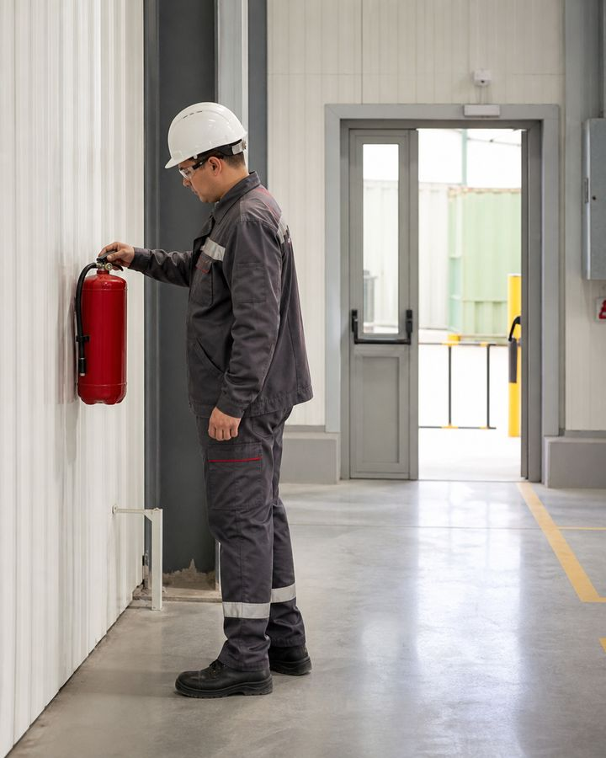
TRAINING COURSE
fire safety
Fire prevention, evacuation and safe use of fire extinguisher
Training course for workers and line personnel
fire safety
01
Notes:
[Sources]
- SafetyHub canonical RU slide source: content/source-materials/derived/pozharnaya-bezopasnost/presentation.pptx
- Reviewed EN text map: content/localizations/staged-2026-09-01/presentations/pozharnaya-bezopasnost/en/text-map.json

Slide 2
After the course worker will be able to
01
Name the first actions in case of smoke, burning smell, alarm or open fire.
Life and safety evacuation take precedence over property and extinguishing.
02
Understand fire conditions, hazards, and methods to stop a fire.
03
Select the appropriate fire extinguisher according to the marking and evaluate the safety of extinguishing.
04
Evacuate, inform 101/112 and act at the collection point.
Standard: Fire safety rules
fire safety
02
Notes:
[Sources]
- SafetyHub canonical RU slide source: content/source-materials/derived/pozharnaya-bezopasnost/presentation.pptx
- Reviewed EN text map: content/localizations/staged-2026-09-01/presentations/pozharnaya-bezopasnost/en/text-map.json

Slide 3
Course logic
01
First actions and basics of combustion.
COURSE
02
Fire classes and choice of fire extinguisher.
5
03
evacuation, message and collection point.
04
Prevention and hot work.
semantic blocks
05
Practical scenarios and final algorithm.
fire safety
03
Notes:
[Sources]
- SafetyHub canonical RU slide source: content/source-materials/derived/pozharnaya-bezopasnost/presentation.pptx
- Reviewed EN text map: content/localizations/staged-2026-09-01/presentations/pozharnaya-bezopasnost/en/text-map.json

Slide 4
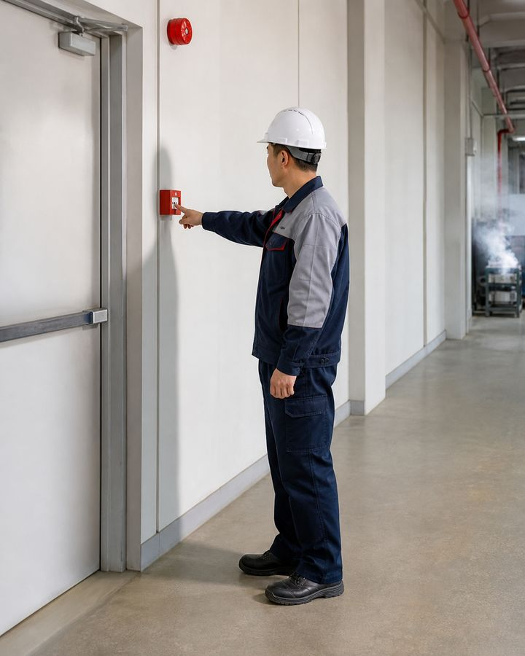
01
Signal and combustion basics
If there are signs of fire, first warn people, inform them and begin evacuating.
fire safety
04
Notes:
[Sources]
- SafetyHub canonical RU slide source: content/source-materials/derived/pozharnaya-bezopasnost/presentation.pptx
- Reviewed EN text map: content/localizations/staged-2026-09-01/presentations/pozharnaya-bezopasnost/en/text-map.json

Slide 5
Alarm requires immediate action
1
2
3
4
Report
Warn
Evacuate
Get ready
Signal and call 101 or 112 if required by role.
Notify people nearby and follow the instructions of the warning system.
Follow a safe route without stopping for things.
Arrive at the collection point, go through roll call and do not return.
The dangerous phrase “do not raise the alarm” has been removed: the alarm is raised immediately.
Standard: Fire safety rules • Recommendations of the Ministry of Emergency Situations: 101/112
fire safety
05
Notes:
[Sources]
- SafetyHub canonical RU slide source: content/source-materials/derived/pozharnaya-bezopasnost/presentation.pptx
- Reviewed EN text map: content/localizations/staged-2026-09-01/presentations/pozharnaya-bezopasnost/en/text-map.json

Slide 6
Fire - uncontrolled burning
• A fire threatens people, property, operations and the environment.
• Its development depends on fuel, oxygen, ignition energy and conditions in the room.
• A small fire can quickly grow beyond the stage suitable for manual firefighting.
• Early detection and reporting shorten the period of uncontrolled fire development.
Flame size is not the only indicator of danger; smoke may be more critical.
fire safety
06
Notes:
[Sources]
- SafetyHub canonical RU slide source: content/source-materials/derived/pozharnaya-bezopasnost/presentation.pptx
- Reviewed EN text map: content/localizations/staged-2026-09-01/presentations/pozharnaya-bezopasnost/en/text-map.json

Slide 7
Hazardous factors act before the flame
risk / SOURCE
CONSEQUENCE
CONTROL MEASURE
Smoke and toxic products
Poisoning, disorientation
Early warning and evacuation
High temperature
Burns and heat exposure
Distance and protected route
Reduced oxygen
Loss of consciousness
Do not enter without special protection
Collapse and explosion
Injuries and blocked exit
Do not approach and inform the authorities
Do not return to a smoky room without special powers and protection.
fire safety
07
Notes:
[Sources]
- SafetyHub canonical RU slide source: content/source-materials/derived/pozharnaya-bezopasnost/presentation.pptx
- Reviewed EN text map: content/localizations/staged-2026-09-01/presentations/pozharnaya-bezopasnost/en/text-map.json

Slide 8
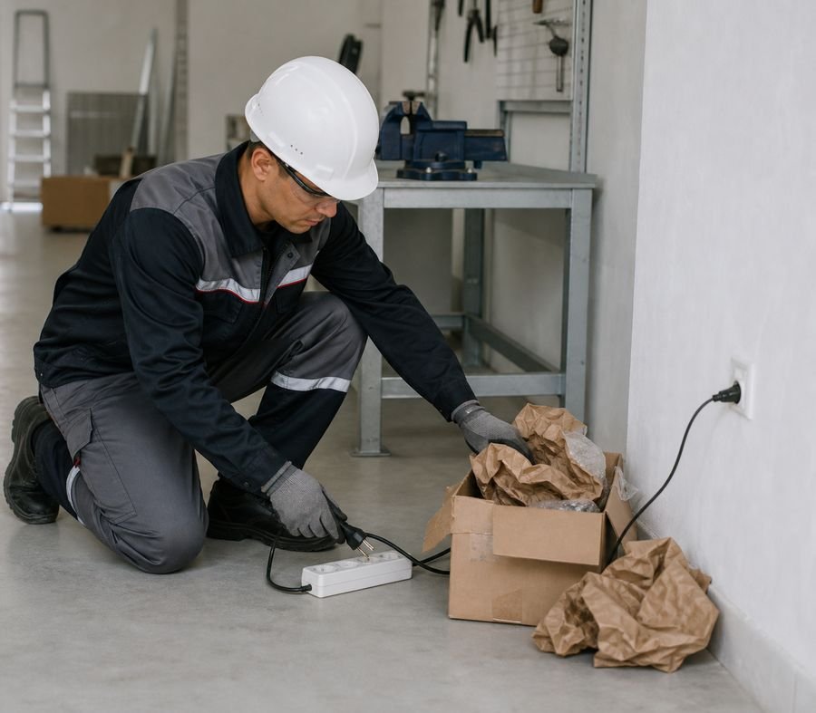
Reasons related to source control
• Faulty electrical equipment, overload and damaged insulation.
• Open flame, sparks and hot work without preparation.
• Improper storage of flammable materials and liquid spills.
• Smoking outside the designated area, hot surfaces and poor cleaning.
Prevention controls the ignition source and fire load simultaneously.
fire safety
08
Notes:
[Sources]
- SafetyHub canonical RU slide source: content/source-materials/derived/pozharnaya-bezopasnost/presentation.pptx
- Reviewed EN text map: content/localizations/staged-2026-09-01/presentations/pozharnaya-bezopasnost/en/text-map.json

Slide 9
Three conditions are required for combustion
• Combustible substance - a material, vapor or gas capable of supporting combustion.
• The oxidizing agent is usually oxygen from the air.
• Ignition source - flame, spark, hot surface or other energy.
• Control of any element can prevent the occurrence or development of a fire.
The fire triangle helps to choose a measure of prevention and extinguishing.
fire safety
09
Notes:
[Sources]
- SafetyHub canonical RU slide source: content/source-materials/derived/pozharnaya-bezopasnost/presentation.pptx
- Reviewed EN text map: content/localizations/staged-2026-09-01/presentations/pozharnaya-bezopasnost/en/text-map.json

Slide 10
Heat travels in four ways
• Conduction transfers heat through the material and connected structures.
• Convection carries hot gases and smoke upward and throughout rooms.
• Radiation heats objects at a distance.
• The flame directly ignites materials upon contact.
A closed door can slow the spread of smoke and heat.
fire safety
10
Notes:
[Sources]
- SafetyHub canonical RU slide source: content/source-materials/derived/pozharnaya-bezopasnost/presentation.pptx
- Reviewed EN text map: content/localizations/staged-2026-09-01/presentations/pozharnaya-bezopasnost/en/text-map.json

Slide 11
Combustion is stopped by affecting the condition
1
2
3
4
Cool
Isolate
Remove fuel
Abort reaction
Reduce temperature with a suitable extinguishing agent.
Restrict oxygen access or cover surface.
Stop feed or remove material if safe to do so.
Apply a suitable composition for the fire class.
The wrong product can spread the fire or create a new hazard.
fire safety
11
Notes:
[Sources]
- SafetyHub canonical RU slide source: content/source-materials/derived/pozharnaya-bezopasnost/presentation.pptx
- Reviewed EN text map: content/localizations/staged-2026-09-01/presentations/pozharnaya-bezopasnost/en/text-map.json

Slide 12
02
Classes and fire extinguishers
The choice is made according to the burning material, the presence of voltage and the marking of a particular fire extinguisher.
fire safety
12
Notes:
[Sources]
- SafetyHub canonical RU slide source: content/source-materials/derived/pozharnaya-bezopasnost/presentation.pptx
- Reviewed EN text map: content/localizations/staged-2026-09-01/presentations/pozharnaya-bezopasnost/en/text-map.json

Slide 13
The fire class determines the fuel
• A - hard materials, usually forming smoldering coals.
• B - flammable liquids and melting solids.
• C - flammable gases; D - combustible metals.
• For live electrical equipment, take into account the electrical risk and the marking of the product; Class F applies to edible oils and fats if it is provided for the facility.
Case color or foreign label does not replace the class designation and instructions.
Standard: Fire safety rules
fire safety
13
Notes:
[Sources]
- SafetyHub canonical RU slide source: content/source-materials/derived/pozharnaya-bezopasnost/presentation.pptx
- Reviewed EN text map: content/localizations/staged-2026-09-01/presentations/pozharnaya-bezopasnost/en/text-map.json

Slide 14
Voltage limits the choice of remedy
• If possible, safely de-energize equipment according to established procedure.
• Do not apply water or foam to live equipment unless the product is specifically designed for use.
• Observe the fire extinguisher markings and the manufacturer's safety distances.
• After relieving the tension, consider the class of the material actually burning.
STOP
The equipment switch does not always guarantee the absence of voltage.
fire safety
14
Notes:
[Sources]
- SafetyHub canonical RU slide source: content/source-materials/derived/pozharnaya-bezopasnost/presentation.pptx
- Reviewed EN text map: content/localizations/staged-2026-09-01/presentations/pozharnaya-bezopasnost/en/text-map.json

Slide 15
Choose the Fire Extinguisher for the Task
• Water cools and applies only to suitable materials and conditions.
• Foam insulates the surface of a flammable liquid, but has electrical hazard limitations.
• Powder is universal in many classes, but reduces visibility and contaminates equipment.
• Carbon dioxide does not leave a residue, but requires consideration of suffocation, cold bell and re-ignition.
Choose according to the label of a specific fire extinguisher, and not according to habit.
Standard: Fire safety rules
fire safety
15
Notes:
[Sources]
- SafetyHub canonical RU slide source: content/source-materials/derived/pozharnaya-bezopasnost/presentation.pptx
- Reviewed EN text map: content/localizations/staged-2026-09-01/presentations/pozharnaya-bezopasnost/en/text-map.json

Slide 16
Each type has limitations
risk / SOURCE
CONSEQUENCE
CONTROL MEASURE
Water
Electric risk; reaction with individual substances
Use only as labeled and after evaluation
Foam
Conductivity and incompatibility with certain fluids
Do not use outside the designated area
Powder
Dust, loss of visibility, re-ignition
Maintain exit and control the outbreak
CO₂
Cold burn, oxygen displacement
Do not touch the discharge horn; ventilate the area safely
Fire extinguishing ability does not negate the danger of the extinguishing method itself.
fire safety
16
Notes:
[Sources]
- SafetyHub canonical RU slide source: content/source-materials/derived/pozharnaya-bezopasnost/presentation.pptx
- Reviewed EN text map: content/localizations/staged-2026-09-01/presentations/pozharnaya-bezopasnost/en/text-map.json

Slide 17
Marking contains a solution for the employee
• Check the type of charge and the designated fire classes.
• Read voltage, temperature and application restrictions.
• Make sure that the instructions are readable, the seal is intact and the service period is valid.
• If the labeling is unclear, do not use the product at random.
The old foreign color scheme is not used as a mandatory marking for Kazakhstan.
Standard: Fire safety rules
fire safety
17
Notes:
[Sources]
- SafetyHub canonical RU slide source: content/source-materials/derived/pozharnaya-bezopasnost/presentation.pptx
- Reviewed EN text map: content/localizations/staged-2026-09-01/presentations/pozharnaya-bezopasnost/en/text-map.json

Slide 18
External verification takes a few seconds
1
2
3
4
Access
Status
Ready
Maintenance
fire extinguisher is visible, marked and unobstructed.
The body, hose, discharge horn and handle are free from damage and corrosion.
The seal and receipt are intact; pressure indicator in the permissible zone, if available.
Marking and inspection mark are legible and valid.
Damaged fire extinguisher is not checked by starting indoors.
Standard: Fire safety rules
fire safety
18
Notes:
[Sources]
- SafetyHub canonical RU slide source: content/source-materials/derived/pozharnaya-bezopasnost/presentation.pptx
- Reviewed EN text map: content/localizations/staged-2026-09-01/presentations/pozharnaya-bezopasnost/en/text-map.json

Slide 19
Accommodation depends on room category
• Maximum distance to a possible fire: 20 m in public buildings.
• For categories A, B and V1–V4 — 30 m; for category G — 40 m; for category D — 70 m.
• Extinguishers are placed in visible locations and near evacuation exits without obstructing evacuation.
• The top of an extinguisher must be no higher than 1.5 m; when its total mass is 15 kg or more, no higher than 1.0 m.
The universal “30 m and 1.1 m” from the old material were erroneous.
Standard: Fire safety rules, annex on primary means
fire safety
19
Notes:
[Sources]
- SafetyHub canonical RU slide source: content/source-materials/derived/pozharnaya-bezopasnost/presentation.pptx
- Reviewed EN text map: content/localizations/staged-2026-09-01/presentations/pozharnaya-bezopasnost/en/text-map.json

Slide 20
First decide: put out or leave
• Firefighting is permitted only for a small incipient fire and only if you have been trained.
• A serviceable extinguisher suitable for the fire and a safe retreat route behind you must be available.
• There must be no dense smoke, explosion hazard, toxic release or rapid fire spread.
• If any condition is not met, warn people, evacuate and notify the emergency services.
STOP
fire extinguisher does not oblige you to risk your life.
Standard: Recommendations of the Ministry of Emergency Situations: do not endanger life
fire safety
20
Notes:
[Sources]
- SafetyHub canonical RU slide source: content/source-materials/derived/pozharnaya-bezopasnost/presentation.pptx
- Reviewed EN text map: content/localizations/staged-2026-09-01/presentations/pozharnaya-bezopasnost/en/text-map.json

Slide 21
fire extinguisher are used steadily and precisely
1
2
3
4
Prepare
Send
Submit
Move
From a safe position, remove the seal and pull out the safety pin.
Hold the nozzle at the base of the flame, not into the smoke.
Press the lever and dispense the mixture briefly or continuously according to the instructions.
Fight the fire systematically while keeping the exit clear and monitoring conditions.
The specific sequence is specified by the marking of the fire extinguisher.
fire safety
21
Notes:
[Sources]
- SafetyHub canonical RU slide source: content/source-materials/derived/pozharnaya-bezopasnost/presentation.pptx
- Reviewed EN text map: content/localizations/staged-2026-09-01/presentations/pozharnaya-bezopasnost/en/text-map.json

Slide 22
The escape route remains behind
• Approach only as far as the instructions and thermal exposure allow.
• Do not walk into smoke or allow fire to cut off your exit.
• Consider the direction of smoke and wind, do not stand in the emission of combustion products.
• Retreat immediately if the flame grows, visibility deteriorates, or the charge runs out.
The position of the worker is more important than trying to get as close to the fire as possible.
fire safety
22
Notes:
[Sources]
- SafetyHub canonical RU slide source: content/source-materials/derived/pozharnaya-bezopasnost/presentation.pptx
- Reviewed EN text map: content/localizations/staged-2026-09-01/presentations/pozharnaya-bezopasnost/en/text-map.json

Slide 23
Extinguishing is stopped when control is lost
• Fire spreads beyond the initial seat of fire or upward along the structure.
• Smoke becomes dense, visibility deteriorates or the retreat route changes.
• Gas, explosion, hazardous substances or concealed combustion are suspected.
• The extinguisher does not operate, its extinguishing agent is exhausted or the wrong extinguisher was selected.
STOP
Retreating on time is a professional decision, not a failure.
fire safety
23
Notes:
[Sources]
- SafetyHub canonical RU slide source: content/source-materials/derived/pozharnaya-bezopasnost/presentation.pptx
- Reviewed EN text map: content/localizations/staged-2026-09-01/presentations/pozharnaya-bezopasnost/en/text-map.json

Slide 24
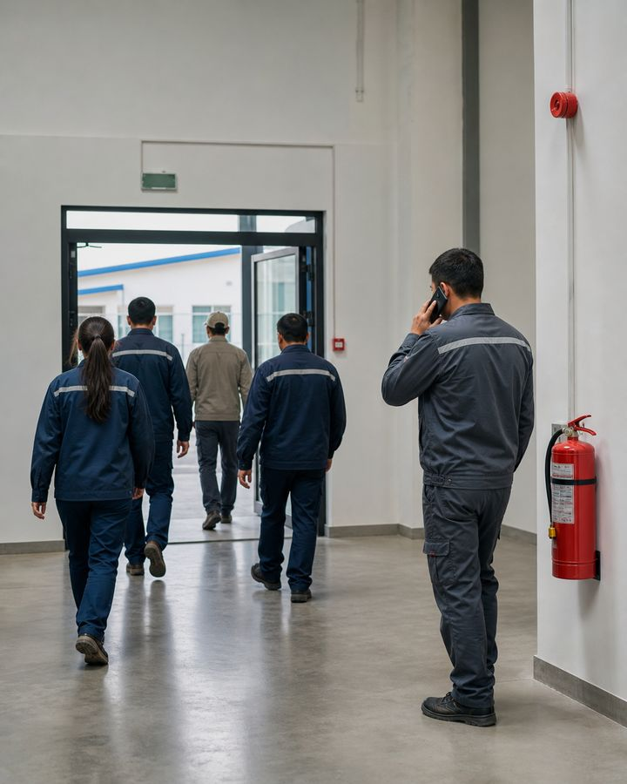
03
evacuation and message
The route, communication and accounting of people must be clear before a fire occurs.
fire safety
24
Notes:
[Sources]
- SafetyHub canonical RU slide source: content/source-materials/derived/pozharnaya-bezopasnost/presentation.pptx
- Reviewed EN text map: content/localizations/staged-2026-09-01/presentations/pozharnaya-bezopasnost/en/text-map.json

Slide 25
Evacuation routes are always clear
• Passages, stairs, doors and exits are not cluttered with material and equipment.
• Doors on the escape route open and are not blocked by improvised devices.
• Signs and emergency lighting must be visible.
• A faulty or blocked path is reported immediately.
The escape route is checked during normal operation and not during an alarm.
Standard: Fire safety rules
fire safety
25
Notes:
[Sources]
- SafetyHub canonical RU slide source: content/source-materials/derived/pozharnaya-bezopasnost/presentation.pptx
- Reviewed EN text map: content/localizations/staged-2026-09-01/presentations/pozharnaya-bezopasnost/en/text-map.json

Slide 26
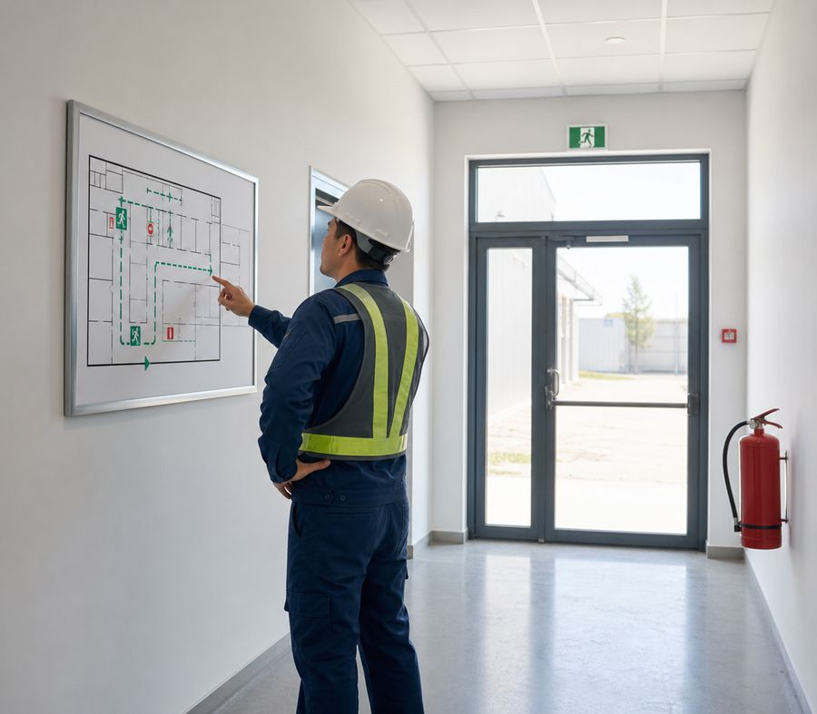
You need to be able to read the evacuation plan
• Find your current position, main route and alternate route.
• Label manual call points, extinguishing media and collection point if shown.
• Check the plan against actual doors and passages.
• Changing the layout requires updating the diagram and instructions.
The plan is a route hint, but the solution takes into account actual smoke and obstacles.
fire safety
26
Notes:
[Sources]
- SafetyHub canonical RU slide source: content/source-materials/derived/pozharnaya-bezopasnost/presentation.pptx
- Reviewed EN text map: content/localizations/staged-2026-09-01/presentations/pozharnaya-bezopasnost/en/text-map.json

Slide 27
When calling 101 or 112, tell the main thing
1
2
3
4
Address
What's burning
People & Hazards
Contact
Object, site, floor, landmark and safe entry.
Material, equipment, premises and visible signs.
Injured, trapped, gas, cylinders or chemicals.
Name, number and who will meet the arriving units.
Do not end the conversation before the dispatcher and answer briefly and accurately.
Standard: Recommendations of the Ministry of Emergency Situations: 101/112
fire safety
27
Notes:
[Sources]
- SafetyHub canonical RU slide source: content/source-materials/derived/pozharnaya-bezopasnost/presentation.pptx
- Reviewed EN text map: content/localizations/staged-2026-09-01/presentations/pozharnaya-bezopasnost/en/text-map.json

Slide 28
Get out quickly, but don’t panic
• Leave your personal belongings behind and take the nearest safe route.
• Assist in assigned role without creating cross flow.
• Close the door behind you if it is safe to do so, but do not lock it.
• The elevator is not used unless it is intended for evacuation according to a special procedure.
A closed, unlocked door can slow the spread of smoke and fire.
fire safety
28
Notes:
[Sources]
- SafetyHub canonical RU slide source: content/source-materials/derived/pozharnaya-bezopasnost/presentation.pptx
- Reviewed EN text map: content/localizations/staged-2026-09-01/presentations/pozharnaya-bezopasnost/en/text-map.json

Slide 29
A collection point is needed to count people
• Arrive at the designated location and remain with your group.
• Report yourself to the person responsible for roll call.
• Provide information about the possible whereabouts of the missing person.
• Do not leave the collection point or return to the building without permission.
Unauthorized departure may direct rescuers to an unnecessary search.
fire safety
29
Notes:
[Sources]
- SafetyHub canonical RU slide source: content/source-materials/derived/pozharnaya-bezopasnost/presentation.pptx
- Reviewed EN text map: content/localizations/staged-2026-09-01/presentations/pozharnaya-bezopasnost/en/text-map.json

Slide 30
Re-entry prohibited without permission
• Do not return for documents, a phone, clothing or tools.
• Do not re-enter to search for a colleague; tell rescuers the person's possible location.
• Do not cross barriers or obstruct access for emergency units.
• Re-entry is permitted only after official authorization from the responsible person.
STOP
Even if no smoke is visible, toxic gases may remain inside and risk collapse.
fire safety
30
Notes:
[Sources]
- SafetyHub canonical RU slide source: content/source-materials/derived/pozharnaya-bezopasnost/presentation.pptx
- Reviewed EN text map: content/localizations/staged-2026-09-01/presentations/pozharnaya-bezopasnost/en/text-map.json

Slide 31
04
Prevention and hot work
Fire is prevented by daily control of order, electricity, flammable materials and ignition sources.
fire safety
31
Notes:
[Sources]
- SafetyHub canonical RU slide source: content/source-materials/derived/pozharnaya-bezopasnost/presentation.pptx
- Reviewed EN text map: content/localizations/staged-2026-09-01/presentations/pozharnaya-bezopasnost/en/text-map.json

Slide 32
Good Housekeeping Reduces the Fire Load
• Combustible waste is disposed of regularly in the provided containers.
• Passages, exits, fire cabinets and fire extinguishers are not blocked.
• Spills are cleaned up according to procedure and contaminated materials are safely contained.
• Temporary storage is not converted into a permanent warehouse.
Cleaning is an element of fire prevention, and not just external order.
Standard: Fire safety rules
fire safety
32
Notes:
[Sources]
- SafetyHub canonical RU slide source: content/source-materials/derived/pozharnaya-bezopasnost/presentation.pptx
- Reviewed EN text map: content/localizations/staged-2026-09-01/presentations/pozharnaya-bezopasnost/en/text-map.json

Slide 33
Electrical fault is not masked
• Do not overload the network or use homemade extension cords or connections.
• Damaged cable, heat, odor and sparking require disconnection and reporting.
• The equipment is turned off upon completion if this is provided for in the instructions.
• Electrical panels and protective devices are kept accessible and closed.
Re-enabling a triggered protection without finding out the reason is dangerous.
Standard: Fire safety rules
fire safety
33
Notes:
[Sources]
- SafetyHub canonical RU slide source: content/source-materials/derived/pozharnaya-bezopasnost/presentation.pptx
- Reviewed EN text map: content/localizations/staged-2026-09-01/presentations/pozharnaya-bezopasnost/en/text-map.json

Slide 34
Store Flammable Liquids Under Control
• Use compatible closed containers with legible labels.
• Limit the quantity kept at the workplace to production needs and local rules.
• Prevent heating, sparks, spills and joint storage of incompatible substances.
• Prepare ventilation and emergency spill-containment equipment in advance.
Liquid poured into an unmarked container creates a double risk.
Standard: Fire safety rules
fire safety
34
Notes:
[Sources]
- SafetyHub canonical RU slide source: content/source-materials/derived/pozharnaya-bezopasnost/presentation.pptx
- Reviewed EN text map: content/localizations/staged-2026-09-01/presentations/pozharnaya-bezopasnost/en/text-map.json

Slide 35
Smoking - only in designated area
• The location is designated and organized taking into account fire risk.
• Smoking is prohibited in warehouses, production areas and other places where it is established.
• Cigarette butts are completely extinguished and placed in the provided non-flammable container.
• Electronic smoking devices are also subject to local mode.
The absence of an open flame does not mean the absence of a heating source.
Standard: Fire safety rules
fire safety
35
Notes:
[Sources]
- SafetyHub canonical RU slide source: content/source-materials/derived/pozharnaya-bezopasnost/presentation.pptx
- Reviewed EN text map: content/localizations/staged-2026-09-01/presentations/pozharnaya-bezopasnost/en/text-map.json

Slide 36
Prepare Hot Work Before Striking an Arc
1
2
3
4
Allow
Prepare
Provide
Monitor
Determine the place, permit-to-work, responsible and time.
Remove or secure flammable material, isolate equipment, test environment.
Extinguishing media, fencing, ventilation, communications and surveillance.
Monitor during and after completion in the prescribed manner.
A portable screen is not a substitute for the removal of concealed flammable materials.
Standard: Fire safety rules
fire safety
36
Notes:
[Sources]
- SafetyHub canonical RU slide source: content/source-materials/derived/pozharnaya-bezopasnost/presentation.pptx
- Reviewed EN text map: content/localizations/staged-2026-09-01/presentations/pozharnaya-bezopasnost/en/text-map.json

Slide 37
Fire Watch Continues After Work
• The fire watch monitors the spark area, concealed spaces and adjacent rooms.
• The fire watch has communications, knows how to stop the work and knows where the firefighting equipment is located.
• Fire-watch duty must not be combined with another task that distracts from monitoring.
• The duration of post-work monitoring is set by the applicable rules and local permit.
Smoldering may be detected after the welder leaves.
Standard: Fire safety rules
fire safety
37
Notes:
[Sources]
- SafetyHub canonical RU slide source: content/source-materials/derived/pozharnaya-bezopasnost/presentation.pptx
- Reviewed EN text map: content/localizations/staged-2026-09-01/presentations/pozharnaya-bezopasnost/en/text-map.json

Slide 38
Smoke or a Burning Odor Calls for Action
1
2
3
4
Do Not Ignore
Give signal
Evacuate
Send information
Stop the safe operation and evaluate the exit route.
Warn people and report via 101/112 and local scheme.
Drive in a safe manner by closing doors without locking them.
State exact location, signs and possible hazardous materials.
Do not wait for visible flame or repeated signal.
Standard: Recommendations of the Ministry of Emergency Situations: 101/112
fire safety
38
Notes:
[Sources]
- SafetyHub canonical RU slide source: content/source-materials/derived/pozharnaya-bezopasnost/presentation.pptx
- Reviewed EN text map: content/localizations/staged-2026-09-01/presentations/pozharnaya-bezopasnost/en/text-map.json

Slide 39
Scenario: a basket at the exit caught fire
SCRIPT
• Assess the situation: the fire is small, but it is close to an evacuation route.
• Raise the alarm and help people leave before the fire can cut off the doorway.
• Attempt extinguishing only if you are trained, have a suitable fire extinguisher and have a clear escape route.
• If smoke increases, withdraw immediately, close the door without locking it and proceed to the assembly point.
The exit should not be between the worker and the fire.
fire safety
39
Notes:
[Sources]
- SafetyHub canonical RU slide source: content/source-materials/derived/pozharnaya-bezopasnost/presentation.pptx
- Reviewed EN text map: content/localizations/staged-2026-09-01/presentations/pozharnaya-bezopasnost/en/text-map.json

Slide 40
Scenario: Smoke from electrical panel
SCRIPT
• Do not open the cabinet without authority and do not touch the cabinet if voltage is suspected.
• Sound the alarm, notify 101/112 and arrange evacuation.
• De-energization is carried out by an authorized person following a safe procedure.
• The use of a fire extinguisher is only permitted if it is properly marked and has a safe escape route.
Latent electric and arc hazard may be higher than visible flame.
fire safety
40
Notes:
[Sources]
- SafetyHub canonical RU slide source: content/source-materials/derived/pozharnaya-bezopasnost/presentation.pptx
- Reviewed EN text map: content/localizations/staged-2026-09-01/presentations/pozharnaya-bezopasnost/en/text-map.json

Slide 41
Final algorithm in case of fire
✓
Report: alarm, 101 or 112, exact location and dangers.
✓
Warn: people nearby and responsible according to the local scheme.
✓
Evacuate: safe route, close door without locking.
✓
Gather: roll call, information about absentees, prohibition of re-entry.
✓
Extinguish only the safe initial fire when all conditions are met.
Click “Start Test”
Updated: 08/21/2026
Notes:
[Sources]
- SafetyHub canonical RU slide source: content/source-materials/derived/pozharnaya-bezopasnost/presentation.pptx
- Reviewed EN text map: content/localizations/staged-2026-09-01/presentations/pozharnaya-bezopasnost/en/text-map.json

