Slide 1

Reaper Route: Death Map
Notes:
Good Morning, our team is called Life is Good and we will be presenting our app reaper route

Slide 2
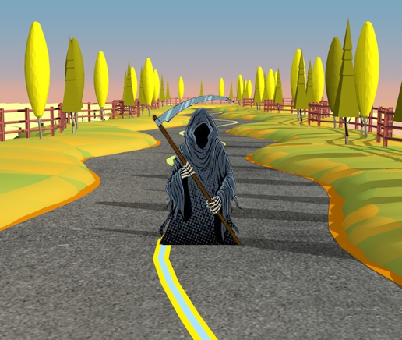
Reaper Route App
Uses fatality and collision statistics to influence driver’s behaviour
Integrates with google maps suggested route
Provides a heatmap showing frequency of collisions
Suggests an alternative safer route and provides the appropriate statistics
Shows other safer transit modes
Notes:
The reaper route app takes routes provided by google maps and displays the statistics for fatalities and serious collisions along with the route on the bottom of the screen.
A heatmap showing collision frequency will inform drivers about the most dangerous intersections on their planned route.
The app will also offer an alternative, safer, routes based on the route with the least recorded fatalities and collisions.
It will also offer the statistics of other modes of travel in an attempt to convince drivers to select the safer option.

Slide 3
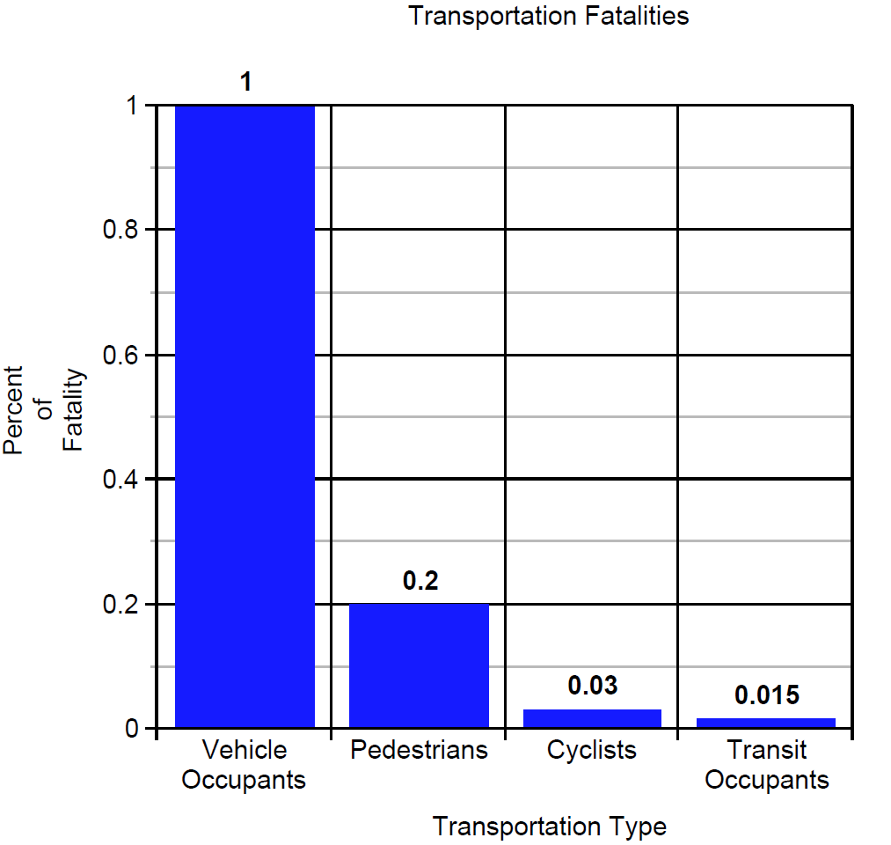
Transit Safety Statistics
Taking public transport reduces collisions by 90%
80% less pedestrians were killed than motor vehicle occupants, 97% less cyclists and 99.85% less transit occupants.
Notes:
According to the American Public Transportation Society, taking public transport can reduce the chance of collisions by 90%,
According to the Bureau of Public Transportation in 2017, 80% less pedestrians were killed in accidents than motor vehicle occupants, 97% less cyclists and 99.85% less transit occupants were killed.
Reaper Route will reflect this data to users showing them how much safer transit, cycling and even walking can be.

Slide 4
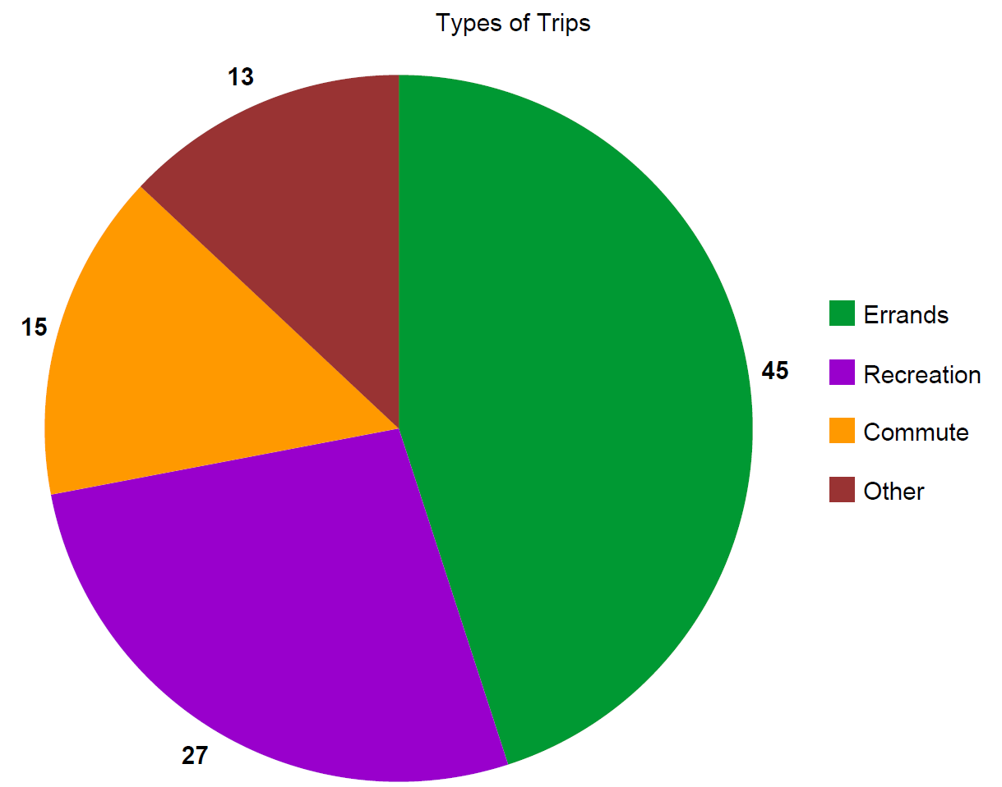
Importance of the App
87% of transportation trips are repeated
Reaper Route can change behaviour for a lifetime
Notes:
According to the Bureau of Public Transportation 87% of trips are made for errands, recreational use or commuting. These are all trips that drivers repeat daily or weekly, so just by using our app once they could be convinced to change their mode of travel or their travel route for hundreds or thousands of total trips.

Slide 5
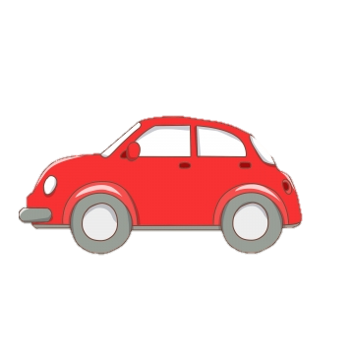
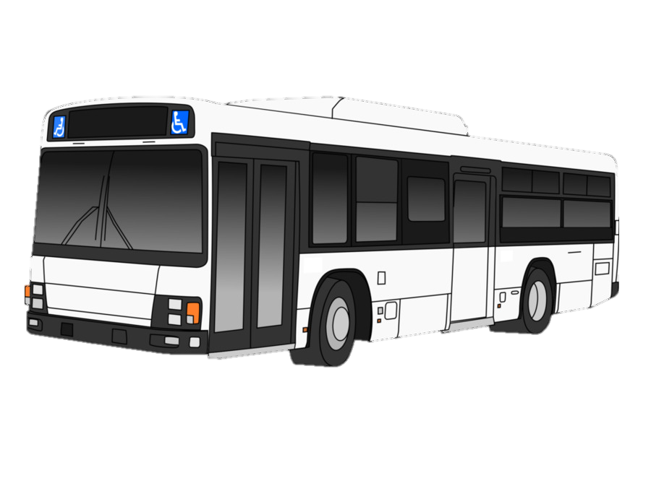
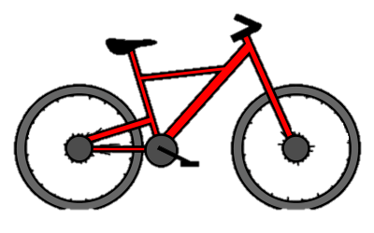

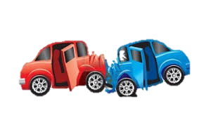
Managing Congestions
Reaper Route manages congestion by influencing driver behaviour
Persuades drivers to change mode of transportation to a safer mode of travel, i.e. transit, biking or walking
Fatalities: 5
Fatalities: 1
Fatalities: 0
Serious Collisions: 374
Serious Collisions: 14
Serious Collisions: 1
Notes:
The primary goal is to persuade drivers to change their mode of transportation to a safer mode of travel, by displaying how much safer other modes can be using statistics like this. This would mitigate congestion by reducing the amount of cars on the road.

Slide 6
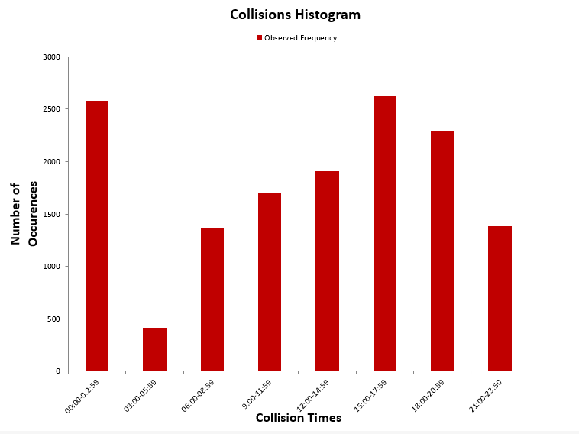
Managing Congestions
Persuades drivers to change their route to one with less fatalities and collisions
Persuades drivers to change their time of travel
Notes:
The app will also suggest an alternate, safer, route. Accidents tend to increase with congestion so by helping drivers avoid collision prone streets, the app will send them to less congested areas, thus helping to spread out the flow of traffic and alleviate congestion. The app will also report the percentage of collisions that occur during specific times of day, and suggest safer times to persuade drivers to make a trip when the roads are less congested

Slide 7
Managing Congestions
Encourage caution by informing drivers of dangerous areas
Prevent congestion after crashes
Target parents and teens
SHOW HEAT MAPS
Notes:
In reality it can be very hard to convince drivers to change their mode of transit or their daily route. At the very minimum Reaper Route will inform drivers about dangerous areas on their daily routes using the heat map. When drivers are more aware of these areas, they will be more cautious when nearing a dangerous intersection. By improving the safety of the roads, collisions will be reduced, along with the congestion that is created after a crash. Reaper Route could be appealing to sensitive road users such as parents driving with a baby in the car.

Slide 8
Proof of Concept Model
Displays google maps integration and statistics
Shows heatmap with collision frequency
SHOW THE HOMESCREEN
Notes:
Now we’ll show you our prototype model.

Slide 9
Questions?

Slide 10
Comprehensive Model
Driver behaviour report telling increased chances of collisions based on speed
Planned mode of transportation
User input of how much extra time they’re willing to spend for a safer route
User profile: age and driving history

