Slide 1

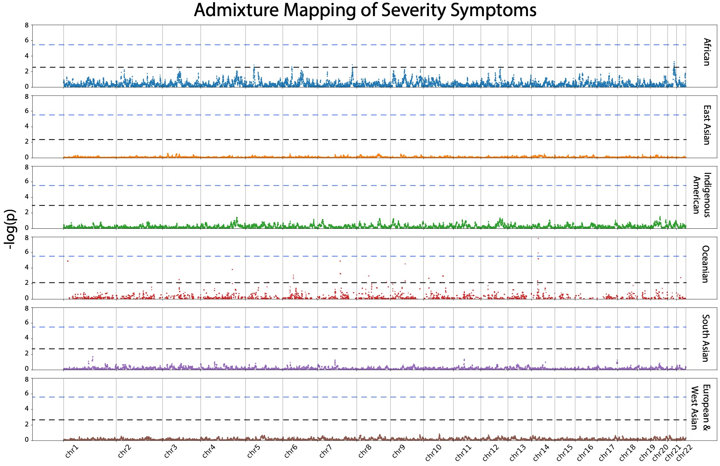
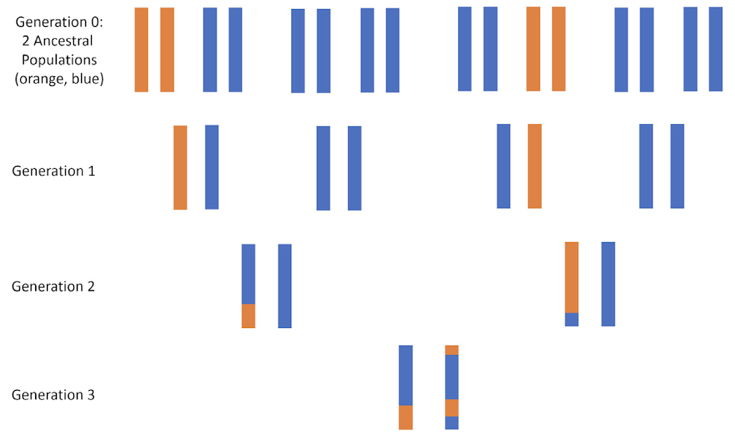





Improving Genome-wide Significance Thresholds in COVID19 Admixture Mapping Study
Sasha Yousefi¹*, Jessica Houghton¹*, Alexander G. Ioannidis^{2,3}, Daniel Mas Montserrat²
*Contributed equally
¹Department of Statistics, Stanford University
²Department of Biomedical Data Science, Stanford University
³Institute for Computational and Mathematical Engineering, Stanford University
“Deconvoluting complex correlates of COVID19 severity with local ancestry inference and viral phylodynamics: Results of a multiomic pandemic tracking strategy” by Parikh et al.
Black dotted line: less stringent ancestry-specific multiple test correction
Blue dotted line: naïve Bonferroni correction (more conservative)
Regions in chromosome 5 of African ancestry and chromosome 14 of Oceanian ancestry showed a significant association with high-severity COVID19
STEAM: Significance Threshold Estimation for Admixture Mapping
by Grinde et al.
Multiple hypothesis testing problem: the number of independent hypothesis tests depends on the amount of admixture
Goal: obtain a more accurate and less conservative significance threshold
STEAM: analytic and simulation based approach to obtain genome-wide significance thresholds
Appropriate significance threshold depends on the number of ancestral populations, generations since admixture, and population structure of the sample.
Methods:
Calculate the observed correlation of local ancestries at pairs of loci for our samples
Attained dataframe consisting of ancestry pairs, recombination fraction between loci, and correlation
Use non-linear least squares to estimate the number of generations since admixture.
Estimate the p-value threshold which will control the family-wise error rate at the 0.05 level.
Results:
Estimated generations since admixture : 11 (11.357)
Using 30 years per generation, this translates to 330 years ago, which is around 1690.
This makes sense, as 1690 is the middle of the colonial period when the majority of our six ancestries were likely to admix!
Naive Bonferroni correction:
Estimated adjusted p-value:
95% confidence interval
[. , ]

