Slide 1
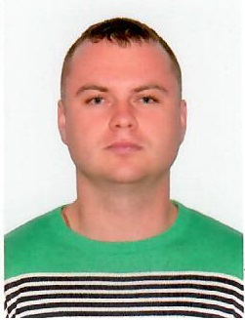
Finished Specialist Degree, Radio Electronic Devices, Systems and Complexes, Kharkiv National university of radioelectronics, Ukraine
Worked Hi-Tech Media system administrator 3 years
PoltavaGasVydobuvannya Gas Production Division
instrumentation and automation engineer
Currently I’m interested in IT and I consider EPAM company as my future path for development in this sphere

Slide 2
Deploy index.html on AWS EC2
Create Oracle VM VirtualBox, install Ubuntu
Install Git on Ubuntu: create git init, add new file (index.html), push on GitHab on SSH.
Install Jenkins on Ubuntu, advanced program, establish an SSH connection with GitHub, creation Script Path Jenkinsfile.
Create Pipline on Jenkins, configure Build Triggers to run every two minutes, add git repository and jenkinfile.
Start pipline, аfter successful compilation, the index.html file is deployed to AWS EC2. And the web page is launched by the server ip.

Slide 3
Work CI/CD
Version
Control
System:
GIT
----------
Cloud Services:
GitHab
AWS EC2
WebServer
CI/CD
framework:
Jenkins
Developer

