Slide 1
AutoGen Multi Agent Conversation Framework
AutoGen is a framework for simplifying the orchestration, optimization, and automation of LLM workflows. It offers customizable and conversable agents that leverage the strongest capabilities of the most advanced LLMs, like GPT-4, while addressing their limitations by integrating with humans and tools and having conversations between multiple agents via automated chat.
With AutoGen, building a complex multi-agent conversation system boils down to:. Defining a set of agents with specialized capabilities and roles.. Defining the interaction behavior between agents, i.e., what to reply when an agent receives messages from another agent.

Slide 2
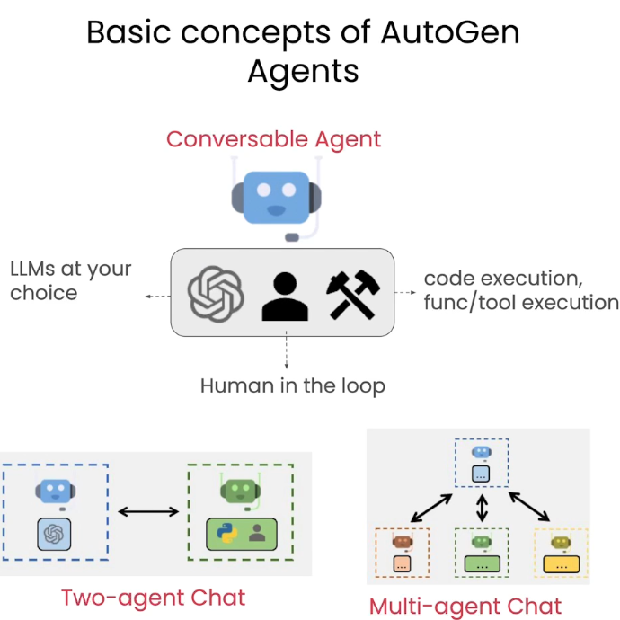
AutoGen Agent: Definition
Autonomous AI Agent(s) act behalf of human intent.
LLM + Code generation/execution +Function\Tool calling + Plugins combined.
Send & Receive messages, perform actions, interact with other agents
Can use any LLM Model. (not dependent on OpenAI)
Multiple AI Agents work together to accomplish tasks
Scenarios
Multiple Agents working on blog post (Writer, Critic, legal, SEO)
Bots
Code generation and Analysis
Etc.

Slide 3
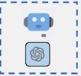
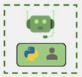
Various Agents
Conversable Agent
……...........
User Proxy Agent
Execute code\Funcs
No LLM
Human Interaction =
ALWAYS/NEVER
Assistant Agent
Generate Code
LLM
Human Interaction = NEVER
GPT Assistant Agent
(OpenAI Assistant API)
Retrieve Assistant Agent
For RAG Scenarios
Text Analyzer Agent
agentchat.assistant_agent | AutoGen (microsoft.github.io)

Slide 4

Call Center Demo: Scenario
Call Center Agent
(user_poxy)
Initiate Chat :
Customer information for phone number 123-456-7890,
Promotions available,
Billing history graph
5G qualification information (RAG)
Developer Assistant
(GPTAssistant)
Execute selected functions
Configured with
LLM
Plugin’s … Tools/Func’s
Code Gen
Output from functions
Generate
Python
Code
Ask Agent to execute generated code

