Slide 1
Aviation Project
Flight delay analysis by e Sashikant Singha

Slide 2
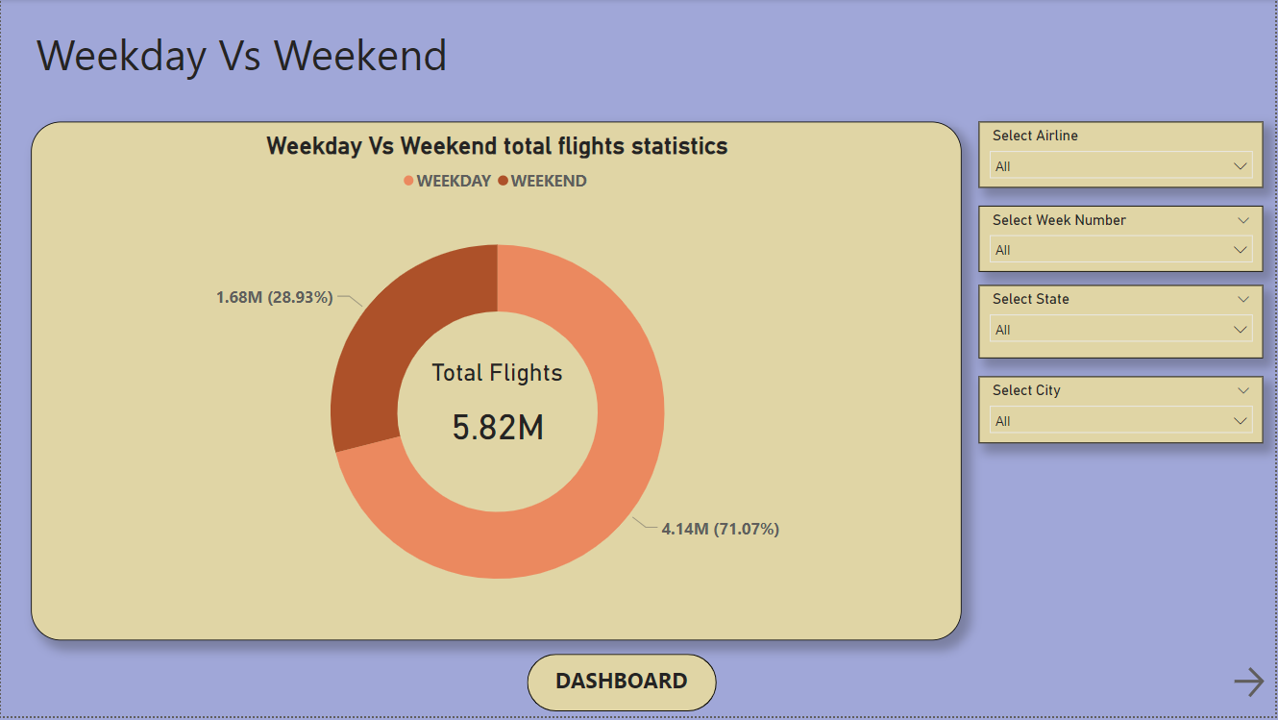
KPI 1 - Weekday Vs Weekend total flights statistics
By analyzing the Donut chart we can conclude that there are total of 5.82M flights. Out of which 4.14M flights over the Weekday and 1.68M flights over the Weekend which constitutes 71.07% and 28.93% respectively.
Slicers to slice the Weekday Vs Weekend statistics by Airline, Week Number, State and City.
Reason behind, obviously Weekday has more number of days than Weekends hence more number of flights.

Slide 3
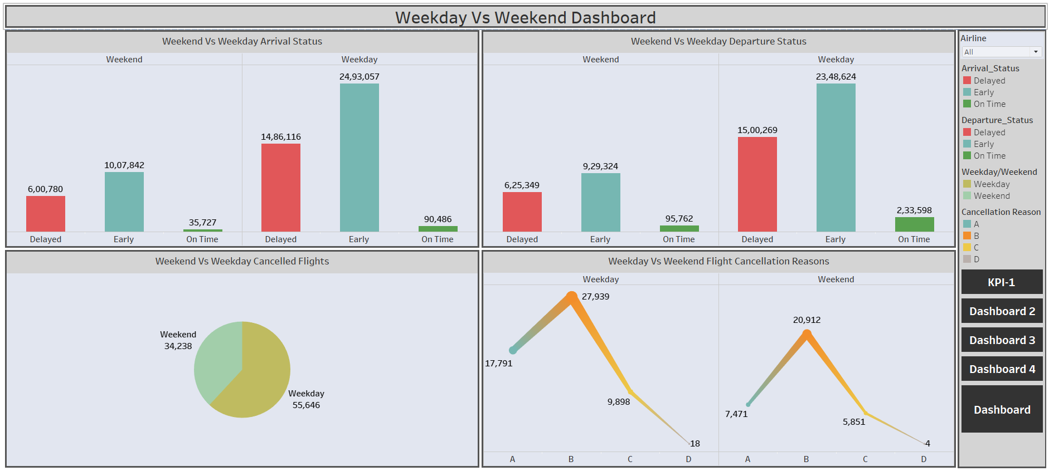
Weekday Vs Weekend dashboard
Most number of flights delayed during arrival on Weekday.
Most number of flights delayed during departure on Weekday.
Reason B is contributing highest number of cancelled flights.

Slide 4
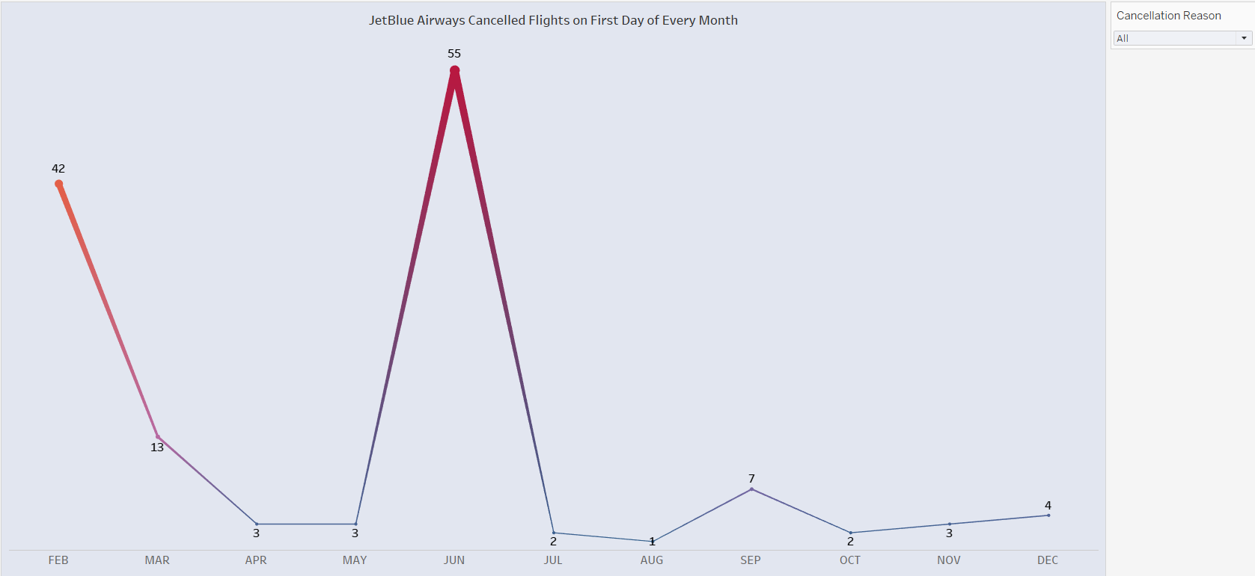
KPI 2 - Total number of cancelled flights for JetBlue Airways on first date of every month
As per the analysis we can say that most number of cancelled flights on 1st date is in June and least is in January month with 55 cancelled flights and no cancelled flight respectively.
Second and third highest number of cancelled flights on 1st date is in February and March with total 42 and 13 flights respectively.

Slide 5
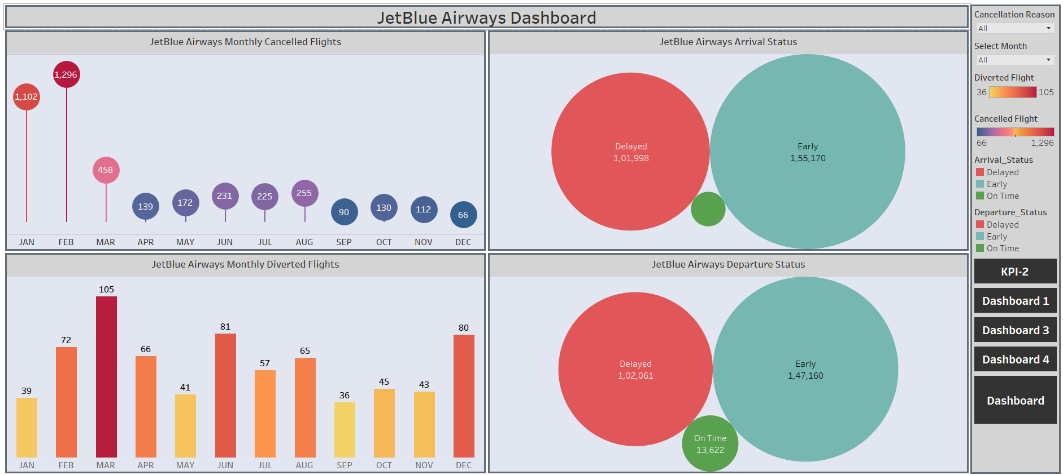
JetBlue Airways dashboard
February has most and December has the least number of cancelled flights.
March has most and September has the least number of diverted flights.
Total 204059 flights delayed.

Slide 6
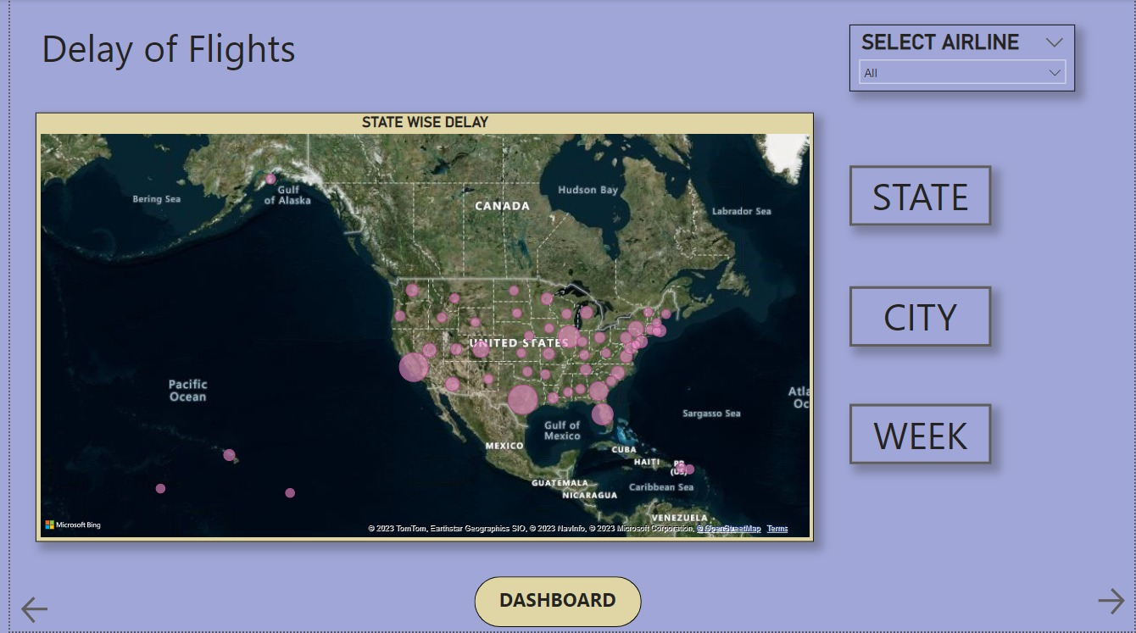
KPI 3 - Week wise, State wise and City wise statistics of delay of flights with airline details
For the this KPI we have used hide unhide feature using bookmarks in Power BI.
States like California, Texas and Florida have more number of flight delays.
Cities like Houston, West Palm Beach, New York contribute to more number of flight delays.
Week number 4 has most number of flight delays while Week number 6 has the least.

Slide 7
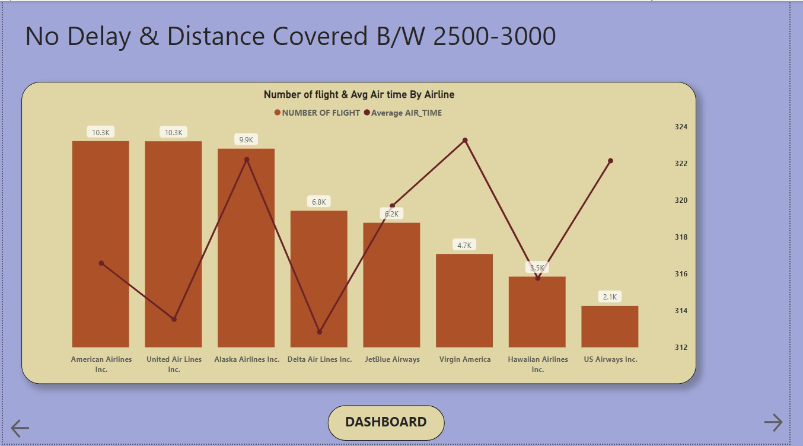
KPI 4 - Number of airlines with No departure/arrival delay with distance covered between 2500 and 3000
By analyzing the visualization we can conclude that American Airlines Inc and United Airlines Inc have the least number of flight delays or have always been on schedule.
US Airways Inc has most number of flights delayed.
And Virgin America has the maximum number of flight duration or air time.

Slide 8
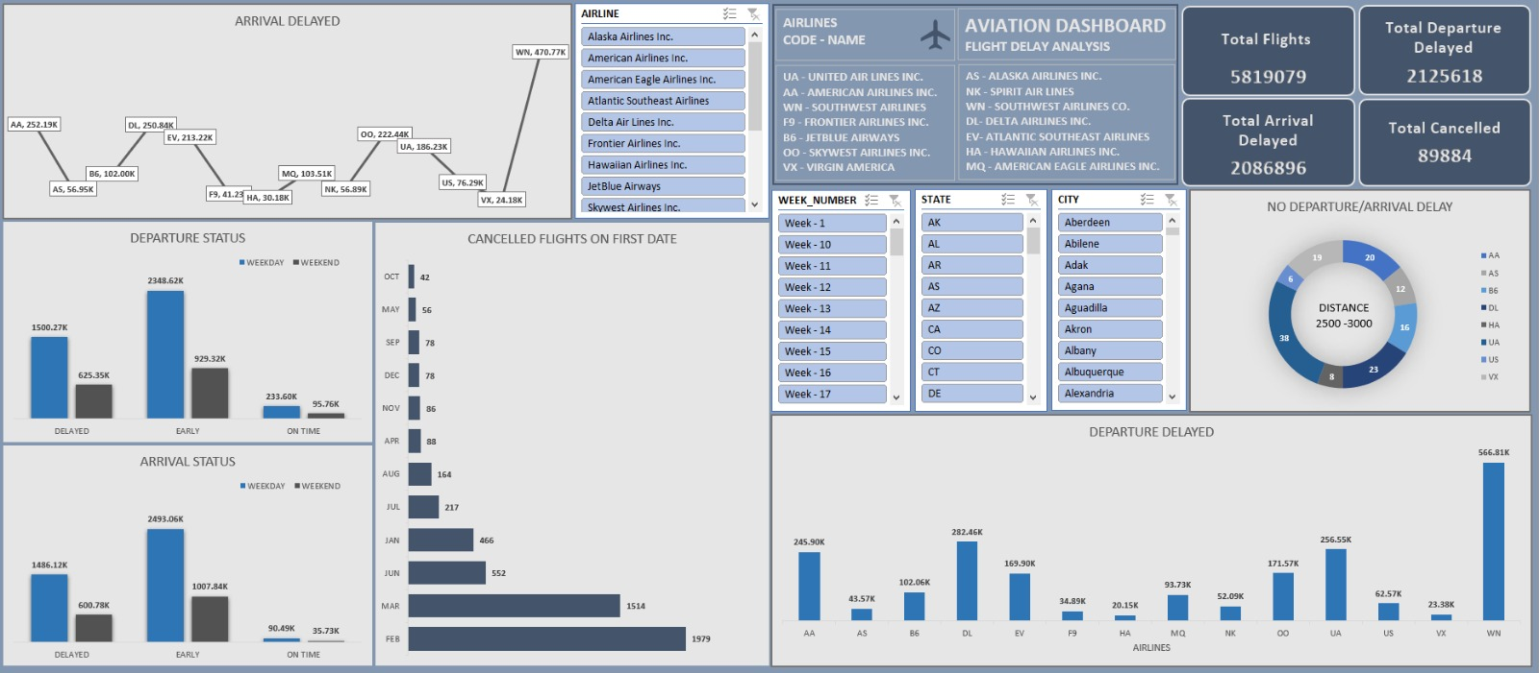
Excel Dashboard

Slide 9
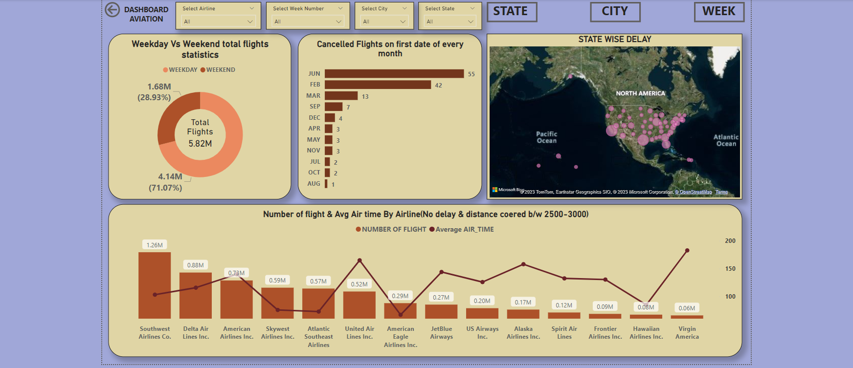
Power bi Dashboard

Slide 10
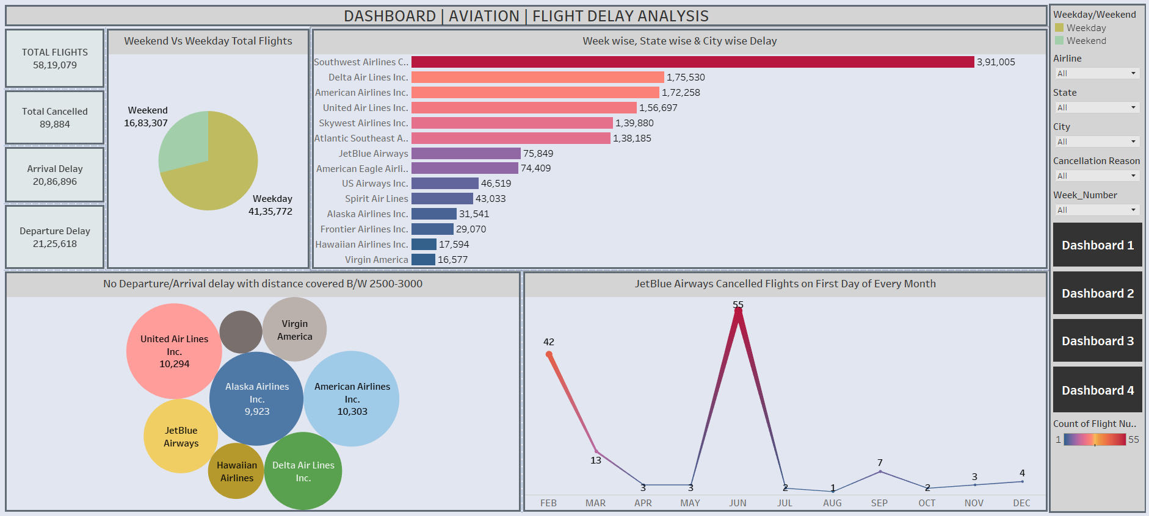
tableau Dashboard

Slide 11
conclusion
Most number of flights over Weekday.
Weekday has most number of Delayed and cancelled flights.
Cancellation Reason B is contributing more.
For JetBlue Airways February and March month is the highest for Cancelled and Diverted Flights respectively.
States like California, Texas and Florida have more number of flight delays.
Cities like Houston, West Palm Beach, New York contribute to more number of flight delays.
Week number 4 has most number of flight delays while Week number 6 has the least.
American Airlines Inc and United Airlines Inc have the least number of flight delays or have always been on schedule with distance covered between 2500 to 3000.

Slide 12

Thank you !

