Slide 1

INTERIM REVIEW 02 · PROGRESS ~60–65%
SecureCloudGuard
A Hybrid Machine Learning and Cryptographic Framework for Selective Image
Encryption and Real-Time DDoS Detection in Cloud-IoT Environments
PROJECT TEAM · CSE DEPARTMENT
SUPERVISION & INSTITUTION
Sashi Bhusan Prusty — 2301020812
Tasha Pattnaik — 2301020388
Parbhu Datta Biswal — 2301020766
Aditya Padhi — 2301020330
Supervisor
Dr. Sampa Sahoo
Department
Computer Science and Engineering
Institution
C.V. Raman Global University, Bhubaneswar, Odisha
SecureCloudGuard
01 / 16

Slide 2
INTERIM REVIEW 02
Problem Statement & Motivation
THE DUAL CLOUD-IoT THREAT
1
Heavy Computational Overhead
WHY IT MATTERS
Full-image cryptographic encryption (e.g. standard AES-256) causes prohibitive latency on resource-constrained IoT cloud gateways, slowing down time-sensitive pipelines.
Cloud-IoT gateways must encrypt sensor and camera imagery without breaking real-time throughput budgets.
A single successful DDoS flood can silently disable the very intrusion pipeline meant to detect it.
Treating every pixel and every packet with equal, maximal cost is the root inefficiency — a smarter, selective approach is needed on both fronts.
2
Volumetric DDoS Vulnerability
Cloud-IoT ingress pipelines are heavily targeted by volumetric DDoS floods, overwhelming storage and backend classification services before legitimate traffic is even processed.
Base Paper Benchmark: Directly inspired by Pathak et al. (Computers & Security, 2026), scaling its concepts into a demonstrable 4-module prototype.
99.98%
51–57%
75–80%
DDoS Detection Accuracy
Encryption Speedup vs Full AES-256
Overall Project Completion
SecureCloudGuard
02 / 16

Slide 3
INTERIM REVIEW 02
Project Objectives
1
Decoupled Architecture
Design a dual-pipeline system that physically separates image cryptographic security from network intrusion detection to remove throughput bottlenecks.
2
Efficient Selective Encryption
Cut encryption latency using ML-guided, bit-plane-selective AES-256 — without sacrificing visual security — versus full-image encryption.
3
High-Accuracy Threat Detection
Achieve reliable, real-time DDoS classification on flow-level network features, clearly outperforming naive threshold-based rules.
4
Benchmark-Grounded Validation
Validate every measured result against a peer-reviewed base paper (Pathak et al., 2026) for fair, reproducible comparison.
5
Unified, Extensible Dashboard
Integrate both engines into one interactive Streamlit interface, extensible toward differential privacy and Bayesian threat prediction.
SecureCloudGuard
03 / 16

Slide 4
INTERIM REVIEW 02
Related Work & Positioning
How SecureCloudGuard differs from conventional approaches in each domain:
CONVENTIONAL APPROACHES
SECURECLOUDGUARD APPROACH
Image security
Full-image AES/DES encryption applied uniformly, regardless of each region's actual visual information density.
Image security
SVM-guided selective bit-plane AES-256 — only high-information planes (4–7) are encrypted, cutting compute ~50%.
Key generation
Standard key schedules with limited added randomness across encryption runs.
Key generation
Chaotic logistic-map generator derives non-linear, run-specific keys and IVs before AES-256 encryption.
Intrusion detection
Static threshold / signature-based rules — brittle against evolving traffic patterns (our own baseline test: 42.45% accuracy).
Intrusion detection
Learned Random Forest classifier on flow-level statistics, adapting to real traffic morphology — 99.98% accuracy.
Positioning: results are benchmarked directly against Pathak et al. (Computers & Security, 2026) rather than compared only to an isolated, self-defined baseline.
SecureCloudGuard
04 / 16

Slide 5
INTERIM REVIEW 02
Proposed System Architecture
PIPELINE 1 · SELECTIVE CRYPTOGRAPHY
PIPELINE 2 · REAL-TIME DDoS ENGINE
1
Grayscale Image Ingestion (8-bit array)
1
Network Traffic Ingestion (CICIDS2017)
2
Bit-Plane Decomposition (Planes 0–7)
2
Header Cleaning (Inf / NaN dropped)
3
SVM Feature Selector (identifies planes 4–7)
3
80 / 20 Stratified Train-Test Split
4
Chaotic Logistic-Map Key / IV Generator
4
Random Forest Classifier (100 trees, depth 12)
5
PyCryptodome AES-256 (selected planes only)
5
Baseline Comparison (95th-Percentile Rule)
6
Reassembly & Bit-Exact Decryption Check
6
Classification Output: BENIGN vs. DDoS
UNIFIED INTERACTIVE DASHBOARD (STREAMLIT) — merges real-time DDoS alerts and image encryption / decryption into one Web UI
SecureCloudGuard
05 / 16

Slide 6
INTERIM REVIEW 02
Novelty & Key Contributions
✓
Decoupled Dual-Engine Design
✓
Adaptive Bit-Plane Selection
Cryptographic security and intrusion detection run as independent pipelines, eliminating the throughput bottleneck of a single shared workload.
An SVM learns which bit-planes carry real visual structure, rather than relying on a fixed or manually chosen plane split.
✓
Chaotic Key / IV Derivation
✓
Reproducible, Literature-Grounded Validation
A logistic-map chaotic generator adds a non-linear, run-specific key source layered underneath standard AES-256.
Every measured result is checked against a peer-reviewed base paper (Pathak et al., 2026), not just an internally defined baseline.
SecureCloudGuard
06 / 16

Slide 7
INTERIM REVIEW 02
Datasets Used & Justification
DATASET 01 · DDoS TRAFFIC
DATASET 02 · LENA BENCHMARK IMAGE
Source: Canadian Institute for Cybersecurity (UNB); Friday-Afternoon-DDoS.csv split, via Kaggle.
Source: Standard 'Lena' test image — a classic 8-bit grayscale image-processing benchmark.
Size: ~225,000 labelled network flow rows (BENIGN vs. DDoS) after cleaning.
Format: Grayscale 8-bit array (pixel values 0–255); resolutions 320×320 and 512×512 px.
Features: Flow duration, packet counts, packet-length stats, byte rate, window size (e.g. Init_Win_bytes_forward).
Role: Primary target for bit-plane decomposition, correlation analysis, and speed benchmarks.
Preprocessing: Header whitespace stripped; Infinity / NaN values dropped; numeric flow metrics retained.
Secondary data: A local set of extra grayscale images used only to train the SVM plane selector.
Why this dataset: Standard benchmark used in the base paper (Pathak et al.), enabling apples-to-apples comparison.
Why this image: Decades of published literature use Lena, guaranteeing direct comparability of results.
SecureCloudGuard
07 / 16

Slide 8
INTERIM REVIEW 02
Tools & Technology Stack
CATEGORY / PURPOSE
LIBRARY / TOOL USED
WHERE IT'S USED
Environment
Python 3.10+, VS Code, pip / venv
All modules and project execution
Data Handling
pandas, NumPy
Loading & cleaning CICIDS2017; pixel matrices
Image Processing
OpenCV (cv2), Pillow
Reading image arrays, bit-plane decomposition
Cryptography
PyCryptodome (AES-256)
Encrypting / decrypting selected bit-planes
Classical ML
scikit-learn (SVC, RandomForest)
Plane selection (SVM) & DDoS detection (RF)
Visualization
Matplotlib, Seaborn
Confusion matrices, correlation & speed graphs
Dashboard & Planned
Streamlit · pgmpy (Phase IV)
Interactive Web UI · upcoming Bayesian Network
SecureCloudGuard
08 / 16

Slide 9
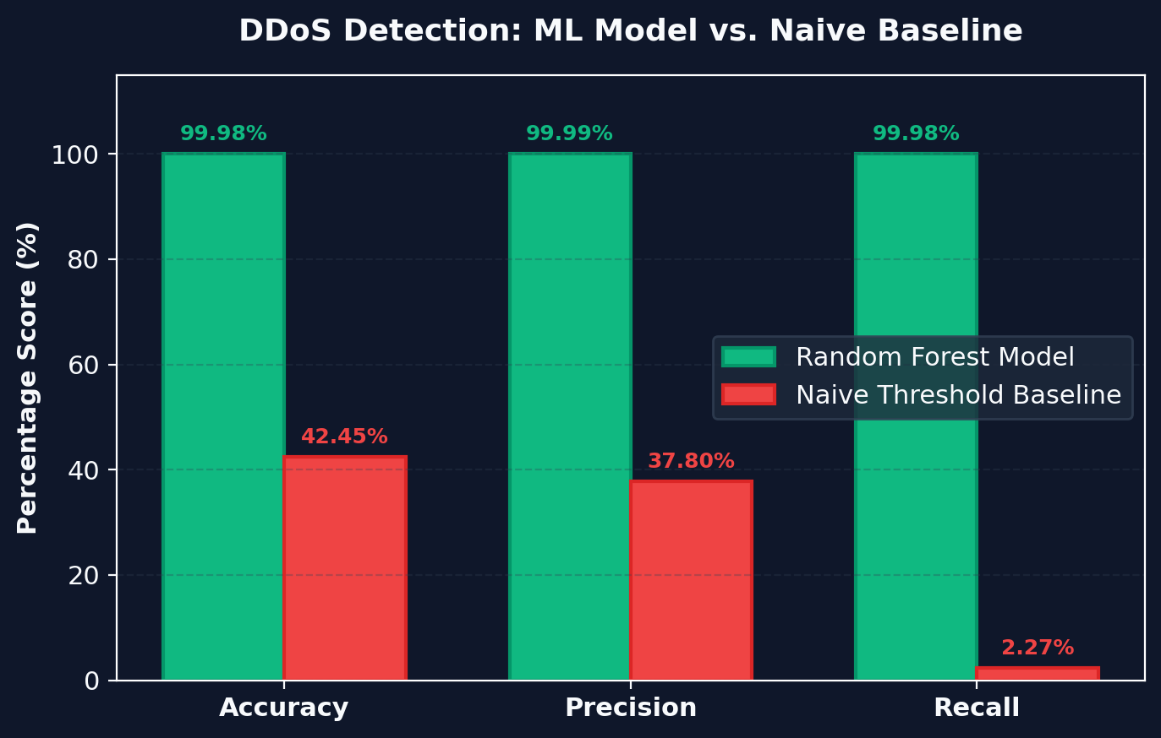
INTERIM REVIEW 02
DDoS Detection: Training Setup & Results
MODEL TRAINING & RESULTS
Model Setup
RandomForestClassifier — 100 trees, max depth 12, fitted on 80% training split (~180k rows).
Held-Out Testing
Evaluated strictly on the 20% holdout test set (~45k rows); zero leakage from training data.
Measured Score
99.98% accuracy · 99.99% precision · 99.98% recall (F1 = 0.9998); only 8 misclassifications in ~45,000 flows.
Baseline Failure
A 95th-percentile flow-duration threshold rule scores only 42.45% accuracy — proving simple static rules fail.
SecureCloudGuard
09 / 16

Slide 10
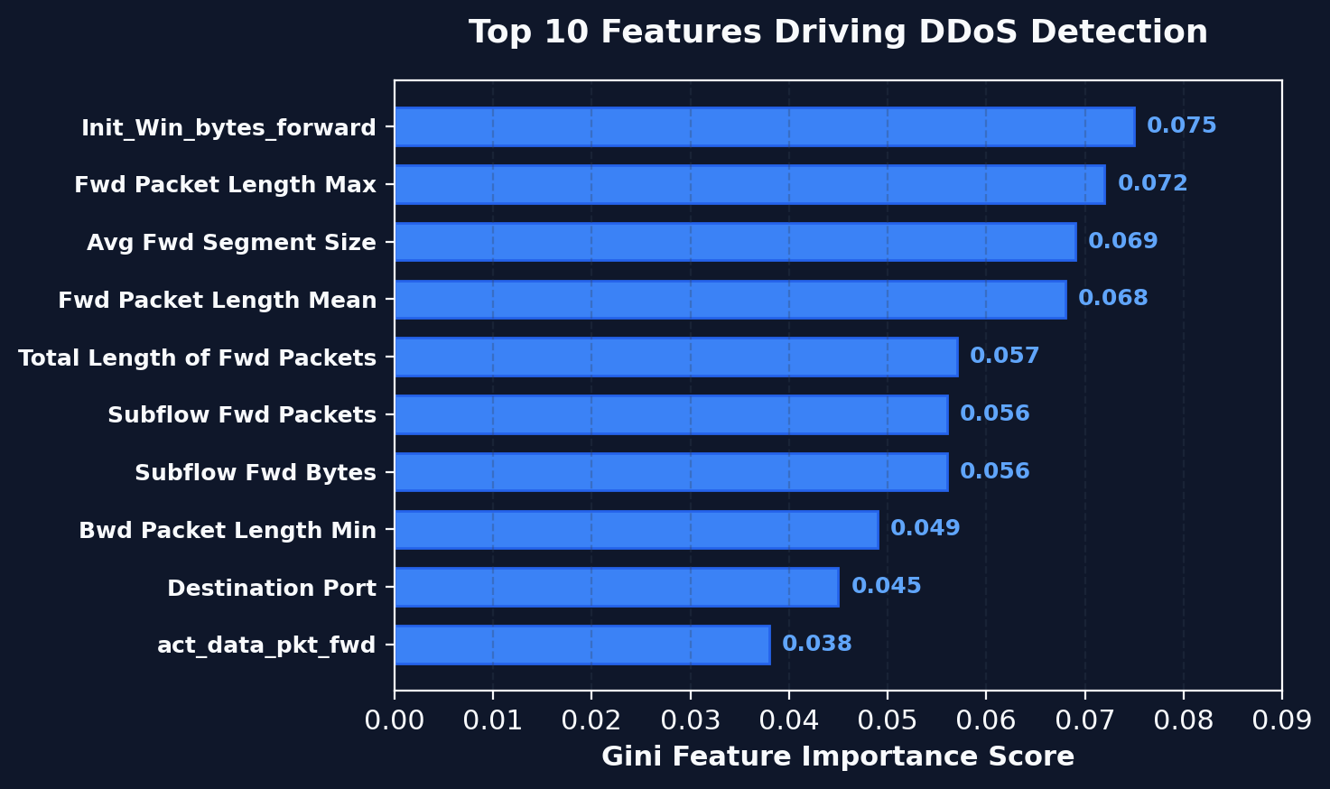
INTERIM REVIEW 02
Explainability: Top Driving Features
FEATURE IMPORTANCE INSIGHTS
Init_Win_bytes_forward (0.075)
Top feature. Initial TCP window size in the forward direction strongly distinguishes attack connection setups.
Fwd Packet Length Max (0.072)
Volumetric flooding bursts create distinct maximum packet-size spikes.
Avg Fwd Segment Size (0.069)
DDoS bots transmit uniformly sized payloads, unlike variable legitimate traffic.
Explainability
Model decisions align with real network-protocol mechanics rather than arbitrary artifacts.
SecureCloudGuard
10 / 16

Slide 11
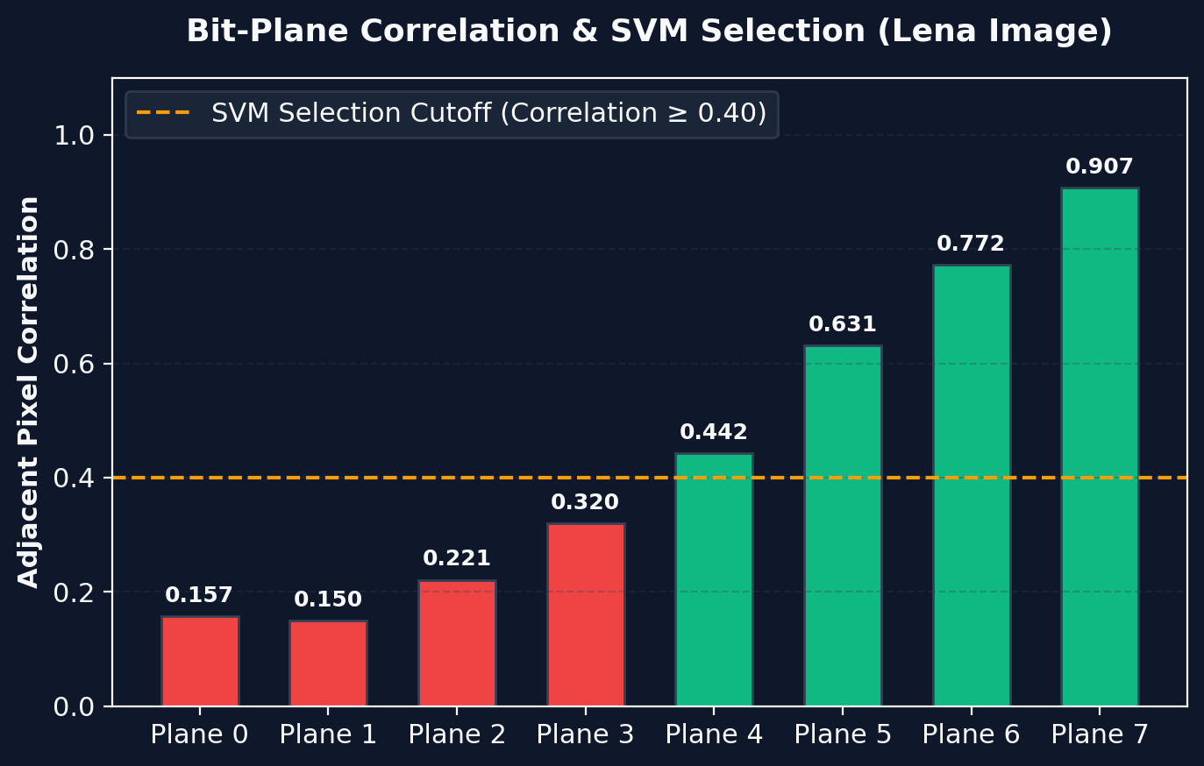
INTERIM REVIEW 02
Selective Encryption: Bit-Plane & SVM Selection
INFORMATION DENSITY & SVM SELECTION
Bit-Plane Decomposition
Each 8-bit grayscale image splits into 8 binary planes (Plane 0 LSB → Plane 7 MSB).
Correlation Shift
Adjacent-pixel correlation rises smoothly from 0.157 (Plane 0, noise) to 0.907 (Plane 7, structure).
SVM Classifier
Trained on per-plane spatial correlation and entropy features to auto-select high-information planes.
Selection Result
SVM selects planes 4–7 (top 50% of data volume), leaving low-density noise planes unencrypted.
SecureCloudGuard
11 / 16

Slide 12
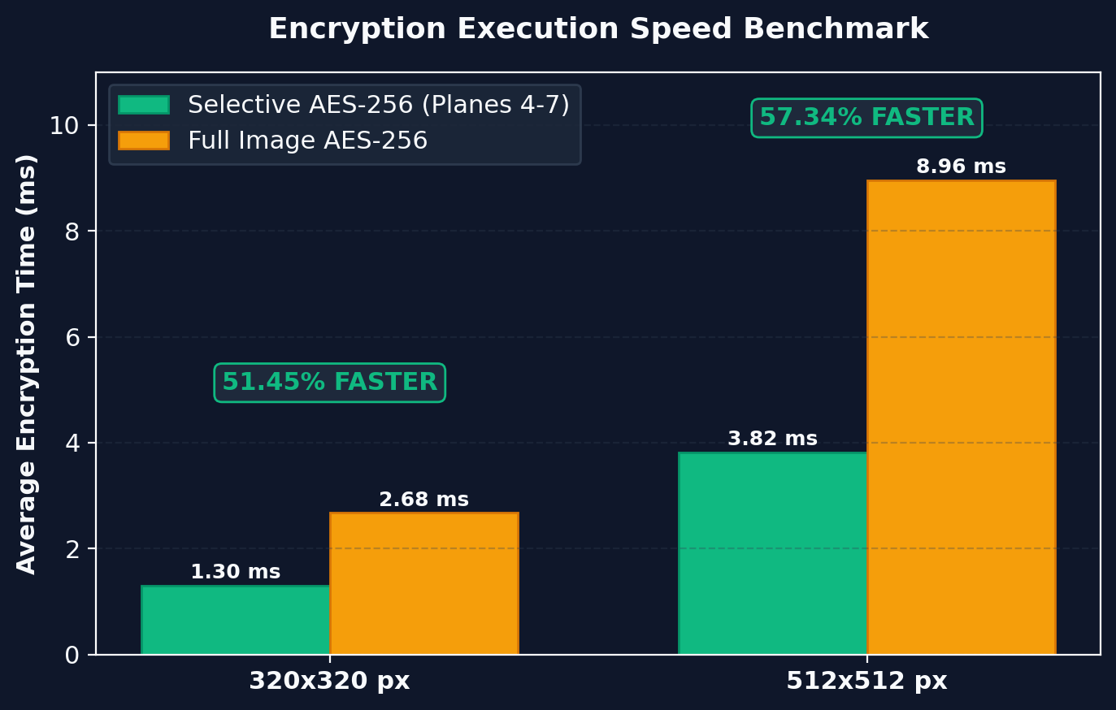
INTERIM REVIEW 02
Speed Benchmark: Selective vs. Full AES-256
EXECUTION TIME & FIDELITY
320×320 Resolution
Selective AES-256: 1.30 ms vs. 2.68 ms full AES-256 → 51.45% speedup.
512×512 Resolution
Selective AES-256: 3.82 ms vs. 8.96 ms full AES-256 → 57.34% speedup.
Byte Volume Reduction
Encrypts exactly 50% byte volume (Planes 4–7) while obfuscating 100% of intelligible visual features.
Bit-Exact Decryption
Decryption perfectly reconstructs the original Lena benchmark image with zero loss (100% verified).
SecureCloudGuard
12 / 16

Slide 13
INTERIM REVIEW 02
Benchmark Comparison: Target vs. Measured
CLAIM / TARGET METRIC
EXPECTED (BASE PAPER)
ACTUAL MEASURED RESULT
VERDICT
Random Forest DDoS Accuracy
~99.9% (Pathak et al.)
99.98% Acc · 99.99% Prec · 99.98% Rec
Exceeds Target
Threshold Weak Baseline
Expected low accuracy
42.45% Accuracy, 2.27% Recall
Gap Confirmed
Top Bit-Planes Correlation
Planes 4–7 carry ~85–89%
Correlation 0.157 → 0.907
Confirmed
Selective Encryption Speedup
Measurable execution gain
51.45% (320px) / 57.34% (512px)
Exceeds Target
Decryption Correctness
Bit-exact reconstruction
Bit-exact, verified across test runs
100% Verified
Phase IV Advanced Modules
Differential Privacy & Bayes
Pending — scheduled next phase
In Progress
Note: security-strength metrics (NPCR / UACI / Shannon entropy) are scheduled for Phase IV — see next slide.
SecureCloudGuard
13 / 16

Slide 14
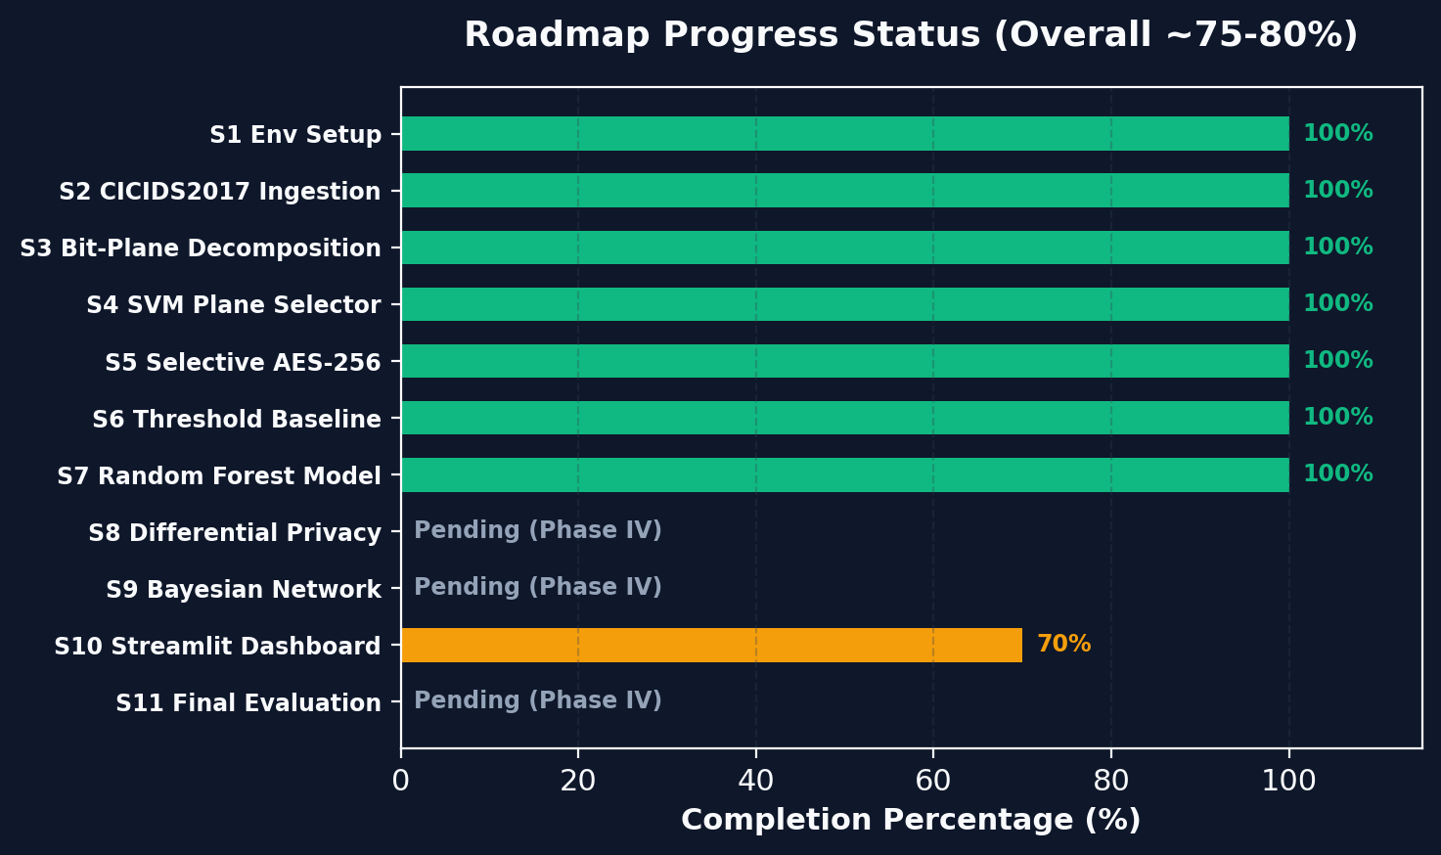
INTERIM REVIEW 02
Project Status & Challenges Faced
CHALLENGES ENCOUNTERED & RESOLVED
CICIDS2017 data artifacts
Raw CSVs contained stray whitespace and Infinity / NaN rows — resolved with a dedicated header-cleaning step before training.
Fixed vs. adaptive plane choice
An initial fixed top-4-plane rule didn't generalize across images — replaced with an SVM trained on correlation + entropy features.
Dashboard integration load
Merging two independent pipelines into one live UI is still ~70% complete and is the current focus area.
SecureCloudGuard
14 / 16

Slide 15
INTERIM REVIEW 02
Security Validation & Remaining Roadmap
Security Validation Plan (Phase IV): beyond the speed gains already measured, NPCR, UACI, and Shannon-entropy tests are scheduled next to statistically confirm resistance to differential and statistical attacks on the selective-encryption output.
REMAINING WORK — PHASE IV
1
Differential Privacy Module
Apply calibrated Gaussian noise N(0, σ²) to aggregated traffic statistics in the Streamlit UI; evaluate the utility-vs-privacy tradeoff.
2
Bayesian Predictive Network
Build a 3–4 node DAG in pgmpy (TrafficRate → AnomalyScore → AttackProb) to forecast emerging threats.
3
Dashboard, Security Metrics & Cloud Integration
Finish the dashboard UI, add NPCR / UACI / entropy metrics, integrate boto3 AWS S3 storage, and deploy to Streamlit Community Cloud.
4
Final Evaluation & Replay Demo
Run a live attack-replay demo using CICIDS2017 rows for the panel and finalize the project report.
SecureCloudGuard
15 / 16

Slide 16
INTERIM REVIEW 02
Thank You
Questions & Discussion
REFERENCE
Pathak, A. et al. — "Data Encryption in Cloud and DDoS Attack Detection Using AI / ML." Computers & Security, 2026. (Base paper for benchmark comparison throughout this work.)
PROJECT TEAM · CSE DEPARTMENT
Sashi Bhusan Prusty (2301020812) · Tasha Pattnaik (2301020388) · Parbhu Datta Biswal (2301020766) · Aditya Padhi (2301020330)
Supervisor: Dr. Sampa Sahoo ·
Department of Computer Science and Engineering · C.V. Raman Global University, Bhubaneswar, Odisha
SecureCloudGuard
16 / 16

