Slide 1
DFA: DATA-FLOW ATTESTATION FOR EMBEDDED SYSTEMS SOFTWARE
SASHIDHAR JAKKAMSETTI
SIDDHARTH NARASIMHAN

Slide 2
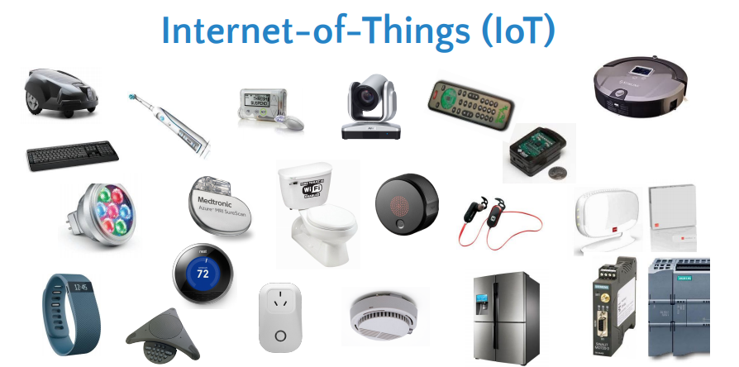
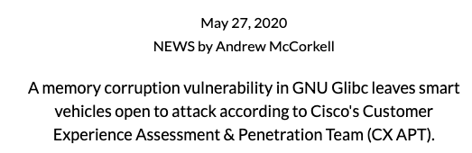
INTRODUCTION
IoT space → runs software vulnerable to attacks
Memory corruption attacks
Control flow and data flow attacks
Why are we doing detection and why not prevention?
IoT has a limited “real estate” and limited budget
Notes:
Why is it important?
These devices are low-end, they cannot afford to do integrity (prevention). So, attestation (detection) is a better option instead.
Widely spread IoT space.
these devices are used in safety critical scenarios, so we cannot afford to lose their integrity.
In this presentation we’ll be talking about data flow attacks, and how DFA can detect such attacks.

Slide 3
RELATED WORK
Remote Attestation is used for detection of malware in IoT devices
Trust Anchor
Trusted hardware component like Intel SGX, Intel TrustLite, ARM TrustZone-M, SMART and VRASED
Runtime Remote Attestation
C-FLAT (Control Flow Attestation)
Data Flow Integrity
“Securing software by enforcing data-flow integrity”
Notes:
It is very important to do runtime attestation and at the same time it is hard to solve.
(small explanation about C-FLAT)
Trust Anchor - used for RA for root of trust.
run time RA -> done in C-FLAT
DFI is proposed in

Slide 4
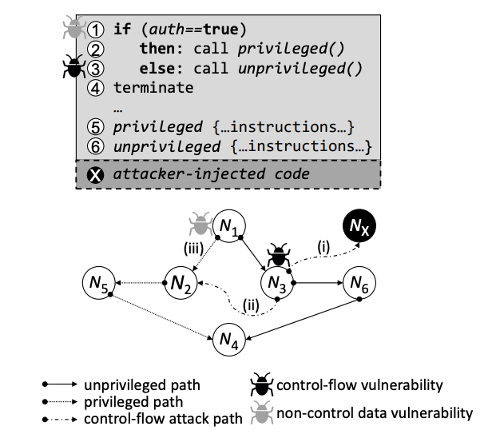
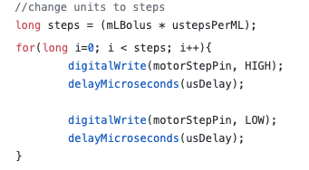
C-FLAT
DOESN’T
WORK!
√
C-FLAT works
C-FLAT fails
C-FLAT identifies attacks which change the control flow
Not immune to attacks targeting data pointers and data variables
Notes:
Why is it interesting?
It is very important to do runtime attestation and at the same time it is hard to solve.
C_FLAT identifies invalid/wrong path taken by the control flow.
However, if control flow graph does not change, but data pointers are changed, C-FLAT will fail.

Slide 5
DESIGN OVERVIEW
Annotate “prime data variables” and instrument DFA stub functions
Use challenge response protocol to check the integrity of the instrumented program during runtime
Secure DFA monitor residing in the TrustAnchor of the IoT device checks the integrity of these variables during runtime
Create a log (Report) of unauthorized changes made to these prime data variables and send it to the verifier
Notes:
Detailed Description
HMAC
instrumented binary will be installed.

Slide 6
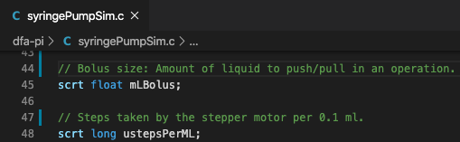
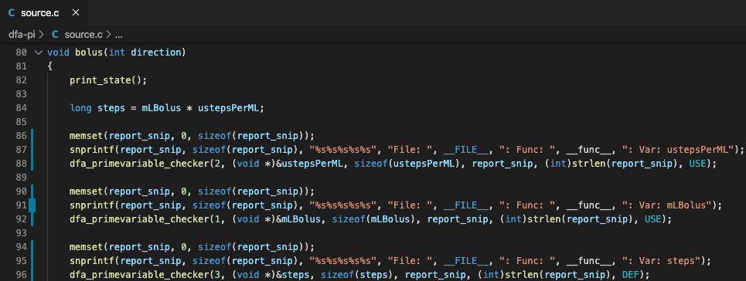
INSTRUMENTATION
Developers semantically identify prime data variables and annotate them
Taint tracking to generate set of all dependant prime variables
Whenever a prime data variable is being DEF / USE (event) in the program, call the Secure DFA monitor
Arrays: Only the accessed index and the value in it will be passed to the Secure DFA monitor
Pointer: Both the pointer and the data it is pointing to will be passed to the Secure DFA monitor
Instrumenting the binary is better than instrumenting the code
Notes:
Explain about arrays. (pointer + index)
Explain about function calls. (identify aliases during taint analysis)
Alternative approach could be to use LLVM for static analysis
Why instrumenting the binary is better -> can handle multiple code files.

Slide 7
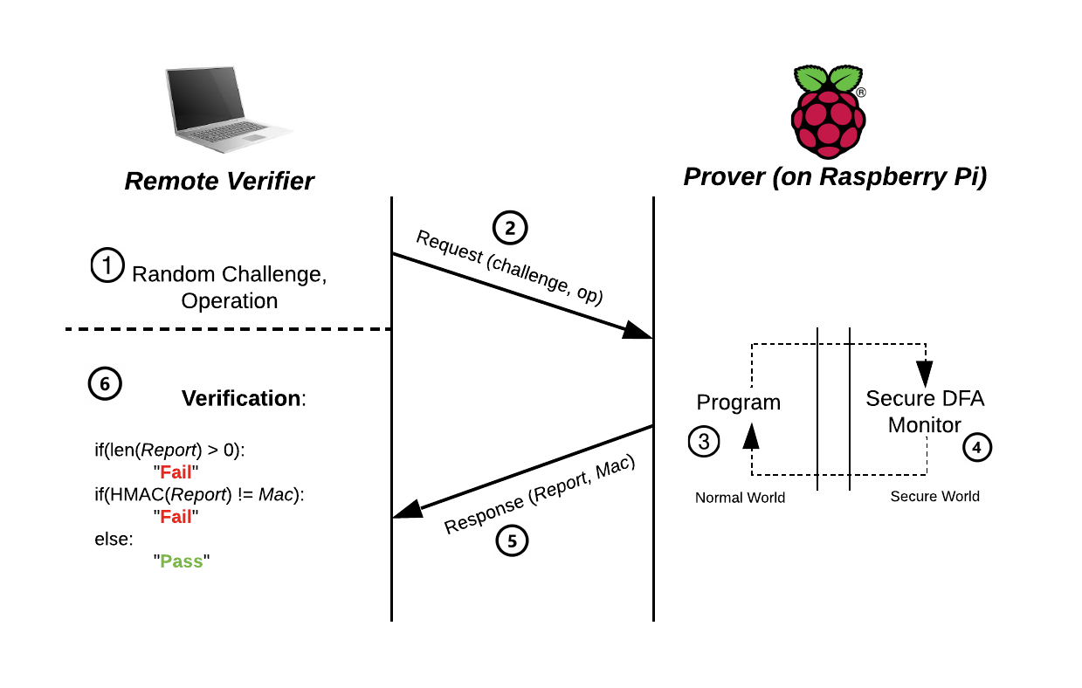
DFA
PROTOCOL
Notes:
Explain what the verifier is doing.

Slide 8
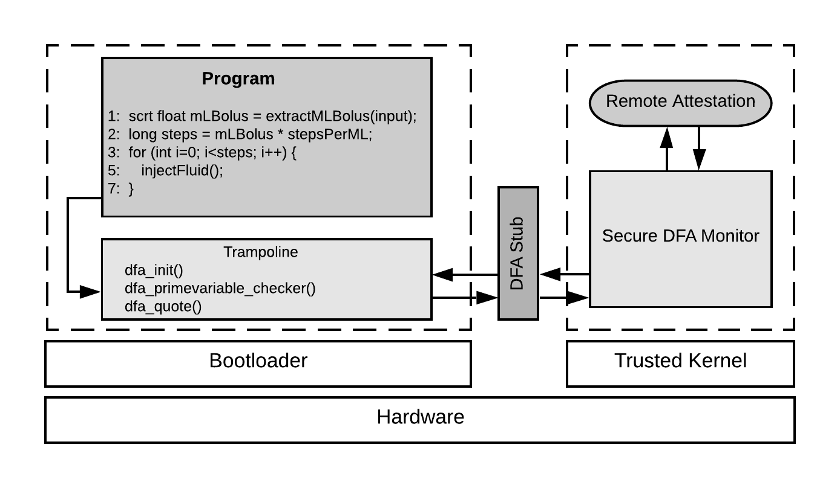
SYSTEM ARCHITECTURE
(of prover)

Slide 9
SECURE
DFA
MONITOR
DFA Initialize
Initiates RA module to derive a one-time key k from master key K, program boundaries and challenge Chal
k = KDF(K, program_boundary, Chal)
DFA Prime Variable Checker
Maintain storage <key, value> pairs for the variables
Update the variable value at event DEF
Verify the variable value at event USE
If it fails, log it in the Report
DFA Quote
Calls the RA module to generate the Mac on the Report
Mac = HMAC (k, Report)

Slide 10
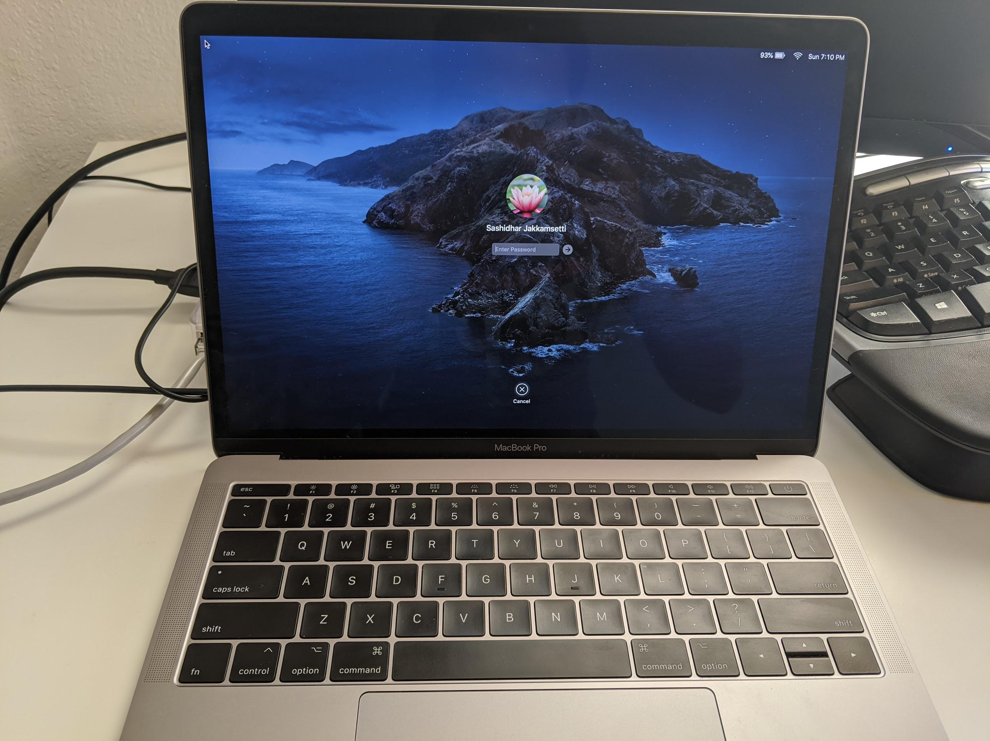
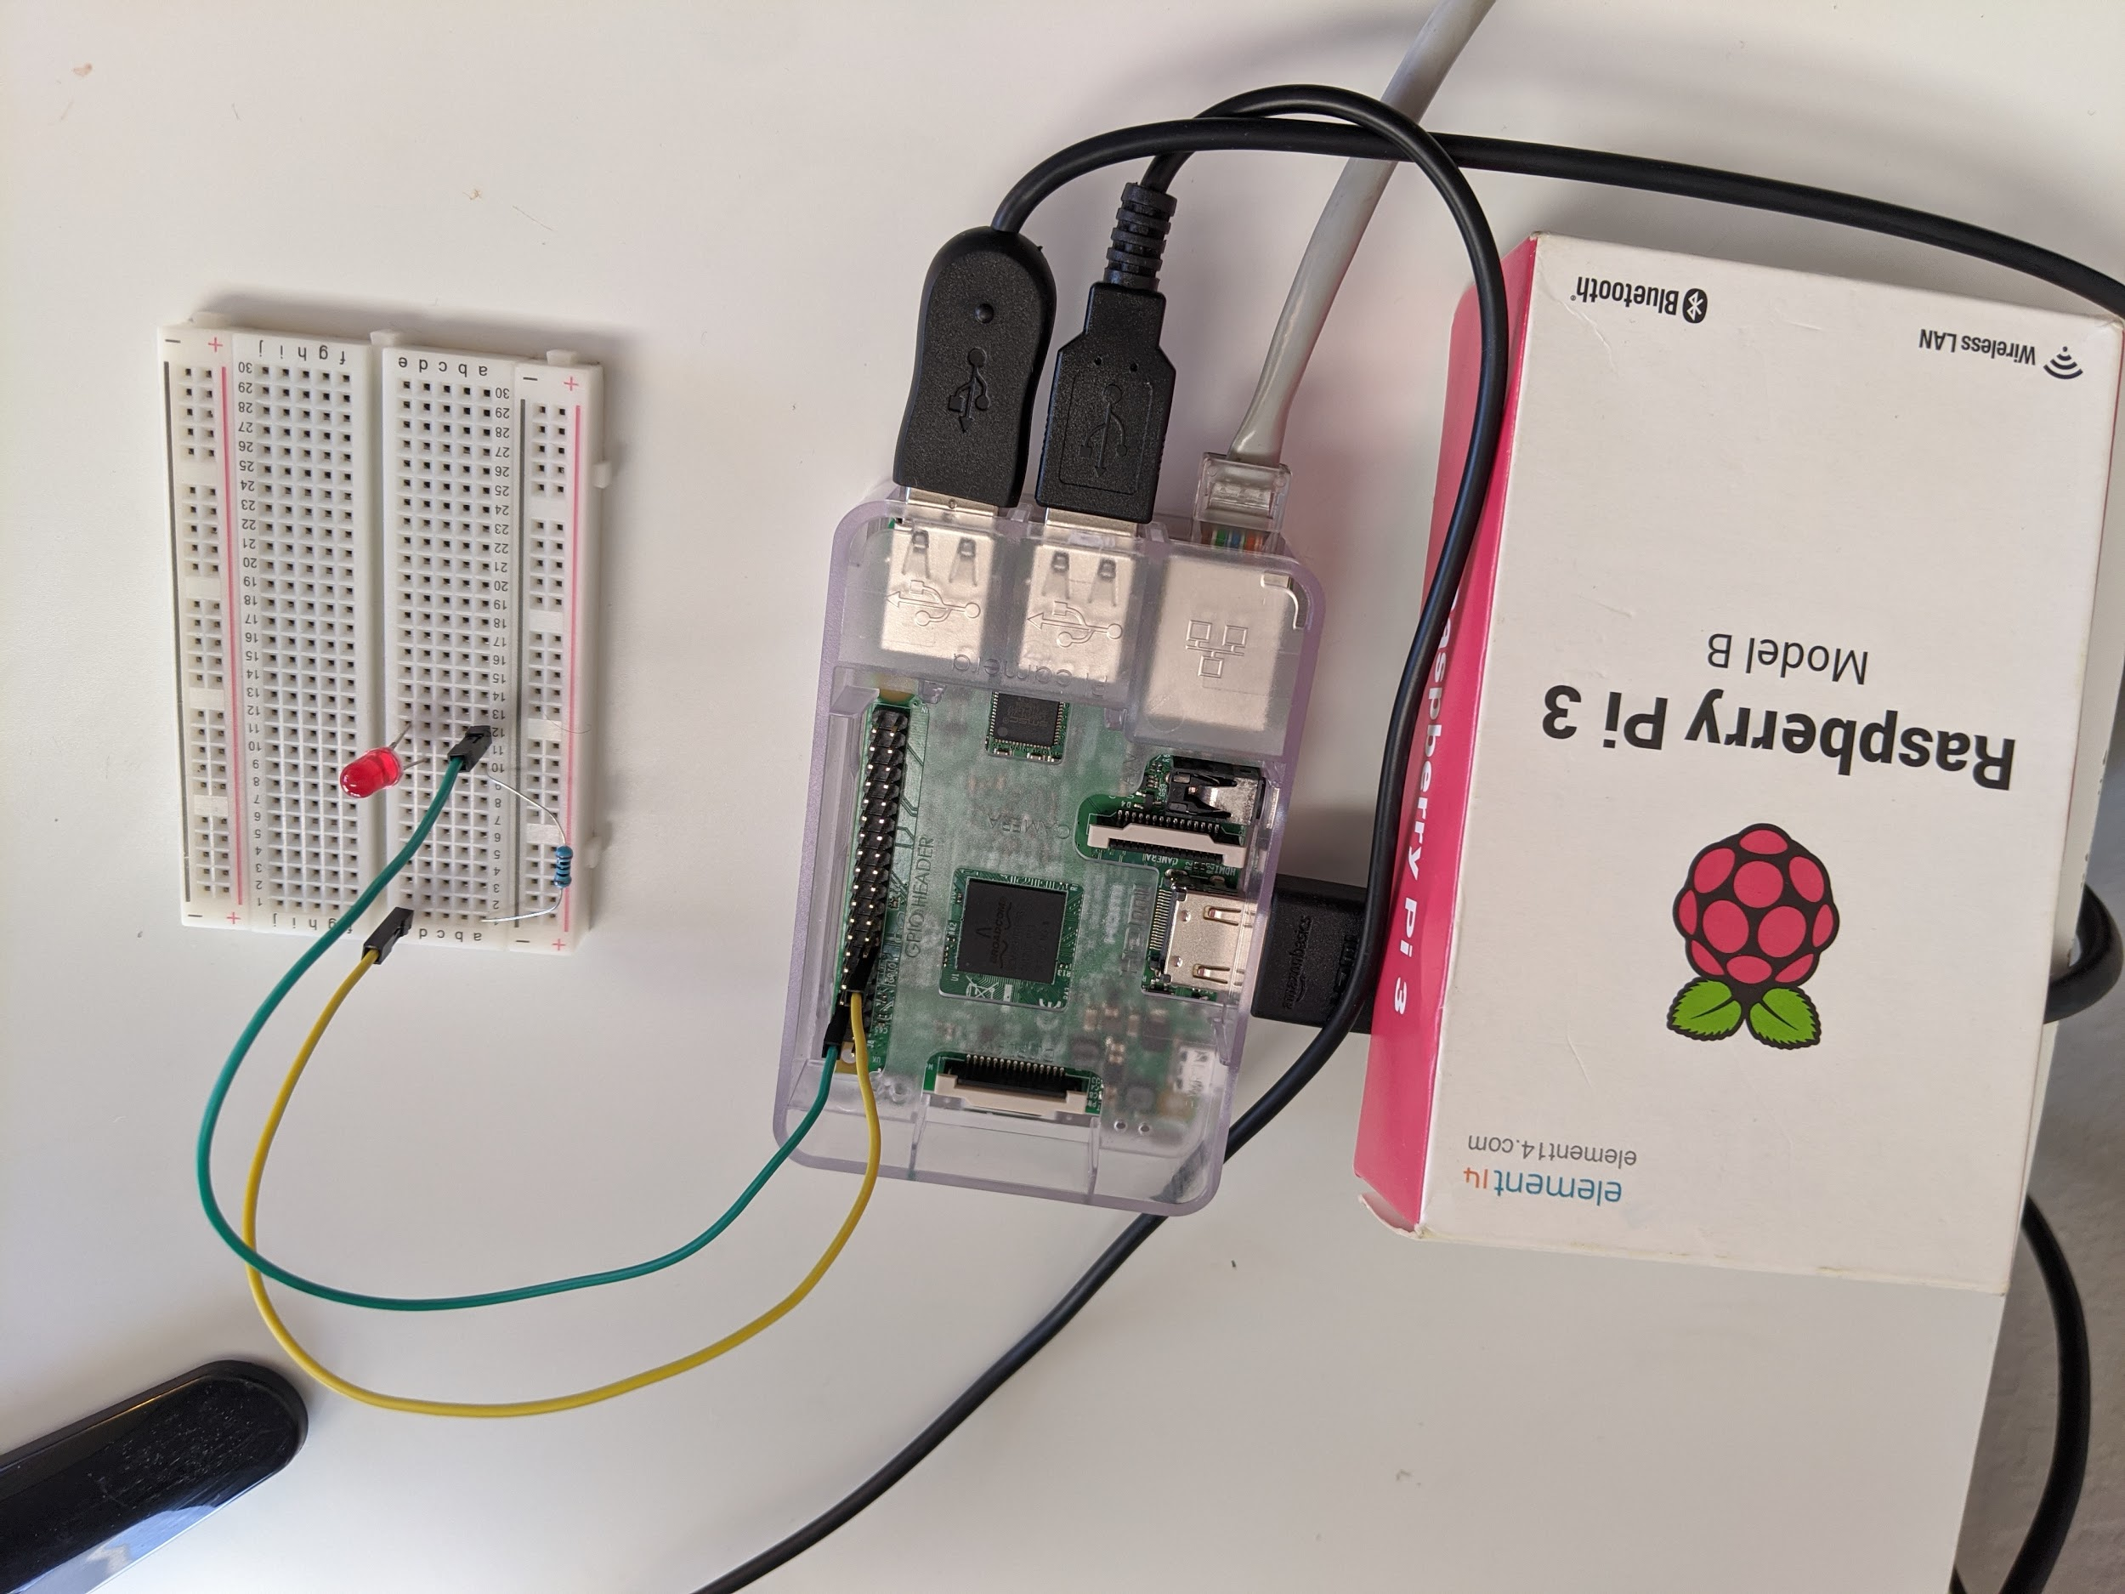
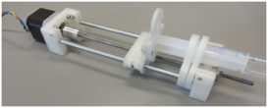
CASE STUDY: OPEN SYRINGE PUMP
Verifier (Laptop)
Prover (Raspberry Pi)
Blinking LED represents Open Syringe Pump pushing/pulling liquid
DFA monitor runs in a separate process in the background
DFA stub is a shared memory with semaphore locking as trampoline
SCP is used for network communication
Implementation: ~1.2K loc in C, ~150 loc in Python (from scratch)

Slide 11
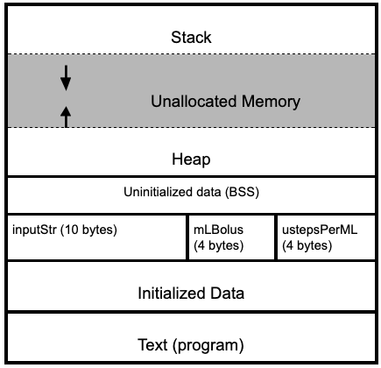

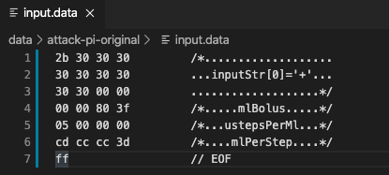
CASE STUDY: LAUNCHING THE ATTACK
/*..ustepsPerMl..*/
BUFFER OVERFLOW
Honest input for push operation
Malicious input for push operation
Memory layout of the program
inputStr: where the input file read and stored, mlBolus: amount of liquid to push/pull in one operation, ustepsPerMl: number of steps motor rotates to push/pull 0.1ml of liquid

Slide 12
CASE STUDY:
DEMO!
PART 1: Open Syringe Pump*
PART 2: Open Syringe Pump with Secure DFA monitor*
*These attacks are real-time, custom crafted and written from scratch. NOT taken from anywhere.

Slide 13



EVALUATION
Overhead Metrics for Open Syringe Pump for two prime data variables
Performance Overhead (on prover) | Depends on the operation, avg: ~118%
Verification time (at verifier) | 0.12s, which is negligible
Instrumentation Overhead (on prover) | 58 lines of code (22.13% increase)
Network Bandwidth (w.r.t prover) | 64B + len(Report) 8B
Discussion:
Operations take time to execute, so performance overhead is almost negligible (1.008 times) including operation time
More number of prime variables, more the overhead!
Frequent usage of these prime variables, more the overhead!

Slide 14
THANK YOU!
REFERENCES:
Tigist Abera, N. Asokan, Lucas Davi, Jan-Erik Ekberg, Thomas Nyman, Andrew Paverd, Ahmad-Reza Sadeghi, Gene Tsudik. C-FLAT: Control-Flow Attestation for Embedded Systems Software.
Miguel Castro, Manuel Costa, Tim Harris. Securing software by enforcing data-flow integrity.
Open Syringe Pump: https://github.com/naroom/OpenSyringePump/

