Slide 1
DFA: Data-flow attestation for embedded systems software
SashiDhar jakkamsetti
Siddharth narasimhan

Slide 2




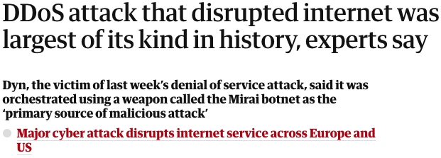
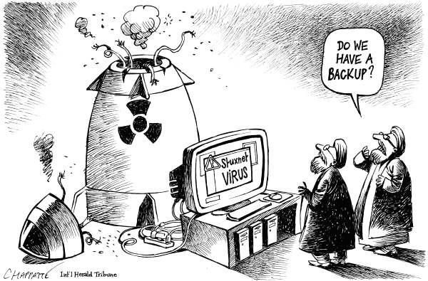


Slide 3
introduction
Remote Attestation (detection) is a means of verifying integrity of software running on a remote device.
Why are we doing detection and why not prevention?
There is a difference between software space and IOT space
IOT has a limited “real estate” and limited budget
It is important to check these IOT devices constantly
Especially when it is doing some to safety critical task like pouring liquids for drug manufacturing or controlling ventilator pressure in ICUs
Notes:
Why is it important?
These devices are low-end, they cannot afford to do integrity (prevention). So, attestation (detection) is a better option instead.
Moreover, these devices are used in safety critical scenarios, so we cannot afford to lose their integrity.

Slide 4
introduction
Remote Attestation in detail
Trust Anchor
Trusted hardware component like Intel SGX, Intel TrustLite, ARM TruztZone-M, SMART and VRASED
Latter ones are hybrid architectures
Static and dynamic root of trust
Able to check the device not only when it boots, but also anytime after that
Runtime root of trust? CFLAT! (we will see in the next slide)
Notes:
Why is it interesting?
It is very important to do runtime attestation and at the same time it is hard to solve.

Slide 5
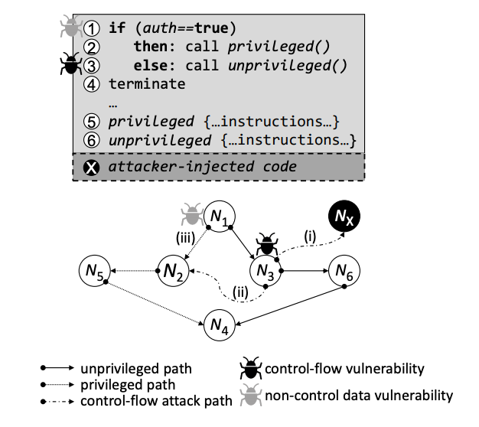
BACKground
Notes:
Why is it interesting?
It is very important to do runtime attestation and at the same time it is hard to solve.

Slide 6
Related work
CFLAT a remote attestation architecture for checking the integrity of the control flow path taken by the remote device
It does a hash chain on the IDs of the program blocks it is executing
If an invalid control path is taken or valid-but-incorrect path is taken, then the hash returned will not be the same

Slide 7
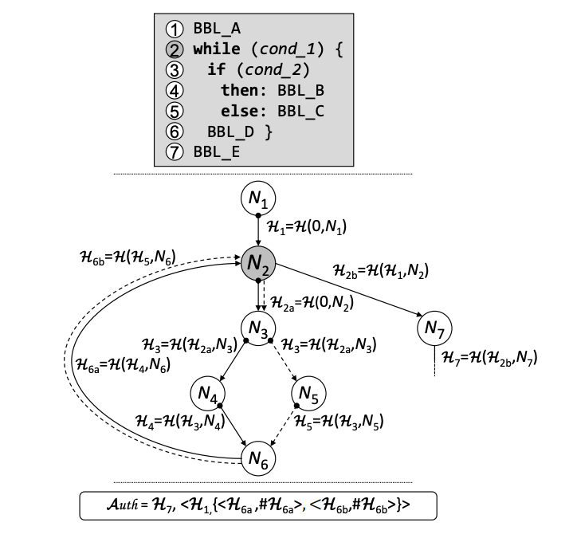
CFLAT

Slide 8
Motivation
There is no scheme yet for doing data flow attestation
CFLAT and others are doing control flow attestation which is not sufficient because the attacker can change the data pointers to point to sensitive data and steal them
Or attacker can change the return values, function arguments and other data pointers to give incorrect output but follow the expected control flow
Notes:
3rd point - if the return values, function arguments or data pointers change, C-FLAT is not equipped to detect the attack. This is where
a runtime data flow attestation mechanism is needed.

Slide 9
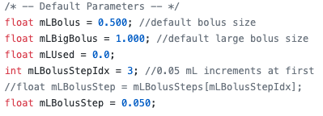


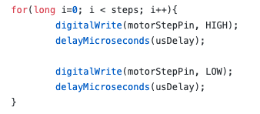
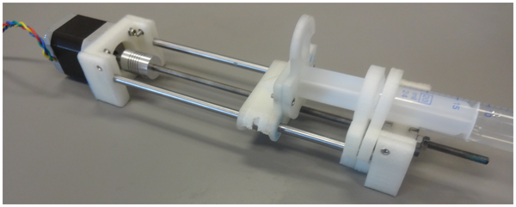
Motivation
syringePump.c (open sourced syringe pump binary)
Open Syringe Pump
Notes:
If the attacker manages to change the arguments to the functions, it will not change the number of iterations
in the for loop. It will also not change the CFG in any way. This means that C-FLAT will not be able protect the system from this attack.
This is a classic scenario where we need a run time data flow attestation mechanism to protect the system
against these kinds of attacks.

Slide 10
Our approach
Secure DFA monitor residing in ARM-TrustZone (Rasberry Pi)
Remote attestation architecture for checking the integrity of the data flow NOT just the control flow
Hash chain for data pointers, function argument pointers and return value pointers
Def-use chain integrity of each data variable

Slide 11
Our Approach
Reproduce CFLAT on our Rasberry Pi
Visual an attack to steal the key or exploit data flow without changing the control flow
Create def-use chains for every data variable
Hash chain each one along with the node id
Deploy it on Rasberry Pi
Measure the performance overhead and compare it with CFLAT and other related ones.

Slide 12
thank you!
REFERENCES
Tigist Abera, N. Asokan, Lucas Davi, Jan-Erik Ekberg, Thomas Nyman, Andrew Paverd, Ahmad-Reza Sadeghi, Gene Tsudik. C-FLAT: Control-Flow Attestation for Embedded Systems Software.
Miguel Castro, Manuel Costa, Tim Harris. Securing software by enforcing data-flow integrity.

