Slide 1
NodeJs Session
Sashidharan Kanagaraj

Slide 2
Errors & Error Handlers
Errors in nodejs are handled through exception
Creating the exception using the ‘throw value’.
In node it doesn’t throw string error, will throw the error as object.
Error Object is a object that either a instance, object or extend the error class.
Handling exception using the try/catch statement.

Slide 3
Errors & Error Handlers
Applications running in Node.js will generally experience four categories of errors:
Standard JavaScript errors such as <EvalError>, <SyntaxError>, <RangeError>, <ReferenceError>, <TypeError>, and <URIError>.
System errors triggered by underlying operating system constraints such as attempting to open a file that does not exist or attempting to send data over a closed socket.
User-specified errors triggered by application code.
AssertionErrors are a special class of error that can be triggered when Node.js detects an exceptional logic violation that should never occur. These are raised typically by the assert module

Slide 4
Sample Error handlers
try {
const a = 1;
const c = a + b;
} catch (err) {
console.log(err);
// throw err
}
const err = new Error('The message');
console.error(err.message);

Slide 5
Events & Event Emitters
Node.js is perfect for event-driven applications.
Every action on a computer is an event. Like when a connection is made or a file is opened.
Node.js allows us to create and handle custom events easily by using events module. Event module includes EventEmitter class which can be used to raise and handle custom events

Slide 6
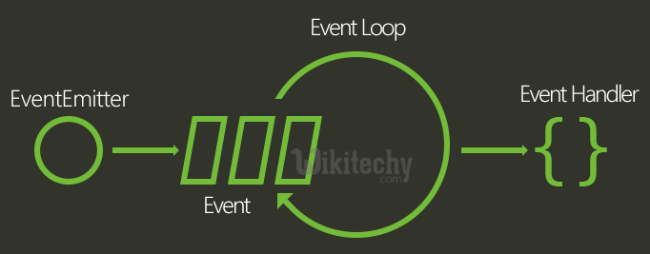
Events & Event Emitters

Slide 7
Event Emitter
The EventEmitter is a module that facilitates communication/interaction between objects in Node.
EventEmitter is kind of objects called emitters periodically emit events that cause listener objects to be called.
When the EventEmitter object emits an event, all of the functions attached to that specific event are called synchronously

Slide 8
Event Handlers & Listeners
Node JS Platform uses the following two components to take of events.
EventEmitter class
Java Script Callback functions
EventEmitter class is responsible to generate events and Java Script Callback functions are responsible to handle them
Functional code respond to the event is Event Listeners
By default, all listeners attached to a particular event object are called by the EventListener object synchronously in the order to which they are registered or attached to the event object

Slide 9
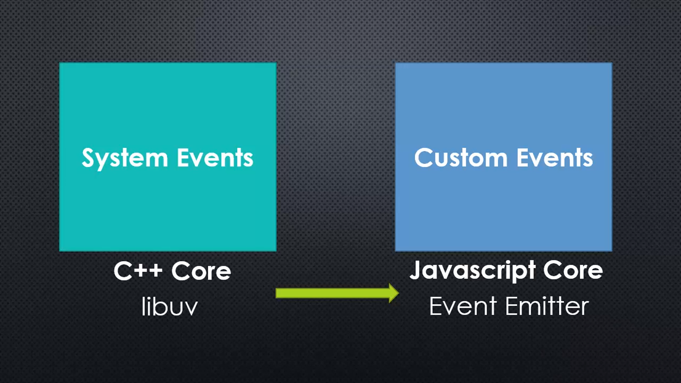
Events
Something that has happend in out app that we can respond to it
In Node we having 2 different types of events
System Events
Custom Events

Slide 10
Queries

Slide 11
Assignment
Create a event emitters
Add the listener to read the file using file system module
Use the Error handler to manage exception in file read/write operation
Write the file in another name.
Remove the listeners and exit the program

