Slide 1
NodeJs Session
Sashidharan Kanagaraj

Slide 2
Buffers
A temporal holding spot for data being moved from one place to another, Internally limited size.
Buffers were introduced to help developers deal with binary data, in the form of a sequence of bytes.
Buffers are deeply linked with streams.
Stream processor receives data faster than it can digest; it puts the data in a buffer.

Slide 3
Buffer & Character Encoding
When converting between Buffers and strings, a character encoding may be specified.
If no character encoding is specified, UTF-8 will be used as the default.
Currently Supporting Encoding,
Utf8, Utf16le, Latin1 - Buffer into a string is referred to as decoding and converting a string into a Buffer is referred to as encoding.
Base64, hex, ascii, binary, ucs2 – Its supports converting binary to text referred as encoding and text to binary is decoding.

Slide 4
Stream
Streams are one of the fundamental concepts that power Node.js applications.
Streams are objects that handles let you read data from a source or write data in Network Communication or any end to end information exchange.
Stream inherits the Event emitters, so eventually all stream is instance of Event Emitters.
Chunks - A piece of data being sent through a stream, Data is split in 'chunks' and streamed

Slide 5
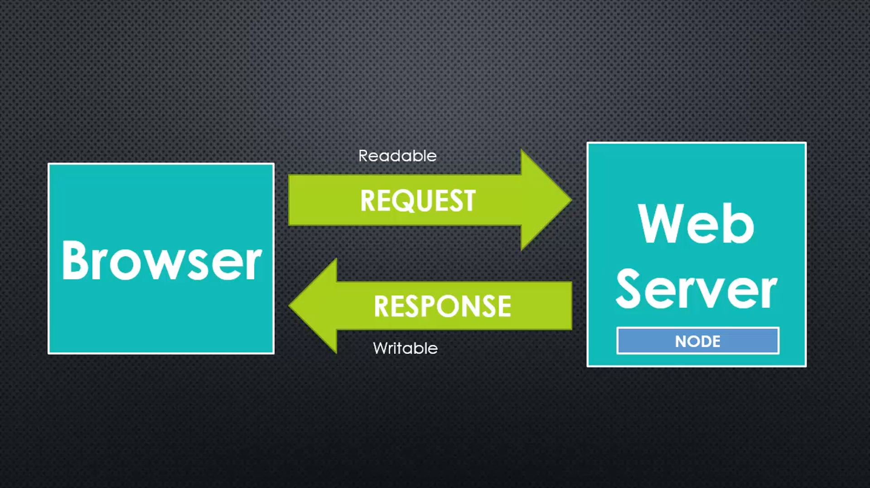
Stream
Sequence of data made available over time, the pieces of data that eventually combine into a whole data.
Streams you read it piece by piece, processing its content without keeping it all in memory
Two major advantages using other data handling methods
Memory Efficiency
Time Efficiency

Slide 6
Object Mode
Streams operates exclusively on strings and buffer object.
Stream implementations to work with other types of JavaScript values, such streams are considered to operate in "object mode".
Stream instances are converted into object mode when the stream is created using the Object Mode option.

Slide 7
Types of Streams
Four fundamental types of stream as follows,
Writeable - streams to which data can be written (for example, fs.createWriteStream()).
Readable - streams from which data can be read (for example, fs.createReadStream()).
Duplex - streams that are both Readable and Writable (for example, net.Socket).
Transform - Duplex streams that can modify or transform the data as it is written and read (for example, zlib.createDeflate()).

Slide 8
Writeable Streams
Writable streams are an abstraction for a destination to which data is written.
It implement the interface defined by the stream.Writable class.
The three arguments which write method uses,
Chunk – must be string or object but simply says buffers.
Encoding – uses when the chunk is a string.
Callback - return the value when the chunk is flushed

Slide 9
Readable Streams
Readable streams are an abstraction for a source from which data is consumed
Two different type of reading mode,
Flowing mode – data is read automatically and provided to application as soon as possible using EventEmitter.
Pause mode – method called explicitly to read the chunks of data from the stream.

Slide 10
Duplex & Transform Streams
Duplex streams are streams that implement both the Readable and Writable interfaces.
Transform streams are Duplex streams where the output is in some way related to the input.
Like all Duplex streams, Transform streams implement both the Readable and Writable interfaces.

Slide 11
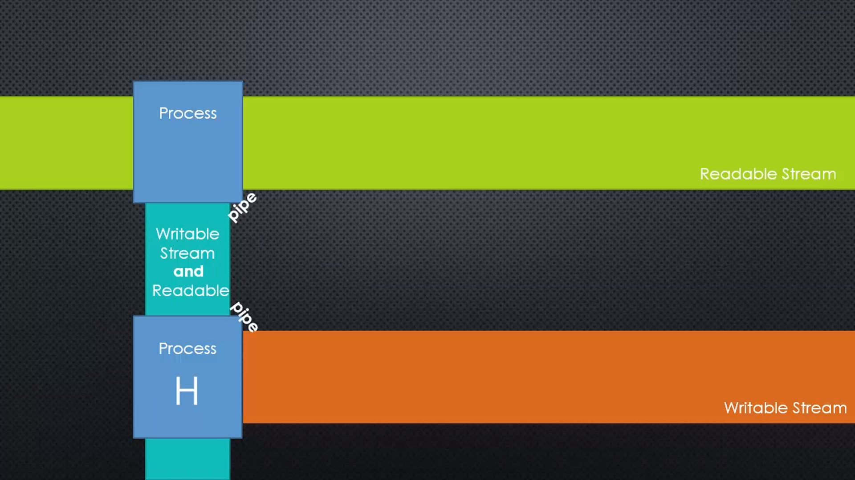
Pipes
Connnecting two streams by writing to one stream whatis being read from another
In node you pipe from a readable stream to a writeable stream

Slide 12
Pipes Method Chaining
Method returns an object so we can keep calling more methods
Sometimes it returns the parent object (called cascading) and sometimes some other object

Slide 13
Callbacks
A function passed to some other function which we assume will be invoked at some point.
The function calls back back invoking the function you give it when it is done doing work.

Slide 14
Queries

