Slide 1
NodeJs Session
Sashidharan Kanagaraj

Slide 2
Express Frameworks
Express is a minimal and flexible Node.js web application framework that provides a robust set of features to develop web and mobile applications.
Allows to set up middleware's to respond to HTTP Requests.
Defines a routing table which is used to perform different actions based on HTTP Method and URL.
Allows to dynamically render HTML Pages based on passing arguments to templates.

Slide 3
Express Frameworks
Web Applications
Express is a minimal and flexible Node.js web application framework that provides a robust set of features for web and mobile applications.
APIs
With a myriad of HTTP utility methods and middleware at your disposal, creating a robust API is quick and easy.
Performance
Express provides a thin layer of fundamental web application features, without obscuring Node.js features that you know and love.

Slide 4
Frameworks build on Express
Several popular Node.js frameworks are built on Express:
Feathers: Build prototypes in minutes and production ready real-time apps in days.
ItemsAPI: Search backend for web and mobile applications built on Express and Elasticsearch.
KeystoneJS: Website and API Application Framework / CMS with an auto-generated React.js Admin UI.
Poet: Lightweight Markdown Blog Engine with instant pagination, tag and category views.
Kraken: Secure and scalable layer that extends Express by providing structure and convention.
LoopBack: Highly-extensible, open-source Node.js framework for quickly creating dynamic end-to-end REST APIs.
Hydra-Express: Hydra-Express is a light-weight library which facilitates building Node.js Microservices using ExpressJS.

Slide 5
Frameworks build on Express
Blueprint: a SOLID framework for building APIs and backend services
Locomotive: Powerful MVC web framework for Node.js from the maker of Passport.js
graphql-yoga: Fully-featured, yet simple and lightweight GraphQL server
Express Gateway: Fully-featured and extensible API Gateway using Express as foundation
Dinoloop: Rest API Application Framework powered by typescript with dependency injection
Kites: Template-based Web Application Framework
FoalTS: Next-generation framework for building enterprise-grade Node.js applications (TypeScript).
NestJs: A progressive Node.js framework for building efficient, scalable, and enterprise-grade server-side applications on top of TypeScript & JavaScript (ES6, ES7, ES8)
Expressive Tea: A Small framework for building modulable, clean, fast and descriptive server-side applications with Typescript and Express out of the box.

Slide 6
Middlewares
Middleware functions are functions that have access to the request object (req), the response object (res), and the next function in the application’s request-response cycle
The next function is a function in the Express router which, when invoked, executes the middleware succeeding the current middleware
Middleware functions can perform the following tasks:
Execute any code.
Make changes to the request and the response objects.
End the request-response cycle.
Call the next middleware in the stack.

Slide 7
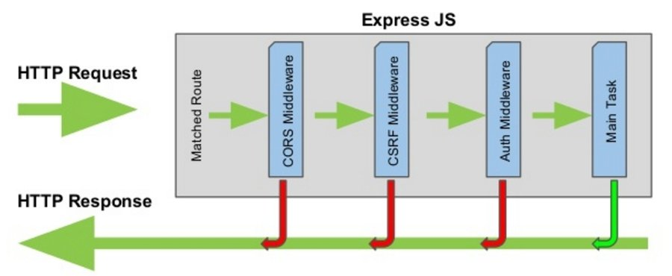
Middlewares

Slide 8
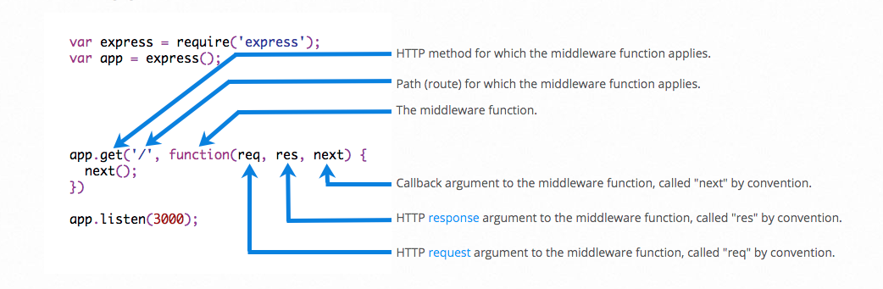
Using Middlewares
An Express application can use the following types of middleware
Built-in middleware
Application-level middleware
Router-level middleware
Error-handling middleware
Third-party middleware

Slide 9
Template Engines
A template engine enables you to use static template files in your application.
At runtime, the template engine replaces variables in a template file with actual values and transforms the template into an HTML file sent to the client.
Some popular template engines that work with Express.
PUG
Mustache
EJS

Slide 10
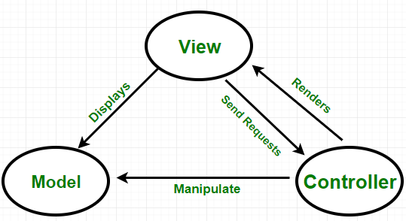
MVC Structured Express
Model: Model represents the structure of data, the format and the constraints with which it is stored. It maintains the data of the application.
View: View is what is presented to the user. Views utilize the Model and present data in a form in which the user wants. A user can also be allowed to make changes to the data presented to the user.
static
dynamic.
Controller: Controller controls the requests of the user and then generates appropriate response which is fed to the viewer.

Slide 11
Queries

Slide 12
Assignments
Create the method verbs (get, post, put, delete) using the express frameworks
Using the JSON document to store the information and retrieve in it.
Create the API apllication using the Express frameworks with error handlers

