Slide 1
NodeJs Session
Sashidharan Kanagaraj

Slide 2
Database with NodeJs
It supports all kinds of databases no matter if it is a relational database or NoSQL database.
Relational Database:
MySql, PostgreSQL, MS Sql Server,
Oracle
SQLite
NoSQL Database:
Monogdb, Cassandra, LevelDB, Redis, CouchDB, etc

Slide 3
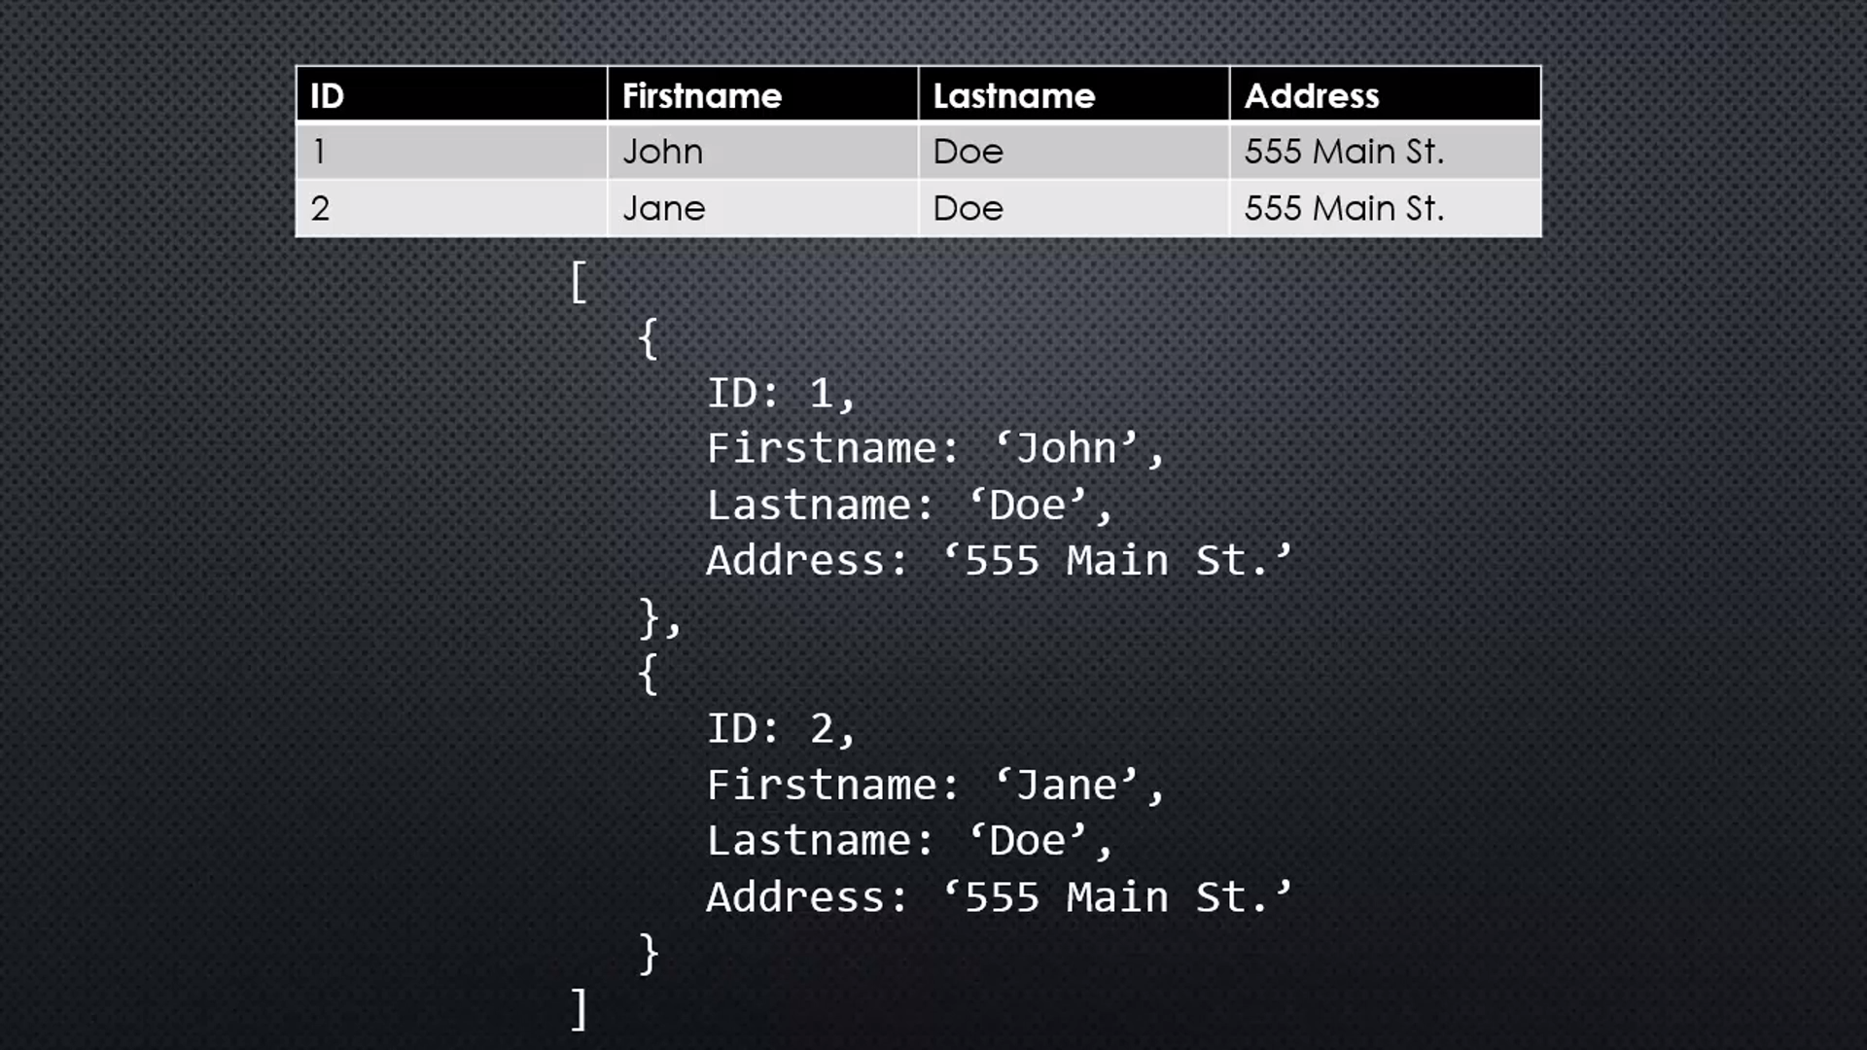
NoSql & Documents
A variety of Technologies that are alternatives to tables and sql.
One of those type named as document database.
MongoDB is one among them.

Slide 4
MongoDB
MongoDB is a document database designed for ease of development and scaling.
MongoDB stores data records as BSON documents. BSON is a binary representation of JSON documents, though it contains more data types than JSON.
MongoDB documents are like JSON objects.
It is a highly scalable, flexible, and distributed NoSQL database.
MongoDB is free to use.

Slide 5
MongoDB Storage
WiredTiger Storage Engine is the default storage engine. It is well-suited for most workloads and is recommended for new deployments. Provides a document-level concurrency model, checkpointing, and compression, among other features.
In-Memory Storage Engine is available in MongoDB Enterprise. Rather than storing documents on-disk, it retains them in-memory for more predictable data latencies.
GridFS is a specification for storing and retrieving files that exceed the BSON-document size limit of 16 MB

Slide 6
Advantages
Non-relational (NoSQL) document-oriented database
Flexible data model (JSON)
Auto-sharding and replication with automatic-failover
No Transactions nor joins

Slide 7
Mongoose
Mongoose is a very popular ODM for MongoDB in Node.js.
Mongoose provides a straight-forward, schema-based solution to model your application data.
It includes built-in type casting, validation, query building, business logic hooks and more

Slide 8
Object ID
An ObjectId is a 12-byte BSON type having the following structure −
The first 4 bytes representing the seconds since the unix epoch
The next 3 bytes are the machine identifier
The next 2 bytes consists of process id
The last 3 bytes are a random counter value
MongoDB uses ObjectIds as the default value of _id field of each document, which is generated while the creation of any document.
The complex combination of ObjectId makes all the _id fields unique.

Slide 9
MongoDB Operation
Create Read Update Delete (CRUD) Operaions
Projections
Selecting only the necessary data rather than selecting whole of the data of a document
Sorting
Method accepts a document containing a list of fields along with their sorting order
Limit & Skip
Method accepts one number type argument, which is the number of documents that you want to be displayed
Method used to skip the number of documents and it accepts only number

Slide 10
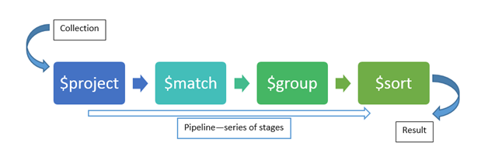
Aggregate

Slide 11
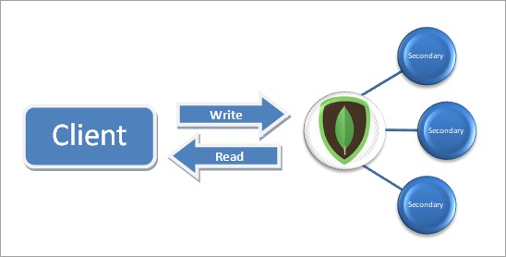
Replication

Slide 12
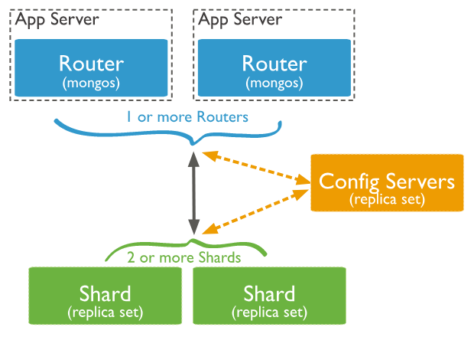
Sharding

Slide 13
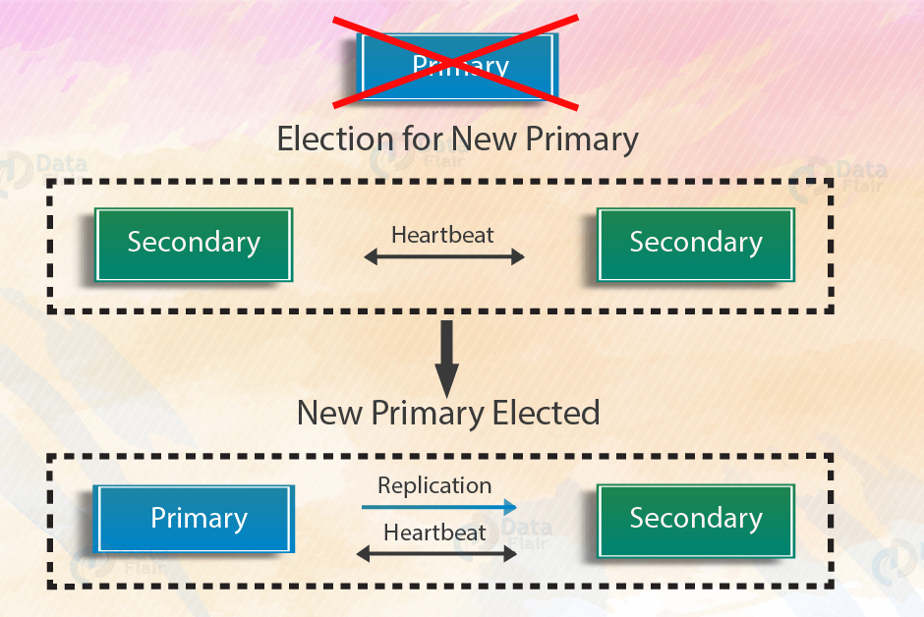
Automatic FailOver

Slide 14
MongoDB Limitiations
High Memory Usage.
Joins not Supported.
Limited Data Size (document size not more than 16MB).
Limited Nesting (not more than 100 levels).

Slide 15
Indexing
Indexes support the efficient resolution of queries.
Without indexes, MongoDB must scan every document of a collection to select those documents that match the query statement.
This scan is highly inefficient and require MongoDB to process a large volume of data.
The index stores the value of a specific field or set of fields, ordered by the value of the field as specified in the index.

Slide 16
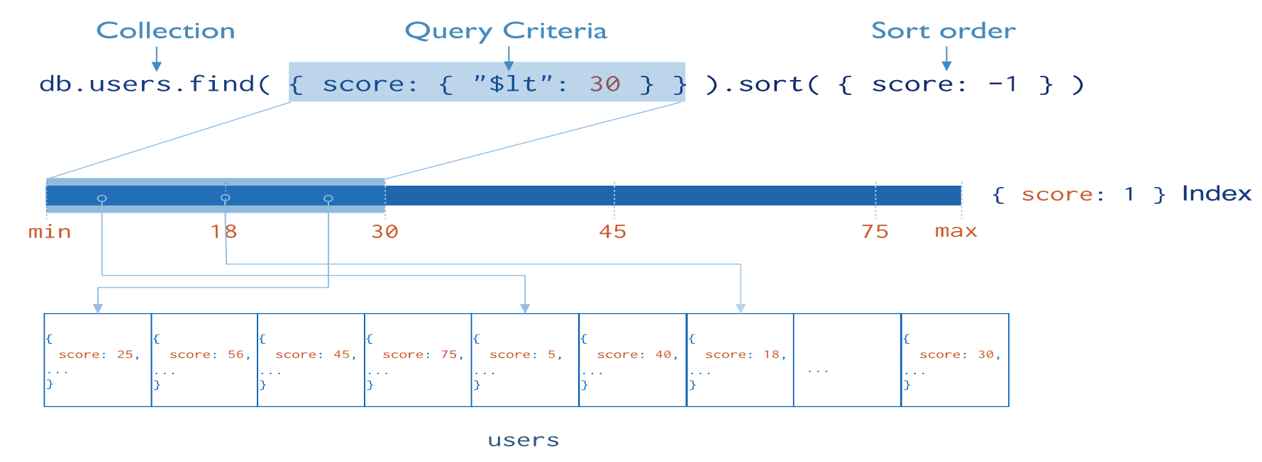
Indexing
return sorted results by using the ordering in the index.
Indexes are special data structures, that store a small portion of the data set in an easy-to-traverse form
Ordered by the value of the field.

Slide 17
Indexing Rules
Query Limitation
Regular expressions or negation operators like $nin, $not, etc.
Arithmetic operators like $mod, etc.
$where clause
Maximum Range
A collection cannot have more than 64 indexes.
The length of the index name cannot be longer than 125 characters.
A compound index can have maximum 31 fields indexed
Ram usage – Index uses RAM memory to access the data, so be specific with RAM Size, If it exceeds, it may delete the old index and cause performance issue.

Slide 18
Queries

Slide 19
Assignments
MongoDB
Create the User management structure in Mongodb.
Perform the CRUD operation in user management collections in mongodb.
NodeJs
Create a API to perform CRUD operations in NodeJs using Express Framework.
Create Nodejs API Structure using MVC architecture.

