Slide 1
NodeJs Session
Sashidharan Kanagaraj

Slide 2
Cluster
NodeJS processes runs on a single process, which means it does not take advantage from multi-core systems by default
The mechanism the cluster module uses to maximize the CPU usage was via forking processes
Using cluster module a parent/master process can be forked in any number of child/worker processes and communicate with them sending messages via IPC communication

Slide 3
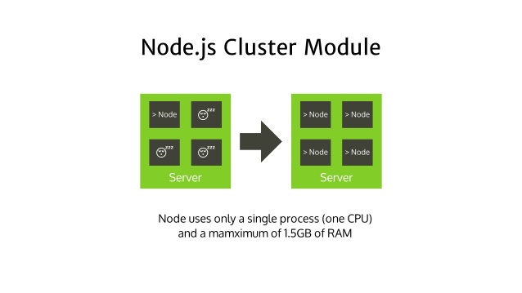
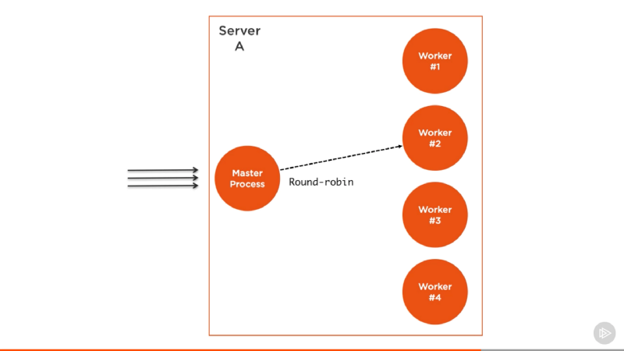
Cluster
It supports two methods of distribution connections,
Round Robin Approach
Master process creates the listen socket and sends it to interested workers

Slide 4
Cluster
Cluster module offers to NodeJS the needed capabilities to use the whole power of a CPU.
All available cores can be utilized for application execution, increases application performance
Resources wastage reduced tremendously by using the maximum capacity of the processor
Easy to implement since all work is managed by NodeJs module and no need to introduce an additional dependency

Slide 5
PM2
Managing processes on a server and taking server resources benefit without an interruption from an application code.
Managing applications on different processor cores without being worrying about a master and worker headache.
It helps to keep application independent of cores and processes management

Slide 6
PM2
PM2 is as good as using the cluster module in an application, therefore it is better to use process manager to reduce code complexity.
Multiple applications management is also possible through centralized ecosystem file.
The PM2 dashboard helps in runtime application monitoring.

Slide 7
Worker Thread
Workers are way to execute code asynchronously on a separate thread.
It enables the use of threads that execute JavaScript in parallel.
Each worker will have its own instance of V8 and Event Loop.
Workers are good for CPU driven tasks.
Its not for I/O tasks traditional async.

Slide 8
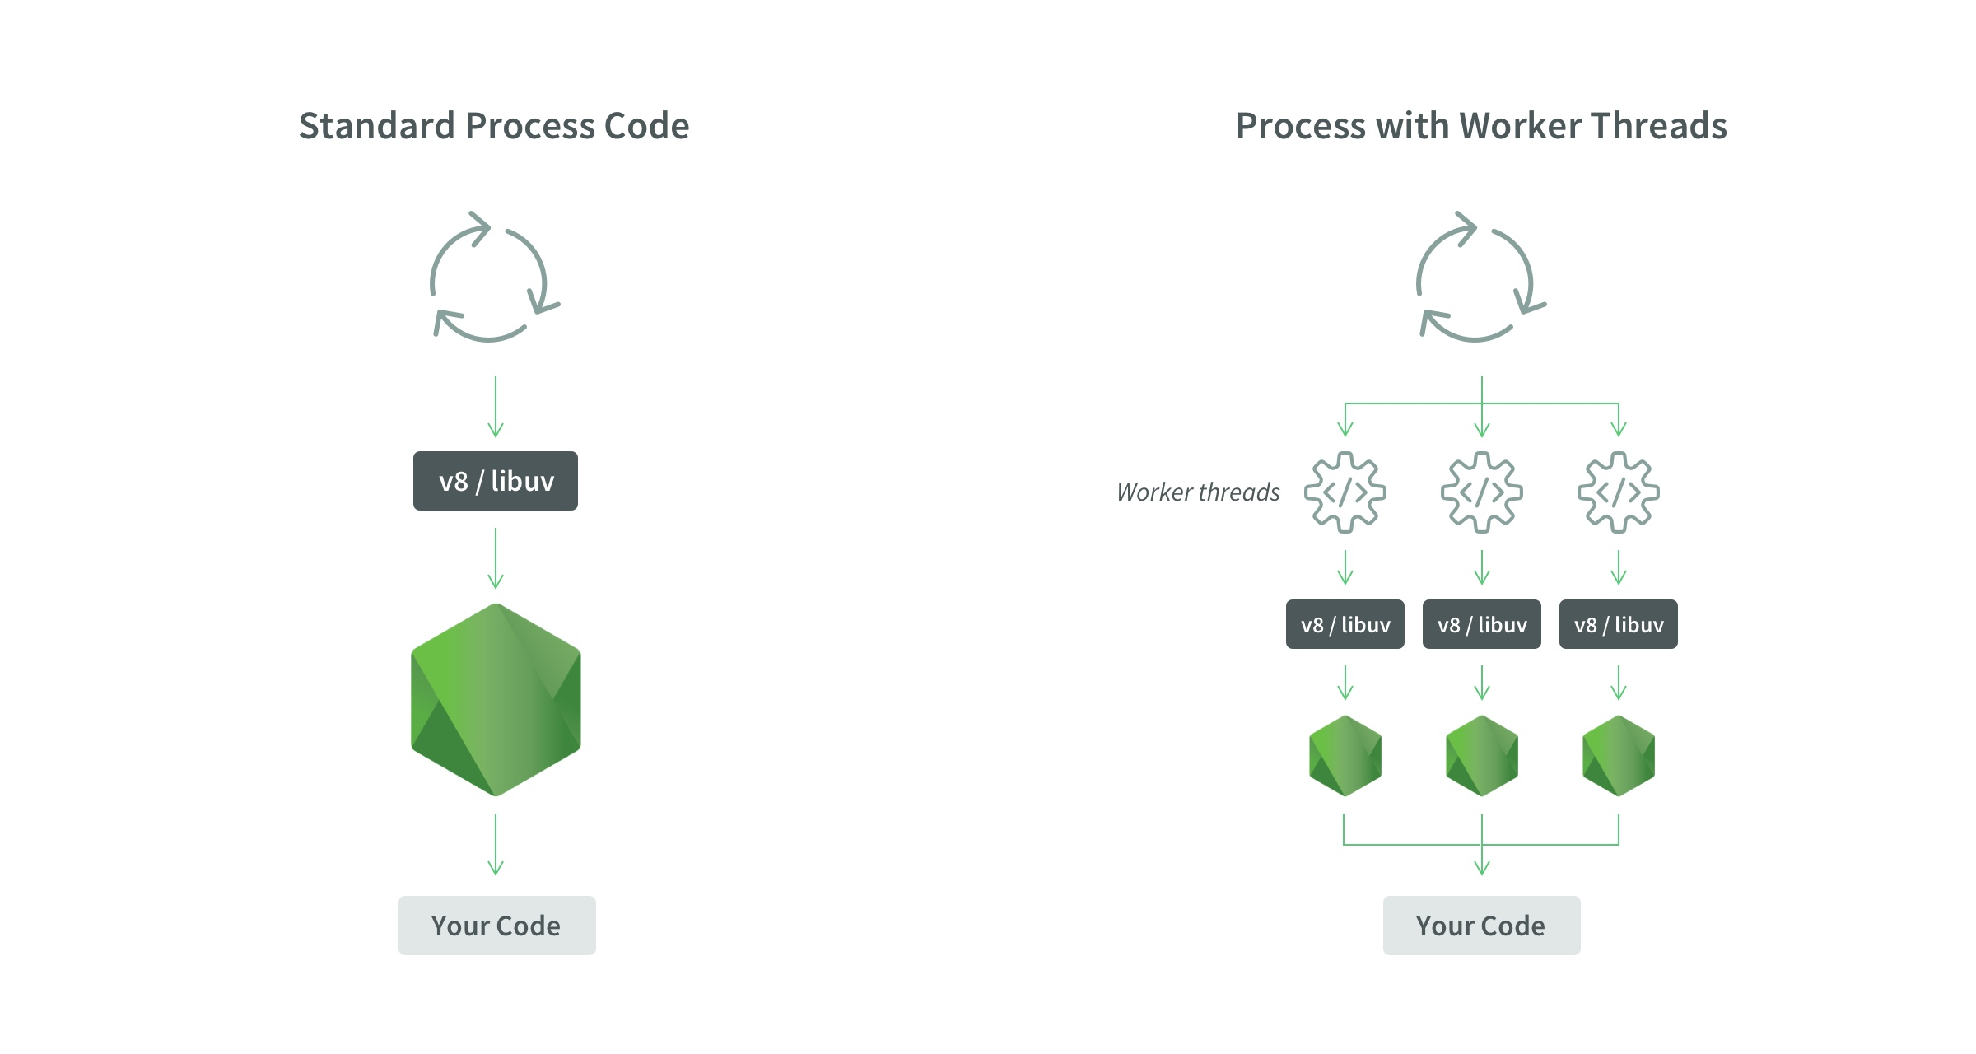
Worker Threads
Nodejs Process | Worker Thread
One Process | One Process
One thread | Muttiple threads
One event loop | One event loop per thread
One JS Engine Instance | One JS Engine Instance per thread
One Nodejs Instance | One Nodejs Instance per thread

Slide 9
WebSocket
WebSocket protocol opens a much faster and more efficient line of communication to the client.
Like HTTP, WebSocket's run on top of a TCP connection but they're much faster.
we don't have to open a new connection for each time we want to send a message since the connection is kept alive for as long as the server or client wants.
Since connection never dies, we finally get the full duplex communication

Slide 10
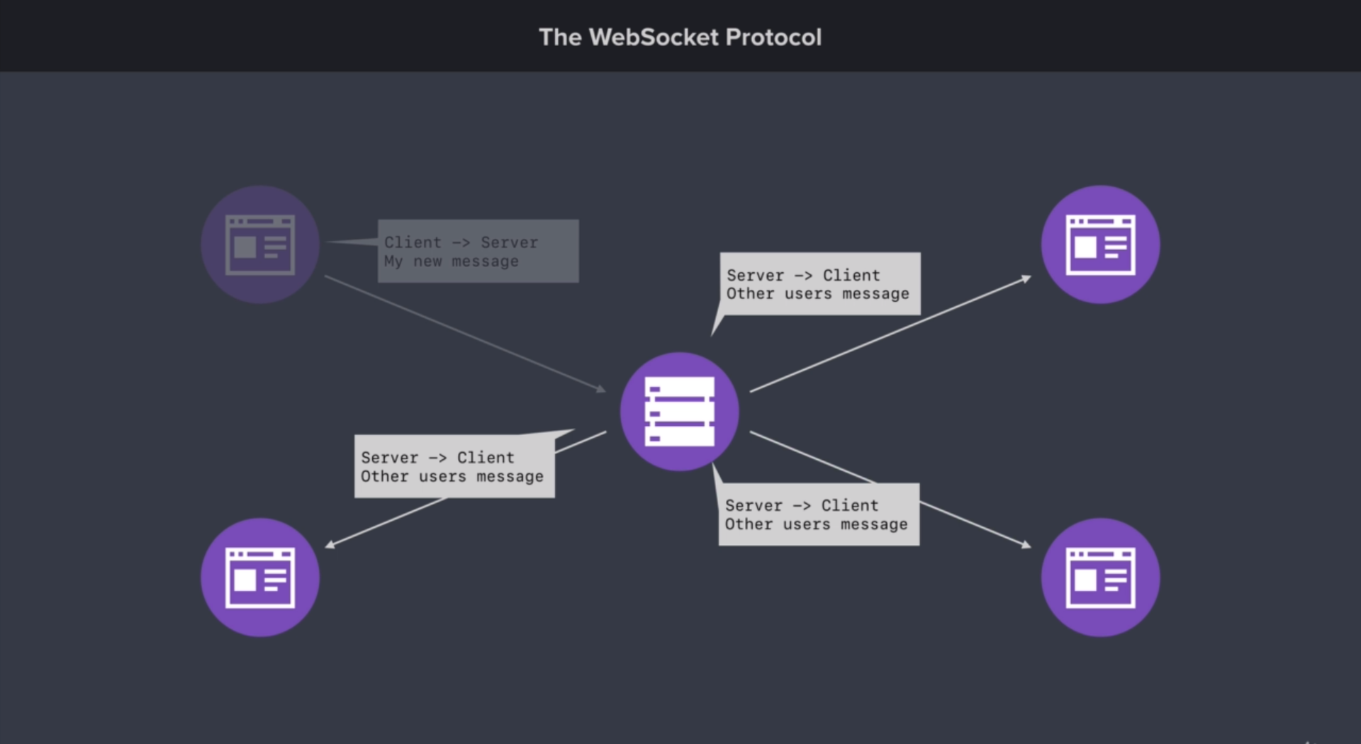
Socket IO
Full duplex communication will provide as to can push data to the client instead of having to wait for them to ask for data from the server.
WebSocket TCP connections will send either side of the connection can send data to the other, even at the same time

Slide 11
Queries

