Slide 1
AI Market Pulse
From one URL to a revenue-ready pipeline.
Vee Technologies · Hackathon 2026

Slide 2
The problem
B2B teams burn a week per prospect turning a website into a real go-to-market plan.
Research who to sell to, why they’d buy, how to reach them — by hand, per company.
Analysts read press, LinkedIn, SEC filings, competitor sites, and stitch it together in spreadsheets.
By the time the outreach lands, the buying signal that started it is stale.
Every rep does this work again from scratch. Nothing compounds.

Slide 3
The solution
Paste any URL. Get a live GTM workspace in about forty seconds.
Instant ICP
Real target accounts
Voice-controlled workspace
A specific ideal-customer profile with named roles, buying signals, and time bounds — not vague B2B filler.
Ten to twenty real companies matched to the ICP, scored on fit, timing, and priority — each with cited intel.
Jarvis, an always-listening assistant, drives navigation, analysis, and reports — hands-free.

Slide 4
How it works
Four AI stages, one continuous pipeline.
1. Ingest
2. Discover
3. Analyze
4. Act
Fetch the site, distill the business.
Find real companies that fit the ICP.
Personas, competitors, warm pathways.
Save, share, dial, or run by voice.
Every claim traces back to a cited source. Real API, real accounts, real numbers.

Slide 5
Product walkthrough
Nine screens, one continuous story.

Slide 6
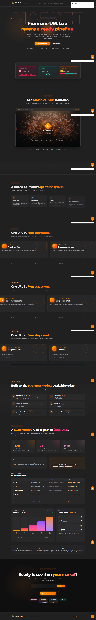
Screen 01
Landing
Marketing landing page with hero, tagline, and CTA — the entry point for new visitors.

Slide 7
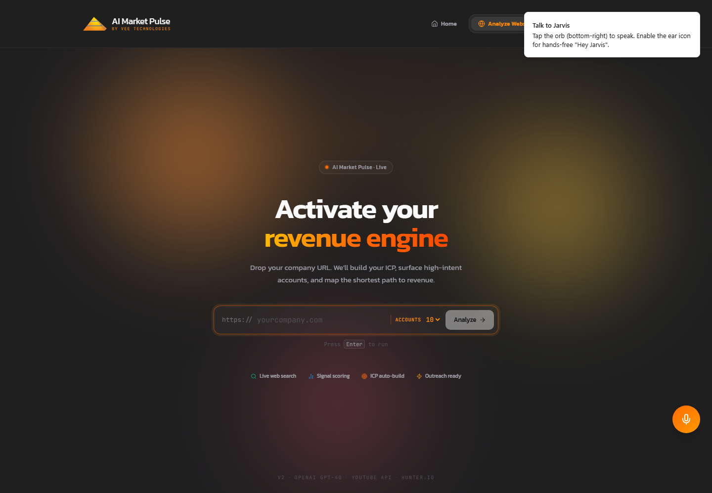
Screen 02
Analyze Input
Analyze Website — user pastes any company URL to kick off the AI pipeline.

Slide 8
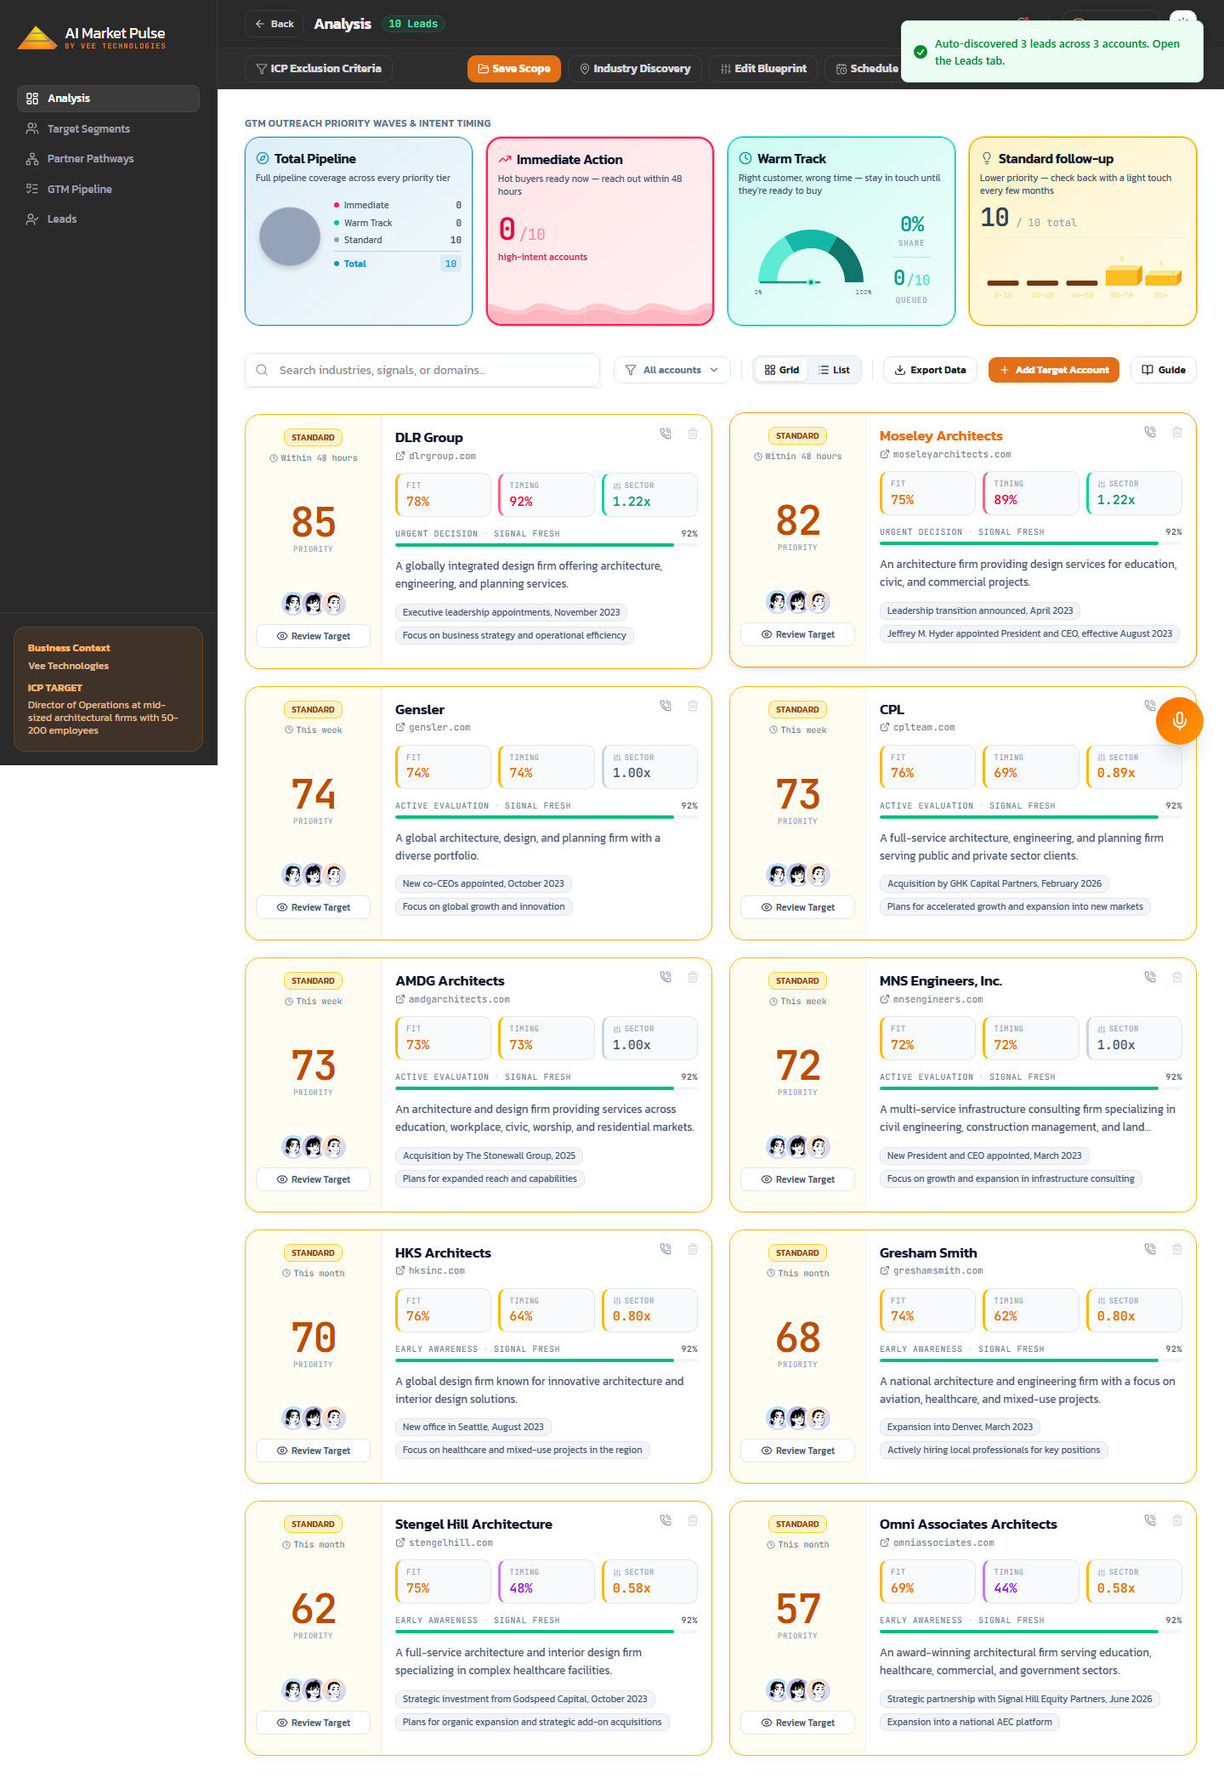
Screen 03
Dashboard Analysis
Dashboard Analysis tab — auto-generated ICP, business overview, and account recommendations.

Slide 9
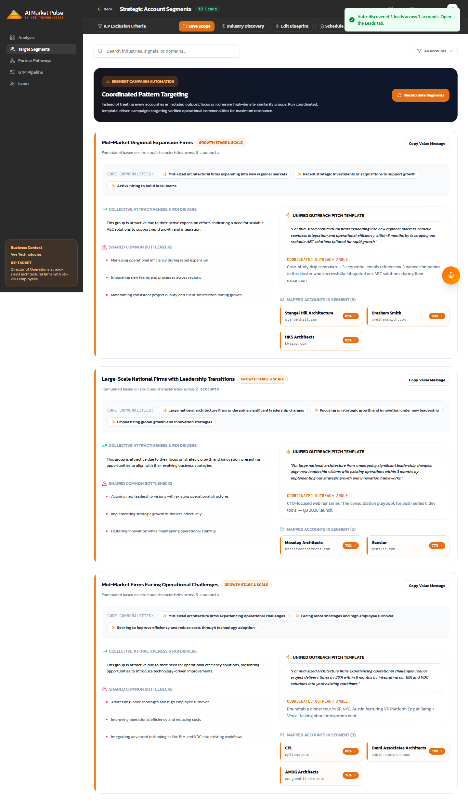
Screen 04
Dashboard Segments
Strategic account segments — AI clusters accounts sharing common characteristics into pursuit-ready groups.

Slide 10
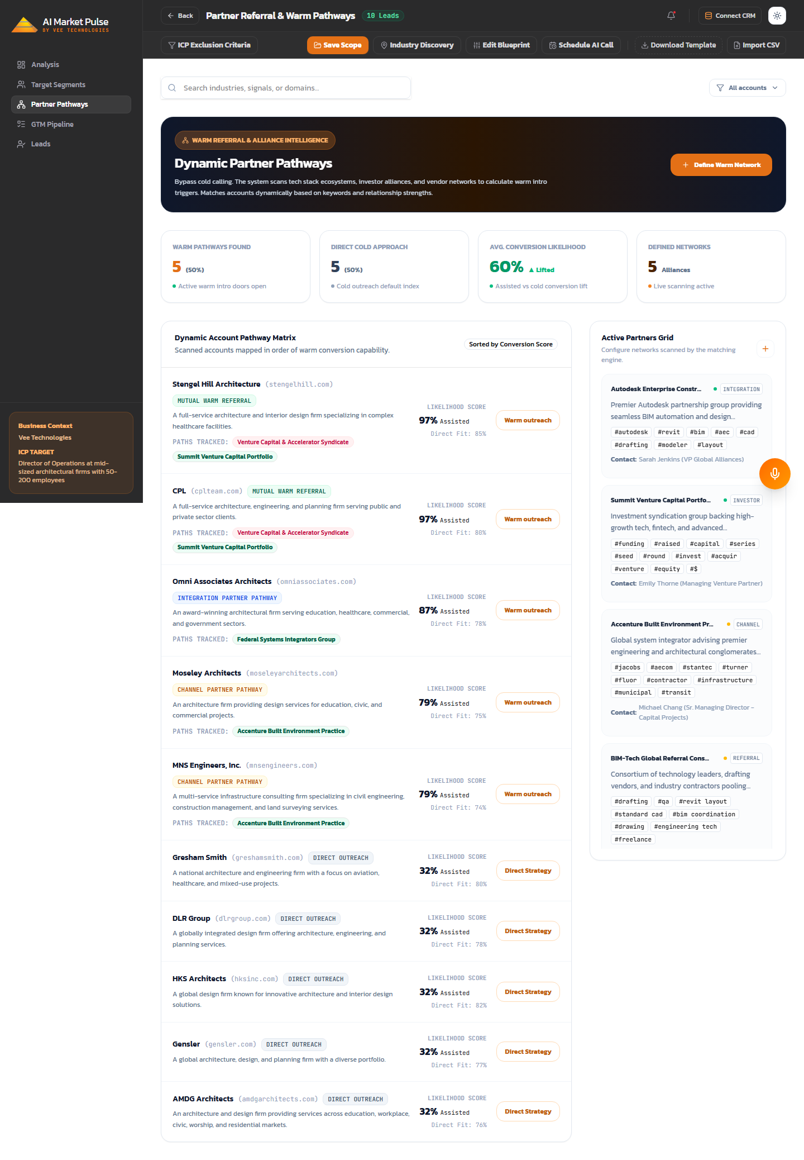
Screen 05
Dashboard Partner Pathways
Partner routing — surfaces warm-intro pathways via channel partners, integrations, or mutual connections.

Slide 11
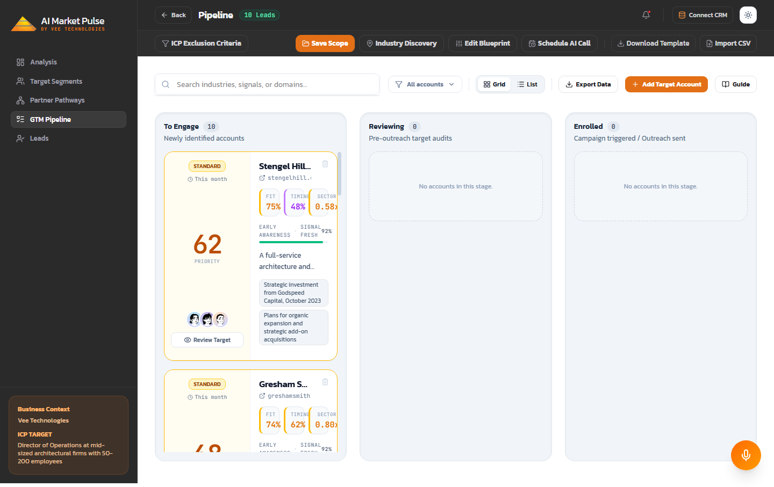
Screen 06
Dashboard Pipeline
Go-to-market pipeline — the full list of discovered target accounts with fit / timing / priority scores.

Slide 12
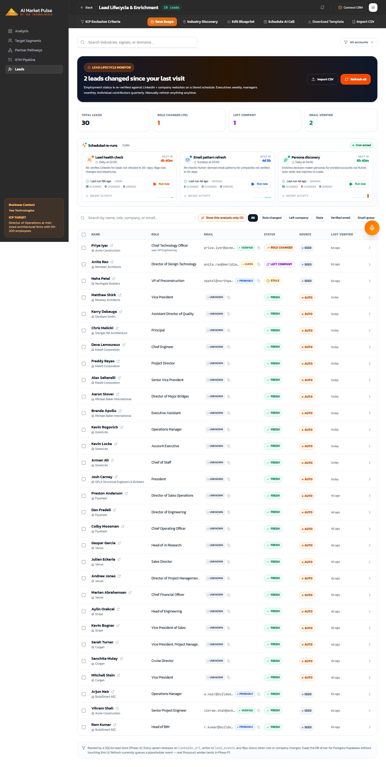
Screen 07
Dashboard Leads
Leads pipeline — individual stakeholders enriched from Hunter.io with roles, emails, and LinkedIn profiles.

Slide 13
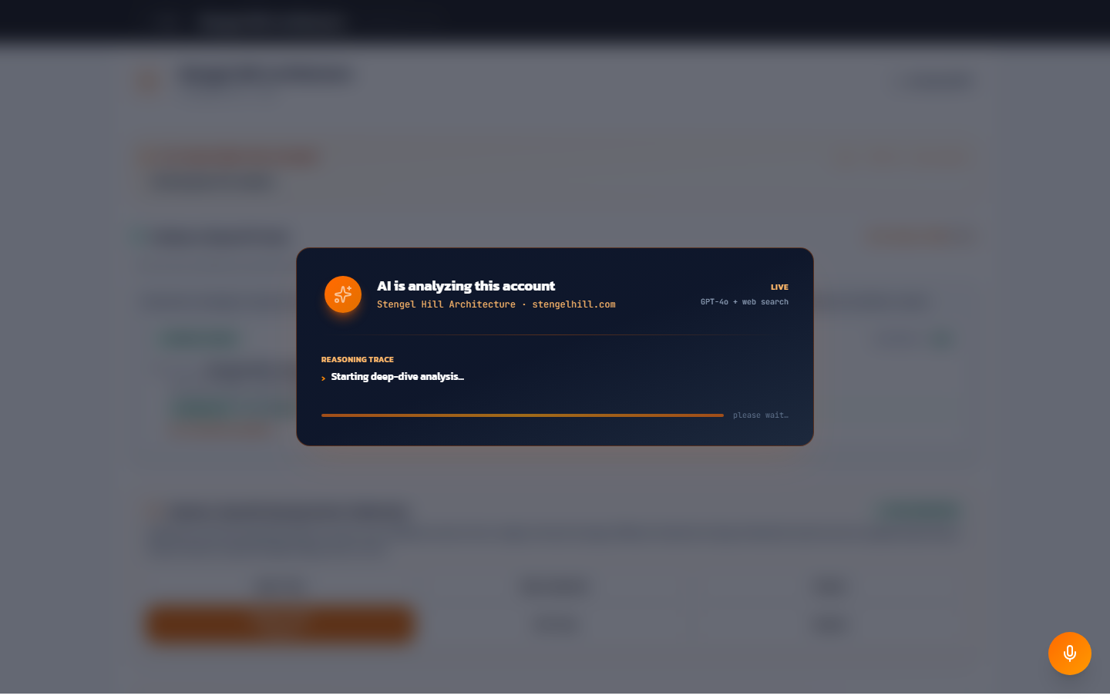
Screen 08
Account Detail
Account Detail — buyer personas, competitor displacement, multi-threading stakeholder map, and cited intel per account.

Slide 14
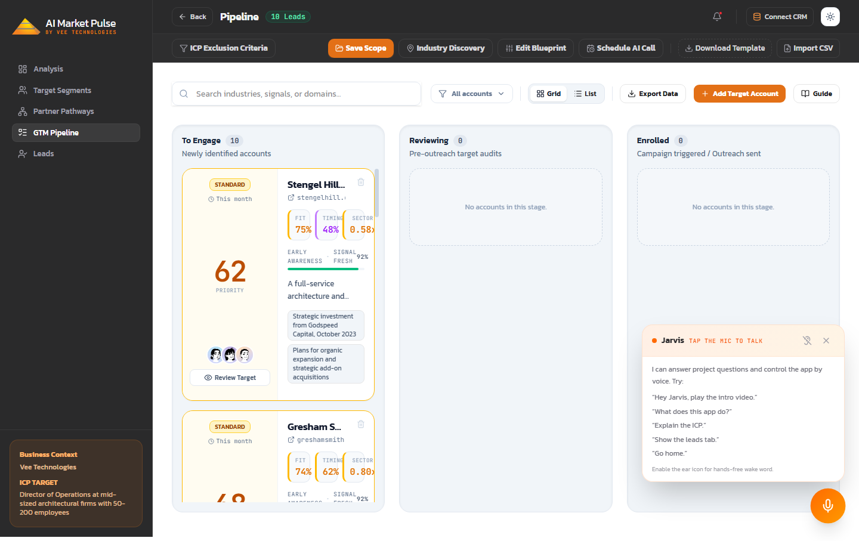
Screen 09
Jarvis Voice
Jarvis — the always-on voice assistant that can navigate, explain, and control the workspace hands-free.

Slide 15
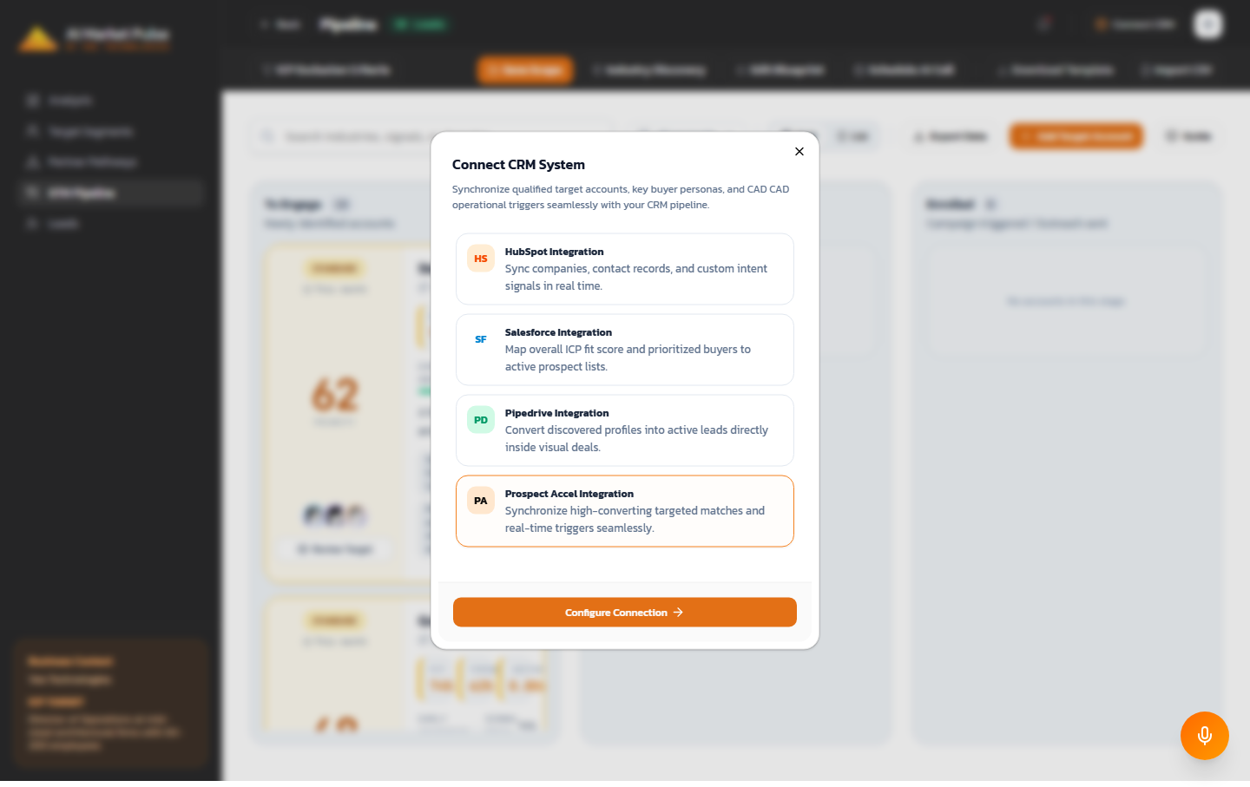
Screen 10
Connect Crm
Connect CRM System — one-click sync of qualified accounts, personas, and outreach triggers into HubSpot, Salesforce, or Pipedrive.

Slide 16
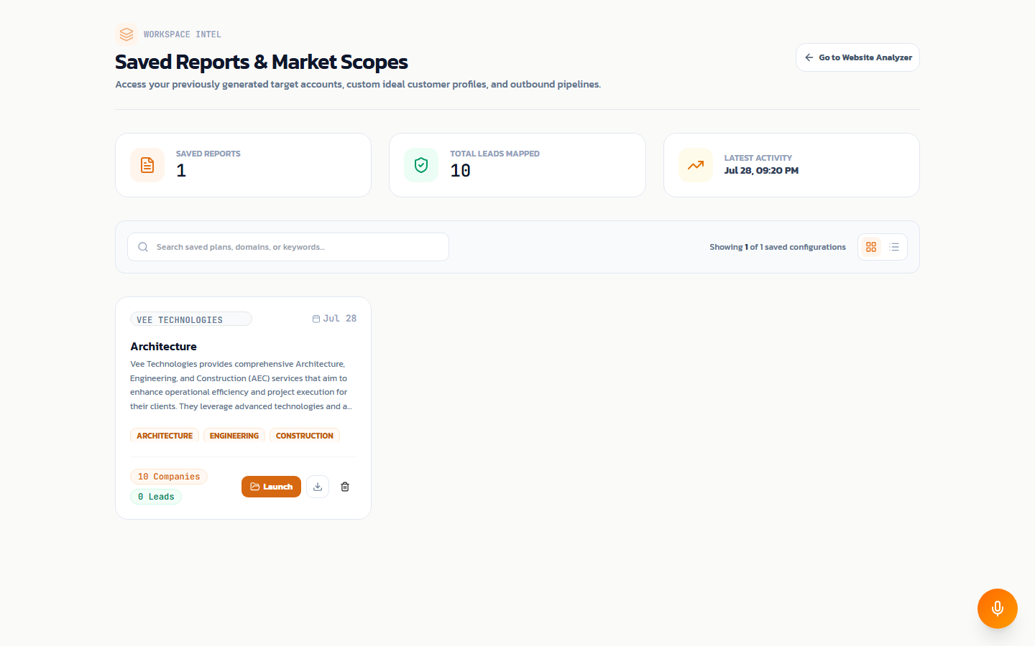
Screen 11
Saved Reports
Saved Reports library — every analyzed scope preserved as a re-openable "market scope" with company + lead counts.

Slide 17
Impact
What used to take a week now takes about forty seconds.
~40s
10-20
4
End-to-end analysis
Target accounts per run
AI stages per pipeline
From URL paste to ranked accounts.
Real companies, scored & cited.
Ingest, discover, analyze, act.
<1s
27
100%
Voice command latency
Voice actions
Every claim cited
Jarvis, always-on, hands-free.
Every surface controllable by voice.
Traceable back to source, tiered by confidence.
Ballpark numbers grounded in the live product. Confirm against your own runs before quoting externally.

Slide 18
What’s next
The 90-day roadmap.
Now (0-30 days)
Multi-tenant auth, saved-scope sharing, CRM connectors beyond ProspectAccel, in-app onboarding.
Next (30-60 days)
Team collaboration, comments on accounts, live pipeline dashboards for managers, weekly re-runs of saved scopes.
Later (60-90 days)
Realtime voice with sub-second turn latency (OpenAI Realtime), auto-outreach sequences, and account-level buying-signal alerts.

Slide 19
Thank you.
Try it: http://localhost:3000
Vee Technologies · Hackathon 2026

