Slide 1
RADIUS Protocol
Sowjanya Talasila
Shilpa Pamidimukkala

Slide 2
Outline
Introduction
Features of RADIUS
Protocol Overview
Proxy Server
Operations of RADIUS
Packet format
Vulnerabilities
Conclusion
References

Slide 3
Introduction
Remote Authentication Dial In User Service
AAA protocol (Authentication, Authorization and Accounting)
Supports applications such as
Network access
IP mobility
Used in embedded network devices such as modems servers, routers, switches
Works in both local and roaming situations

Slide 4
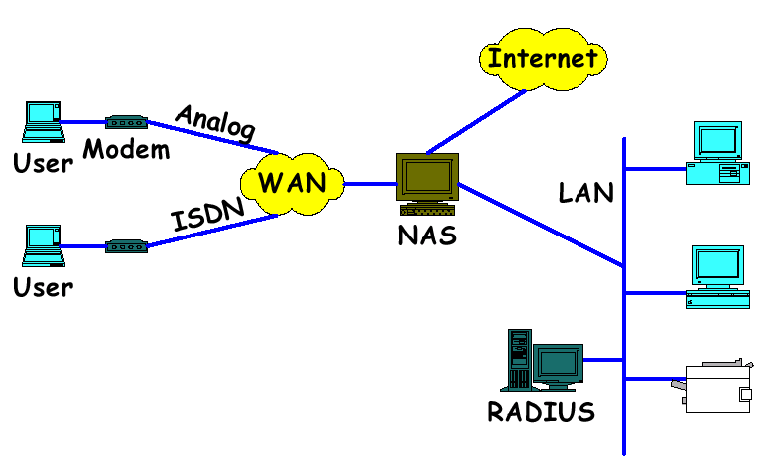
Network Topology

Slide 5
Features of RADIUS
Client-server Model
Network Security
Flexible Authentication Mechanisms
Extensible Protocol

Slide 6
Protocol Overview
RADIUS client sends a message to a RADIUS server
RADIUS server authenticates and authorizes requests and sends back a response message
Client and server use a pre-shared secret key
Accounting messages sent from clients to severs, and acknowledged by servers

Slide 7

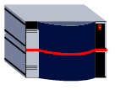






Logical System View
PPP
IP
ISP POP
Customer
Information
Provider
NAS / RAS
ROUTER
Internet
PSTN
Workstation
Modem
Remote
Server
RADIUS
AAA SERVER
USER DB

Slide 8
RADIUS Details
RADIUS uses UDP instead of TCP as a transport protocol
The following are some of the reasons for using UDP:
User can wait for only few seconds. It
can’t wait for several minutes
No special handling for rebooting or
offline clients and servers

Slide 9
RADIUS Details Contd..
Reasons for using UDP:
Stateless protocol
Easy to implement multi-threaded server
to service multiple client requests

Slide 10
Advantages
Facilitates Centralized user administration
Provides certain level of protection against sniffing and active attackers
Omni present support
Current standard for remote authentication
Current versions of RADIUS protocol:
RFC 2865 (RADIUS)
RFC 2866 (RADIUS Accounting)

Slide 11
Access and Accounting Details
Access to a network includes both authentication and authorization
RFC 2865 protocol helps for carrying access
Port 1812
Accounting
RFC 2866 protocol used
The assigned port number for RADIUS accounting is 1813

Slide 12
Access Messages
Access-Request : authentication and authorization for a connection attempt by a RADIUS client
Possible responses from the server to the client:
Access-Accept : connection attempt is authenticated and authorized
provides specific configuration information necessary to begin the delivery of service to the user

Slide 13
Access messages Contd..
Responses from the server
Access-Reject : issued by the server when unacceptable attributes are received
Access-Challenge : demands challenge response and causes access deny for subscribers

Slide 14
Accounting messages
Accounting-Request : sent by the RADIUS client to specify accounting information for the connection accepted
Accounting-Response : acknowledges the successful receipt and processing of Accounting-Request message

Slide 15
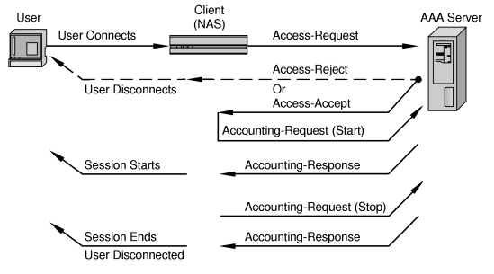
Client-server Transaction

Slide 16
RADIUS Clients
Theorem (for Java)
Livingstone (for c, unix)
Radiusclient (for c, unix)
Vopcom (for VC++)

Slide 17
RADIUS Server
Cistron
freeRADIUS
ICRADIUS
YARD RADIUS
GNU-radius

Slide 18
RADIUS Proxying
The proxy feature forwards authentication (and accounting) to another server
Used for
Carriers
Roaming users
Applications where different organizations use shared resources

Slide 19
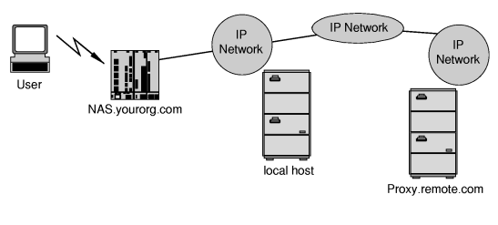
Proxy Setup

Slide 20
RADIUS Proxy Servers
Client sends access request to forwarding server
Gets forwarded to remote server
Remote server sends access-accept
Forwarding server sends the access accept to the client

Slide 21
RADIUS
Operations

Slide 22
Operations
Authentication
Accounting

Slide 23







The Authentication Process
the Internet
RADIUS
Server
Access Accept
Access Request
Access Request
Access Accept
Subscriber
PSTN
User Information
User Information
Data Store

Slide 24
When a client is configured to use RADIUS, any user of the client presents authentication information to the client.
Once the client has obtained such information, it may choose to authenticate using RADIUS. To do so, the client creates an "Access- Request“ containing such Attributes as the user's name, the user's password, the ID of the client and the Port ID which the user is accessing.
The Access-Request is submitted to the RADIUS server via the network.
Once the RADIUS server receives the request, it validates the sending client. A request from a client for which the RADIUS server does not have a shared secret MUST be silently discarded.

Slide 25
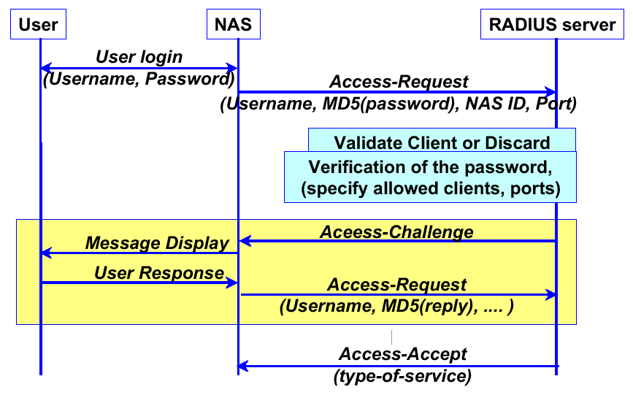
Authentication Flow

Slide 26
If any condition is not met, the RADIUS server sends an "Access- Reject" response indicating that this user request is invalid.
If all conditions are met and the RADIUS server wishes to issue a challenge to which the user must respond, the RADIUS server sends an "Access-Challenge" response.
If the client receives an Access-Challenge and supports challenge/response it MAY display the text message, if any, to the user, and then prompt the user for a response. The client then re- submits its original Access-Request with a new request ID .
If all conditions are met, the list of configuration values for the user are placed into an "Access-Accept" response.

Slide 27

RADIUS: Basics
Authentication Data Flow
ISP User Database
UserID: bob
Password: ge55gep
NAS-ID: 207.12.4.1
Select UserID=bob
ISP Modem Pool
Bob
password=ge55gep
Timeout=3600
[other attributes]
UserID: bob
Password: ge55gep
Access-Accept
User-Name=bob
[other attributes]
ISP RADIUS Server
Framed-Address=217.213.21.5
The Internet
User dials modem pool and establishes connection
Internet PPP connection established

Slide 28
Accounting Process
At the start of service delivery it will generate an Accounting Start packet describing the type of service being delivered and the user it is being delivered to, and will send that to the RADIUS Accounting server, which will send back an acknowledgement that the packet has been received.
The Accounting-Request (whether for Start or Stop) is submitted to the RADIUS accounting server via the network. It is recommended that the client continue attempting to send the Accounting-Request packet until it receives an acknowledgement, using some form of backoff.

Slide 29
RADIUS: Basics
Accounting Data Flow
Sun May 10 20:47:41 1998
Acct-Status-Type=Start
User-Name=bob
Framed-Address=217.213.21.5
…
...
Acct-Status-Type=Start
User-Name=bob
Framed-Address=217.213.21.5
…
...
ISP Modem Pool
ISP Accounting
Database
Acknowledgement
ISP RADIUS Server
The Internet
Internet PPP connection established
The Accounting “Start” Record

Slide 30
RADIUS: Basics
Accounting Data Flow
Sun May 10 20:50:49 1998
Acct-Status-Type=Stop
User-Name=bob
Acct-Session-Time=1432
…
...
Acct-Status-Type=Stop
User-Name=bob
Acct-Session-Time=1432
…
...
ISP Modem Pool
ISP Accounting
Database
Acknowledgement
ISP RADIUS Server
The Internet
User Disconnects
Internet PPP connection established
The Accounting “Stop” Record

Slide 31
RADIUS
Packet Format

Slide 32
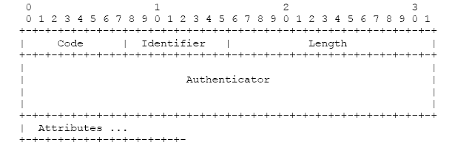
RADIUS Packet

Slide 33
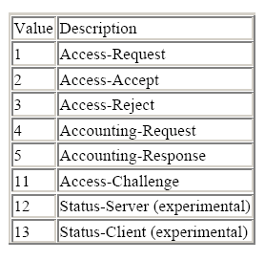
Packet Details
Code (8 bits) indicates the type of RADIUS packet
The table shows the
codes assigned to
packet types
255 is reserved for
future use
Packet with invalid code
is discarded

Slide 34
Packet Details
Identifier (8 bits) helps in matching requests and response
Server can use identifier to detect duplicate requests from the same client IP address
Identifiers must be reused frequently

Slide 35
Packet Details
Length (16 bits) indicates the entire length of the RADIUS packet
If packet received was shorter than Length , then it is dropped
The extra bits are ignored, if packet is longer than Length
Minimum length is 20 bits and maximum is 4096 bits

Slide 36
Packet Details
Authenticator (16 bytes) used to authenticate the reply from the RADIUS server
Different for both access and accounting requests and responses
Request Authenticator:
The value should be unique and unpredictable random number over the entire lifetime of the secret key

Slide 37
Packet Details
Request Authenticator:
Secret key followed by Request Authenticator is put through MD5 hash, then XORed with user password
Result is placed in the password attribute
Response Authenticator:
The values of authentication fields in all access responses indicate Response Authenticator

Slide 38
Packet Details
Response Authenticator:
MD5 hash over concatenated fields
Code + ID + Length + Request Authenticator + Attributes + Secret key
Accounting Authenticator:
Request Authenticator:
MD5 hash over concatenated fields
Code + ID + Length +Request Authenticator + Response attributes + shared secret

Slide 39
Packet Details
Accounting Authentication:
Response Authenticator:
MD5 hash over
Response code + ID + Length + Request Authenticator +Response attributes +shared secret
Attributes ( variable length) contains the list of attributes that are required for the type of service

Slide 40
Vulnerability
RADIUS hiding method ( MD5 hash and stream cipher) may not be adequate.
Client Access-Request message is not authenticated.
Request Authenticators may be poorly implemented.
Administrators may choose the RADIUS shared secrets poorly.
Multiple clients sharing the same secret make the key easier to discover.

Slide 41
Conclusion
RADIUS is Commonly used in embedded systems (routers, switches, etc), which cannot handle large numbers of users with distinct authentication information.
Facilitates centralized user administration (useful for ISPs)
Other alternatives have less security.
Widely implemented by hardware vendors.

Slide 42
Questions
What are the possible responses to an Access-Request packet?
  Access-Accept, Access-Reject, Access-Challenge
Explain the unique timing requirements of RADIUS (i.e. why is UPD used rather than TCP).
  User can wait a few seconds to be authenticated, no ack overhead and aggressive packet retransmission required.
  Users don’t want to wait several minutes, so a reliable delivery 2 minutes later is unacceptable. Send request to alternate server instead.

Slide 43
Questions
What are the 2 primary concerns or best practices for a RADIUS installation?
  High “information entropy” (randomness) in the shared secret.
  Unpredictable and unique random numbers are generated for Request Authentication.

Slide 44
References
http://www.zvon.org/tmRFC/RFC2138/Output/
http://www.untruth.org/~josh/security/radius/radius-auth.html
http://docs.hp.com/en/T1428-90056/ch01s01.html#d0e382
Richard Perlman For CEENet #9 Budapest, Hungary

