Slide 1
Effect of combustion on the frequency response of jets in crossflow ERCOFTAC SIG 33 Workshop, 19th June 2017
Palash Sashittalª
Taraneh Sayadi^{a,b}
Peter Schmid^{c}
ª Department of Aerospace Engineering, University of Illinois at Urbana-Champaign, USA
^{b} Institute of Combustion, RWTH Aachen University, Germany
^{c} Department of Mathematics, Imperial College London, UK

Slide 2
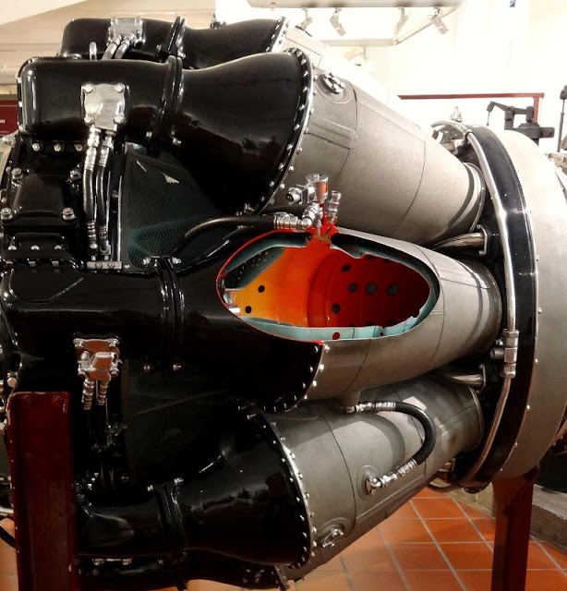

Motivation
Jets in crossflow (JICF) are common feature
Combustion chambers
Dilution jets
Film cooling, …
Two important aspects
Flow related
Interaction of the jet with the cross stream: Absolute vs. convective instability (dependent on the velocity ratio of the incoming jet)
Combustion related
Impact of reactions on overall instability of the jet
Rolls-Royce Nene 103
Jeff Swensen, Getty

Slide 3
Motivation
JICF are common feature
Combustion chambers
Dilution jets
film cooling, …
Two important aspects
Flow related
Bagheri et al. (2009), Megerian et al. (2007 & 2008), Mahesh (2013), Karagozian (2014)
Combustion related
Kolla et al. (2012), Lyra et al. (2015)
Rolls-Royce Nene 103
Difference in the nature of instability and the impact of combustion on the overall dynamics and interaction is less understood
Jeff Swensen, Getty

Slide 4
Objective
Quantifying the effect of reactions
Considering both reactive and non-reactive setup
Dominant frequencies in the flow
Dominant modal shapes extracted from the data
Parametric sensitivity analysis
Optimal gain for various frequencies
Methods
Spectral and data decomposition methods (DMD)
Adjoint-based method for sensitivity analysis
Analyzing the forward solution

Slide 5
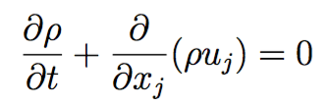
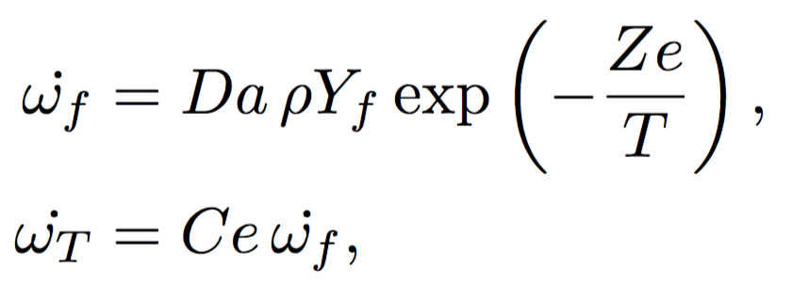
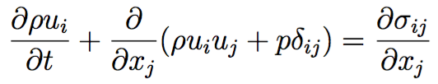
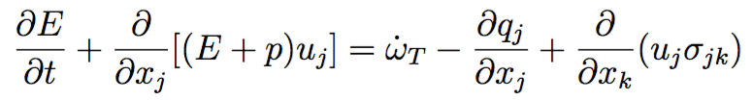
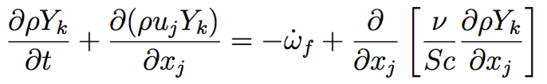
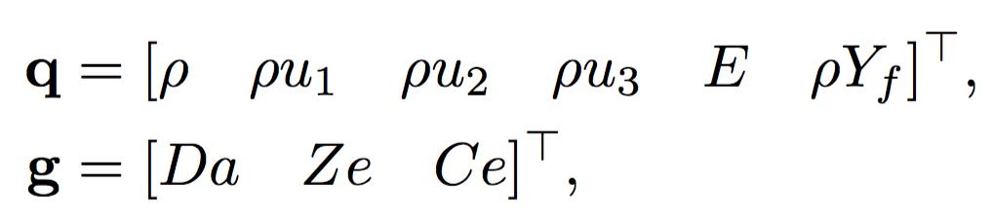

Numerical framework
Compressible NS equations, ideal gas, Ma = 0.2
Fourth-order finite differences in three spatial directions
Staggered variables, Curvilinear coordinates
Time advancement scheme
NS equations : low storage RK3
Chemistry : fifth-order backward differentiation (DVODE)
Sponges are used at all the boundaries except at the wall
NS equations
Chemistry
Da : Damkohler number
Ce : Heat release parameter
Ze : Zeldovich number
State variable q & combustion parameters g:
Notes:
For the energy norm carry the Yf for both the cold and hot cases to stay consistant

Slide 6
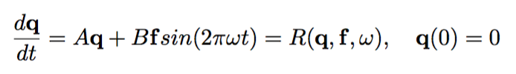
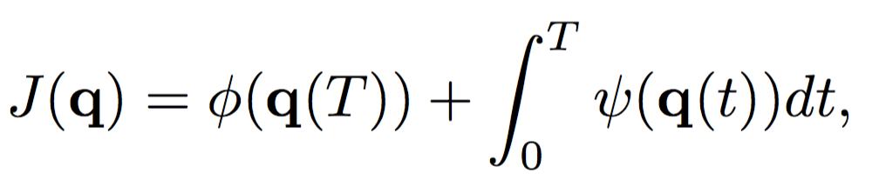
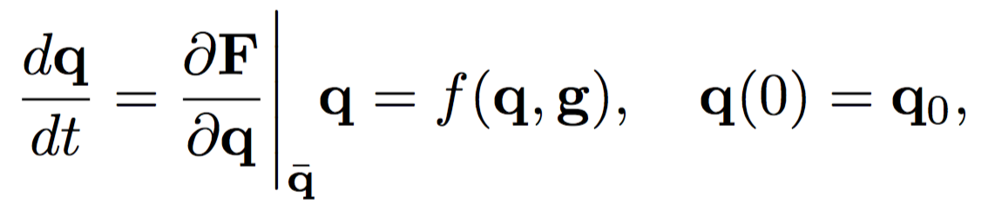
Formulating the optimization problem
State equation (constraint)
q, state variable
f, forcing fucntion
State equation
Objective function
Here, and a simple energy norm.
Forming the Lagrange function
Transforms the constrained optimization to an unconstrained system
Final time
Integrated time
Objective function
q : state variable
g : model parameters

Slide 7
Formulating the optimization problem
State equation (constraint)
q, state variable
f, forcing fucntion
State equation
Objective function
Forming the Lagrange function
Setting the variation w.r.t state variable to zero adjoint equation
Objective function
q : state variable
g : model parameters

Slide 8
Formulating the optimization problem
State equation (constraint)
q, state variable
g, model/control parameters
State equation
Objective function
Adjoint equation
Derivative
Objective function
In effect normalizes the forcing function
q : state variable
g : model parameters

Slide 9
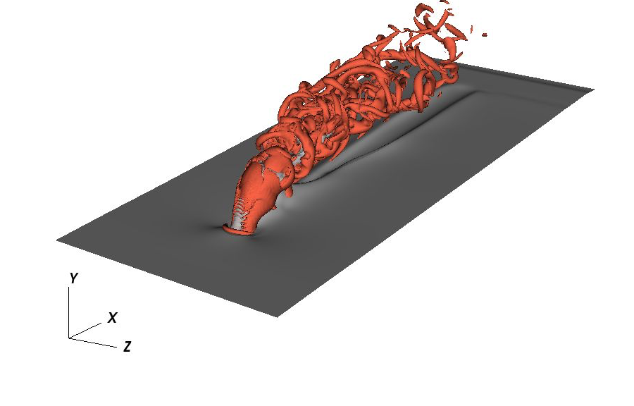
Configuration
Crossflow (air)
Laminar boundary layer over a flat plate
Jet (fuel)
Laminar circular jet in wall normal direction
Ma = 0.2
Re_{jet} _{inlet} = 10,000
 | X/D | Y/D | Z/D
Size | 24 | 8 | 10
Grid | 480 | 256 | 200
BC | Periodic | Wall/outflow | Periodic
V_{jet}/V∞=3
In the reactive case, the fuel is injected at the nozzle

Slide 10
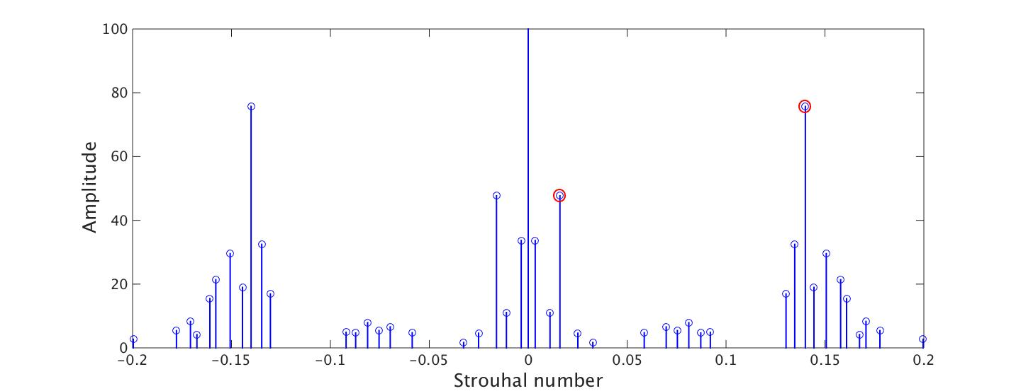
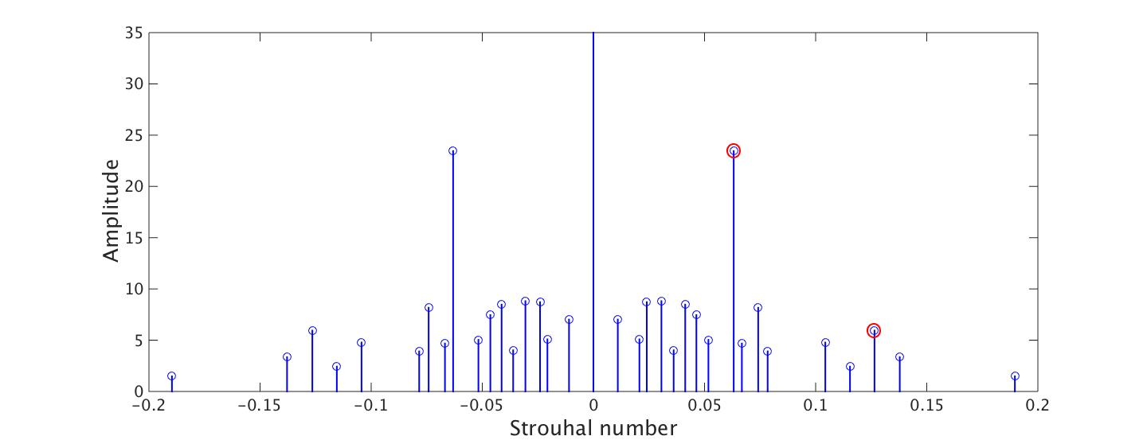

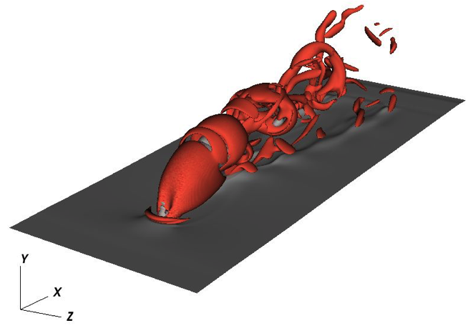
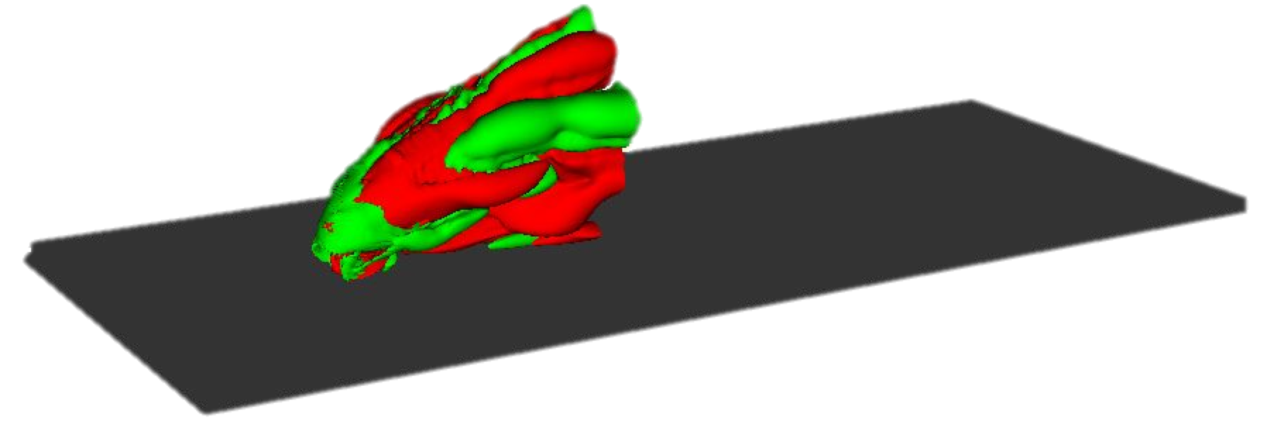

Dominant frequencies
Frequencies are extracted using DMD
Compare well with the energy spectra of probe data
Sparsity promoting algorithm (Jovanovic et al 2014) used to extract the amplitudes
Cold case
Hot case
St = 0.016
Frequency of the mode related to the motion near the wall
St = 0.14
Frequency of the mode on the shear layer

Slide 11
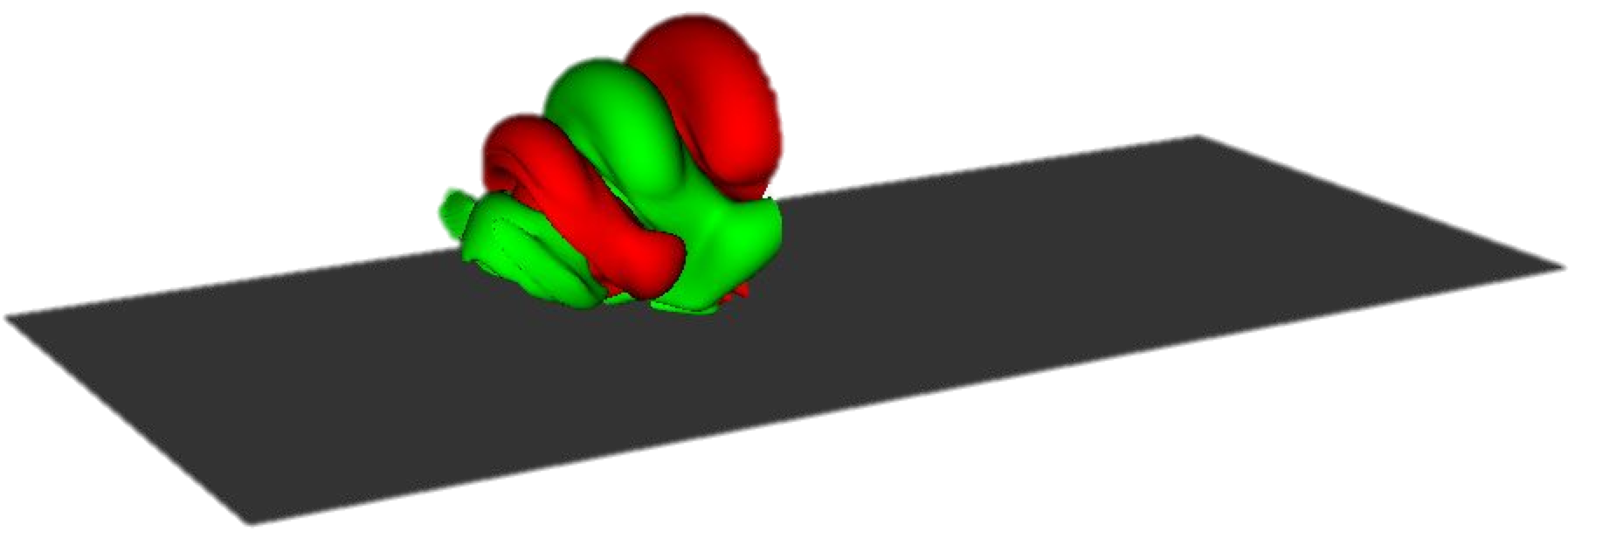
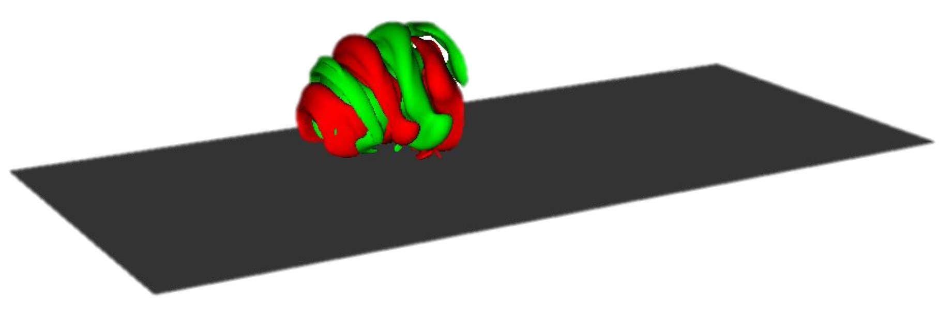
Dominant frequencies
Frequencies are extracted using DMD
Compare well with the energy spectra of probe data
Sparsity promoting algorithm (Jovanovic et al 2014) used to extract the amplitudes
Cold case
Hot case
Frequency of the mode related to the motion on the shear layer
St = 0.06
The subharmonic of the previous mode
St = 0.12

Slide 12
Dominant frequencies
Frequencies are extracted using DMD
Compare well with the energy spectra of probe data
Sparsity promoting algorithm (Jovanovic et al 2014) used to extract the amplitudes
Cold case
Hot case
Both the shape and the frequency of the dominant modes are altered through combustion

Slide 13
Frequency response
From the extracted frequency an interval is selected
F = [0.05, … , 0.15]
Frocing at the selected frequencies
Extract the optimal gain for these frequencies and the slopes: Adjoint-based algorithm
Compare the interpolated results between the reactive and non-reactive case
G_{max}
St

Slide 14
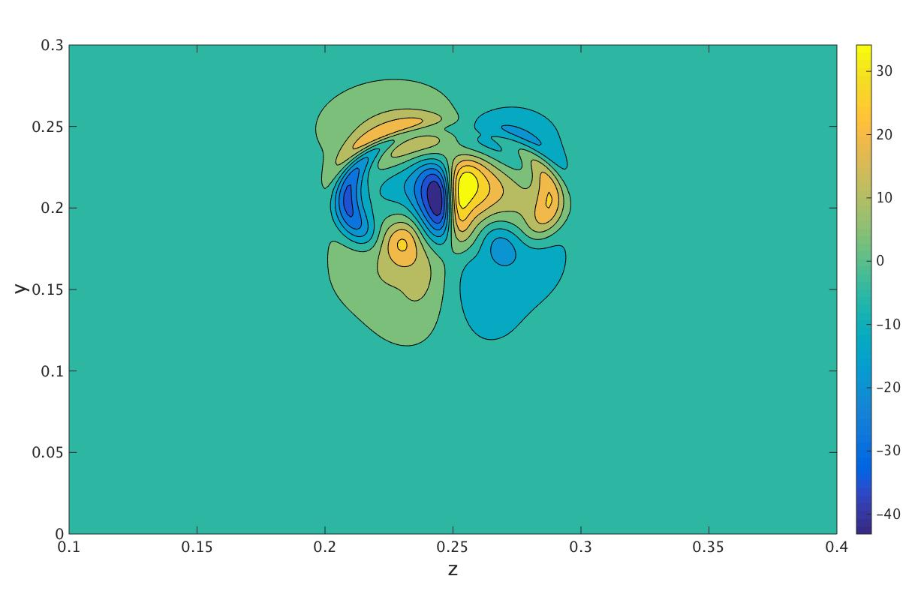
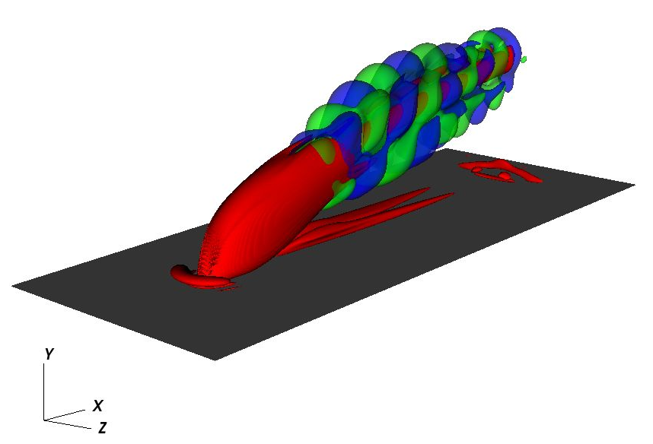
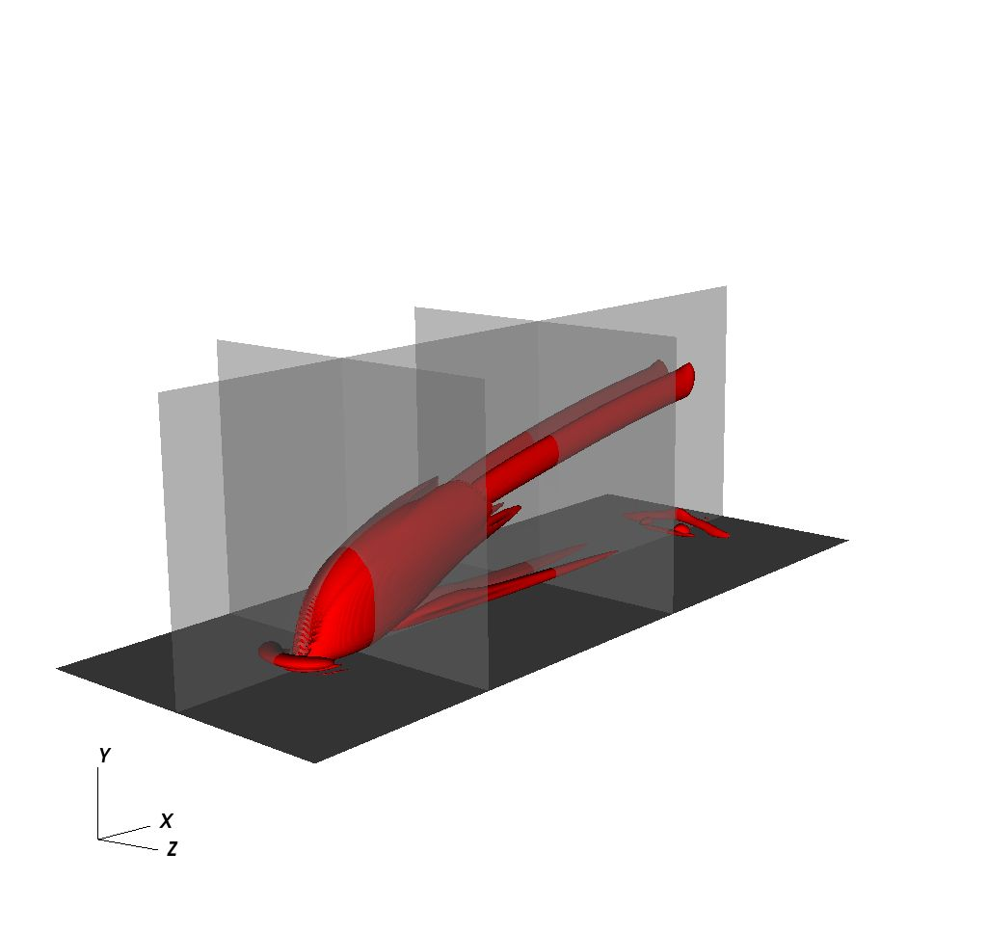
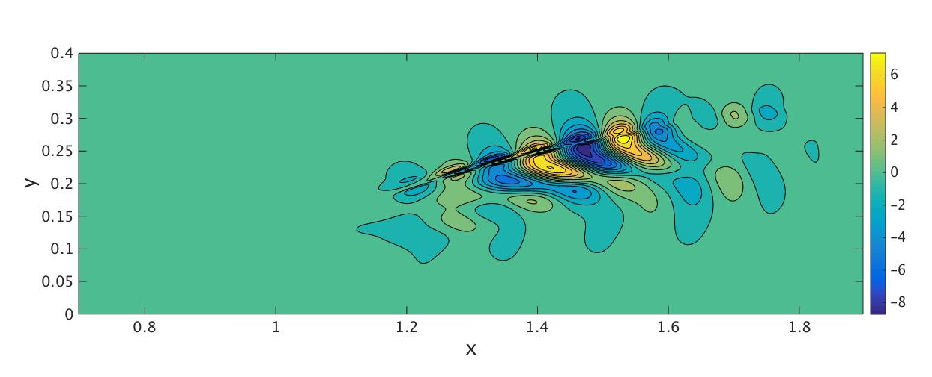
Response function- Cold case
Frequency St = 0.05, lower limit of the interval
Shape of the mode evolves downstream
Iso-surfaces of Q-criterion
2
3
1
3
Slice : contours of streamwise velocity
1
Slice : contours of streamwise velocity

Slide 15
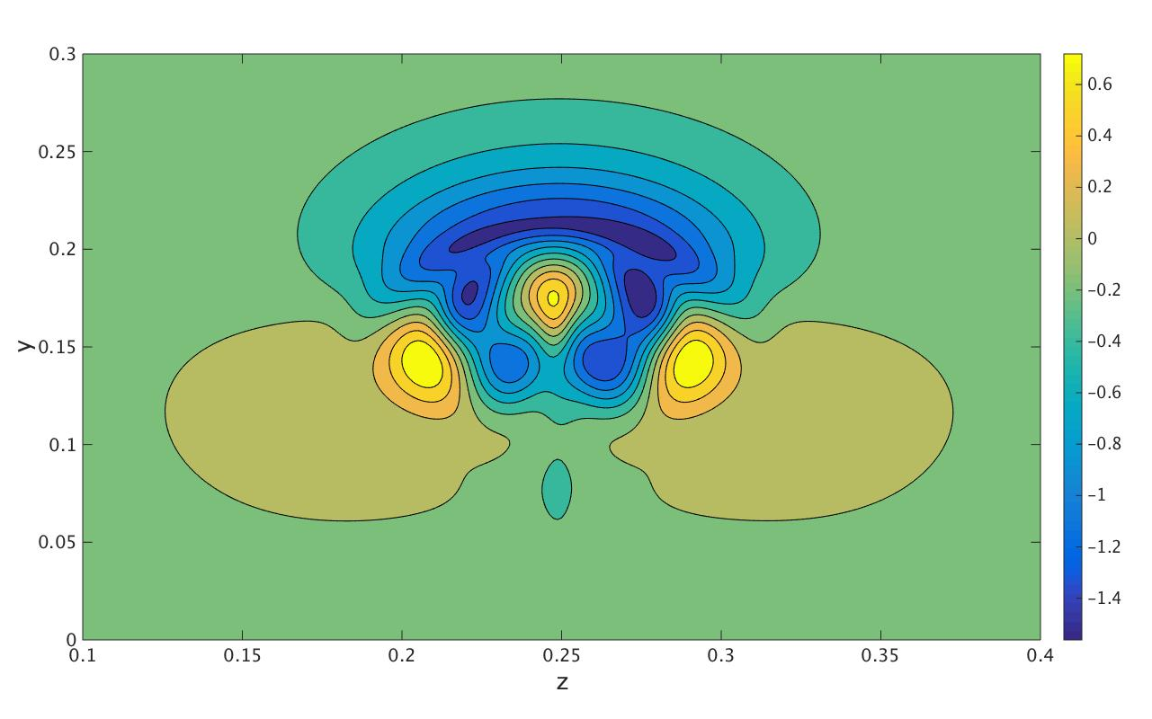
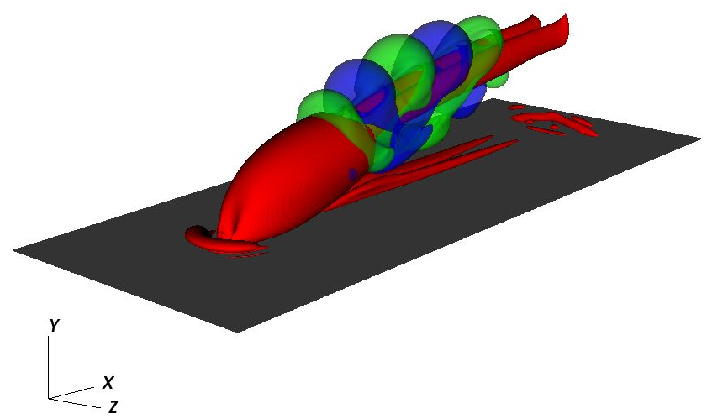
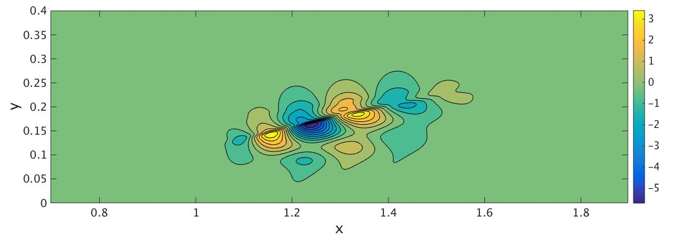
Response function- Hot case
Frequency St = 0.05, lower limit of the interval
Frequency close to the peak frequency in the spectra
Iso-surfaces of Q-criterion
2
3
1
3
Slice : contours of streamwise velocity
1
Slice : contours of streamwise velocity

Slide 16
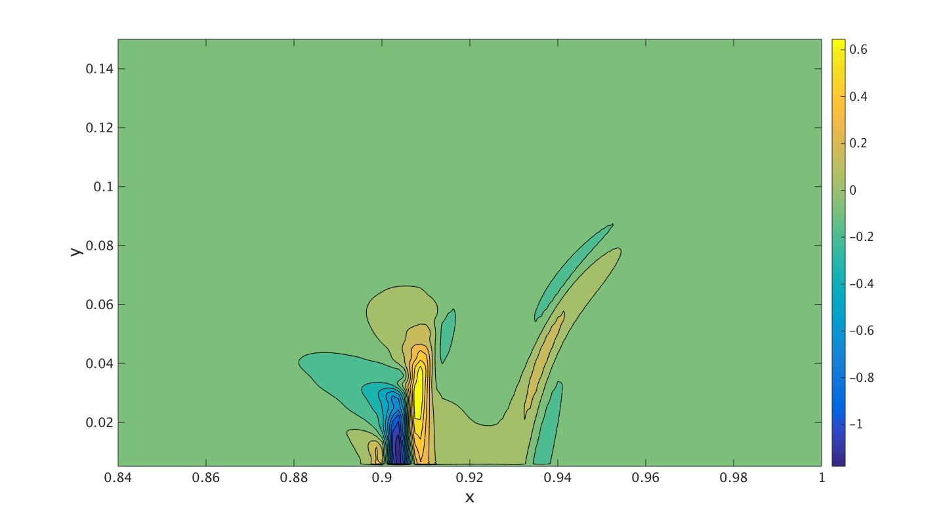
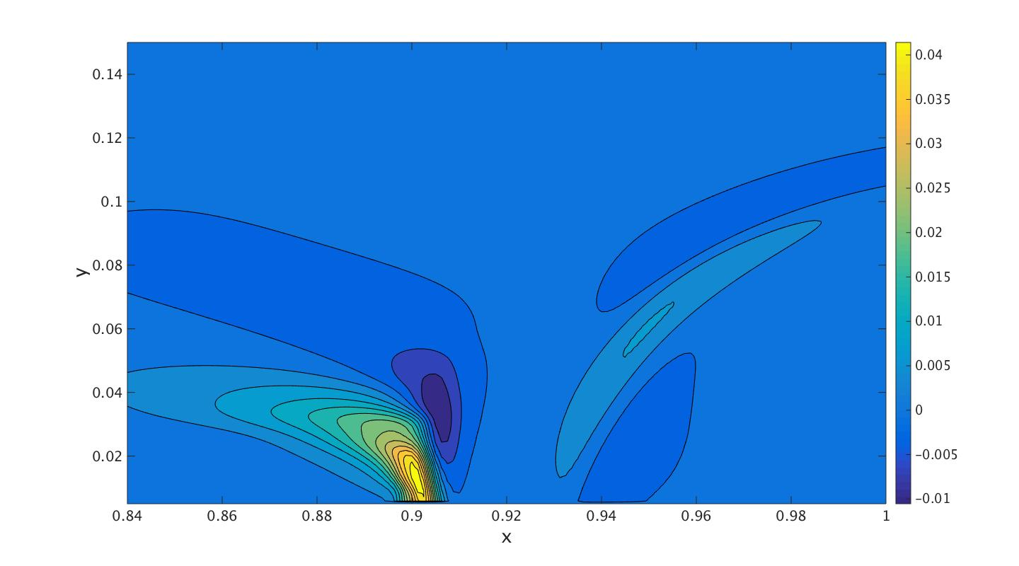
Comparing forcing and response function, St = 0.05
Cold case
Hot case
Forcing
response
Response in the cold case is of higher wavelength in all spatial direction, travels further on the CVP
Forcing function is also of higher frequency in the cold case
 | G_{max} | Slope
Cold case | 34 | 89 degrees
Hot Case | 1.2 | 60 degrees

Slide 17
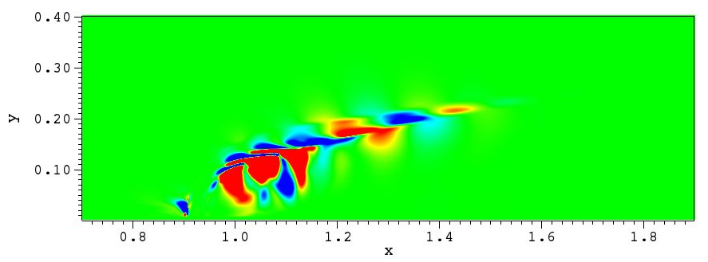
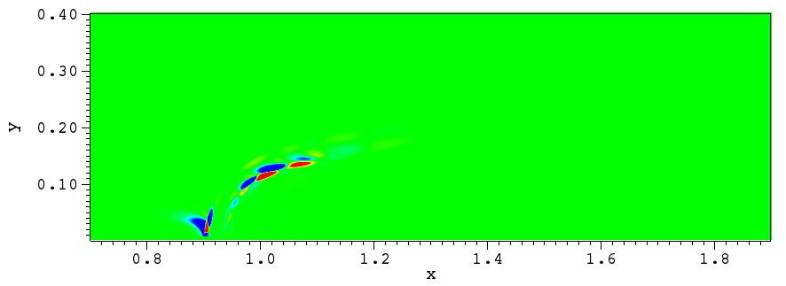
Outlook and conclusions
Combustion has an obvious effect on the forcing and response functions
The response and forcing functions are both of lower wavelength in the reactive case
Analyze the optimal gain of various frequencies and compare between the hot and cold cases
Assess the contribution of each component to the overall sensitivity
Streamwise velocity
Fuel mass fraction

Slide 18
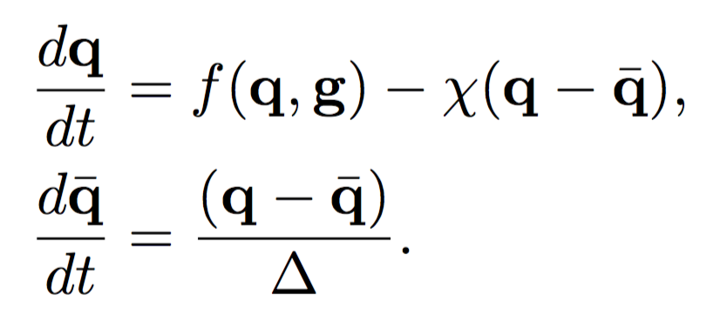
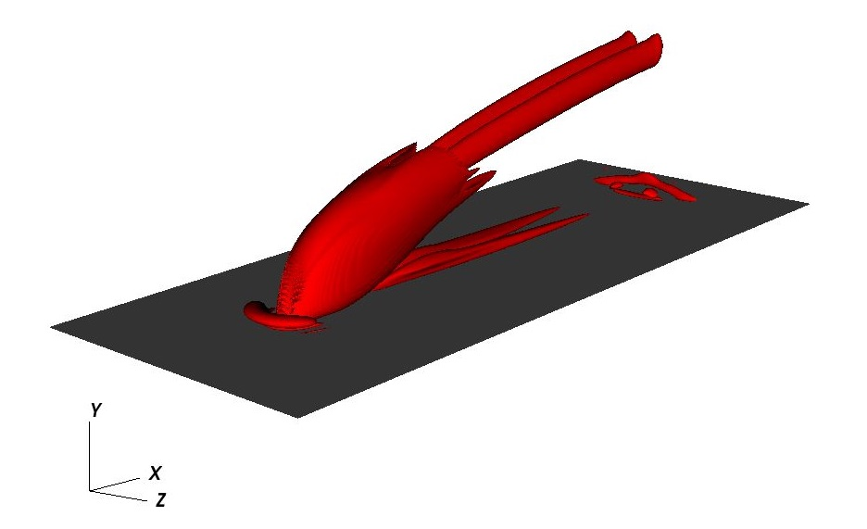
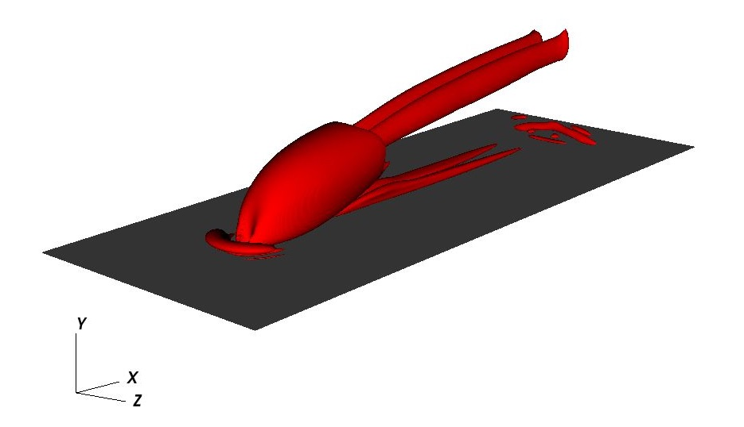
Base flow
Selective frequency damping (SFD) (Espen Åkervik et al. 2006) on the non-linear forward equations
This ensures that the base flow is a stationary solution of the nonlinear governing equations
Instantaneous
Base-flow
Iso-surfaces of Q criterion indicate vortical structures in the flow

