Slide 1
Digital Portfolio
STUDENT NAME: Ashok Kumar S
REGISTER NO AND NMID: 222403552/asunm285222403552
DEPARTMENT: bsc(cs)
COLLEGE: SRI DEVI ARTS AND SCIENCE COLLEGE/MADRAS UNIVERSITY

Slide 2
PROJECT TITLE
Cricket login page

Slide 3


AGENDA
Problem Statement
Project Overview
End Users
Tools and Technologies
Portfolio design and Layout
Features and Functionality
Results and Screenshots
Conclusion
Github Link
3/21/2024 Annual Review

Slide 4

PROBLEM STATEMENT
A full-screen cricket-themed background image.
A centered login form styled with modern UI design techniques (rounded corners, box shadow, transparency).
Input fields for username and password with basic validation.
A login button that triggers a JavaScript function to check for empty fields and display appropriate feedback.

Slide 5

PROJECT OVERVIEW
Technologies Used:
HTML: For structuring the login form and page layout.
CSS: For styling the user interface with a sports-themed background, responsive design, and modern form aesthetics.
JavaScript: For handling basic form validation and user interaction.
🎯 Key Features:
Cricket-Themed UI: Includes a cricket-related background image and emojis to connect with cricket fans.

Slide 6

WHO ARE THE END USERS?
👥 1. Cricket Website Users
Purpose: To log into a website related to cricket, such as:
Cricket news or updates site
Online fantasy cricket platforms
Cricket clubs or associations
Cricket fan communities
🏏 2. Cricket Players or Club Members
Purpose: To access personal profiles, match schedules, team updates, or training materials.
Could be used by:
Amateur or professional players
Coaches
Club managers

Slide 7

TOOLS AND TECHNIQUES
Tool | Purpose
HTML5 | To create the structure and content of the login form (inputs, buttons, etc.)
CSS3 | To style the layout, form elements, background, and make the interface visually appealing
JavaScript (Vanilla) | To implement form validation and user interaction logic (e.g., checking input fields, showing alerts)
⚙️ 1. Tools Used

Slide 8
POTFOLIO DESIGN AND LAYOUT
🖼️ Visual Layout Summary
The design features a centered login form on top of a full-screen cricket-themed background image. It uses modern UI principles to ensure readability, responsiveness, and a polished appearance.
📐 Layout Structure
🔸 1. Background Layer
A full-screen cricket-related image adds visual appeal.
8

Slide 9
FEATURES AND FUNCTIONALITY
🎯 1. Thematic Design
Cricket Background Image: The login page uses a high-quality cricket-themed background image to visually engage users.
Color Scheme: Dark green tones with white text reinforce the cricket theme (green pitch feel).
📐 2. Responsive Layout
Full-Screen Flexbox Centering: The login form is perfectly centered both vertically and horizontally using display: flex.
Mobile-Friendly: While basic, the layout adapts reasonably well to different screen sizes.

Slide 10

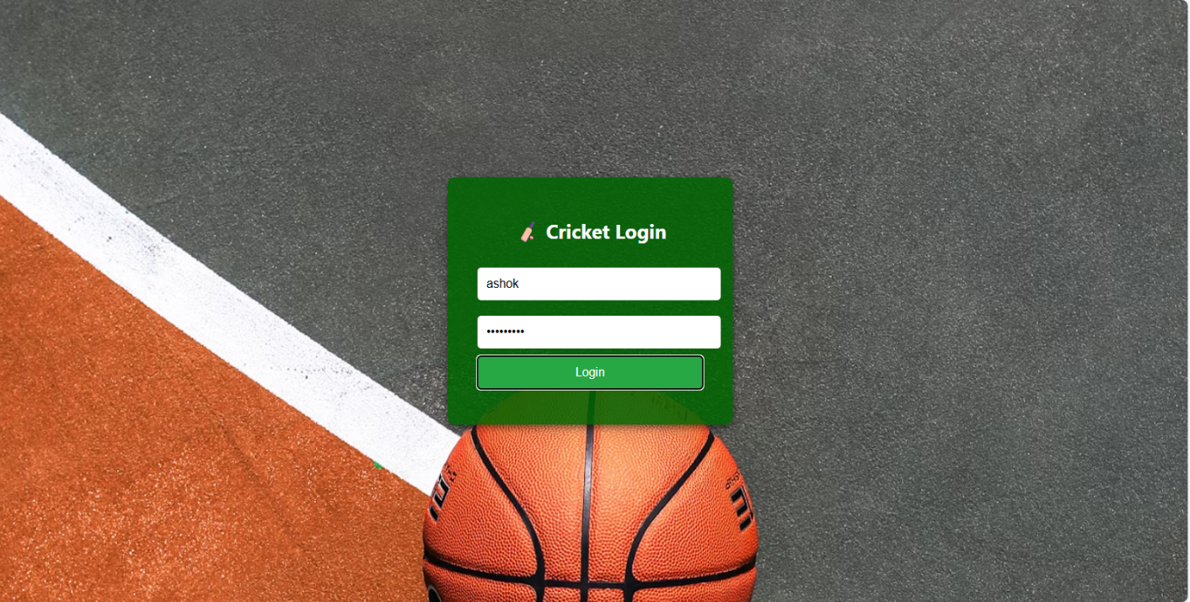
RESULTS AND SCREENSHOTS
The page displays a centered login box with a cricket-themed background.
The login box includes:
A heading with a cricket emoji and the title "Cricket Login".
Two input fields: Username and Password.
A green Login button.
3/21/2024 Annual Review
10

Slide 11
CONCLUSION
The Cricket-Themed Login Page is a simple yet effective front-end web project that demonstrates essential web development skills using HTML, CSS, and JavaScript. With its visually appealing cricket background and responsive design, the interface creates an engaging user experience tailored for cricket fans, clubs, or sports-related platforms.
11

Slide 12
GITHUB LINK

