Slide 1
iot Water level indicator
Project by,
Sashwat K (TVE17MCA042)
Vijitha V Nair (LTVE17MCA071)

Slide 2
PROBLEM STATEMENT

Slide 3
Existing System
A person should manually check water level.
Turn ON/OFF water pump manually.
Wastage of water due to overflow.
No pump usage logs.
No remote control over the pump.

Slide 4
Proposed solution

Slide 5
Objectives
An IOT based solution for the problem.
Automate water pump switching based on water level.
Develop a strong and accurate system to measure water present in the tank.
Provide detailed information on all the events related to the system.

Slide 6
Continue..
Give remote access to the pump switch control along with all the other details via an android application or web application.

Slide 7
System Specification

Slide 8
Requirements
Hardware
Control board
Water Tank board
Software
Web Application
Android Application

Slide 9
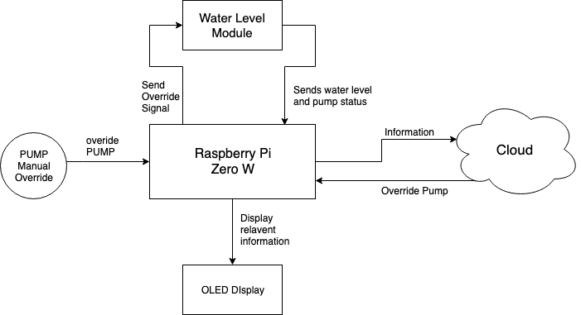
Hardware - control board

Slide 10
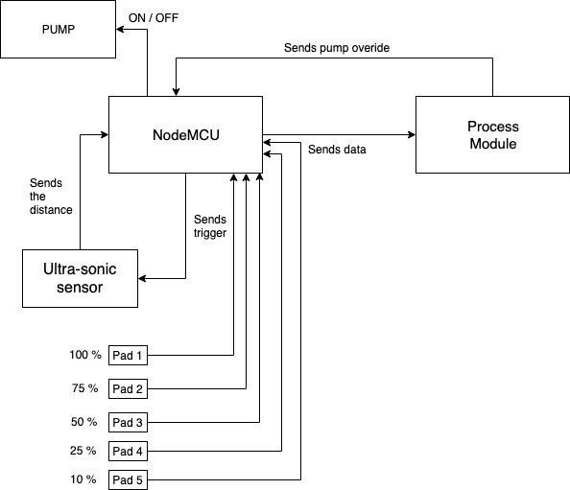
Hardware - water tank board

Slide 11
Modules included

Slide 12
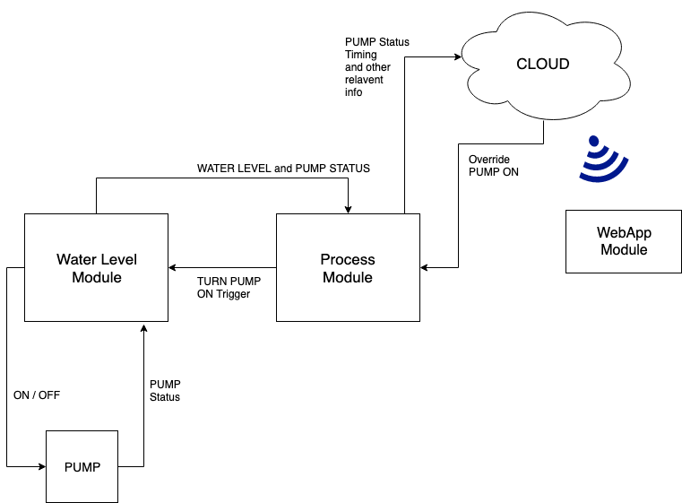

Slide 13
MODULE -1: Water level module
Two methods to detect water level:-
Ultrasonic sensor
Conductive pads
Sends water level to process Module.
Controls the switching of the water pump.

Slide 14
MODULE -2:process module
Shows Water level and water pump status.
Manual switch to start water pump.
Uploads pump status and log to cloud.

Slide 15
Module 3 - Webapp and android app
Web Application and the android application provides the system’s dashboard.
The user can turn ON/OFF motor remotely.
The user can view motor switching logs and errors.

Slide 16
Conclusion

Slide 17
iot Water level indicator
This system is a cost effective method to implement an IOT water level indicator.
Eliminate manual effort.
User-friendly and informative dashboard
Accessible through web application and android application.

Slide 18
Thank you

