Slide 1

Flight Management System

Slide 2

Team Members
Akshitha Gampa
Bhavana Teja Allada
Sashwat Dubey
Sindhura Paruchuri
Tejaswi Paridi

Slide 3
Abstract
The Flight Management System is a Java-based booking solution for flight tickets. It consolidates data provided by different airline carriers and hence provides the user details and rates in real-time.
Travelers may want to make changes in their bookings.
The application allows them to book, cancel, view and update their bookings with ease.
Other than this, it eases the management of bookings too. All the bookings, flights, schedules and routes can be viewed, added and modified on a single application by the administrator.

Slide 4
In scope
Following is the functionality provided by the system: There are two categories of people who would access the system: customer and administrator. Each of these would have some exclusive privileges.
The customer can:
Create his user account.
Login into the application.
Check for available flights.
Make a booking.
View the bookings made.
Cancel or modify a booking.
2. The administrator can:
Login into the application.
Add flight, schedule and route details.
View the flight, schedule and route details.
Modify the flight, schedule and route details.

Slide 5
Out Scope
The following functionalities have not been covered under the application:
The application does not cover boarding pass generation and seating plans.
Third party applications like email & SMS integrations.
Payments are not yet accepted by the application.

Slide 6
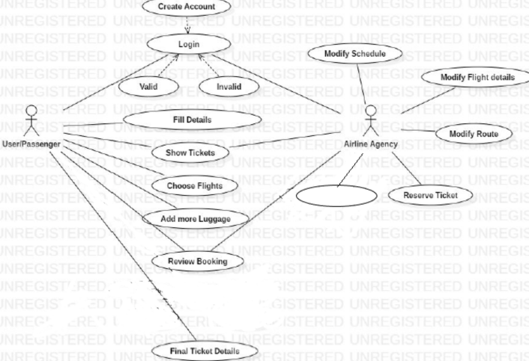
Use Case Diagram
Add Flight
Add Flight

Slide 7
Work Division
Team Leader: Sashwat Dubey -- Booking and Viewing Flights
Bhavana Teja Allada -- Sign Up and Login
Akshitha Gampa – Modification and Cancellation
Sindhura Paruchuri – Add Flights and Schedule Flights
Tejaswi Paridi – Search Flight and View Scheduled Flights

Slide 8
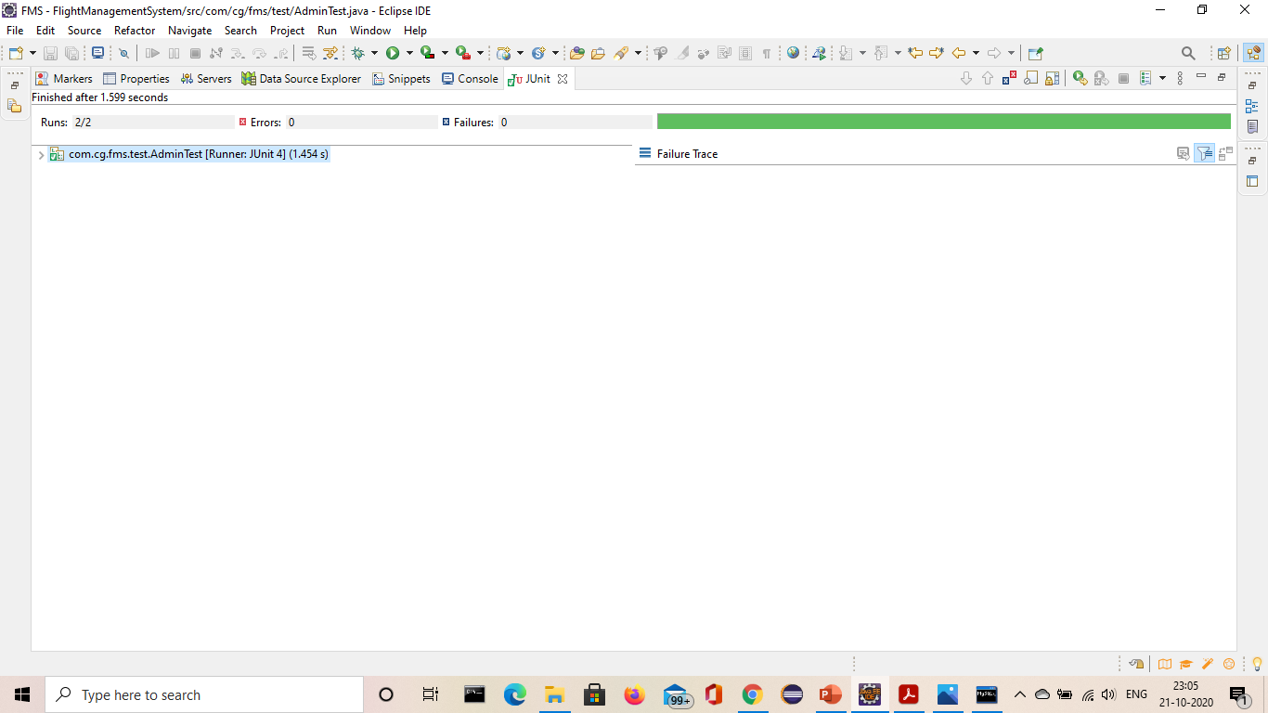
Junit Testing
AdminTest

Slide 9

UserTest

Slide 10
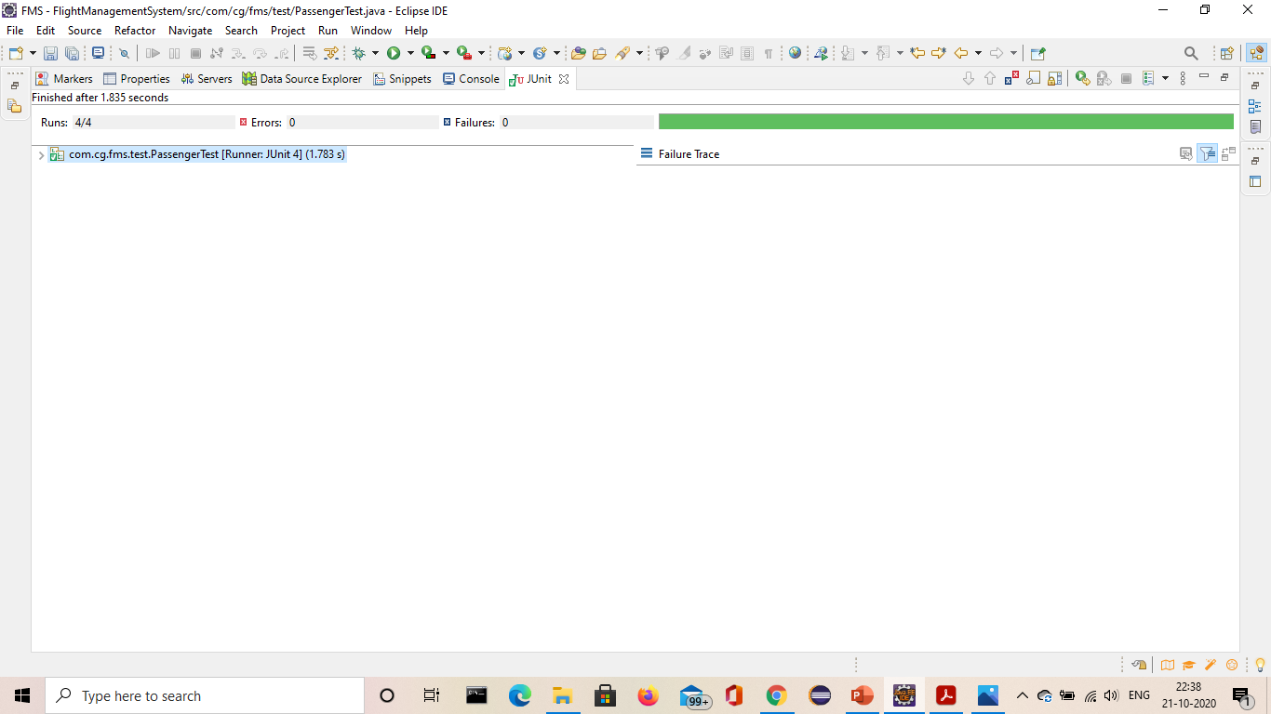
PassengerTest

Slide 11

BookingTest

Slide 12

FlightTest

Slide 13
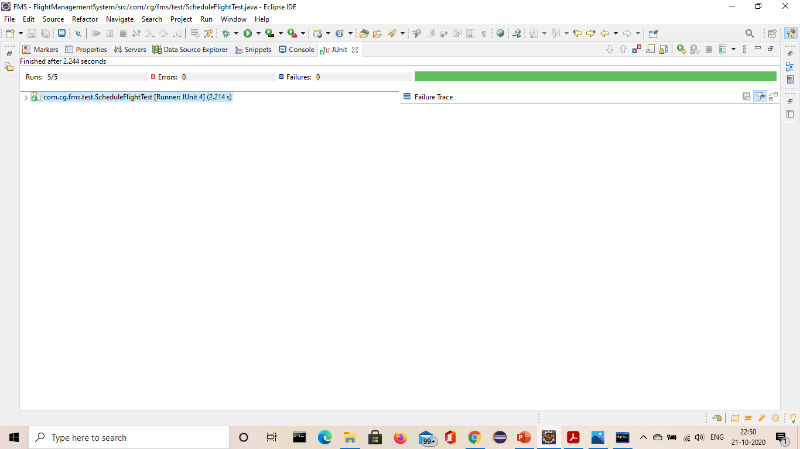
ScheduleFlightTest

Slide 14
Thank you

