Slide 1

Flight Management System

Slide 2

Team Members
Akshitha Gampa
Bhavana Teja Allada
Sashwat Dubey
Sindhura Paruchuri
Tejaswi Paridi

Slide 3
Abstract
The Flight Management System is a Java-based booking solution for flight tickets. It consolidates data provided by different airline carriers and hence provides the user details and rates in real-time.
Travelers may want to make changes in their bookings.
The application allows them to book, cancel, view and update their bookings with ease.
Other than this, it eases the management of bookings too. All the flights, schedules and routes can be viewed and added on a single application by the administrator.

Slide 4
In scope
Following is the functionality provided by the system: There are two categories of people who would access the system: customer and administrator. Each of these would have some exclusive privileges.
The customer can:
Create his user account.
Login into the application.
Check for available flights.
Make a booking.
View the bookings made.
Cancel or modify a booking.
2. The administrator can:
Login into the application.
Add flight, schedule and route details.
View the flight, schedule and route details.
Schedule and route details.

Slide 5
Out Scope
The following functionalities have not been covered under the application:
The application does not cover boarding pass generation and seating plans.
Third party applications like email & SMS integrations are not used.
Payments are not yet accepted by the application.

Slide 6
Technologies Used
Java 8
JDBC
MySql
Apache Tomcat 9.o
Junit 4
HTML, CSS, JavaScript

Slide 7
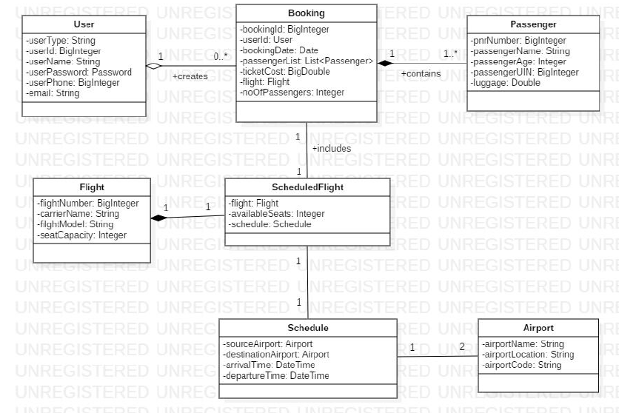
Class Diagram

Slide 8
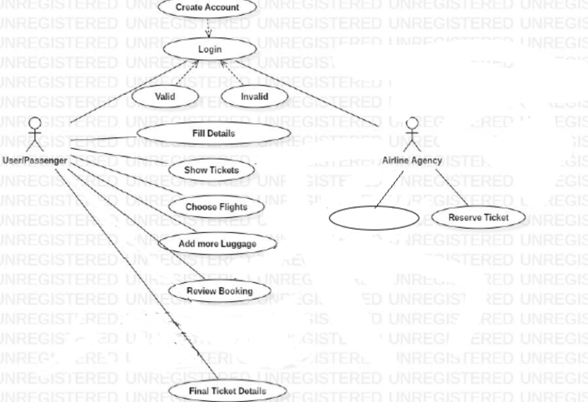
Use Case Diagram
Schedule Flight
View Flights
View Scheduled Flights
Add Flight
Search Flight
Search Flights

Slide 9
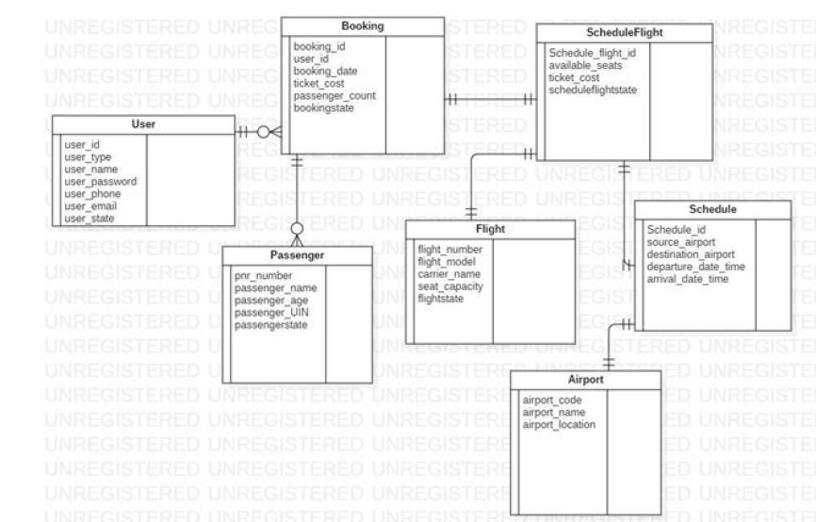
Entity Relationship Model

Slide 10
Work Division
Team Leader: Sashwat Dubey - Booking and Viewing Flights
Bhavana Teja Allada - Sign Up and Login
Akshitha Gampa - Modification and Cancellation
Sindhura Paruchuri - Add Flights, Schedule Flights, Get Flight Details, View all airports
Tejaswi Paridi - Search Flight, View Scheduled Flights, View Flights, View all airports

Slide 11
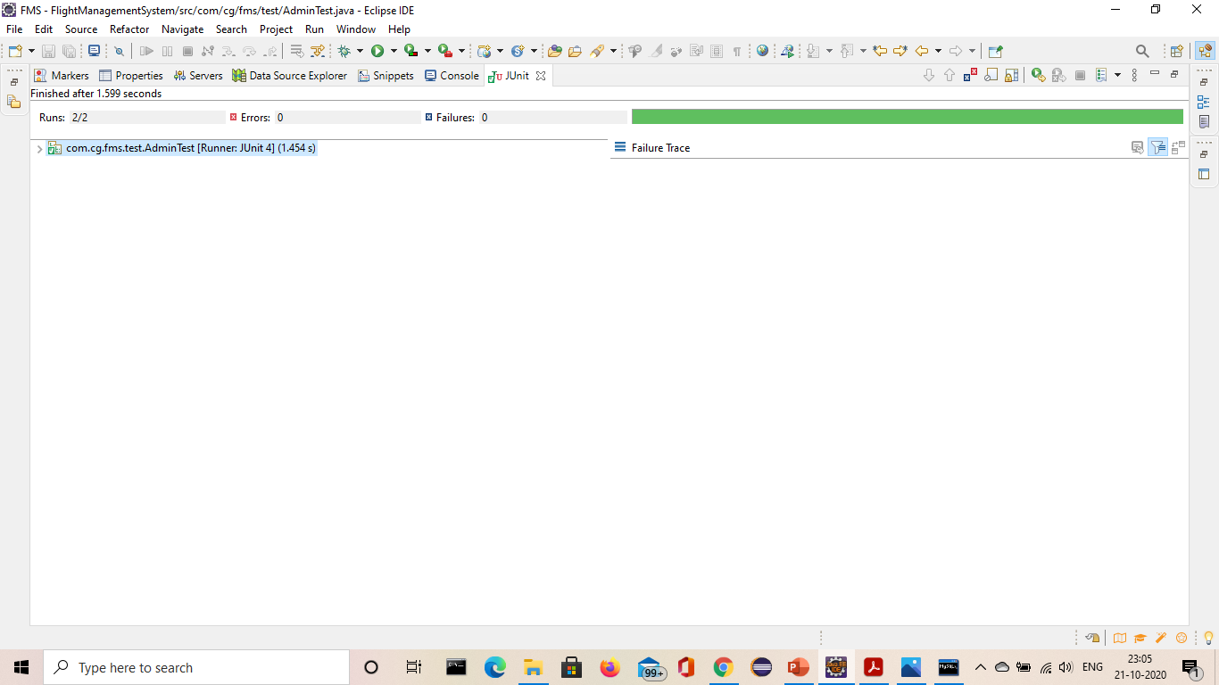
Junit Testing
AdminTest

Slide 12

UserTest

Slide 13
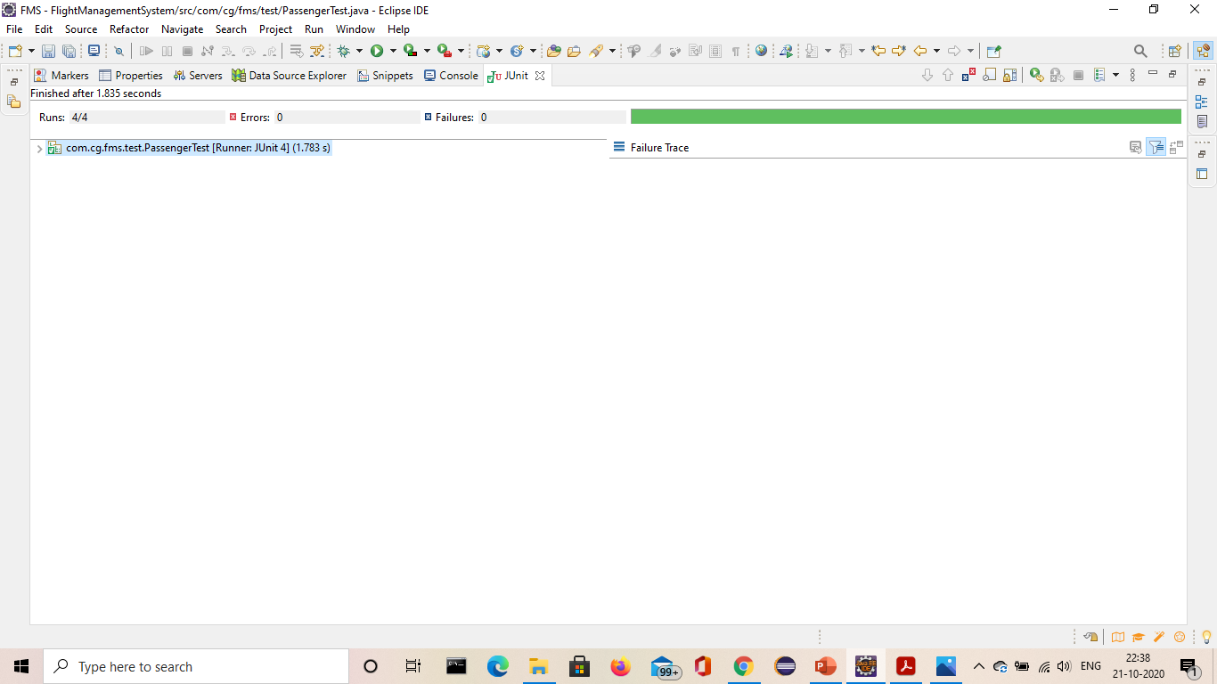
PassengerTest

Slide 14

BookingTest

Slide 15

FlightTest

Slide 16
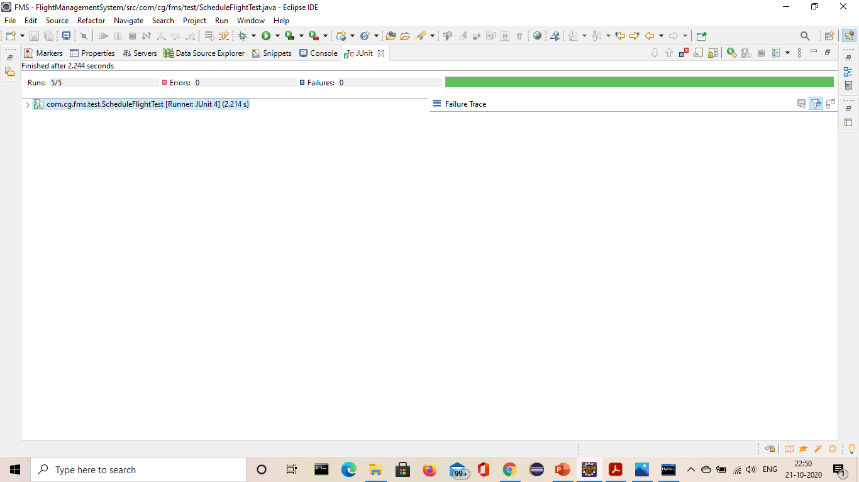
ScheduleFlightTest

Slide 17
Thank you

