Slide 1
THADI SUVARNA SASI
Final Project
3/21/2024 Annual Review

Slide 2
KEYLOGGER AND SECURITY
A keylogger (short for keystroke logger) is a type of surveillance
software or hardware device that records the keystrokes made
on a computer or mobile device.
Provides security measures like anti-malware, system hardening,
user education can effectively prevent and detect
keylogging threats.
3/21/2024 Annual Review

Slide 3


AGENDA
01
Problem Statement
Project Overview
02
03
Who are the end users?
Your solution and its value proposition
04
05
Modelling
Results
06
3/21/2024 Annual Review

Slide 4

PROBLEM STATEMENT
Problem:
The escalating prevalence of keyloggers poses a critical threat to digital security, endangering the confidentiality and integrity of sensitive information across personal and organizational domains.
Solution:
This project aims to develop effective countermeasures against
keyloggers through advanced detection algorithms and encryption techniques, bolstering digital security to safeguard against unauthorized data access
and theft.
3/21/2024 Annual Review

Slide 5

PROJECT OVERVIEW
Objective:
The project aims to understand keylogging mechanisms for educational purposes and develop security measures to prevent, detect, and mitigate such threats. It provides an in-depth understanding of keylogger operations, detection techniques, and system security strategies.
Key Components:
1. Detection Mechanisms (Signature-based Detection, Behavioral Analysis);
2. Mitigation Techniques (Response Plans, User Education)
Keylogger Functionality:
Keyloggers capture and record all keyboard inputs. For example, searching "natureimages" is recorded as:
['n', 'a', 't', 'u', 'r', 'e', Key.space, 'i', 'm', 'a', 'g', 'e', 's', Key.enter]
3/21/2024 Annual Review

Slide 6

WHO ARE THE END USERS?
Ethical Hackers and Security Professionals:
Usage: Part of penetration testing or security assessments to identify vulnerabilities
in systems and applications.
Concerns: Ensuring that keyloggers are used ethically and legally, focusing on
improving security posture.
2. IT Administrators:
Usage: Troubleshoot technical issues, diagnose problems, and monitor system
usage within an organization.
Concerns: Compliance with organizational policies and legal standards, maintaining
user privacy while monitoring.
3. Cybercriminals:
Usage: Steal sensitive information like passwords, financial details, or
personal data for identity theft, financial fraud, or other illicit activities.
Concerns: Evading detection by security measures, exploiting vulnerabilities
for malicious gain.
3/21/2024 Annual Review

Slide 7

YOUR SOLUTION AND ITS VALUE PROPOSITION
Antivirus and Anti-malware Software
Solution: Use reputable antivirus and anti-malware programs to detect and remove keyloggers and other malicious software.
Value Proposition: Enhance security by proactively identifying and eliminating keyloggers before they can cause harm.
User Education and Awareness
Solution: Educate users on keylogger risks and provide training on safe computing practices.
Value Proposition: Prevent keylogger installation and exposure by increasing user vigilance and knowledge.
Regular Software Updates
Solution: Keep operating systems, applications, and security software up-to-date.
Value Proposition: Protect against known vulnerabilities that keyloggers exploit,
ensuring systems are less susceptible to attacks.
3/21/2024 Annual Review

Slide 8

THE WOW IN YOUR SOLUTION
Revolutionary AI-Powered Detection
Solution: Utilize cutting-edge artificial intelligence (AI) algorithms to detect and prevent keylogger threats with unprecedented accuracy and efficiency.
Predictive Behavioral Analysis and Auto-Remediation
Solution: Harness the power of predictive behavioral analysis to anticipate and preemptively neutralize keylogger threats.
3/21/2024 Annual Review
8

Slide 9
MODELLING
1. Import Required Modules:
Import necessary modules such as tkinter, pynput, json, and potentially others for
logging, encryption, or network communication.
2. Set Up Logging:
Configure logging settings to define log format (format), output location (filename),
and other relevant parameters.
3. Define Keylogger Functions:
Create a function to capture and log keystrokes using pynput or similar libraries.
Utilize keyboard.on_press() (if using keyboard module) to register a callback function for
capturing each key press.
4. Main Function:
Develop a main function to start the keylogger.
Implement a loop or event listener to keep the keylogger running indefinitely until
manually stopped.
5. Testing and Deployment:
Test the keylogger thoroughly to ensure it accurately captures keystrokes.
Consider legal and ethical implications before deploying the keylogger on target
systems.
3/21/2024 Annual Review
9

Slide 10
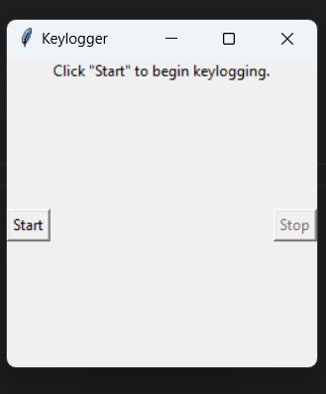
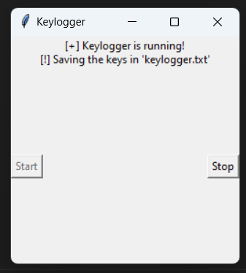
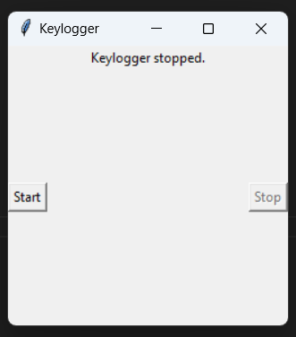
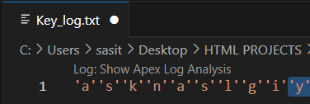
RESULTS
3/21/2024 Annual Review
10

Slide 11
Github link: https://github.com/sasi-7/Key_logger

Slide 12
Thank You

