Slide 1
EDA - Breast Cancer Survival
Name : Sasikumar Dhanasekar
Email : sasi.msec@gmail.com

Slide 2

Survival of Breast Cancer Patients
Dataset Information
Study that was conducted between 1958 and 1970
Conducted at the University of Chicago's Billings Hospital
Survival rate of patients who had undergone surgery for breast cancer.
Patient entries count is 306

Slide 3
Attribute Information
Age
Operation year
Axillary nodes detected
Survival Status (1 – Survived more than 5 years, 2- Survived less than 5 years)

Slide 4
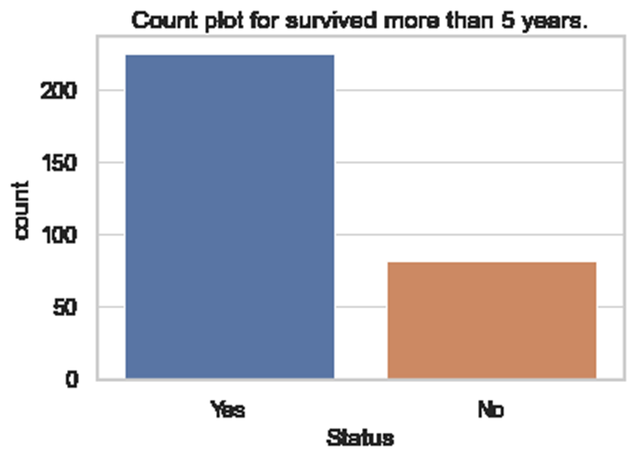
What is the overall survival rates?
Total Patients – 306
Survived after 5 years – 225 ( 73.52%)
Survived less than 5 years – 81 (26.48%)

Slide 5
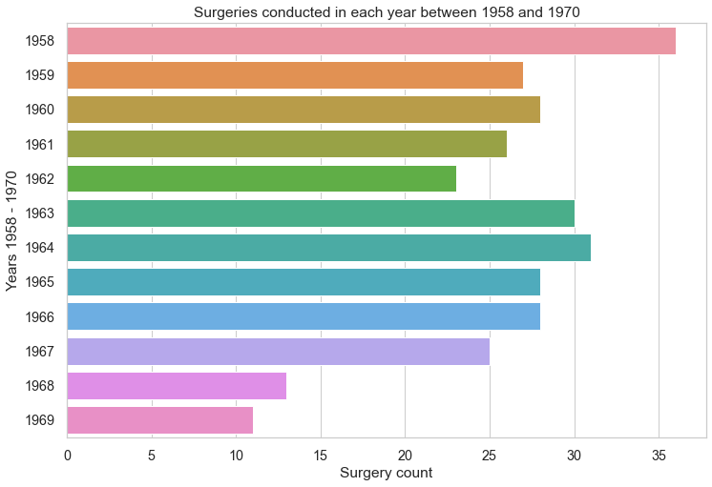
Which year has the maximum number of surgeries?
Top 3 years based on surgeries
YEAR | COUNT
1958 | 36
1964 | 31
1963 | 30
Maximum surgeries had been recorded in the year of 1958.

Slide 6
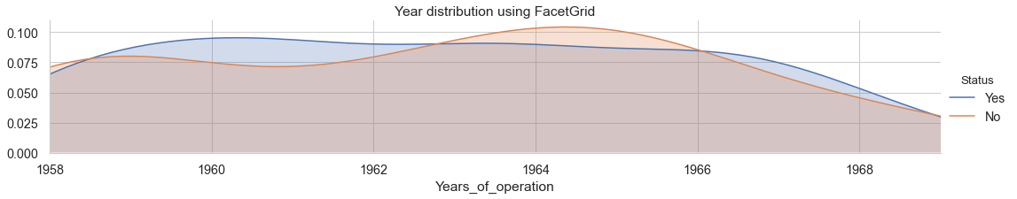
Which year has lowest success rate in surgeries ?
Between the year 1963 and 1966, We can see a rise in the graph which tells that there were more unsuccessful operations.

Slide 7
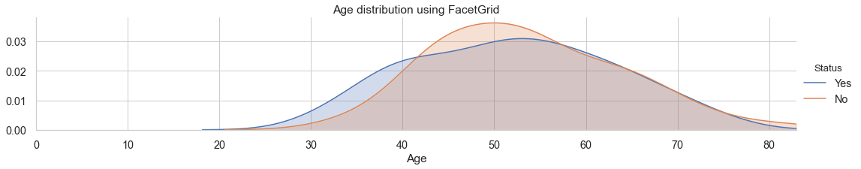
Does the age factor decide the survival chance?
Patients age between 25 and 40 are slightly having higher chance to survive after 5 years.
Patients age which are more than 40 and less than 55 are having less chances to survive after 5 years.
Patients whose age are between 60 and 75 are having equal chances of surviving and not surviving, while the survival chances are less after the age of 80.

Slide 8
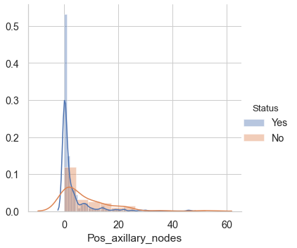
Does the axillary nodes decide the survival chance?
Patients with less nodes are more likely to survive.
Majority of long survived patients are having "0" axillary nodes

Slide 9
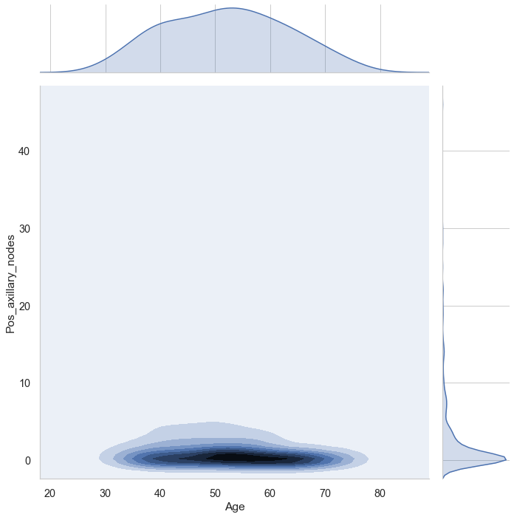
Which age group has high Survival rate?
Density for long survival is more from the age range 47–60 and axillary nodes from 0–3

Slide 10
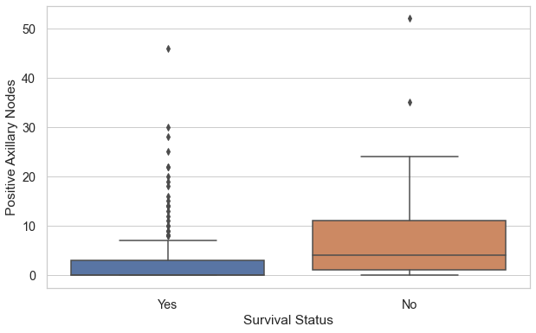
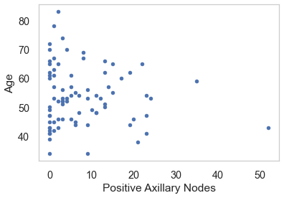
What % of Short survival patients having 0 nodes
Fig 1 – Long and Short Survival
Fig 2 – Short Survival
Large percentage of patients who survived had 0 nodes.
Small percentage of 6.21 % patients who had no positive axillary nodes died within 5 years of operation
Patients with more than 1 nodes are not likely to survive

Slide 11
Conclusion
Patients with less than 35 years of age will survive more than 5 years
Patients who has less nodes having high rate of survival. However, the data has shown that an absence of positive axillary nodes does not always guarantee survival.
Patients who had undergone surgery in the year between 1963 and 1966 having high number of less survival rate

