Slide 1




TASTIFY
Online Food Ordering System

Slide 2
CAPSTONE PROJECT
Guided by:
Kolaparthi Srinivas.
Submitted by:
Bhanu Prasad Kummari.
Sujeeth Chikoti.
Sinduja Katepalli.
Arun Kumar Kesa.
Sasi Kiran Katta.

Slide 3
CONTENTS
INTRODUCTION
SOFTWARE & HARDWARE REQUIREMENTS.
TECHNOLOGIES USED.
CLASS DIAGRAM.
ACTIVITY DIAGRAM.
USE CASE DIAGRAM
CONCLUSION.

Slide 4
INTRODUCTION
Online food ordering is the process of ordering food from a website. The product can either be food that has been specially prepared for direct consumption (such as vegetables straight from a farm or garden, frozen meats, etc.) or food that has not been (such as direct from a certified home kitchen, restaurant).
The effort to create an online food ordering system aims to replace the manual method of taking orders with a digital one. The ability to rapidly and correctly create order summary reports whenever necessary is a key factor in the development of this project. The potential of an online food ordering system is enormous. Any restaurant or fast-food chain can use this project to keep track of customer orders.

Slide 5
Software and Hardware Requirements.
Software Requirements:
IDE - Eclipse/STS.
Database support - MySQL 8.0 .
Hardware Requirements:
Operating system – Windows 8 and above.

Slide 6



TECHNOLOGIES USED
Front end – React.
Backend – Spring Boot Layered Architecture.
Database - MYSQL.

Slide 7
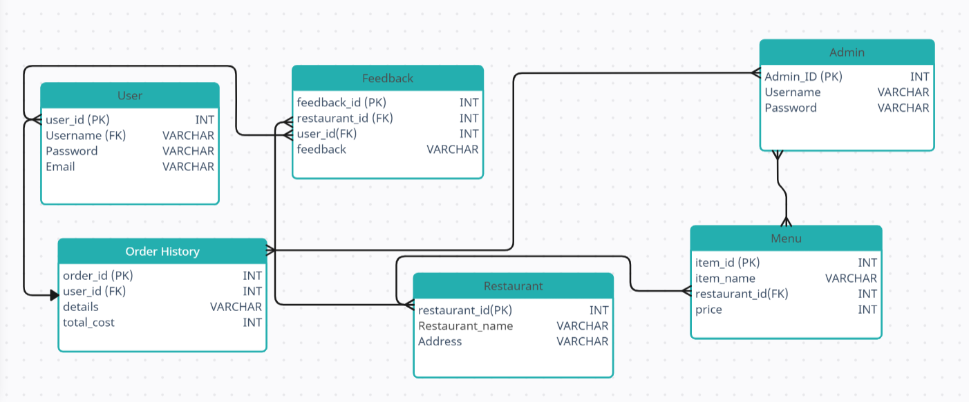
CLASS DIAGRAM

Slide 8
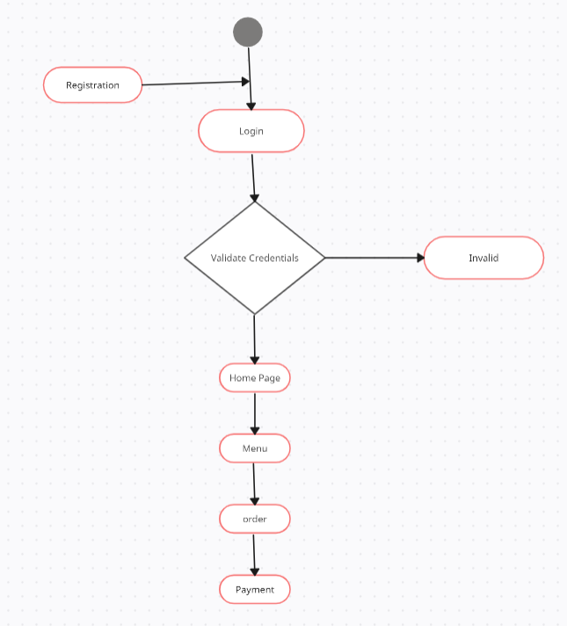
ACTIVITY DIAGRAM

Slide 9
CONCLUSION
An online food ordering system is developed where the customers can make an order for the food and avoid the hassles of waiting for the order to be taken by the waiter. Using the application, the end users register online, see the menu and select the food from the menu to order food online. Once the customer selects the required food item the chef will be able to see the results on the screen and start processing the food. This application nullifies the need for a waiter or reduces the workload of the waiter.

Slide 10


