Slide 1

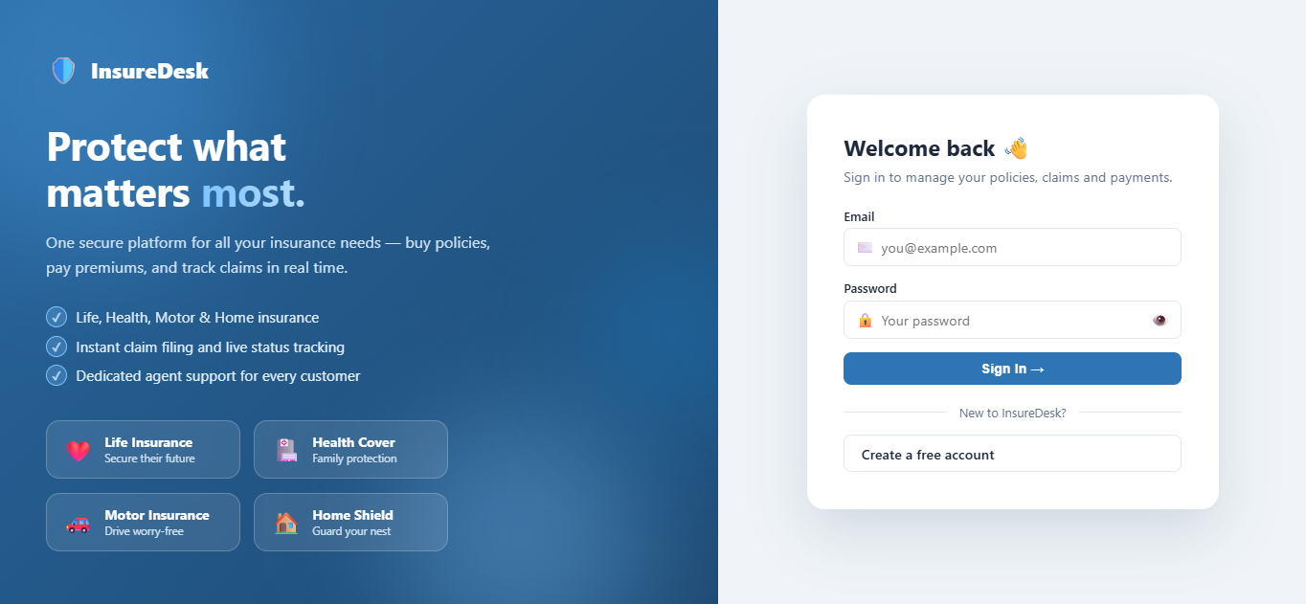




INSUREDESK · STEP-BY-STEP USER GUIDE
How to Use the
Insurance
Management System
A simple walkthrough for customers — create your account, sign in, buy a policy, pay your premium, file a claim and track everything in one place. No paperwork, no branch visits.
Life
Health
Motor
Home
This is where your journey starts — the InsureDesk sign-in page
Covers all four insurance types · 10 easy steps · Every screen shown

Slide 2
Your Journey in 10 Steps
Everything you can do as a customer, in the order you will normally do it
1
2
3
4
5
Sign Up
→
Sign In
→
Dashboard
→
Browse Plans
→
Apply
Create your free account
Log in with email & password
See your policies at a glance
Compare Life, Health, Motor, Home
Send an application for approval
6
7
8
9
10
Get Approved
→
Pay Premium
→
File a Claim
→
Track & Notify
→
Profile
Agent reviews · policy goes ACTIVE
Pay dues, keep the policy alive
Claim against an active policy
Follow status in real time
Update details & password

Slide 3
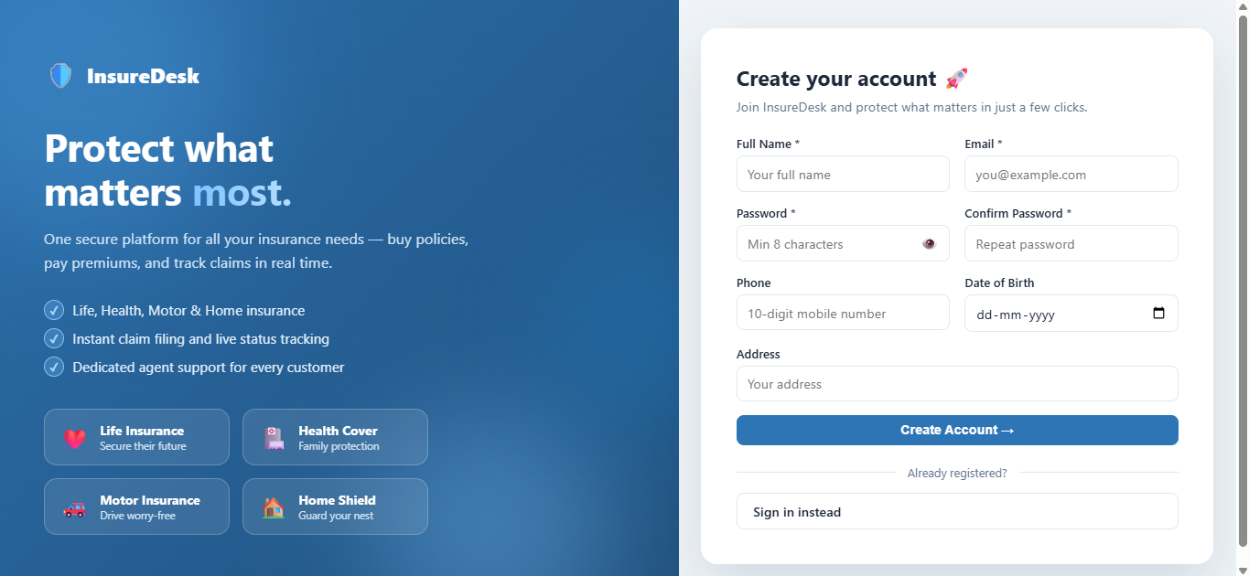

1
Sign Up — Create Your Account
Only customers self-register. Agent and admin accounts are created for you by the administrator.
On the sign-in page, click “Create a free account” to open the registration form.
Fill in your full name, email address, phone number, date of birth and address.
Choose a password of at least 8 characters and re-type it in “Confirm Password”.
The form checks you as you type — a red message appears under any field that needs fixing (bad email, mismatched passwords, phone that isn’t 10 digits).
Registration page — http://localhost:5173/register
Tip: Your email is your username and cannot be changed later, so use one you check regularly — policy and claim notifications are tied to it.
Click Register. You are signed in straight away and land on your dashboard.

Slide 4
2
Sign In — Log In to Your Portal
One login for every role — the system automatically opens the correct portal for you.
Enter the email and password you registered with.
Use the eye icon inside the password box to reveal what you typed if the sign-in fails.
Click “Sign In →”. The system checks your details and issues a secure token that keeps you logged in.
You are taken to your own portal — Customer, Agent or Admin — with only the menu items you are allowed to use.
Sign-in page — http://localhost:5173/login
Tip: Seeing a “Network Error”? The backend server isn’t running. Start it first, then reload the page.
Your session lasts 24 hours; after that, simply sign in again.

Slide 5
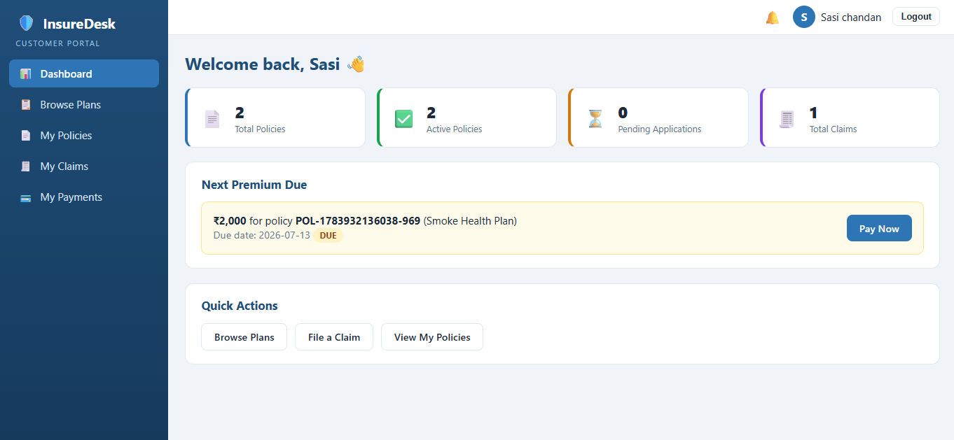
3
Your Dashboard — Everything at a Glance
The first screen you see: your policy counts, what you owe next, and shortcuts to common tasks.
Four stat cards show Total Policies, Active Policies, Pending Applications and Total Claims.
The “Next Premium Due” banner shows the amount, the policy number and the due date — with a Pay Now button right there.
Quick Actions take you straight to Browse Plans, File a Claim or View My Policies.
The bell icon in the top bar shows a red count whenever something new has happened.
Customer dashboard — your home screen after signing in
Tip: A due date shown in yellow means the premium is DUE; if it turns red it is OVERDUE — pay it to keep your policy active.
Use the left sidebar any time to move between Browse Plans, My Policies, My Claims and My Payments.

Slide 6
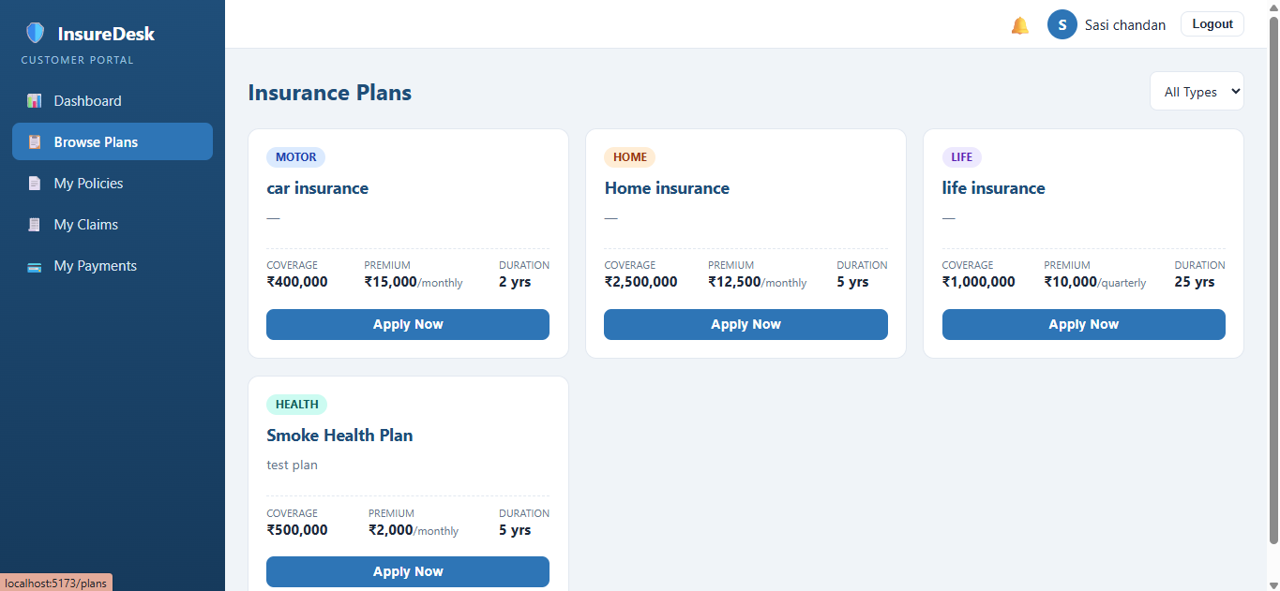
4
Browse Plans & Apply for a Policy
Compare plans across Life, Health, Motor and Home — then apply in one short form.
Open “Browse Plans” from the sidebar. Each card shows the coverage amount, the premium (and how often it is paid) and the duration in years.
Use the “All Types” dropdown to filter by LIFE, HEALTH, MOTOR or HOME.
Click “Apply Now” on the plan you want to open the application form.
Fill the details the plan needs — nominee for Life, family members for Health, vehicle registration for Motor, property address for Home.
Browse Plans — every active plan with an “Apply Now” button
Tip: Applying does not charge you anything. Your first premium is only generated once your agent approves the policy.
Submit. Your application is created with status PENDING and a unique policy number.

Slide 7
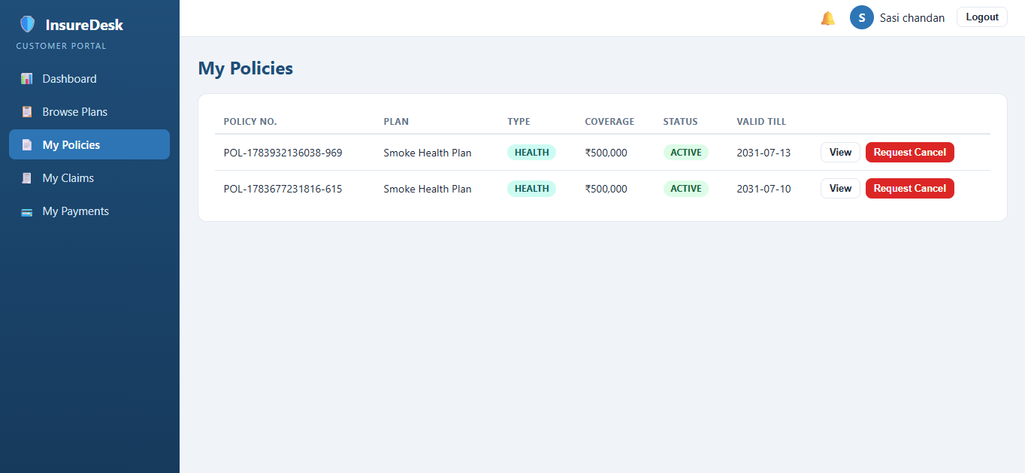
5
Track Your Policies
Follow an application from PENDING to ACTIVE, and see all your cover in one table.
“My Policies” lists your policy number, plan, type, coverage, status and valid-till date.
Status badges tell you where you stand: PENDING (waiting for approval), ACTIVE (you are covered), REJECTED, EXPIRED or CANCELLED.
Click View to open the full policy details, including the information you entered when applying and any remark from your agent.
Once approved, the start and end dates are calculated automatically from the plan duration.
My Policies — track every application and active policy
Tip: You can only file a claim against a policy that is ACTIVE — a PENDING application is not yet cover.
Use “Request Cancel” on an active policy if you no longer need it — the admin confirms the cancellation.

Slide 8
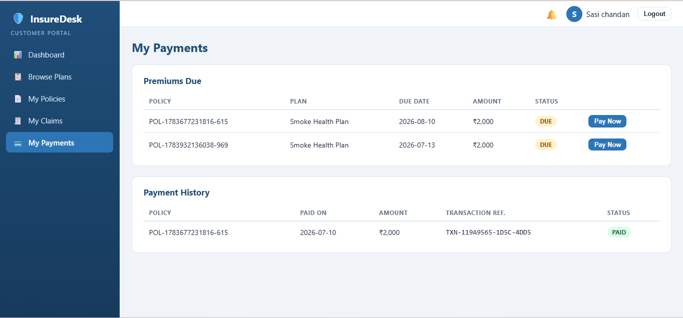
6
Pay Your Premiums
Payments are simulated in this system — no real card details are ever entered or stored.
Open “My Payments”. The “Premiums Due” table lists every upcoming payment with its policy, due date, amount and status.
Click Pay Now to open the confirmation box, check the amount, and confirm.
The payment is recorded instantly with a generated transaction reference and marked PAID.
“Payment History” keeps a permanent record of everything you have paid, and when.
My Payments — premiums due on top, payment history below
Tip: If a premium passes its due date it is flagged OVERDUE and you are notified. Clearing it keeps your policy in good standing.
Dues are created automatically according to your plan’s frequency — monthly, quarterly or yearly.

Slide 9
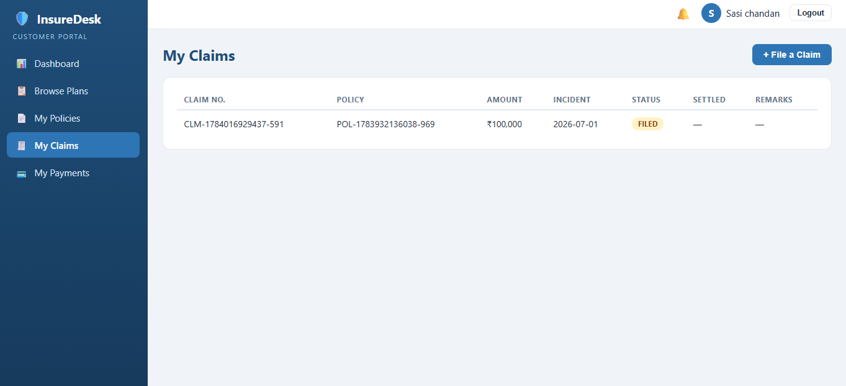
7
File a Claim
Raise a claim against any active policy — from your phone or laptop, at any time.
Go to “My Claims” and click “+ File a Claim”.
Select the policy from the dropdown — only your ACTIVE policies are listed.
Enter the claim amount, the incident date and a description of what happened.
The claim amount can never be more than that policy’s coverage amount; the system rejects it with a clear message if it is.
My Claims — the “+ File a Claim” form and your claim history
Tip: Be specific in the description and use the correct incident date — that is what your agent reads when reviewing the claim.
Submit. Your claim gets a unique claim number and starts life with status FILED.

Slide 10
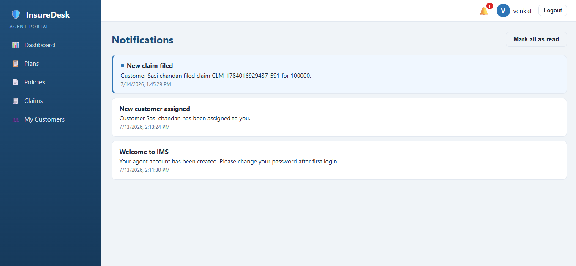
8
What Happens to Your Claim
Every claim moves through the same four stages — you can see the current stage on “My Claims” at any time.
FILED
→
UNDER_REVIEW
→
APPROVED / REJECTED
→
SETTLED
You submitted the claim. It is waiting in your agent’s queue.
Your agent has picked it up and is checking the details.
Your agent records a decision, with remarks explaining it.
The admin settles an approved claim — settled amount and date are recorded.
The Status column on “My Claims” always shows the current stage.
The Remarks column carries your agent’s or the admin’s note on the decision.
Once settled, the Settled column shows the exact amount paid out.
Open “Notifications” from the sidebar to see every update, newest first.
Click “Mark all as read” to clear the red count on the bell icon.
Notifications — you are told the moment your claim status changes

Slide 11
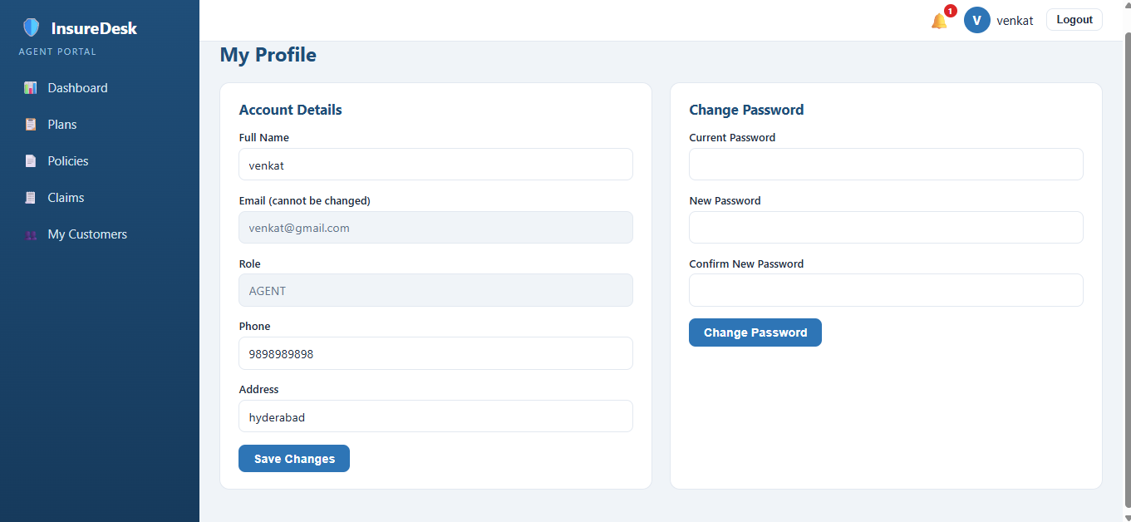
9
Manage Your Profile & Password
Keep your contact details current and change your password whenever you want.
Click your name in the top-right corner to open “My Profile”.
Update your full name, phone number and address, then save. Your email and role are fixed and cannot be edited.
In “Change Password”, enter your current password, then the new one twice.
New passwords must be at least 8 characters. Passwords are stored scrambled — nobody, not even the admin, can read yours.
My Profile — account details on the left, change password on the right
Tip: Keep your phone number correct — it is the detail your assigned agent uses to reach you about policies and claims.
Use Logout in the top-right whenever you finish, especially on a shared computer.

Slide 12







Good to Know — Quick Answers
The questions users ask most often, answered in one line each
How long until my policy is approved?
Is my data safe?
Your assigned agent (or the admin) reviews the application and approves or rejects it with a remark. You are notified either way — check My Policies for the live status.
Your password is stored only as an irreversible hash, every request is checked against a secure token, and you can only ever see your own policies, claims and payments.
Is my money really taken?
Why was my claim rejected?
No. Premium payments are simulated for this system — no card or bank details are asked for or stored. Each payment gets a generated transaction reference.
The reason is always written in the Remarks column on My Claims. Common causes: the policy wasn’t active, or the claim amount exceeded the coverage.
Who is my agent?
I missed an update.
The admin assigns one agent to each customer. Your agent handles your policy approvals and claim reviews — you’ll get a notification when you are assigned.
Nothing is lost — open Notifications from the sidebar to see the full history of policy, claim and payment events on your account.
Still stuck? Contact your assigned agent through the details on your policy, or reach the administrator — the account you sign in with is all they need to help you.

