Slide 1

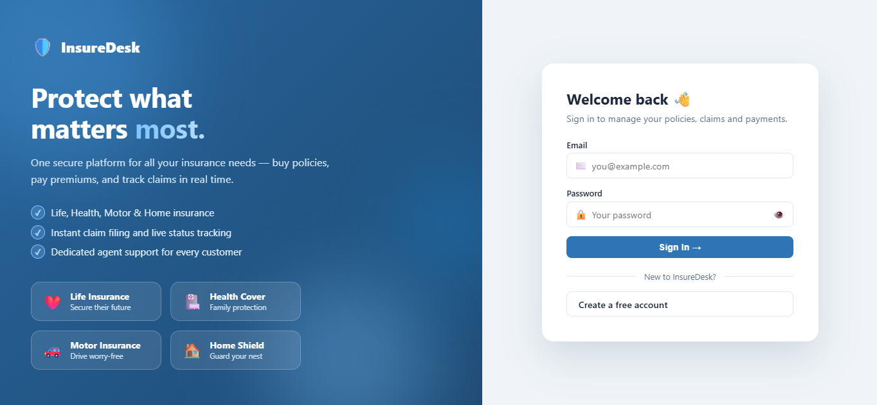




FULL-STACK WEB APPLICATION · ACADEMIC PROJECT
Insurance
Management System
A role-based platform that digitalizes the complete insurance life cycle — plans, policies, premiums, claims and notifications — for Admin, Agent and Customer.
Login — animated split-screen with floating insurance cards
LIFE
HEALTH
MOTOR
HOME
React 18 · Spring Boot 3 · MySQL 8 · JWT Security
github.com/sasichandan23/insurance-management-system

Slide 2


Why This System — Manual Process vs. IMS
System analysis from the SRS: the existing paper-based workflow and how the proposed system removes each pain point
Existing Manual System
Proposed IMS
Records kept on paper and disconnected spreadsheets — redundancy and inconsistency
Customers must visit the branch to buy policies, pay premiums or file claims
No visibility of policy status, premium dues or claim progress
High probability of human error in premium and claim calculations
Physical documents vulnerable to loss; no centralized reporting
Single centralized MySQL database — consistent, backed-up, queryable
Self-service portals: register, browse plans, apply, pay and claim from any device
Real-time status tracking plus in-app notifications for every stakeholder
Automated policy numbering, premium-due generation and status transitions
Role-based JWT security and live dashboards for management decisions

Slide 3
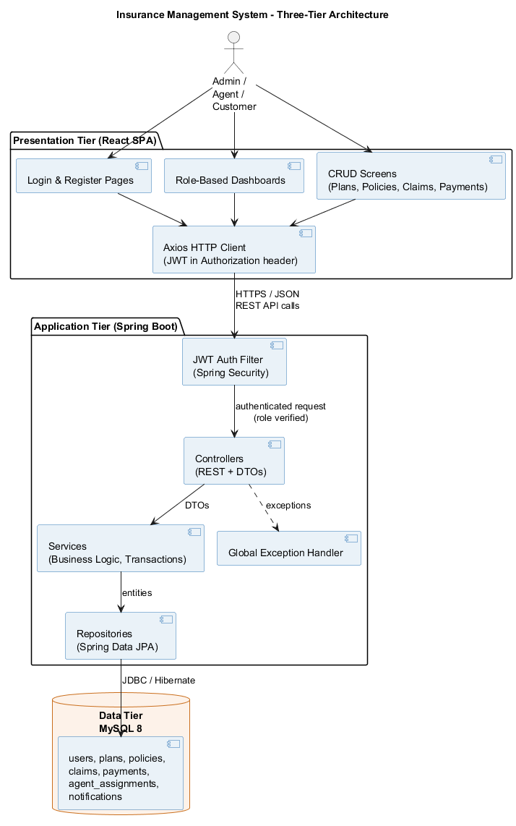



System Architecture & Technology Stack
Three-tier layered architecture — every request flows React → REST API → Service → Repository → MySQL
Presentation Tier
React 18 SPA (Vite) with Axios and React Router. Role-based navigation, client-side validation, JSON over HTTP only.
Application Tier
Java 17 + Spring Boot 3 layered as Controller → Service → Repository with DTOs, global exception handling and transactions. Spring Security 6 + JWT filter authorizes every request.
Data Tier
MySQL 8 normalized to 3NF — 7 tables with foreign keys, unique constraints and enum status columns.
Build & tooling
Maven
npm
Git + GitHub
Postman
Swagger UI
Docker
Architecture diagram (docs/diagrams)

Slide 4






Users & Role-Based Access Control
Three JWT-secured portals — every endpoint enforces role authorization (401 unauthenticated, 403 forbidden)
ADMIN
AGENT
CUSTOMER
Full system control
Assigned customers only
Self-service portal
Manage users & create agents
Own the plan catalogue (CRUD)
Approve/cancel policies
Settle approved claims
Assign agents to customers
System-wide dashboard
See only their customers' data
Approve / reject pending policies
Review claims (Under Review → Approved / Rejected)
Track customer payments
Workload dashboard
Register & manage profile
Browse and filter active plans
Apply with type-specific details
Pay premiums (simulated)
File & track claims
Personal dashboard & alerts
JWT stateless auth (24 h expiry)
BCrypt password hashing
Role checks on every endpoint
JPA parameterized queries — no SQL injection

Slide 5









Functional Specification — Nine Modules
40+ traceable requirements (FR-1.1 … FR-9.3) organized into nine feature modules, each with High / Medium priority
Authentication
User Management
Insurance Plans
Register, login → signed JWT; token verified on every request; BCrypt-only storage (FR-1)
Admin CRUD, agent creation, activate/deactivate; self-service profile & password (FR-2)
Catalogue across LIFE / HEALTH / MOTOR / HOME with coverage, premium, frequency, duration (FR-3)
Policy Lifecycle
Claims Workflow
Premium Payments
Apply → approve/reject → auto numbering, start/end dates, expiry & cancellation (FR-4)
File → review → approve/reject → settle; claim ≤ coverage enforced in service layer (FR-5)
Due generation per frequency, simulated payment with txn reference, overdue flags (FR-6)
Agent Assignment
Notifications
Dashboards
Admin links one agent ↔ many customers; assignment drives all data visibility (FR-7)
In-app alerts on policy, claim & payment events; unread counts, mark-as-read (FR-8)
Live role-specific statistics for Admin, Agent and Customer (FR-9)

Slide 6
Core Workflow Specifications
State machines defined in the SRS and enforced by service-layer business rules and scheduled tasks
Policy lifecycle (FR-4)
PENDING
→
ACTIVE
→
EXPIRED
→
CANCELLED
Apply under an active plan → agent/admin decision with remarks → approval computes start & end dates; a scheduled task auto-expires policies past their end date. Rejected applications end as REJECTED.
Claim lifecycle (FR-5)
FILED
→
UNDER_REVIEW
→
APPROVED / REJECTED
→
SETTLED
Customer files against an ACTIVE policy → agent reviews → admin settles approved claims with settled amount and date. Rule: claim amount can never exceed the policy's coverage amount.
Unique auto-generated policy & claim numbers
Premium dues generated per frequency (monthly / quarterly / yearly)
Overdue premiums flagged & customer notified

Slide 7
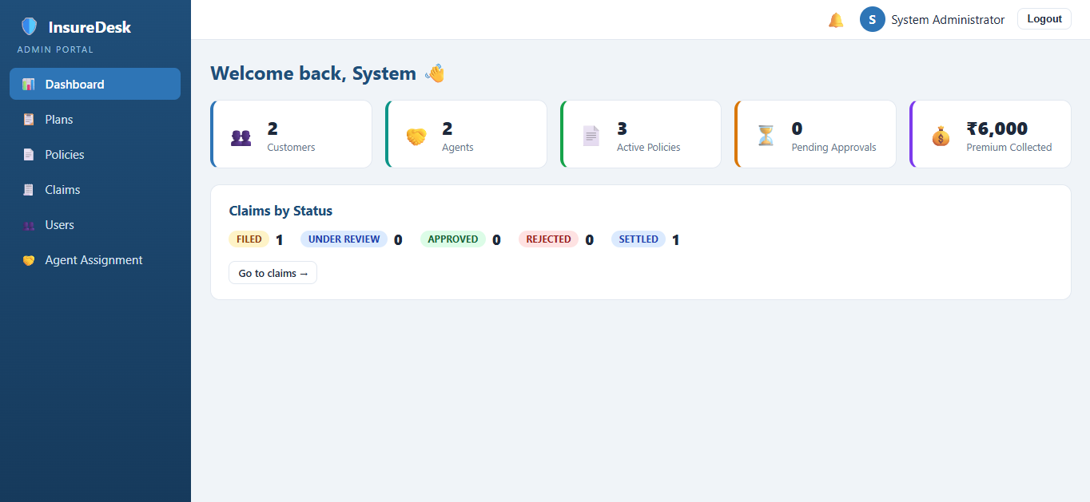
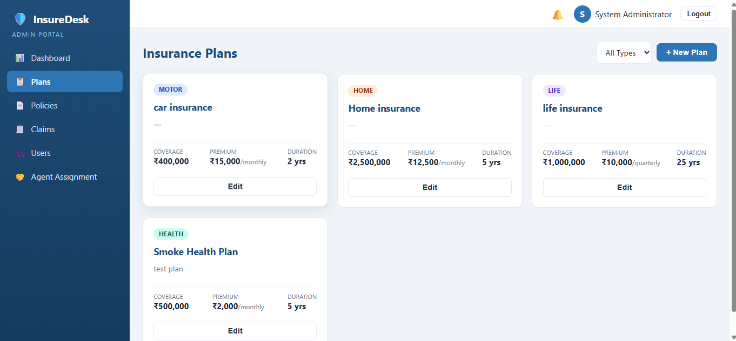
Output — Administrator Portal
Live screenshots of the running application (logged in as admin@ims.com)
Admin dashboard — system-wide stats & claims by status
Plan catalogue — card view with “+ New Plan” and type filter
Also in the admin portal: Policies table with approve / reject / cancel actions and status badges · Claims management with settlement modal · Users directory with search, role filter and “+ New Agent” · Agent–customer assignment screen

Slide 8
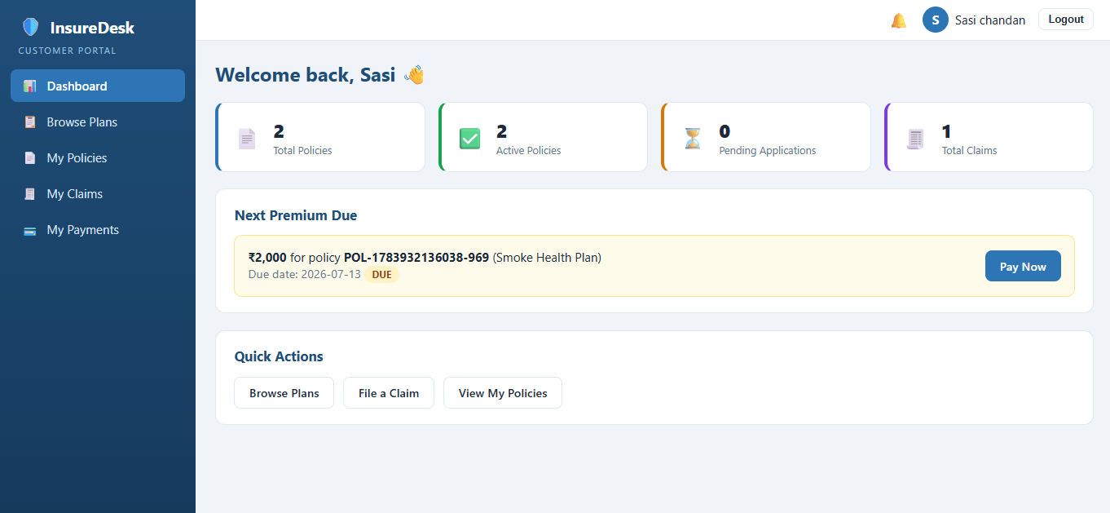
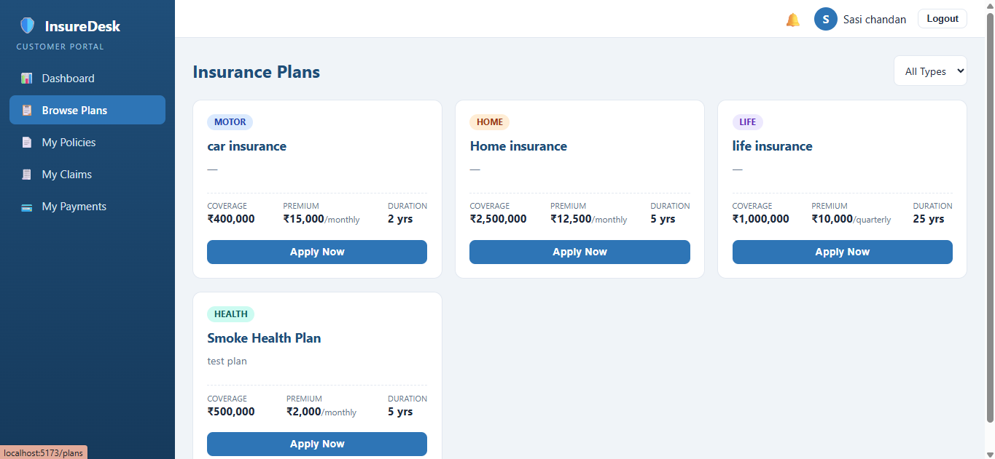
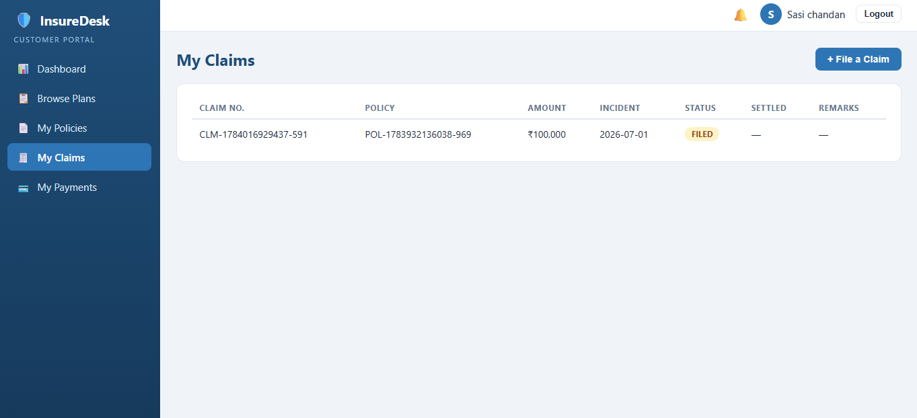
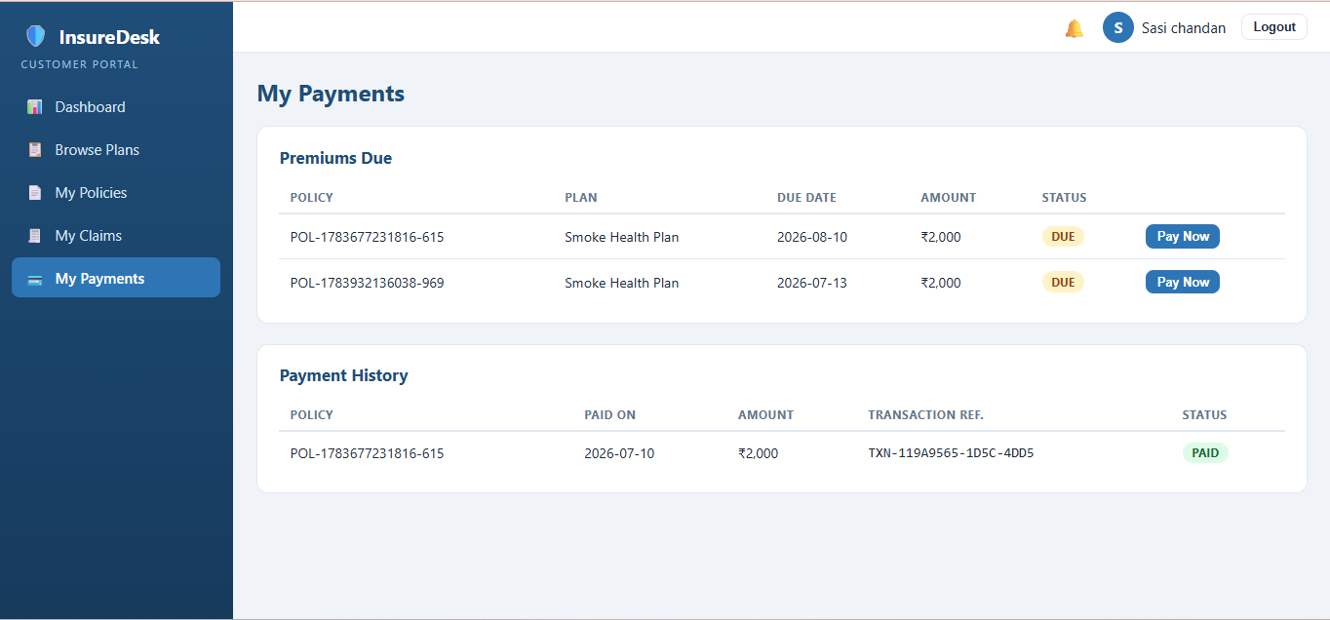
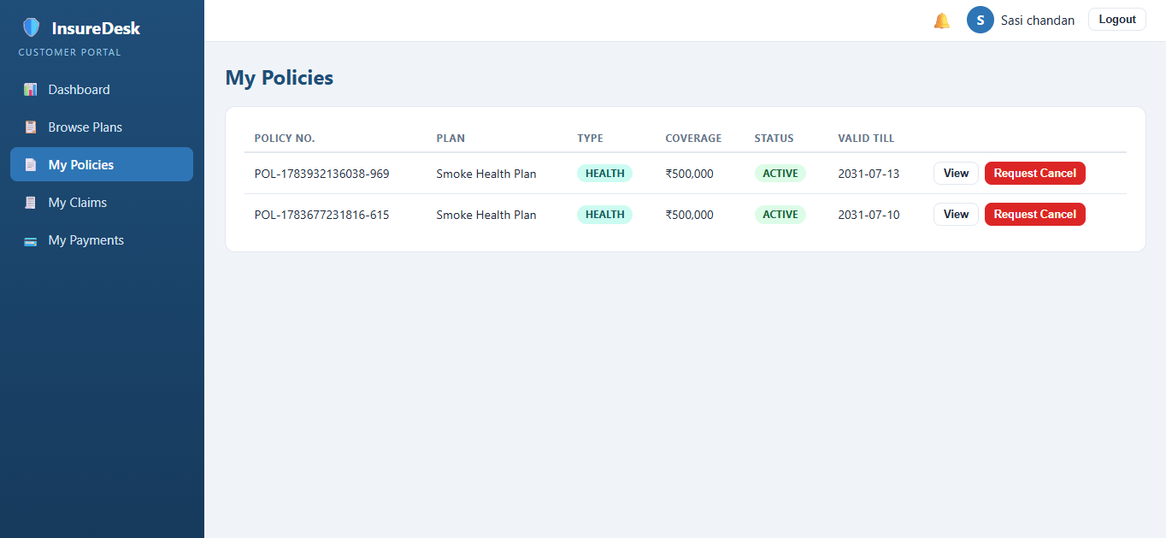
Output — Customer Portal
Self-service journey: dashboard with next premium due, plan application and claim filing
Customer dashboard — “Pay Now” banner & quick actions
Browse Plans — Apply Now modal with type-specific fields
File a Claim — policy picker & claim details
My Payments — simulated Pay Now & history
My Policies — status & detail view

Slide 9
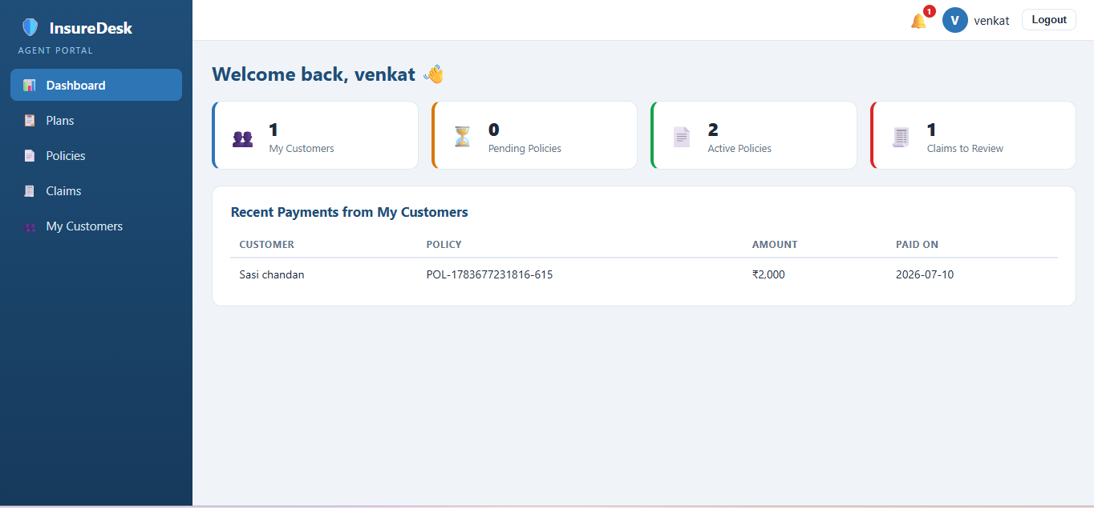
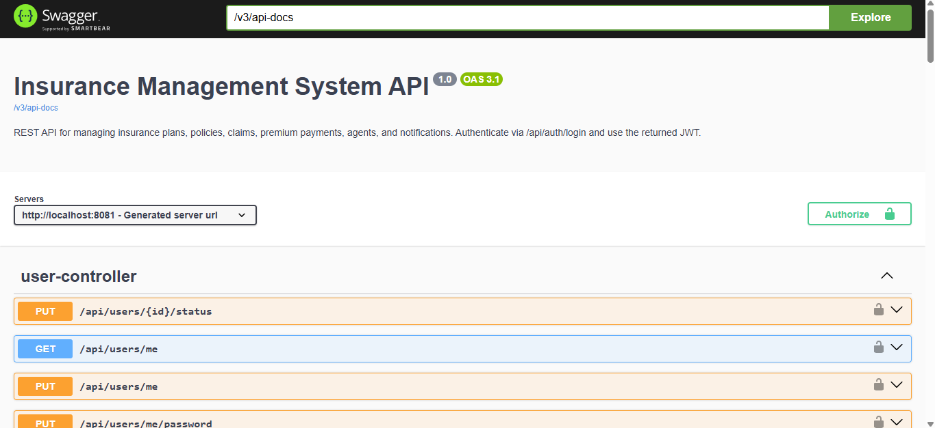
Output — Agent Portal & REST API
Agent workload views plus the auto-generated Swagger documentation of all 9 endpoint groups
Agent dashboard — assigned customers, pending reviews
Swagger UI — interactive API docs with JWT Authorize
/api/auth
/api/policies
/api/claims
/api/payments
register · login → JWT
apply · approve · cancel
file · review · settle
pay · history · dues

Slide 10
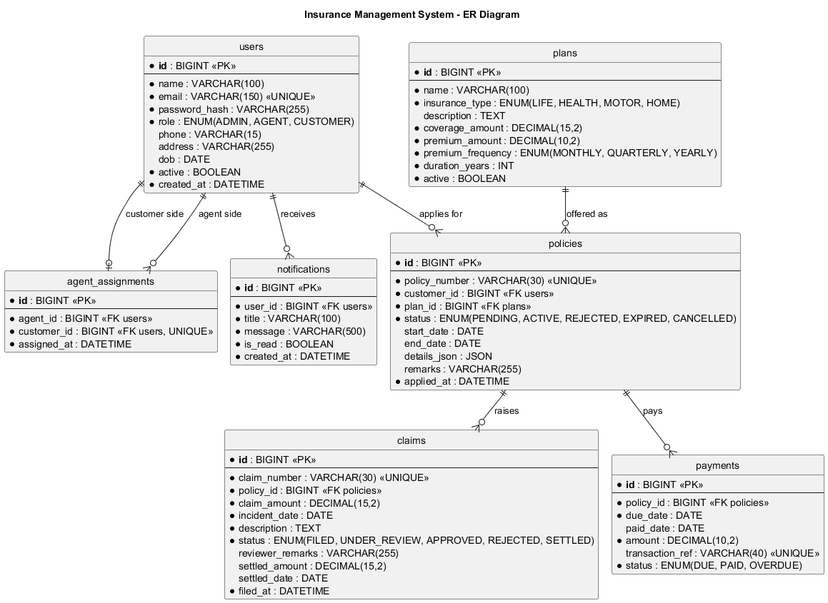

Quality Attributes, Data & Deployment
Non-functional specifications from the SRS, the normalized data model, and the zero-cost cloud path
Performance
API responses < 2 s at 50 concurrent users; paginated list endpoints
Security
JWT + BCrypt + RBAC; CORS locked to frontend origin; no secrets in source
Reliability
Transactional services, FK integrity, global exception handler — no stack-trace leaks
Scalability
ER diagram — 7 tables in 3NF (users, plans, policies, claims, payments, assignments, notifications)
Stateless backend → horizontal scaling; portable across Windows / Linux / macOS
Phases 1–5 complete: Design → Backend → Frontend → Integration → Deployment & Docs
Deployment: one-command Docker Compose (MySQL + backend + frontend) or free cloud — TiDB Cloud Serverless + Render + Vercel, no credit card. Login: admin@ims.com / Admin@123

