Slide 1
Histopathology Cancer Detection
Data 690-Modern Practical Deep Learning
Prof. Andre Nguyen
Presenter:
Sasidhar Guthi
IJ43577

Slide 2
Contents
Introduction
Data and Data Preparation
Modelling and Results
Conclusion
Further Improvements

Slide 3
Introduction
Pathologists face a substantial increase in workload and complexity of histopathologic cancer diagnosis due to the advent of personalized medicine.
Traditionally, pathologists analyse tissue samples under a microscope to identify cancer cells. However, this process is time-consuming, subjective, and prone to errors.
The emergence of deep learning, specifically Convolutional Neural Networks (CNNs), has revolutionized cancer detection in histopathology images.
This project focuses on finding evidence of cancer in images by using CNN and also by using autoencoders an unsupervised deep learning model, we try to denoise and reconstruct the images.

Slide 4
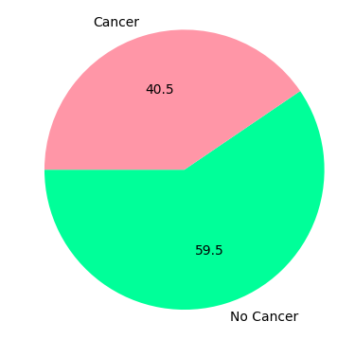
Data and Data Preparation
This data is obtained from the Kaggle competition dataset.
This data consists of test and train data which we have used to train our model and evaluate the results of our model.
The dataset size is 6.3 GB, used google drive to warehouse the dataset and then by using the colab environment extracted the data to train models.
In the training dataset, the value counts of images having cancer and images with no cancer are as follows.

Slide 5
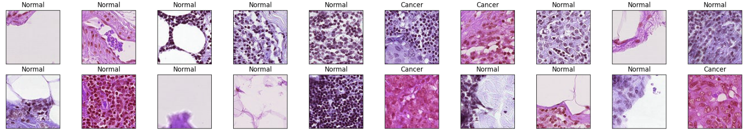
Modelling
Built a Convolutional Neural Network with 5 convolutional layers and an increasing number of filters from 32 to 512.
This model has given an AUC score of 96.89%.
These are the results of the test data predictions.

Slide 6
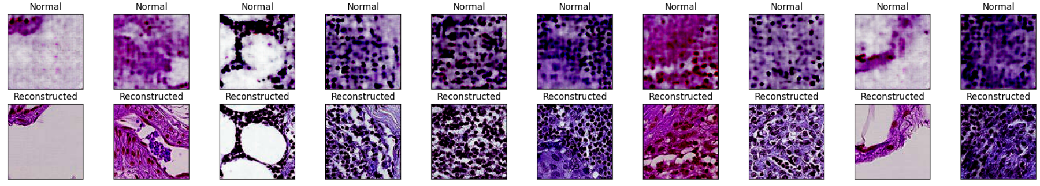
Modelling Cont.
An Autoencoder model with 3 colour channels is used, it is passed through a series of convolutional layers.
This autoencoder is used to denoise and reconstruct the test dataset
These are the results.

Slide 7
Conclusion
This project discusses creating a CNN model to identify the evidence of Cancer in the Histopathology images.
The CNN has performed well resulting in a 97% Area Under the Curve.
It also goes on to show how the Unsupervised learning model Autoencoder has helped to enhance the images.
From the results, we can observe that there was a lot of noise in the dataset images.
The Autoencoder has denoised the images and reconstructed them so that the pathologists would have a better visual of the evidence of cancer-affected cells.

Slide 8
Further Improvements
Usage of Reconstructed images to train the CNN model.
Increasing the number of epochs.

Slide 9
Thank You
All The Best

