Slide 1
Open Ended Lab Project
Movie Recommending System from IMDb
Presented by : M.V.Karthikeya, 112101027 &
N.Sasidhar Reddy, 122101025
Mentor : Dr. Koninika Pal

Slide 2
Problem statement
The objective is to develop a content-based recommendation system using Matrix factorization that provides suggestions for movies that are similar to a specific movie, based on several factors such as cast, director, writer, popularity, genres, keywords, and story.

Slide 3
Recommender system
A recommender system is an algorithm that provides personalized suggestions to users. These systems are widely used in various online platforms to help users discover new products, services, or content based on their preferences and behavior.
Content-Based Filtering
This approach recommends items based on their features like genres, actors, directors,writers and user ratings to recommend movies.
Non Negative matrix factorization(NMF)
Non-negative Matrix Factorization (NMF) is a mathematical technique used in recommendation systems to decompose a user-item interaction matrix into two lower-dimensional matrices, representing latent features of users and items. By capturing these underlying patterns, NMF helps identify preferences and make personalized recommendations.

Slide 4
Methodology
Overview
Data Collection: Web scraping using BeautifulSoup and Selenium from IMDb.
Data Preprocessing:
Handling Missing Values
Dealing with Categorical Data
Preprocessing Storyline Data
Combining the features in movie:
Making matrix-For different movies
Matrix Normalization:Applying Min-Max Scaling to ensure equal contribution of features.

Slide 5
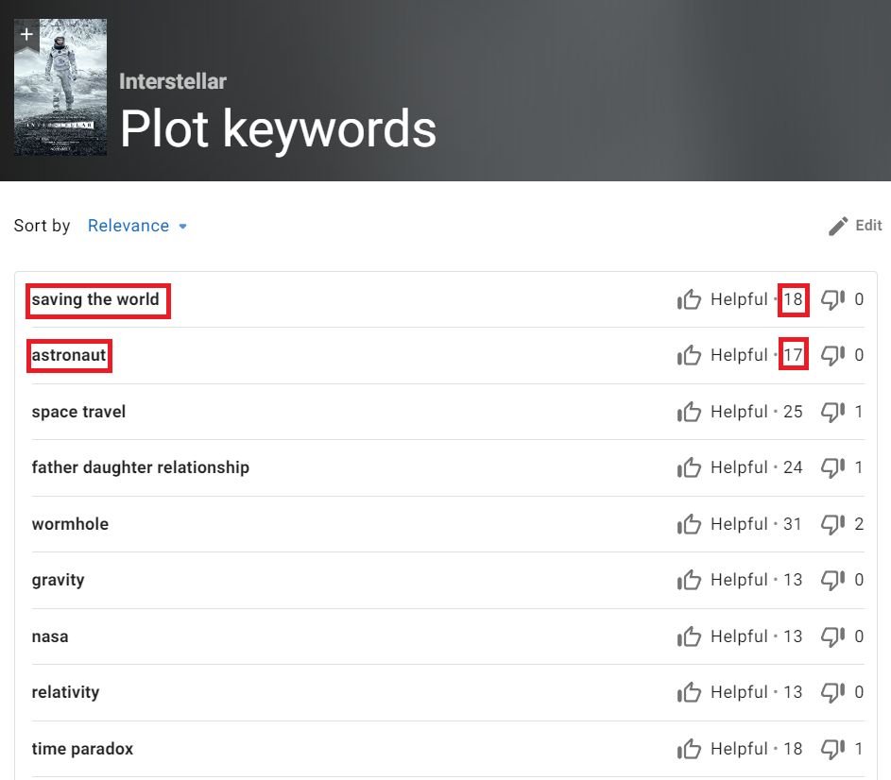
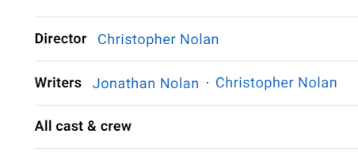
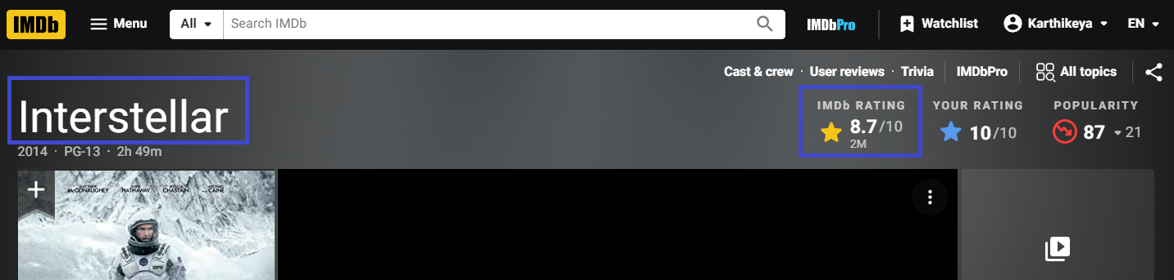
Data collection
.The Data which have extracted are Title, Director, Writers, Cast ,Storyline, keywords and their helpfulness and popularity rank of cast,writer,director.
These data were extracted using BeautifulSoup and Selenium.
.
Director, Writers, Cast and Crew are taken from here.
Title and rating are extracted from here as shown
Keywords and their corresponding helpful score (in red box)
Notes:
The first step is to obtain data from the imdb website,we didn’t used the pre existed data sets in the internet.we used web scraping methods to collect our own dataset from the imdb site.
This process takes approximately 20 seconds to scrap the needed data from a movie.such as……..Title, Director, Writers, Cast and Crew, Average IMDb rating, Storyline,Keywords of the movie and also information about how helpful and relevant these keywords are to the movie.
(At last)
Majority of the scraping part is done by using the beautiful soup library but the helpfulness of the keywords are collected by using selenium cuz the data is dynamically stored which makes harder for extraction in beautiful soup.

Slide 6
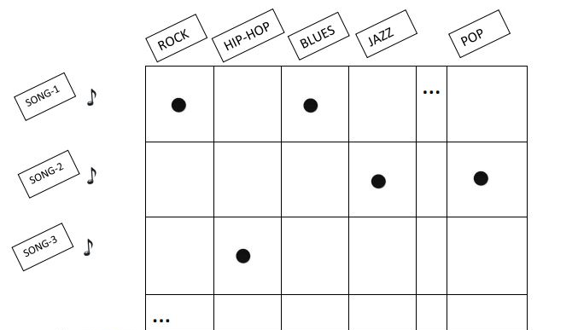
Combining Features
Non binary data
Normalized with Min-Max Scaling

Slide 7
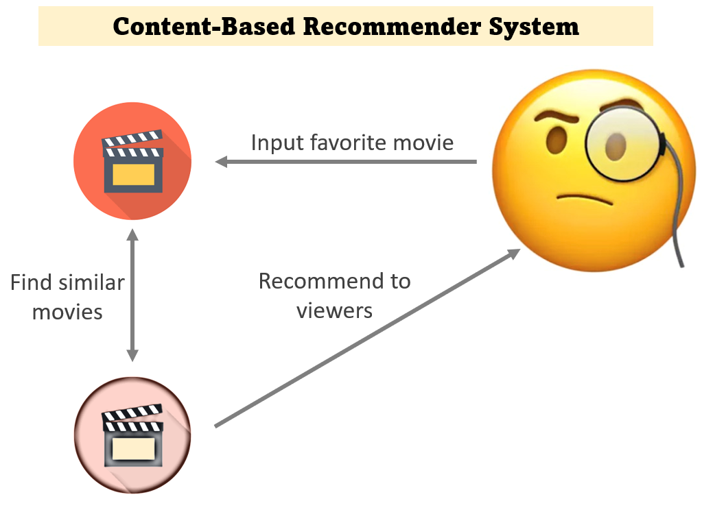

Content-Based filtering
Cosine similarity to find similarity between 2 movies
Notes:
We used the cosine similarity method to find the relevant recomendations for the given movie.
1.First, we make a list of all the unique features from all the movies, leaving out the keywords and their helpful number.
we used some NLP methods to process our data
using nltk library we can efficiently modify the datasets and helps in creating a count vector for better results
2.Now we're going to make a count matrix, where each row is a movie and each column is a unique feature word. And entries will show how often these specific words appear in that movie.
3.We can think of each row in the count matrix as a vector now that we know how often each movie's unique feature words appear.
4.Similarity scores are calculated using cosine distance between movies or rows. A separate similarity matrix with movie rows and columns will hold these scores.

Slide 8
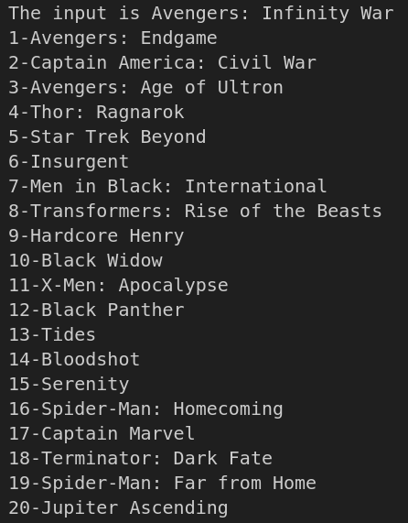
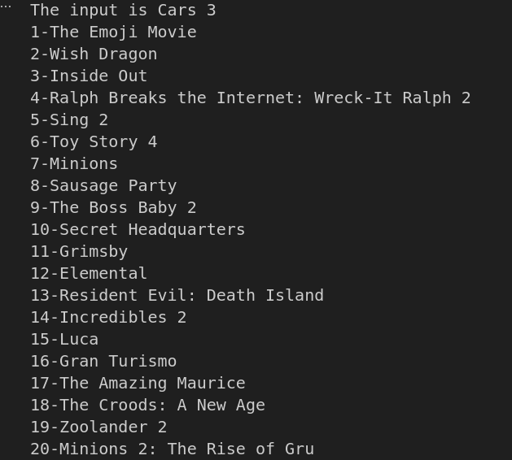
Some Outputs:

Slide 9
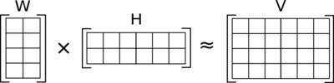
Non-negative Matrix Factorization (NMF)
One matrix contains the characteristics or features of movies, while the other matrix contains the preferences or weights for those latent features.
Objective function V~WH

Slide 10

W and H iterates until the approximation WH closely matches the original matrix V.
Constraint-NMF is non negative, W and H are non Negative
Perplexity measure for number of components
Gives the best value of K for Matrix factorization
one with least uncertainty is the best value for k
Entropy for the matrix
Entropy is the measure of uncertainty. So for calculating entropy for each row in the matrix we need to transform our values in the matrix so that these follow the properties of probabilities, that are:
All the values in the row are non negative and scaled between 0 and 1 (which is done already)
All the values in a row should sum to 1.

Slide 11
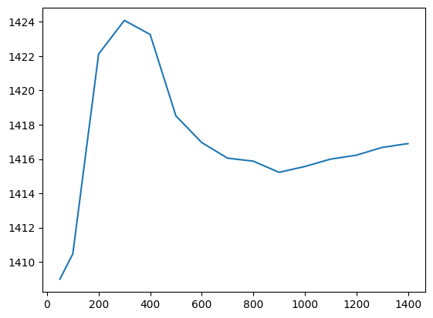
For making all the rows sum to 1, we will divide each row with their corresponding sum of the row.
Now, for each row we calculate entropy by:
H(P) = − ∑_{i}​ P(i) ・log₂​(P(i))
Perplexity = 2^{H(P)}
For finding total perplexity measure, we take mean of all the entropies.
The one with least perplexity measure is the best value.
Plot between number of latent features and perplexity measure (local minima occurs at k ≈ 900)

Slide 12
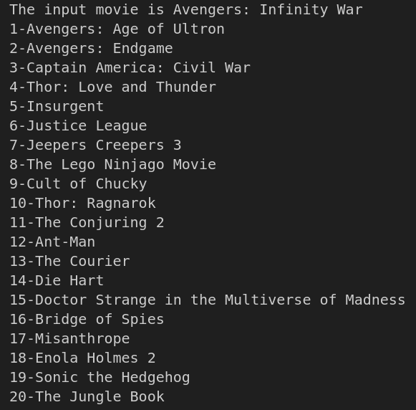
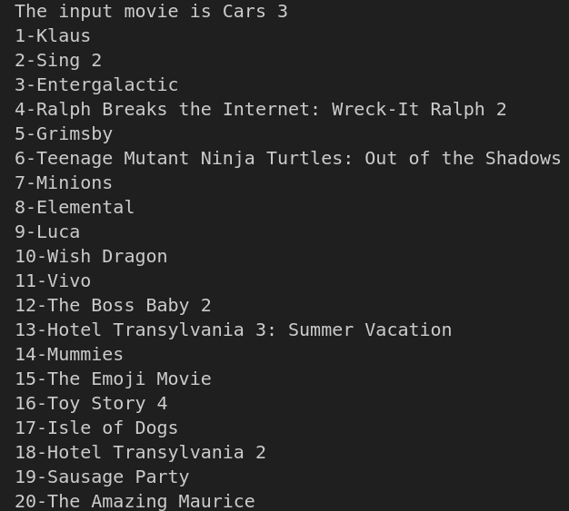
Outputs

Slide 13
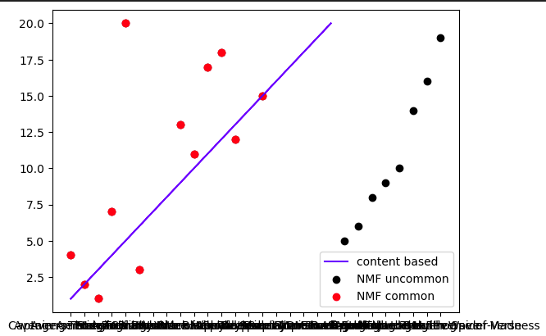
comparison

Slide 14
Thank You
Sasidhar 122101025
Karthikeya 112101027

Slide 15
Conclusion
Movie recommendation system blends genres, keywords, cast, directors, writers, and story to deliver personalized suggestions. Leveraging Non-negative Matrix Factorization (NMF) and cosine similarity, the system provides a refined approach to movie recommendations.

Slide 16
References
A. Fanca, A. Puscasiu, D. -I. Gota and H. Valean, "Recommendation Systems with Machine Learning," 2020 21th International Carpathian Control Conference (ICCC), High Tatras, Slovakia, 2020, pp. 1-6, doi: 10.1109/ICCC49264.2020.9257290.
A. R. Lahitani, A. E. Permanasari and N. A. Setiawan, "Cosine similarity to determine similarity measure: Study case in online essay assessment," 2016 4th International Conference on Cyber and IT Service Management, Bandung, Indonesia, 2016, pp. 1-6, doi: 10.1109/CITSM.2016.7577578.
Y. -X. Wang and Y. -J. Zhang, "Nonnegative Matrix Factorization: A Comprehensive Review," in IEEE Transactions on Knowledge and Data Engineering, vol. 25, no. 6, pp. 1336-1353, June 2013, doi: 10.1109/TKDE.2012.51.

