Slide 1
MACHINE LEARNING PROJECT
Matt Lombardo
John Michals
Kenneth Reed
Yamini Sasidhar
Khrystyne Vaughan
Fardi Yeung
February 7, 2019

Slide 2
PROJECT OVERVIEW
The scope of work was to create a series of robust models with the goal of predicting user likelihood of being diagnosed with different medical conditions.
These conditions were based on:
Patient Blood Profile
Behavioral Practices
Individual attributes
Medical History

Slide 3
DATA ORIGIN
The dataset was requested from and provided by the National Heart, Lung, and Blood Institute (https://biolincc.nhlbi.nih.gov/teaching/) for the landmark Framingham Heart Study
The architecture of the dataset is as follows:
1948 origin with 5,209 subjects all living in Framingham, MA
Focused on a subset of 4,434 subjects
Data collected approximately six years apart, from 1956 to 1968; each participant was followed for a total of 24 years for Angina Pectoris, Cardiovascular Disease (CVD) or Stroke (and death)
Total of 11,627 unique observations
Data Visualization

Slide 4
CONDITIONS AND PREDICTORS
The Conditions were:
Diabetes
Angina Pectoris
Cerebral hemorrhage (Stroke)
Cardiovascular disease (CVD)
The Predictors were:
Glucose
Education
Age
Gender
Smoking per day
Total cholesterol
BP Medication
BMI
Heart Rate
Systolic

Slide 5
DATA LIMITATIONS
Some of the data limitations were:
Incomplete HDL/LDL Cholesterol Data prior to the third observation
General nulls in the data
Inconsistency of the subject’s attendance throughout the study
Small data set—9,300+ after cleaning

Slide 6

ONTO THE MODELS

Slide 7
MODELS USED & DISCLAIMER
Neural Networks
Several different versions of NN model parameters
Additional Models
Support Vector Machine, Random Forest
Logistic Regression
Regression trained/tested in R
Disclaimer
Our group does not verify the scientific validity or relevance of the presented information beyond a limited quality control review for apparent errors, deficiencies or inconsistencies within the data.
In other words….

Slide 8
DISCLAIMER CONT’D
This is purely academic…..
everyone take a deep breathe, none of this is meant to frighten or shame you

Slide 9
ANN for Cardiovascular Disease (CVD)
Artificial Neural Network using Keras
Tried multiple iterations: different dimensions, layers, epochs
Final model:
8 dimensions: 'SEX', 'AGE', 'CIGPDAY', 'HEARTRTE', 'SYSBP', 'TOTCHOL', 'BMI', 'GLUCOSE'
Network: 2 hidden layers ('relu'); output layer ('sigmoid')
Optimizer: 'adam'; loss: 'binary_crossentropy'
CVD Model Accuracy (Train/Test):
74.6/74.9

Slide 10
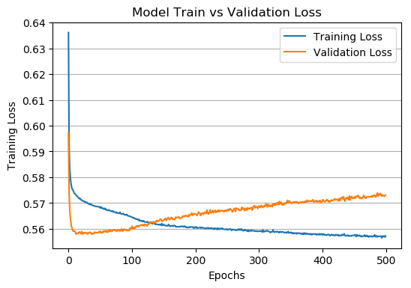
ANN for Cardiovascular Disease (CVD)
Even with this accuracy, predictions were bad. Used validation to avoid overfitting, splitting training data 50/50
Reduced epochs from 500 to 130
Used the method in Chollet, François. Deep Learning with Python. Manning Publications 2018.

Slide 11
ANN for Cardiovascular Disease (CVD)
# Bad Patient Values
pt = {'SEX':[1],'AGE':[54],'CIGPDAY':[0],'HEARTRTE':[92],'SYSBP':[160],
'TOTCHOL':[504],'BMI':[22.51],'GLUCOSE':[82]}
scaled_pt = {}
for key in pt:
if f'{key}_scaler.joblib' in os.listdir('scalers'):
scaler = load(f'scalers/{key}_scaler.joblib')
a = scaler.transform(pt[key][0])
scaled_pt[key] = [a[0,0]]
bad_patient = pd.DataFrame(scaled_pt)
# return probability of response (cvd)
cvd_model.predict_proba(bad_patient)
Out: array([[0.51666445]], dtype=float32)
print(f"Predicted class: {cvd_model.predict_classes(bad_patient)}")
Out: Predicted class: [[1]]

Slide 12
ANN for Angina Pectoris (Angina)
Artificial Neural Network using Keras
6 predictive parameters: 'Sex','Age','Total Cholesterol ','Body Mass Index (BMI)','Heart Rate','Systolic Blood Pressure (SYSBP)'
Network (hidden): 1 layer with 2 nodes
Predicting Parameters Selection:
Tried adding these parameters ‘CGPDAY','BPMEDS','GLUCOSE','DIABETES','EDUC' But it does not change much in the accuracy of the model.
Using regression model in R seems to have a reasonable prediction. hence the ANN model uses the same parameters.

Slide 13
Hyperparameters Tuning (Angina)
Hyperparameters selected: Using GridSearchCV
parameters = {'batch_size': [10,32,50],
'epochs': [50,100, 200,300,500],
'optimizer': ['adam', 'rmsprop']}
cv = 10 (randomly divide the data into 10 train and test sets)
Outcome:
{'batch_size': 32, 'epochs': 50, 'optimizer': 'adam'}
Best Accuracy:
0.836734693877551

Slide 14
Model Accuracy vs Predictability
ANN vs Regression (Angina)
Model’s Accuracy: 0.836734693877551
Better accuracy better model predictability ? Accuracy Paradox !!
Train accuracy vs Test accuracy -- Validity of model?
Model’s Predictability:
A bad patient has a predicted probability of 34.39% of getting Angina.
A good patient has a predicted probability of 4.52% of getting Angina
Model’s Interpretability:
Do we interpret predicted percentage based on the range of 0 - 100%?
How do we interpret the accuracy of a model and its predicted percentage? accuracy * predicted probability?
ANN model seems to have less predicted percentage compared to regression model. Does it mean regression is a better model to choose than ANN with the data given?

Slide 15
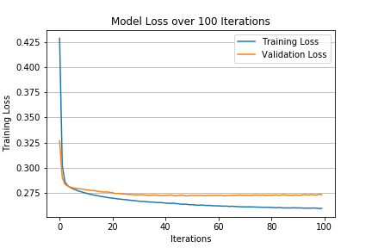
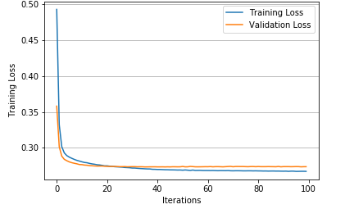
ANN for Stroke Prediction
Artificial Neural Network -- KERAS Sequential Model
Network architecture: [9-10-1]
Dropped Parameters: [ ‘EDUC’ ]
Data scaled before training
Converges at 25 epochs, trained to avoid overfit
Model Accuracy:
Training: 0.9103408765396734
Testing: 0.9076460481099656
Model Loss:
Training: 0.2628566668918706
Testing: 0.27581046362922773

Slide 16
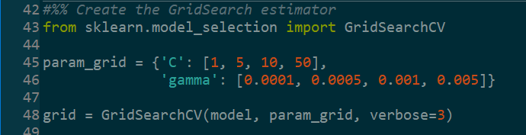
SVM Models for Prediction
C-Support Vector Classification -- SKLEARN SVM Model
GridSearchCV to perform exhaustive parameter search (C, gamma)
All (3) models used { C: 1, gamma: 0.0001 }
Dropped Parameters: [ ‘EDUC‘ ] for CVD
Data scaled before training
Key attribute: probability = True
Model Accuracy (Train/Test):
Angina: 83.6/83.8
CVD: 75.9/74.8
Stroke: 91.0/90.5
Notes:
add diagrams

Slide 17
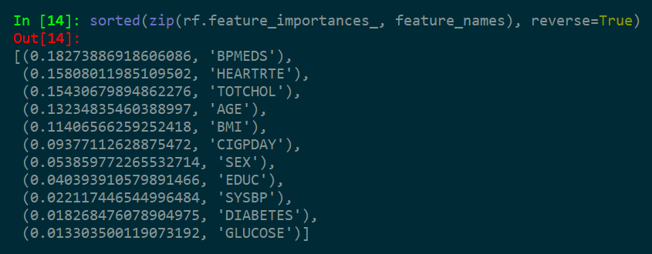
RF Models for Prediction
Random Forest Classifier -- SKLEARN RF Model
n_estimators = 500, # of decision trees
min_samples_leaf = 100, training samples at node
Dropped Parameters: [NONE]
Data NOT scaled before training
Paying attention to feature_importances_
Model Accuracy (Train/Test):
Angina: 83.6/83.8
CVD: 75.9/74.8
Stroke: 91.0/90.5
Notes:
who’s talking data preprocessing?
feature importances

Slide 18
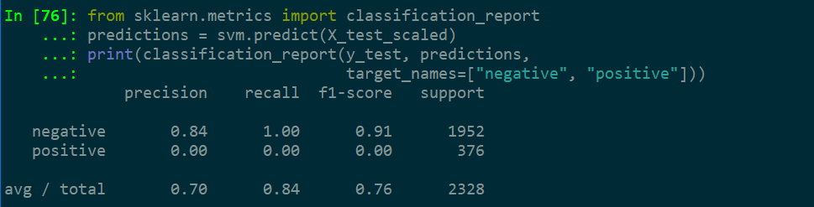
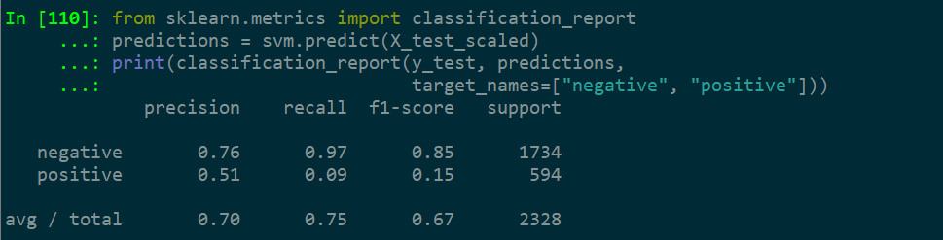

SVM Classification Reports
Angina
CVD
Stroke

Slide 19
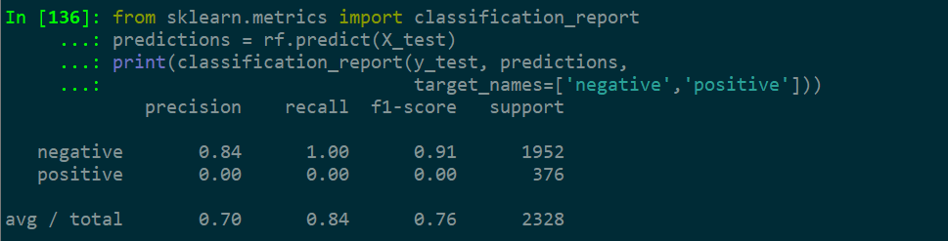
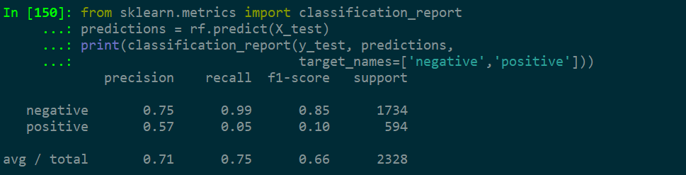
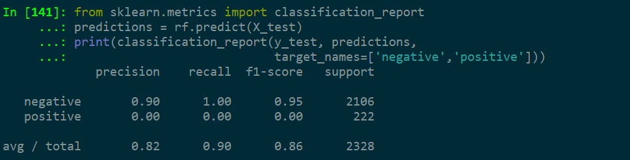
RF Classification Reports
Angina
CVD
Stroke

Slide 20

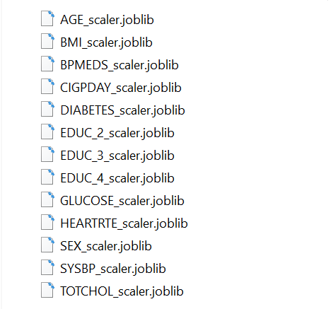
Data Preprocessing
Categorical Encoding:
Original data holds values for [ ‘EDUC’ ] (1 to 4) Dummy-encoded for n–1=3 encoded categories
Original data holds ordinal values for [ ‘SEX’ ] (1 or 2) Label-encoded for integers (0 or 1)
Standard-Scaling:
Transform data distribution N~(μ=0,σ=1)
Necessary for ANN/SVM models
Avoid for RF models
Individual scalers created for each feature

Slide 21
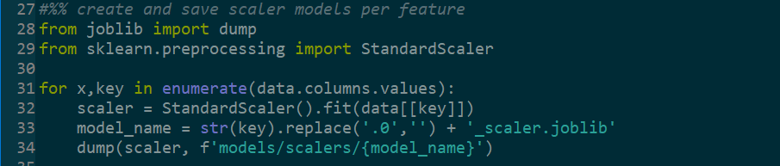
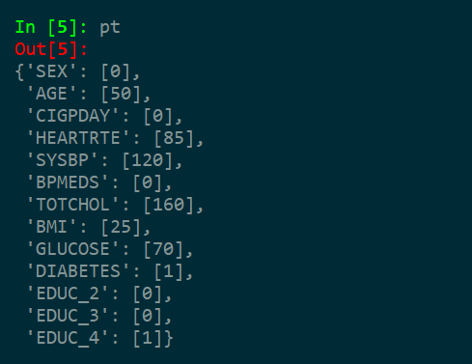
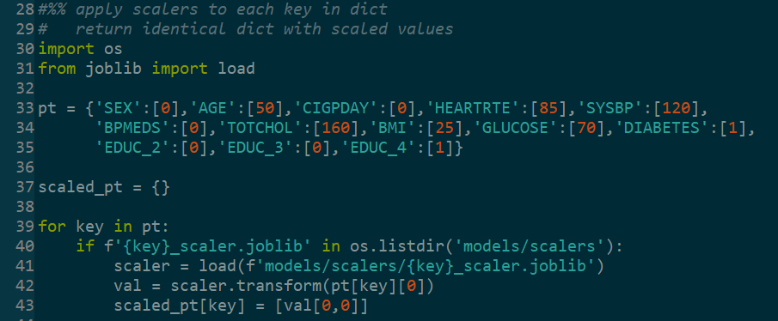
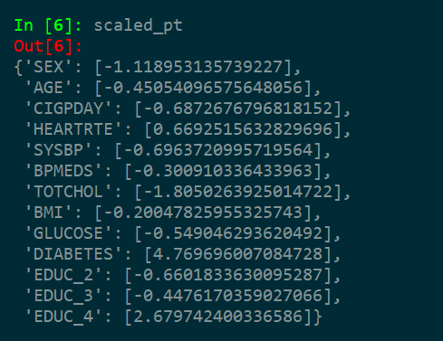
Data Preprocessing

Slide 22


LOGISTIC REGRESSION
3 Steps:
1) LASSO variable selection/ regularization
First, use k-fold CV to get the tuning parameter (lambda)
Then, apply LASSO with our lambda
2) Fit GLM (with logit link function)
3) Further dimension reduction with stepwise selection (with AIC criterion)
When you plug in your own values to the GLM, we get the log odds of a “success”. In order to get the probability of “success”, use inverse of logit on the log odds:

Slide 23
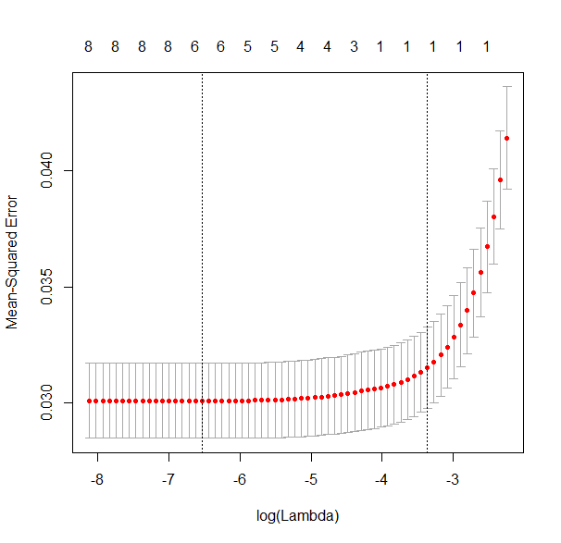
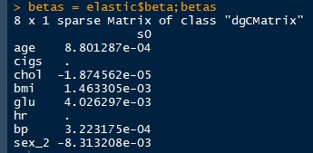
LASSO

Slide 24
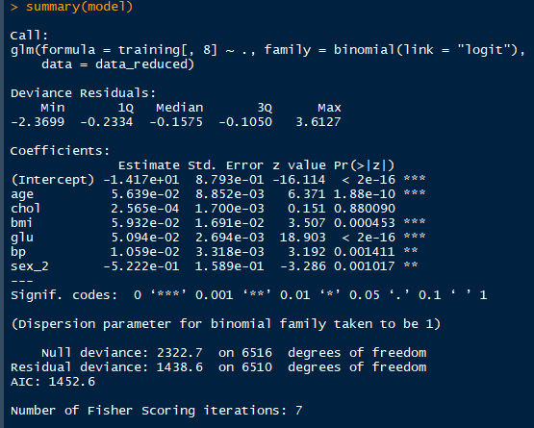
Initial GLM fit

Slide 25
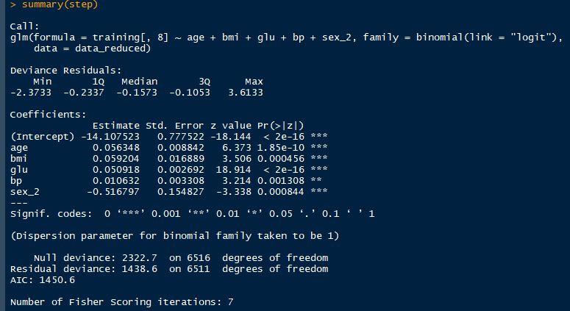
Final Model

Slide 26
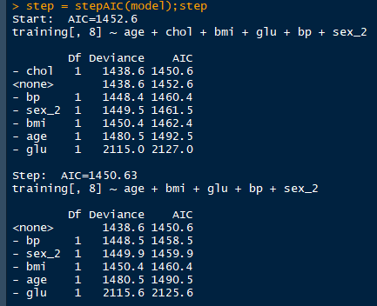
Stepwise Selection

Slide 27
Models
Diabetes (97.5%):
-14.16203 + 0.0590(age) + 0.0583(bmi) + 0.0517(glu) + 0.0094(bp) - 0.3793(female)
Stroke (92.1%):
-7.9184 + 0.0578(age) + 0.0123(cigs) - 0.0026(chol) + 0.0230(bmi) -0.0056(hr) + 0.0201(bp) - 0.14949(female)
Angina (83.5%):
-5.6791 + 0.0252(age) + 0.0056(chol) + 0.0319(bmi) - 0.0061(hr) + 0.0085(bp) - 0.5480(female)
CVD (76.5%):
-7.1657 + 0.0440(age) + 0.0095(cigs) + 0.0032(chol) + 0.0312(bmi) + 0.0045(glu) - 0.0051(hr) + 0.0176(bp) - 0.9816(female)

Slide 28
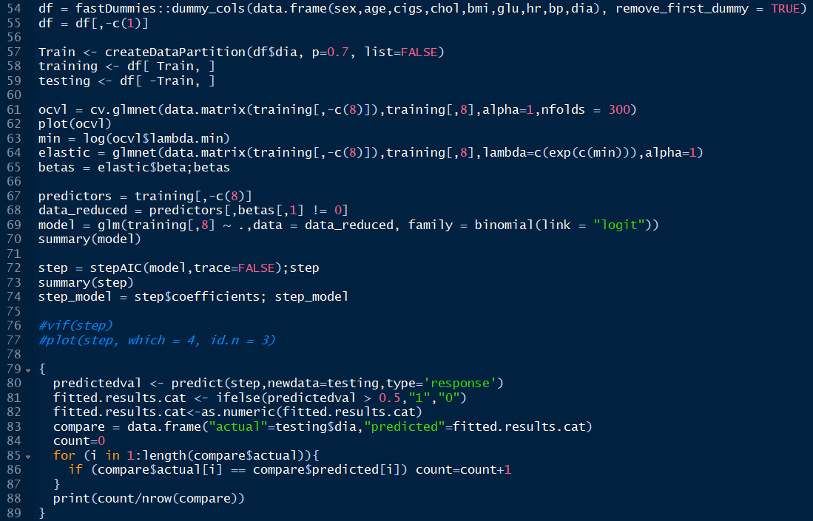
R Code

Slide 29
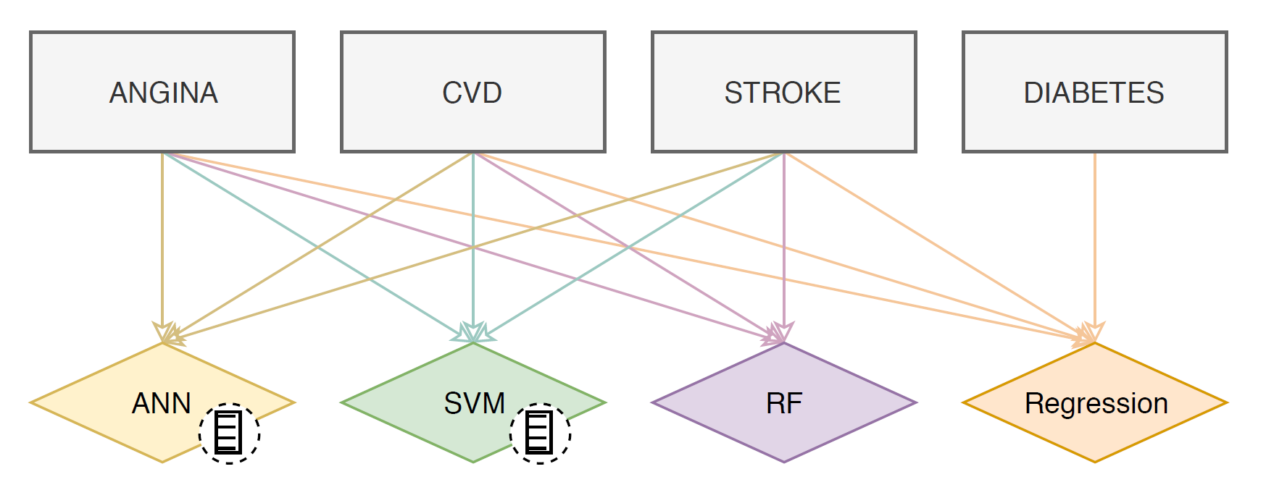
The App
-The application is a user driven app that allows the patient to input a set of health data in an effort to predict the likelihood of a number of health related risks.

