Slide 1
Amazon
Discount Analysis

Slide 2
Assumptions
Discounts margins and Profit margins are directly related.
Maximum discount availed is 30%.

Slide 3
Business objectives
To reduce revenue lost due to discounts by 10%.
Evaluate how discounts margins effect Revenue and Profit.
Recommend discount strategies to improve overall efficiency

Slide 4
Key KPIs
Total Revenue - $32.9M.
Average Order Value - $657.
Total Quantity Sold – 150K.
Discount Percentage of Total Quantity – 83.6%.
Top Category with highest discounted items – Fashion.

Slide 5
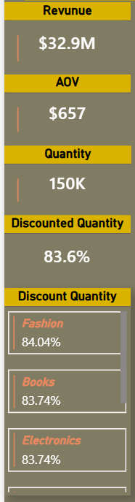
Key findings
Revenue & Volume: Total revenue stands at $5.5M with a total quantity sold of 150K units. The Average Order Value (AOV) is $659.
Discount Penetration: A staggering 83.7% of all quantities sold are discounted. In the Books category specifically, this rises slightly to 83.74%.
Category Performance: Beauty leads in both total quantity and discount totals, followed by Books. Home & Kitchen sits at the bottom of the volume scale.
Discount Distribution: The "Quantity by Discount" donut chart shows an almost perfectly even split across discount slabs (0%, 5%, 10%, 15%, 20%, 30%), each hovering around 2.6% to 2.9% of the total.

Slide 6
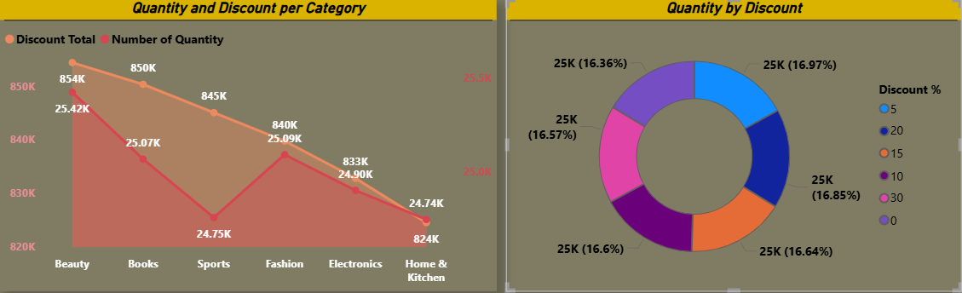
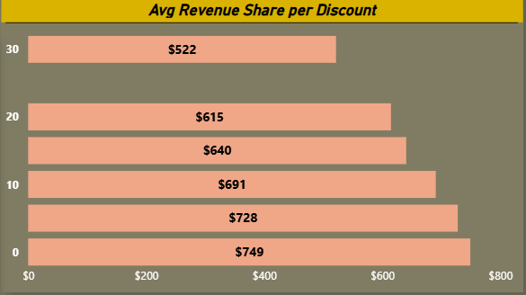
Insights and Patterns
The Price Elasticity Trap: There is a clear inverse relationship between discount depth and AOV. At a 0% discount, the AOV is $749, but it drops to $522 at a 30% discount. This suggests that while higher discounts move volume, they are significantly eroding the premium value of the orders.
Inelastic Categories: Despite different discount levels across categories, the "Quantity and Discount per Category" chart shows that quantities stay within a relatively tight range (824K to 854K in the line chart peaks). This suggests that customers may be buying based on need rather than being heavily swayed to switch categories by the size of the discount.
Discount Slab Efficiency: The "Total Discount by Discount Slab" chart shows that the 30% slab accounts for the highest total discount spend (0.31M), yet it results in the lowest average revenue share.

Slide 7
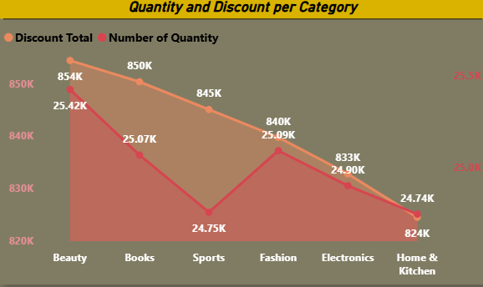
Recommendations- Short term Strategies
AOV Protection: Reduce the frequency of the 30% discount slab, as it yields the lowest revenue share ($522). Shift that promotional budget toward the 10% and 15% slabs, which maintain a healthier AOV (approx. $691–$728).
Category-Specific Bundling: Since Books and Beauty have the highest discount reliance, introduce "Buy One Get One" or "Bundle" offers to increase the number of items per order, helping to offset the high discount rate.
Inventory Clearing: Use the high-volume/high-discount trend in Beauty to aggressively clear slow-moving stock, but keep the discounts capped at 20% to avoid excessive revenue erosion.

Slide 8
Recommendations- Long term Strategies
Loyalty-Driven Full Price Sales: With 83.7% of sales being discounted, the brand risks being perceived as a "discount-only" destination. Implement a loyalty program that rewards full-price purchases with non-monetary perks (early access, exclusive content).
Personalized Discounting: Transition away from "flat" discount slabs across all categories. Use predictive modeling to identify which customers would have purchased at 5% or 10% instead of giving everyone the "default" high discounts.
Premium Category Expansion: Focus on growing the Home & Kitchen and Sports categories through value-based marketing rather than price-based marketing, as these currently show lower volume and higher potential for AOV growth.

