Slide 1
Mizuho UK
December 2024

Slide 2




Mizuho Global – Open Positions
Mizuho Global
Notes
Notes
Notes
Mizuho
UK
Mizuho Japan
Fixed Income
FX
Current Head Count (FT)
12.2
0
3.2
Open Positions
5
3

Slide 3

Mizuho Global – Open Positions
Mizuho Global
Notes
Notes
Notes
Mizuho
UK
Mizuho Japan
Fixed Income
FX
Current Head Count (FT)
12.2
0
3.2
Open Positions
5
3

Slide 4
Mizuho – 1st of May to Dec (2024)
Out of Risk Status
1st May 2024
18th June2024
21 -28
June2024
July
August
October
November
December
Escalation and
SOW’s went
on Hold
Discussion with
Sujit & Jonathan
Training on
Life cycle (Bonds)
New SOW
Opened DevOps
Request For
BA replacement
Starts of the
QA POC framework
Client request
For a QA PoD
SOW for UI & QA
Start
Contr
Appointing Rohan
For facilitation
& Governance
Hand Book on Bonds
For developers
DevOps
replacement
QA & DS
replacement
New BA
Joins
Demo of
QA Framework and
Roadmap
Key Issues during escalation
Lack of business knowledge
Less coordination between team members
Catching up with Kotlin
Project came on notice and SOW’s went on hold.
6 Months Pilot was on a risk
Measures
Domain training targeting Fixed income
Documenting the business on Confluence
More internal team discussions to bring teams together and sync
Project governance
Kotlin trainings and follow ups
Outcomes
Mizuho no longer needs to train Acuity staff
Domain and Developer hand books are on confluence
Daily planning calls and team is in sync
By weekly governance calls
On demand training availability for the team
More growth opportunities

Slide 5
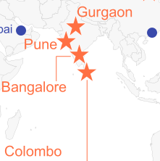
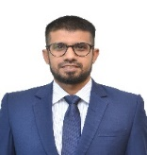


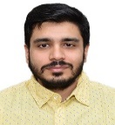



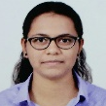
PoD structure – Acuity Merlin Team
Project Sponsors and Reporting
Jonathan
Head of Front Office Technology
DevOps/ UI
Dean
BA
Sujit
Director (Engineering)
Kiran
DevOps
Data Science
Primary escalation point
Rohan
Engineering Manager
BA - Mahanama
Delivery Facilitator
Backend/BA/QA
DevOps
UI: Mridul
QA: Isuru
BackEnd: Sasitha
DS: Navneet
DevOps: Kanika
Gurgaon
Colombo
Colombo
Bangalore
Gurgaon/ Colombo
Current Team locations
3 Member PoD
4 Member PoD
5 Member PoD
2.2 Member PoD
3 Member PoD
New Pods

Slide 6














Mizuho Skills
Backend
Data Science
DevOps
BA, QA Automation
Techstack : Java, Kotlin, Kafka Experts : Sasitha, Miyuru. Chinthaka Ruchira, Niranjan
Techstack : Databricks, Data Science
Experts : Ruchira, Navneet, Aman
Techstack : Azure Cloud, Docker Experts : Kanika, Rahul, Thulitha
Techstack : Project Management,
SQL, RPA Expert: Mahanama
Techstack : Python Experts: Sasitha Niranjana, Miyuru, Ruchira, Navneet, Aman
Techstack : Kubernetes Experts : Sasitha, Miyuru, Ruchira Kanika , Rahul, Thulitha
Techstack : Test Automation, Karate,
Selenium Expert : Isuru
Techstack : Pyspark Experts : Navneet, Aman
Techstack : MongoDB Experts : Sasitha, Miyuru, Chinthaka, Ruchira, Niranjan

Slide 7
Current openings
Fix Income | Status
Data Engineer (Onsite) | L1 Interviews
React Lead (Onsite) | Waiting for Profiles
Senior QA Engineers (3) | HR Process (Hiring)
Senior UI engineers (3) | Finalized
FX Team | Status
Business analyst | Client second round
React Lead | Client second round
Java Lead | Waiting for client

Slide 8
Mizuho UK revenue
Existing PoD's
SOW # | Description | Expected Exp (SOW | Experince | Per Resrouce | # of resources | Annual rate (USD) | Monthly (USD) | Margin
SOW 7 | Tech Lead | 7 | 9 | 75000 | 1 | 75000 | 6250 | 20%
 | Sr Engineer (Backend) | 5 | 9 | 70000 | 4 | 280000 | 23333 | 15%
 | Sr QA | 5 | 12 | 65000 | 1 | 65000 | 5417 | 8%
 | Sr DevOps | 5 | 6 | 72000 | 1 | 72000 | 6000
 | Sr BA | 5 | 15 | 70000 | 1 | 70000 | 5833 | 35%
 | Data Science | 5 | 10 | 75000 | 1 | 75000 | 6250
Total (SOW 7) |  |  |  |  |  | 637000 | 53083
SOW 9 | Sr DevOps | 5 | 3 | 72000 | 1 | 72000 | 6000 | 19%
Total (SOW 9) |  |  |  |  |  | 72000 | 6000
SOW 10 | Sr DevOps | 5 | 7 | 72000 | 1 | 72000 | 6000 | 46%
Total (SOW 10) |  |  |  |  |  | 72000 | 6000
SOW 3 | Data Science | 5 | 10 | 70000 | 1.2 | 84000 | 7000
Total (SOW3) |  |  |  |  |  | 84000 | 7000
Total bill |  |  |  |  |  | 865000 | 72083 | 24%
New PoDs (UI & QA)
UI PoD | Tech Lead |  | 10 | 86000 | 1 | 86000 | 7167 | 23%
 | Sr Engineer (UI) |  | 10 | 80000 | 2 | 160000 | 13333 | 57%
Total (UI PoD) |  |  |  |  |  | 246000 | 20500
QA PoD | Senior Manual Testers |  |  | 72000 | 2 | 144000 | 12000
 | Senior Automation |  |  | 80000 | 1 | 80000 | 6667
Total (QA PoD) |  |  |  |  |  | 224000 | 18667
Total bill for new PoDs |  |  |  |  |  | 470000 | 39167 | 40%
 |  |  |  |  |  |  |  | 32%

Slide 9
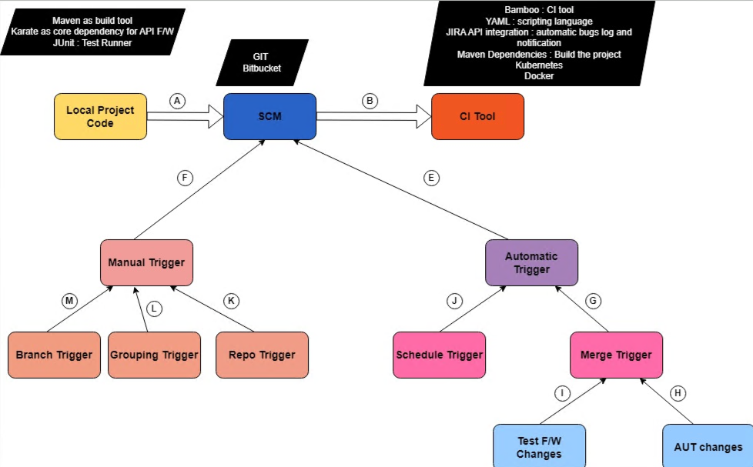
Quality Assurance
Started with 1 FT and won 3FT’s based on the capability and demo
QA Demo
Showcasing how RFQ get mocks and travel through Kafka to web socket layer
Automation capabilities on backend
Show casing the QA practice and roadmap
Mizuho QA practice and how to integrate to the current segments
Java automation engineer?

Slide 10
QA Pod structure
QA Role | Experience level (years) | Responsibility | Skills required
QA Lead (Isuru from Acuity) | 11+ years | Back-end Automation Framework authoring Framework maintenance Scripting Leading and mentoring Team Authoring and overlooking QA practices / Process | Leadership skills Test automation skills QA Practices expertise
Back-End Manual Tester | 5+ Years (Senior QA Engineer) | Manual verification of the back-end Product specifics RESTAPIs related testing GraphQL related testing WebSocket related testing Data persistence related testing (mongo-db, data-bricks & audit logs) ION connectivity components Runs similar components | Back-end testing technical skills (REST / GraphQL / Messaging Ques / Real time data processing) Functional testing Regression testing System testing Non-functional testing Performance testing Security testing
Front-End Manual Tester | 5+ Years (Senior QA Engineer) | Manual verification of the front-end Product specifics Order Management Insights (RFQ / Trax / ISIN) Trader Performance Blotters (Historical / Sales Live / Order) Recent Inventory Algo Settings | Front-end testing technical skills (Blotters / Insights / Algo/ Inventory) Functional testing Regression testing System testing UAT Verification Prod Verification
Automation Tester (SDET) | 5+ Years (Senior QA Engineer) | Front-end Automation Framework authoring Framework maintenance Scripting | Front-end Test automation skills (Selenium / Playwright / Cypress)

Slide 11
Mizuho client visit Jan - Feb
To be discuss with Gopa

Slide 12
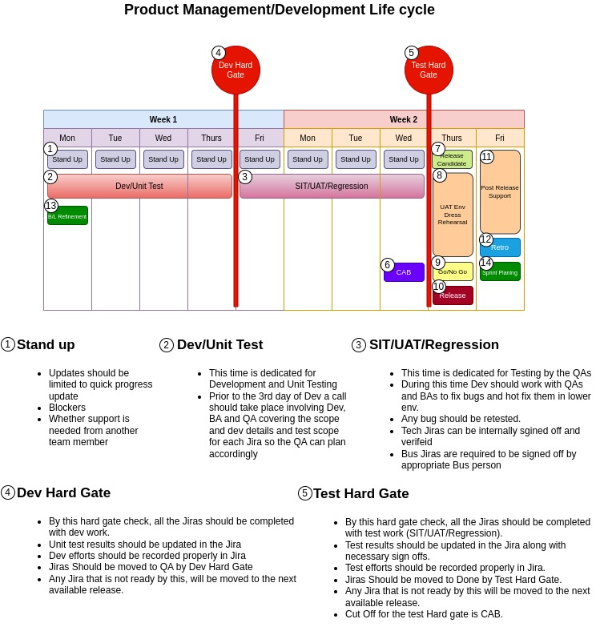
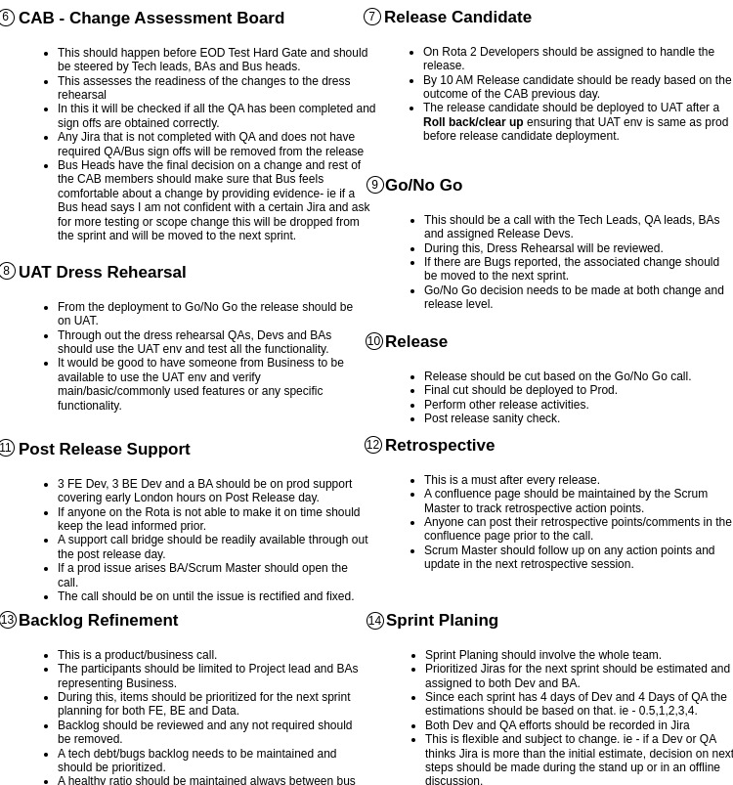
Project management - WIP

Slide 13
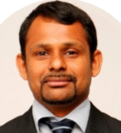
Kavinda Gihan
BA / PM
Dynamic Senior Business Analyst/product manager with extensive experience in platforms related foreign exchange (FX) transactions and investment, leading the development and implementation of business systems across trading, pricing, and risk management functions. Proven ability to gather and analyze complex requirements, streamline processes, and deliver robust technology solutions that enhance operational efficiency in FX markets. Skilled in collaborating with stakeholders to optimize workflows, ensuring alignment between business needs and system capabilities. Adept at managing multi-phase projects, delivering results in fast-paced financial environments, and driving strategic initiatives to improve overall performance and profitability in global markets.
April 2022 – September 2024, HCL Tech – Senior Business Analyst​
Currently working as a Senior Business Analyst for the development of wealth management systems for Avaloq clients.
Leading the mobile development projects for iOS and Android platforms
April 2017 – April 2022, HSBC – Senior Business Analyst – Market Operations (Middle/Back Office)
Experience in handling projects on various accounting, trading and collateral management/ pricing/derivative management platforms. (e.g. Geneva, Business Integrator, Markit EDM and Calypso)·
In depth knowledge of non OTC products/ETDs (Equities, Spot FX, Forward FX, Futures, Options, bonds, TD, CD, CP) OTC products (CDS, CDX, TRS, EIO, FXO, CCS, IRS, Swaptions, Repos/ Rev Repos etc..) and Experience in requirement gathering, Analysis and documentation of client requirements using JIRA.·
Handling testing cycles while following agile methodology by creating test plans, conducting SIT/UAT/Regression testing.·
Knowledge in Agile/waterfall methodologies and maintaining confluence pages.
May 2008 – April 2017, HSBC – FUND ADMINISTRATOR / FUND ADMINISTRATION SUPERVISOR
Trade booking/processing into A&V systems, Valuation, NAV and GAV calculation and supporting the fund accounting process.
Experience in handling trade tickets and trade blotters for Equities, Bonds, Spot FX, Forwards FX, Options, Futures and OTC products.
Having worked with accounting and valuation platforms such as Geneva, ICON and Calypso.
Technical skills: ​
Capital Market change management, BRD, FRD, Requirements elicitation, Jira, Confluence, Avalog, API, Reference data, UAT, SIT, JUAT, Equities, FX, Derivatives, SWIFT, XML, FPML, CSV, SQL, Visio, SDLC, Middle/Back office Investment Banking, OTCs, Pricing, Trade Settlement
Education:
Higher National Diploma In Accountancy- Advanced Technical Institute. Kandy | 2002 – 2006
Master of Business Administration - Cardiff Metropolitan University . UK | 2014 - 2015
Certifications:
Investment Operations - Charted Institute of Securities and Investment (CISI) . UK (2013 & 2015)
Lean Six Sigma Yellow Belt - HSBC

Slide 14
Pod Commercials
 | Roles | Resource Count | Experience as per SOW | Actual experience of the team | Annual Price/ Resource | Monthly Price -Total
Existing Pod/SOW
 | Tech Lead | 1 | 7 | 9 | $ 75,000 | $ 6,250 | Java, Kotlin, Kafka, DevOps, MongDB
 | Backend Engineer | 4 | 5 | 9 | $ 70,000 | $ 23,333
 | BA | 1 | 5 | 15 | $ 70,000 | $ 5,833
 | DevOps | 3 | 5 | 5 | $ 72,000 | $ 18,000
 | Data Science | 1.2 | 5 | 10 | $ 70,000 | $ 7,000 | Includes 20% of BA - Nikita
 | Data science Engineer | 1 | 5 | 10 | $ 75,000 | $ 6,250
 | QA | 1 | 5 | 12 | $ 65,000 | $ 5,417 | Isuru repositioned as Lead
Sub Total |  |  |  |  |  | $ 72,083
Addition to POD/ New SOW - Available from 6th Jan
 | QA - Manual | 2 |  | 10 | $ 72,000 | $ 12,000
 | QA - Automation | 1 |  | 10 | $ 80,000 | $ 6,667
 | UI Lead | 1 |  | 10 | $ 109,049 | $ 9,087 | Price includes 3 months Onshore.
 | UI Engineers | 2 |  | 10 | $ 80,000 | $ 13,333
Sub Total |  |  |  |  |  | $ 41,087
Monthly Total |  |  |  |  |  | $ 113,171
Additional Roles to Consider – Available from 6th Feb
 | UX | 0.25 |  | 5 | $ 82,000 | $ 1,708
 | PMO | 0.25 |  | 8 | $ 76,000 | $ 1,583
Sub Total |  |  |  |  |  | $ 3,292

