Slide 1
FEDERATED IMPROVED RE-FED INCREMENTAL LEARNING WITH SPIKING LONG SHORT-TERM MEMORY NETWORK FOR SMART HEALTHCARE SYSTEMS
G. Sasikala¹ and Dr. G. Kalpana²
¹Assistant Professor, Department of Computer Science, Dr. G. R. Damodaran College of Science, Coimbatore, India
E-mail: sasikala.g@grd.edu.in
² Associate Professor, Department of Computer Science, Sri Ramakrishna College of Arts & Science for Women, Coimbatore, India
E-mail: kalpanacs@srcw.ac.in

Slide 2
IoMT sector evolving rapidly (from wristwatches to airplanes)
Smart Health Care (SHC) uses IoMT, cloud-edge computing, AI
Cloud deep learning uses large memory and high processing cost
FL allows hospitals/edge clients to train together without sharing raw medical data

Slide 3
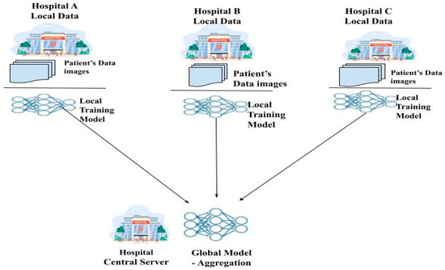
Federated Learning (FL) is a method where many hospitals or devices train one AI model together, but they do not share their real patient data. They share only what the model learned (numbers called weights).
Each hospital/device trains the model inside its own system
After training, it sends only model weights (numbers) to server
Server combines (aggregates) all weights into one global model
Global model goes back to clients for the next learning round

Slide 4
Ref | Method | Limitations
[10] | FedCSCD (Federated Learning + GAN) for collaborative clinical cancer diagnosis | • GAN training introduces high computational cost, unsuitable for low-power edge clients. • Causes communication overhead due to iterative parameter exchange.
[11] | FEDEHR (FL + IoT-based EHR) for cardiac/heart-disease forecasting | • Missing values, noise, and signal distortions in IoT-EHR reduce model stability. • Client heterogeneity impacts global prediction consistency.
[12] | FL + IoT-based HER/EHR shared learning for heart-disease prediction | • Affected by class imbalance and noisy IoT-HER signals. • High communication cost persists for large model updates. • Data heterogeneity lowers merge efficiency.
[13] | SVM classifier + Bi-Directional LSTM encoder for ECG arrhythmia classification in FL | • Bi-LSTM is parameter-heavy, increasing memory and inference latency on edge. • Catastrophic forgetting (CF) risk when adapting to new FL tasks.
[14] | Federated Transfer Learning (FTL) + Adaptive Gradient Clipping (AGC) using wearables, medical devices & HER | • AGC prevents gradient explosion but does not handle: – asynchronous new task arrival – late client updates – malfunctioning client contributions. • Client data heterogeneity still biases model merge.
[15] | Deep CNN + Explainable AI (XAI) for arrhythmia classification supporting clinical decisions in FL | • CNN increases server-client communication payload. • XAI improves interpretability but does not suppress faulty/late updates. • Assumes synchronized learning, limiting real-world edge-FL.
[16] | FedCure (IoMT-aware intelligent federated healthcare framework considering heterogeneity) | • Heterogeneity support exists but malfunctioning or asynchronously-arriving clients are not managed. • Unseen tasks arriving at different times remain unaddressed.
[17] | FL integrating Spiking Neural Network (SNN) + LSTM for fully supervised human activity detection | • Spiking loops add latency and energy overhead. • LSTM component still remains heavy for edge inference. • No fault-aware or async client update handling.
[18] | Federated LSTM (F-LSTM) for privacy-preserved distributed training | • Large parameter size → high memory, latency, and power draw on edge. • Communication overhead remains high due to frequent weight sharing.
[19] | Spiking RNN (SRNN) with fully differentiable events | • Requires recurrent spiking run-loops, increasing edge compute cost. • No support for malfunctioning, late or asynchronous client updates.
[20] | Federated Class-Incremental Learning (FICL) allowing new clients with unseen classes to join anytime | • Enables unseen client joins but not fault-aware. • No handling for asynchronous task arrival or malfunctioning client weights.
[21] | FIL with random client sample sampling to maintain initial FL pre-training balance | • Balances early rounds only; temporal priority over updates is absent. • Malfunctioning or delayed updates still not managed.
[22] | FedRCIL (Federated Knowledge Distillation + Contrastive Incremental Representation Learning) | • Scalable but assumes synchronized incremental learning. • Faulty or late client updates are ignored.
[23] | pFedDIL (Personalized Federated Domain-Incremental Learning) | • Personalized task selection, but no suppression or validation for faulty/late/async updates. • Malfunctioning clients and unsynchronized new tasks are not supported.
[24] | FFSCIL (Federated Few-Shot Class-Incremental Learning) for CF under data scarcity | • Solves CF under scarcity, but does not manage: – malfunctioning clients – late updates – asynchronously-arriving tasks – temporal weighting for faulty update suppression.

Slide 5
Problem 1 — High computation + cost of centralized training
Smart healthcare systems collect huge data from wearables/IoMT devices.
Training DL models in cloud is memory and computation heavy, creating processing expense and privacy risk.
Need: train collaboratively without sharing raw health data.
Problem 2 — Catastrophic Forgetting (CF)
When models learn new data/tasks, they forget old knowledge, reducing accuracy on previous disease patterns.
Problem 3 — Asynchronous / faulty client updates
In traditional Re-Fed Federated Incremental Learning:
Clients receive new tasks/data at different times
Some devices may be faulty or malfunctioning
Server aggregation does not handle time inconsistency
→ Result: desynchronized learning, model divergence, CF increases

Slide 6
Catastrophic Forgetting | Model forgets old Samples when learning new ones
LSTM heavy for edge | Normal LSTM is slow and consumes more energy in small healthcare computers
Late/Faulty updates | Server merges all weights equally, even if updates are outdated or faulty → model becomes unreliable

Slide 7
Why new model is proposed?
Need a better system that:
remembers old disease knowledge with small memory
handles late and faulty client updates
trains fast for real-time healthcare
reduces computation cost, latency, and energy
protects privacy laws by keeping medical data at source

Slide 8
Proposed Work
Model = FIRFIL – TISSLSTM
FIRFIL = Federated Improved Re-Fed Incremental Learning Framework
  Uses temporal weighted aggregation at server to handle outdated/faulty updates
  Merges client knowledge based on timing + quality importance
TISSLSTM = Time-Invariant Stochastic Spiking LSTM Network
  LSTM memory for sequence learning
  Spiking neurons using stochastic (probability-based firing) to reduce computation
  Time-invariant internal rule → enables faster or partly parallel training

Slide 9
Why new model?
To make the system:
Remember old knowledge (using caching)
Train faster and use less energy than normal LSTM
Reduce the impact of late/faulty updates during FL merging
Support real-time diagnosis in hospitals and wearables (edge)

Slide 10
New Model and Framework
Proposed Model = TISSLSTM
A hybrid model that learns sequential health signals, uses spiking neurons efficiently, and avoids repeated spiking loops using time-invariant design.
Proposed Framework = FIRFIL
An improved Federated Incremental Learning system where each client stores only important old samples (caching) and the server merges weight updates by giving importance to recent good updates (temporal weighting).

Slide 11
New Methodology
Method = FIRFIL + TISSLSTM
Client side learning:
Train on one patient sample at a time
Compute gradients and measure importance
Store only Top-M important past samples into local cache so old diseases are not forgotten
Server side merging:
Collect only weight numbers from clients
Give more importance to recent good updates, reduce late/faulty ones, merge all using weighted FedAvg

Slide 12
Dataset Used
Dataset
Comprehensive Heart Dataset – 1190 cases, 11 features
UCI Heart Disease Dataset – binary 1/0
Kaggle Heart Disease Dataset – 14 selected features

Slide 13
Performance Results
:
Accuracy: 95.09% – 95.25% – 94.28% on 3 heart datasets
Latency: ~160 ms (very fast for real-time use)
Energy: 80–90 Joules (light for edge healthcare)

Slide 14
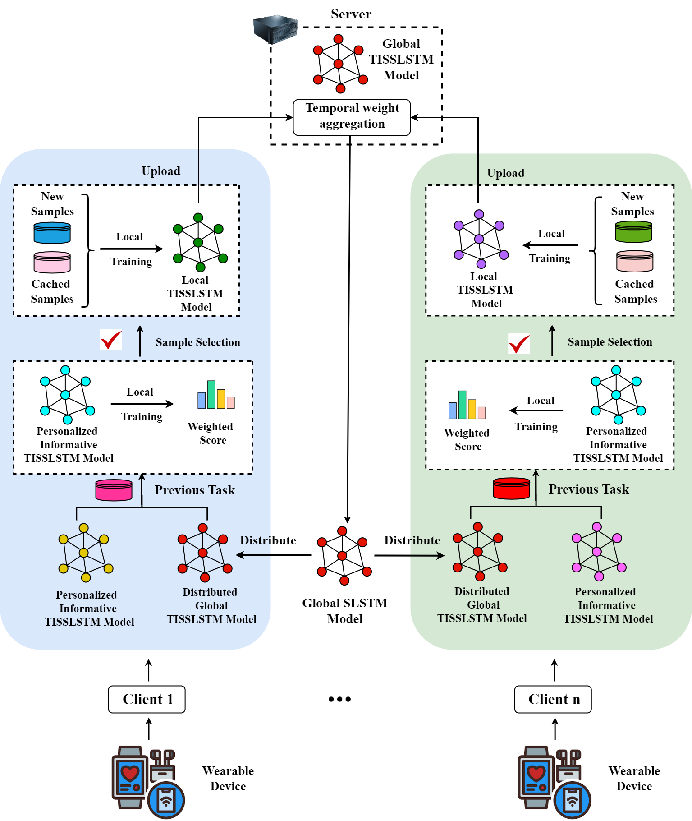

Slide 15
At client side (hospitals or IoMT edge computers):
Each client trains the TISSLSTM model locally, using its own patient samples.
During early training epochs, gradients are computed for each sample and the gradient norm is measured as the importance score for that sample.
Old samples are ranked using that score and only the Top-M important ones are saved in a tiny cache (because devices cannot store everything).
→ This saves memory and prevents forgetting old disease knowledge.
After training, clients send only the final learned weight number vector + timestamp to the fog/aggregation layer or cloud/server.

Slide 16
t server side:
The server receives only client weights and their time of update.
It does NOT merge equally like old FedAvg.
It applies temporal weighted FedAvg aggregation, meaning:
  recent & consistent updates get more importance
  late or inconsistent client updates get less importance
  → This protects the global model from outdated or faulty information
The improved global model is sent back to clients for the next training round or real disease prediction.

Slide 17
Server combines those numbers using a rule called:
Temporal Weighted Federated Averaging (Weighted FedAvg)
Latest correct updates get more weight
Late or faulty updates get less weight
→ This keeps the global model reliable and up-to-date
After merging, server sends back the new global model to Fog/Edges, as updated weight numbers

Slide 18
Initial weights are random numbers from server
Training uses Cross-Entropy loss → Gradients → Gradient norms
Local weight update uses Gradient Descent by Backpropagation
Old important samples are selected using Gradient Norm Ranking → Top-M caching
Server merging uses Temporal Weighted FedAvg Aggregation
Only model update numbers (weights) are transmitted, never raw medical data

Slide 19
UCI Heart Disease Dataset → 14 mixed numeric + categorical features, target = 1/0
Comprehensive Heart Disease Dataset → 11 features, 1190 cases, merged from 5 heart datasets
Kaggle Heart Disease Dataset → 76 features, 14 used, target = 1/0
Dataset Description (UCI Heart Disease Dataset)
Variable Name | Type
Existence or Nonexistence of Cardiac Disease (Target variable) | Integer
Age | Integer
Chest Pain Type | Categorical
Serum Cholesterol | Integer
Angina Induced by Exercise | Categorical
Fasting Glucose Level | Categorical
Peak Heart Rate Attained | Integer
Number of Major Vessels | Integer
Previous peak (ST segment depression elicited by activity compared to rest) | Integer
Resting Blood Pressure | Integer
Resting Electrocardiographic Results | Categorical
Gender | Categorical
Slope of the Peak Exercise ST Segment | Categorical
Thalassemia | Categorical

Slide 20
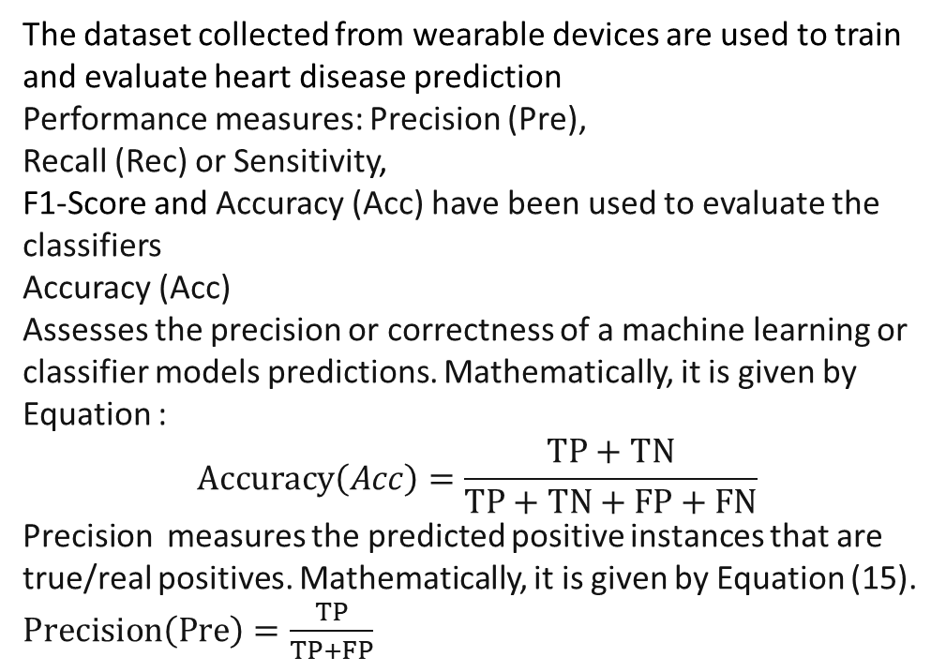
Performance Analysis
The dataset collected from wearable devices are used to train and evaluate heart disease prediction
Performance measures: Precision (Pre),
Recall (Rec) or Sensitivity,
F1-Score and Accuracy (Acc) have been used to evaluate the classifiers
Accuracy (Acc)
Assesses the precision or correctness of a machine learning or classifier models predictions. Mathematically, it is given by Equation :
$$Accuracy\left(Acc\right)=\frac{TP+TN}{TP+TN+FP+FN}$$
Precision measures the predicted positive instances that are true/real positives. Mathematically, it is given by Equation (15).
$Precision\left(Pre\right)=\frac{TP}{TP+FP}$

Slide 21
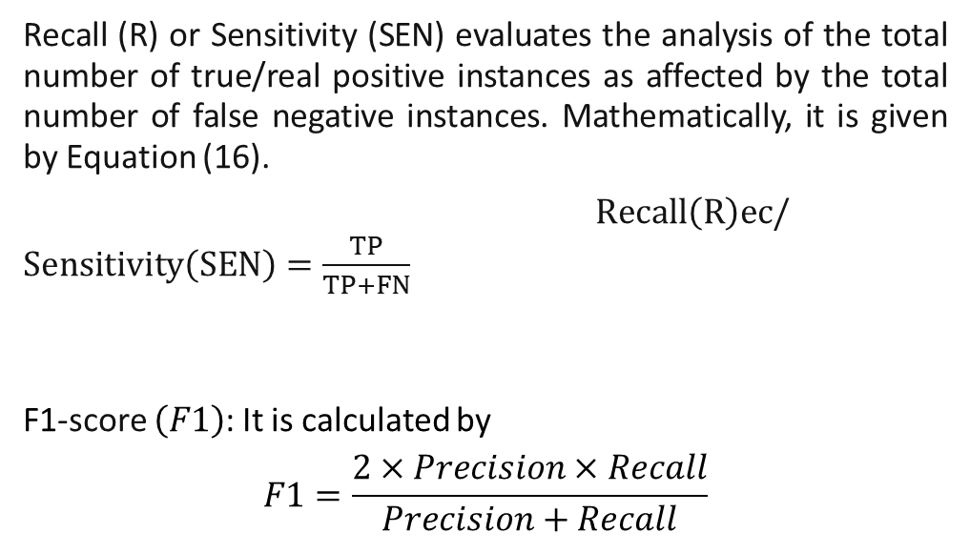
Recall (R) or Sensitivity (SEN) evaluates the analysis of the total number of true/real positive instances as affected by the total number of false negative instances. Mathematically, it is given by Equation (16).
$Recall\left(R\right)ec/Sensitivity\left(SEN\right)=\frac{TP}{TP+FN}$
F1-score $\left(F1\right)$: It is calculated by
$$F1=\frac{2×Precision×Recall}{Precision+Recall}$$

Slide 22
Table 3. Performance analysis of proposed and standard models on three dataset
Dataset | Metrics | Models
 |  | LSTM | Bi-LSTM | S-LSTM | I-LSTM | TISSLSTM
Comprehensive Heart Disease Dataset | Acc | 82.75 | 85.49 | 88.67 | 94.28 | 96.12
 | Pre | 81.33 | 83.01 | 86.52 | 92.19 | 94.88
 | Rec | 80.6 | 83.95 | 87.18 | 93.43 | 95.57
 | F1 | 81.81 | 84.69 | 87.97 | 93.24 | 95.09
UCI Heart Disease Dataset |  | LSTM | Bi-LSTM | S-LSTM | I-LSTM | TISSLSTM
 | Acc | 80.12 | 84.05 | 88.37 | 91.48 | 95.33
 | Pre | 82.62 | 86.64 | 90.13 | 94.24 | 96.24
 | Rec | 81.07 | 87.59 | 89.47 | 92.06 | 94.74
 | F1 | 83.27 | 85.25 | 89.67 | 92.06 | 95.24
Kaggle Heart Disease Dataset |  | LSTM | Bi-LSTM | S-LSTM | I-LSTM | TISSLSTM
 | Acc | 81.67 | 86.43 | 89.65 | 91.43 | 94.28
 | Pre | 80.23 | 87.56 | 91.28 | 94.29 | 95.65
 | Rec | 82.52 | 85.12 | 89.17 | 90.14 | 96.14
 | F1 | 83.07 | 86.32 | 89.49 | 92.75 | 94.28

Slide 23
Dataset | Metrics | Models
 |  | FedRCIL | FedDIL | FFSCIL | Re-Fed | FIRFIL
Comprehensive Heart Disease | Energy Consumption (J) | 120.4 | 114.8 | 110.3 | 102.6 | 89.7
UCI Heart |  | 105.2 | 99.6 | 95.1 | 91.4 | 80.3
Kaggle Heart |  | 112.7 | 108.2 | 104.5 | 98.3 | 86.1
Comprehensive Heart Disease | Latency (ms) | 235.6 | 222.1 | 210.4 | 198.2 | 173.8
UCI Heart Disease |  | 218.3 | 205.7 | 198.9 | 187.6 | 162.5
Kaggle Heart |  | 225.0 | 212.6 | 202.3 | 191.9 | 168.4
Table 4 Analysis of Energy Consumption and Latency for proposed and standard models

Slide 24
Model | ATA (%) | TT (s) | IT (s) | ATA (%) | TT (s) | IT (s) | ATA (%) | TT (s) | IT (s) | ATA (%) | TT (s) | IT (s)
 | M = 500 |  |  | M = 1000 |  |  | M = 1500 |  |  | M = 2000
FedRCIL | 32.5 | 315.7 | 115.3 | 29.8 | 621.2 | 233.3 | 25.4 | 933.1 | 411.5 | 21.4 | 1245.9 | 778.9
FedDIL | 33.9 | 298.2 | 127.6 | 32.2 | 590.5 | 220.1 | 28.1 | 880.4 | 397.6 | 23.50 | 1190.3 | 674.1
FFSCIL | 36.5 | 275.8 | 143.9 | 35.0 | 555.3 | 208.4 | 30.6 | 833.6 | 366.7 | 26.8 | 1132.8 | 668.9
Re-Fed | 39.2 | 248.6 | 129.8 | 38.9 | 497.5 | 187.6 | 33.3 | 750.2 | 315.3 | 28.7 | 1016.9 | 602.4
FIRFIL | 41.7 | 210.4 | 133.4 | 40.4 | 425.9 | 160.8 | 35.6 | 640.1 | 308.6 | 30.22 | 875.2 | 552.6
Table 5 Computational Metrics Evaluation of 20 clients (Exemplary memory size M, incremental task T= 20)
*(Average Test Accuracy = ATA (all dataset); Training Time (TT); Inference Time (IT); Seconds (s))

Slide 25
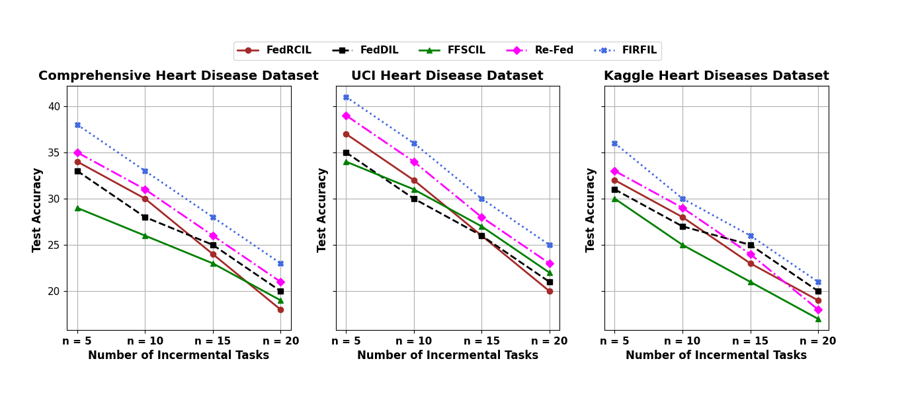

Slide 26
CONCLUSION
The experimental results prove that the proposed FIRFIL–TISSLSTM model achieves high accuracies of 95.09%, 95.25%, and 94.28% on the Comprehensive, UCI, and Kaggle heart disease datasets respectively, outperforming existing FL and incremental models. Additionally, the model records low energy usage of 89.7 J, 80.3 J, and 86.1 J, and fast response times (latency) of 173.8 ms, 162.5 ms, and 168.4 ms on the same datasets, demonstrating low computation delay and improved real-time capability. T

Slide 27
When M is small → training is faster
inference is okay
accuracy is a bit higher
When M increases → training becomes slower
inference becomes slower
accuracy drops
Because storing too many samples introduces data imbalance and overhead
It increases noise and model coordination delay
Comparison with other models
older models (FedRCIL, FedDIL, FFSCIL, Re-Fed, FedDIL etc.) also get slower when M grows, but FIRFIL:
is faster than others in training rounds
has better global reliability by avoiding equal merging of bad/late updates
performs best in balanced ATA, TT, and IT trade-off

Slide 28
FL provides privacy-safe hospital collaboration
Re-Fed addressed forgetting but not faulty/late updates
FIRFIL improves merging using time-weighted FedAvg
TISSLSTM reduces computation using probabilistic spiking, fixed time-invariant rule, and LSTM memory
Results prove:
✔ high accuracy
✔ lower computation cost
✔ lower latency
✔ lower energy
Enables real-time SHC disease prediction on edge/IoMT clients

Slide 29
An Enhanced Hierarchical Federated Incremental Learning Network for Smart
Healthcare Systems Using Spiking Long Short-Term Memory

Slide 30
Top Level — Central Server / Cloud
Holds the global TISSLSTM model
Receives only numbers from Fog/Edge hubs
  These numbers are: model weights, gradients, and importance scores
Server combines those numbers using a rule called:
Temporal Weighted Federated Averaging (Weighted FedAvg)
  Latest correct updates get more weight
  Late or faulty updates get less weight
  → This keeps the global model reliable and up-to-date
After merging, server sends back the new global model to Fog/Edges, as updated weight numbers

Slide 31
Middle Level — Fog / Edge Hubs
Acts as a group aggregator
Each hub:
  Receives only numbers from its clients (local hospitals/IoMT devices)
  Combines those numbers into a single cluster update
  Forwards the cluster’s final weight vector numbers to the server
  Receives the improved global model numbers from server
  Distributes only those updated model numbers back to its clients

Slide 32
Clients train on real data
↓ send only weight/gradient/importance numbers
Fog aggregates client numbers into 1 cluster update
↓ send only those cluster weight numbers
Server merges fog updates using Temporal Weighted FedAvg
↓ send back only improved model numbers
Fog distributes global model numbers to clients
↓ clients personalize & continue next round

Slide 33
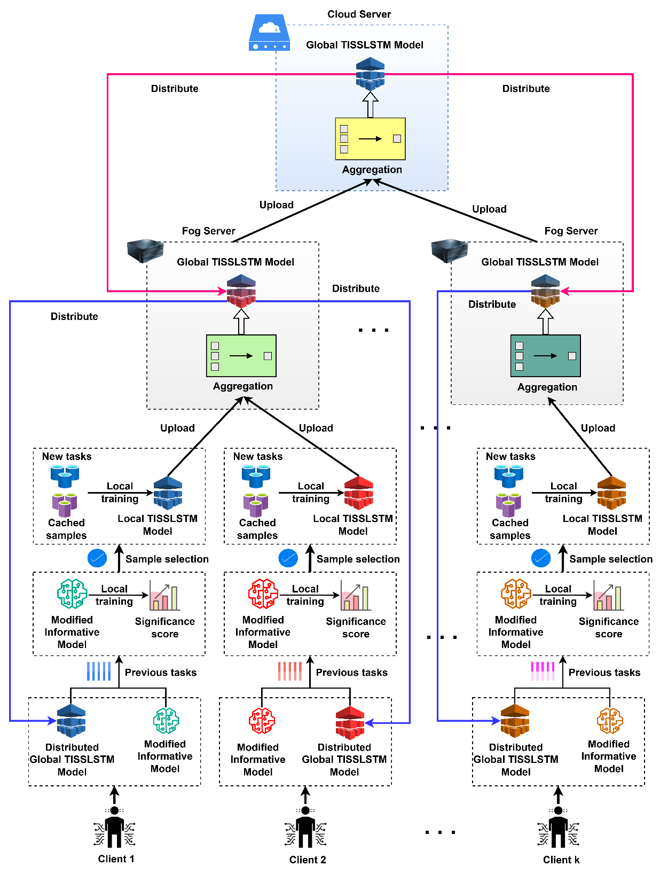

Slide 34
Dataset | Use cases | Sample size | Attributes | Classes | Clients | Group aggregators
Body performance | Remote health monitoring | 13394 | 11 | 4 | 100 | 10
Diabetes | Diabetes monitoring | 769 | 8 | 2
Details about Datasets Used

Slide 35
Dataset | Metrics (%) | Models
 |  | BO-SWNF | Dense-DNN | Mu-LSTM | Conv-BiLSTM | TISSLSTM
Diabetes | Accuracy | 81.97 | 84.63 | 87.01 | 89.85 | 92.72
 | Precision | 80.81 | 83.60 | 86.14 | 88.53 | 91.96
 | Recall | 81.66 | 84.51 | 86.98 | 89.70 | 92.65
 | F1-score | 81.24 | 84.06 | 86.56 | 89.12 | 92.31
Body performance | Accuracy | 80.88 | 83.45 | 86.03 | 88.67 | 91.59
 | Precision | 80.05 | 82.67 | 85.49 | 87.92 | 90.84
 | Recall | 80.83 | 83.31 | 86.00 | 88.64 | 91.40
 | F1-score | 80.44 | 82.99 | 85.75 | 88.28 | 91.12
Evaluation of Proposed TISSLSTM with Existing DL Models

Slide 38
Dataset | FedEHR | FedCure | FDEIoL | Re-Fed | EHFIL
 | Energy Consumption (J)
Diabetes | 89.3 | 84.8 | 80.4 | 76.1 | 72.5
Body performance | 97.9 | 93.6 | 91.0 | 88.3 | 84.8
Dataset | Latency (ms)
Diabetes | 201.2 | 193.7 | 186.3 | 179.6 | 167.0
Body performance | 210.6 | 200.4 | 195.8 | 187.3 | 175.7
Evaluation of Energy Consumption and Latency for Proposed with Existing FL Algorithms

Slide 39
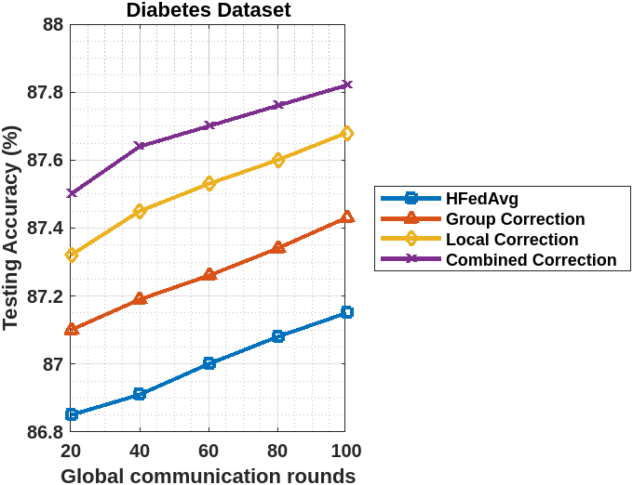

Slide 40
Testing Accuracy of Different FL Algorithms with respect to Data Heterogeneity (𝛼) for Different Datasets

