Slide 1
DIGITAL MARKETING MINOR PROJECT
SEO AUDIT REPORT
Billionaire Hair Salon, Salem
Submitted by:
BOOMIKAA Academic Year: 2025–2026

Slide 2
CERTIFICATE OF COMPLETION
Thisisto certify that the project report entitled"SEO Audit - Billionaire Hair Salon, Salem" submitted by BOOMIKAA in partial fulfillment of the requirements for the Digital Marketing Minor Project is a bonafide record of work carried out by her under guidance.
_____________________

Slide 3
DECLARATION
Iherebydeclare that the project entitled "SEO Audit - Billionaire Hair Salon, Salem" submitted for the Digital Marketing Minor Project is an original work done by me during the academic year 2025–2026 under the supervision of faculty guide.
Date: _____________ Place: Salem
BOOMIKAA

Slide 4
TABLE OF CONTENTS
Page 1 Page 2 Page 3 Page 4 Page 5 Page 6 Page 7 Page 8 Page 9 Page 10 Page 11 Page 12 Page 13 Page 14 Page 15 Page 16 Page 17 Page 18
CoverPage
Certificate
Declaration
Table of Contents
Introduction
Objectives & Methodology
About the Business
Technical SEO Audit
On-Page SEO Audit
Keyword Gap Analysis
Content Audit
Page Speed Analysis [Image 5]
Keyword & Backlink Profile [Image 6]
Competitor Comparison Table
Local SEO Gap Analysis
Google My Business (GMB) Audit [Image 7] Website Wireframe & Recommendations [Image 8] Conclusion & 6-Month Roadmap

Slide 5
PAGE 5: INTRODUCTION
Understanding Search Engine Optimization (SEO)
SearchEngineOptimization(SEO)isthe practice ofoptimizing web pages and online presence to improve visibility and organic ranking on search engine result pages (SERPs). Over 93% of online experiences begin with a search engine query.
Importance of Local SEO for Businesses in Salem
Forlocalized retail andservicebusinessessuch as salons, Local SEO plays a crucial role. Customers actively search for terms like 'hair salon near me' or 'best salon in Salem'. A robust local online presence ensures high digital footfall, conversion rates, and brand dominance in targeted geographical regions.

Slide 6
PAGE 6: OBJECTIVES & METHODOLOGY
Project Objectives
• Auditthe existingdigital footprint and web presence of Billionaire Hair Salon.
• Identify critical technical, on-page, and local SEO errors hindering performance.
• Formulate actionable recommendations and solutions to establish search dominance.
Audit Methodology & Tools Used
To conductacomprehensive digitalaudit, industry-standard audit tools were utilized:
1. Google PageSpeed Insights: Mobile and desktop site performance diagnostics.
2. Ubersuggest & SEMrush: Keyword gap identification, search volume analysis, and backlink auditing. 3. Google Maps & GMB Insights: Local map pack visibility and profile completeness.
4. Screaming Frog (Free Tier): Technical web crawling and page element identification.

Slide 7
PAGE 7: ABOUT THE BUSINESS
Business Overview
Business Name: BillionaireHair Salon
Location: Gugai, Salem, Tamil Nadu
Core Services: Haircut, Hair Colour, Keratin Treatments, Styling, and Beauty Services
Target Audience: Women aged 18–35 looking for premium hair and aesthetic services
Current Digital Footprint
Currently, BillionaireHairSalonlacks a dedicated, self-hosted functional website. The business relies solely on a basic third-party Justdial business listing, severely limiting organic discoverability, brand trust, and digital conversion potential.

Slide 8
PAGE 8: TECHNICAL SEO AUDIT
Technical Audit Findings
Thetechnicalaudit revealedfundamental infrastructure deficiencies that prevent search engines from crawling, indexing, and ranking the business effectively:
• Missing HTTPS Security: The current Justdial link lacks custom secure protocol implementation.
• Absence of XML Sitemap: No http://sitemap.xml found to guide search engine crawlers.
• Missing Robots.txt File: Absence of http://robots.txt leads to unguided web crawling.
• Unoptimized URL Structure: URLs are not SEO-friendly and lack target local keywords.

Slide 9
PAGE 9: ON-PAGE SEO AUDIT
On-Page Critical Findings
• Title Tag: Generic 'HairSalon' tagwithout regional keyword attachment (e.g., missing 'Salem').
• Meta Description: Completely missing metadata, reducing search engine click-through rates (CTR). • Heading Hierarchy: Complete absence of structured H1 and H2 heading tags.
• Image Alt Text: Images lack alternative text attributes for search indexing and accessibility.
• Thin Content: Page contains roughly 50 words total, far below minimum contextual indexing standards.

Slide 10
PAGE 10: KEYWORD GAP ANALYSIS
Keyword Misses & Search Volumes
BillionaireHairSaloncurrentlyranksforzerotarget keywords in the Salem regional market. Major uncaptured high-intent keyword opportunities include:
1. 'best hair salon in Salem' — Monthly Search Volume: 1,300 (1.3K)
2. 'bridal makeup Salem' — Monthly Search Volume: 880
3. 'keratin treatment Salem' — Monthly Search Volume: 720
Competitor Search Positioning
Directcompetitor 'Naturals Salem'currentlyoccupies top positions (Positions 1–3) across all targeted high-volume local keywords, capturing the vast majority of search traffic.

Slide 11
PAGE 11: CONTENT AUDIT
Content Vulnerabilities
• Absence ofEducational Content: No official blog section to target informational search queries.
• Missing Service Pages: Lacks detailed individual landing pages for specialized hair/beauty services.
• No Visual Proof: Absence of before-and-after transformations gallery.
• Lack of Customer Guidance: No Frequently Asked Questions (FAQs) section to capture voice search. • Duplicate Content: Relying on duplicate description text scraped directly from Justdial directories.

Slide 12
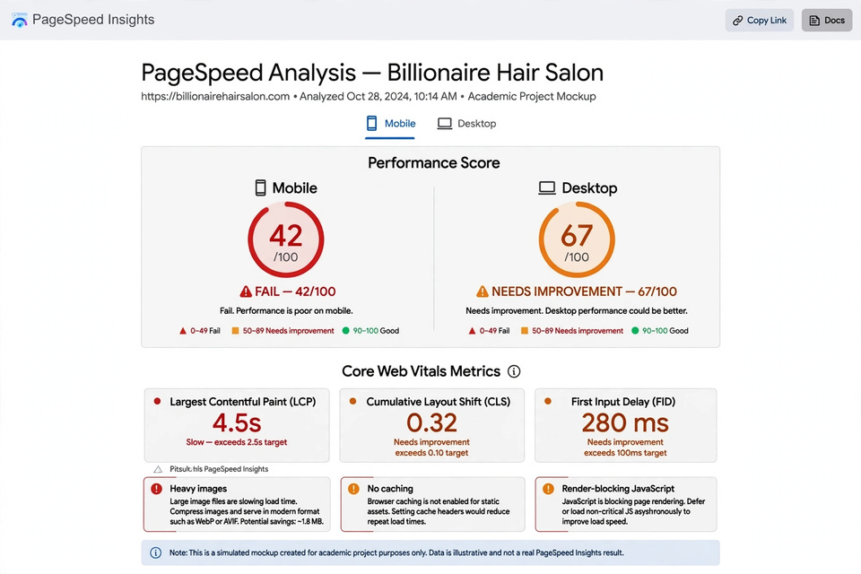
PAGE 12: PAGE SPEED ANALYSIS
Performance Diagnostics
Mobile PerformanceScore:42 / 100(STATUS: FAIL)
Largest Contentful Paint (LCP): 4.5 seconds (Threshold: < 2.5s)
Root Causes & Remediation
Theslow page load is primarilydrivenby uncompressed heavy images and un-optimized script loading. Recommended fixes include compressing images to WebP formats, implementing browser caching, and deferring non-essential scripts.

Slide 13
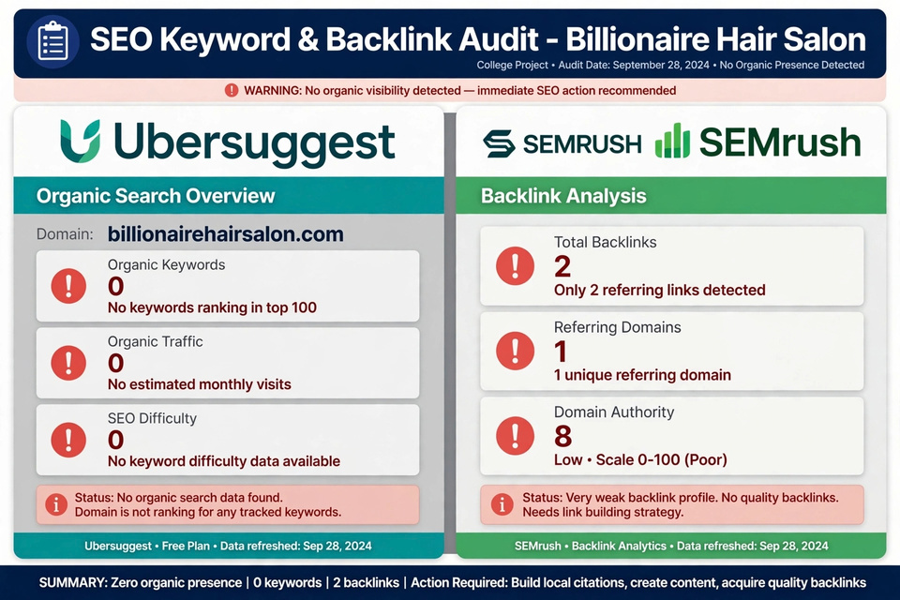
PAGE 13: KEYWORD & BACKLINK PROFILE
Authority & Link Metrics
• Organic Ranking Keywords: 0
• Total Backlinks: 2 (Low Quality / Directory Listings)
• Domain Authority (DA): 8 / 100 (Very Low)
The search authority profile is critically weak, making it virtually impossible to rank against established market leaders without intentional link building and authority development.

Slide 14
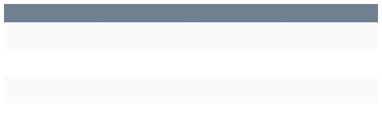
PAGE 14: COMPETITOR COMPARISON TABLE
Benchmarking Against Regional Leaders
Feature / Metric
Billionaire Salon
Naturals Salem
Yes (Salem Keywords)
Green Trends
Yes (Salem Keywords)
SEO Title
No (Unoptimized)
GMB Photos
0 Photos
120+ Photos
90+ Photos
Backlinks
2 Backlinks
450 Backlinks
300 Backlinks
Reviews Rating
0 Reviews
4.5
★
(800+ Reviews)
4.3
★
(500+ Reviews)

Slide 15
PAGE 15: LOCAL SEO GAP ANALYSIS
Google Business Profile Gaps
• Inactive Updates: No GoogleMyBusiness (GMB) posts or promotional updates.
• Missing Q&A: Absence of community Q&A elements to clarify service questions.
• No Appointment Link: Missing direct link integration for booking customer slots.
• Map Pack Absence: Lacks inclusion in Google Local Top 3 Map Pack for Salem searches.

Slide 16
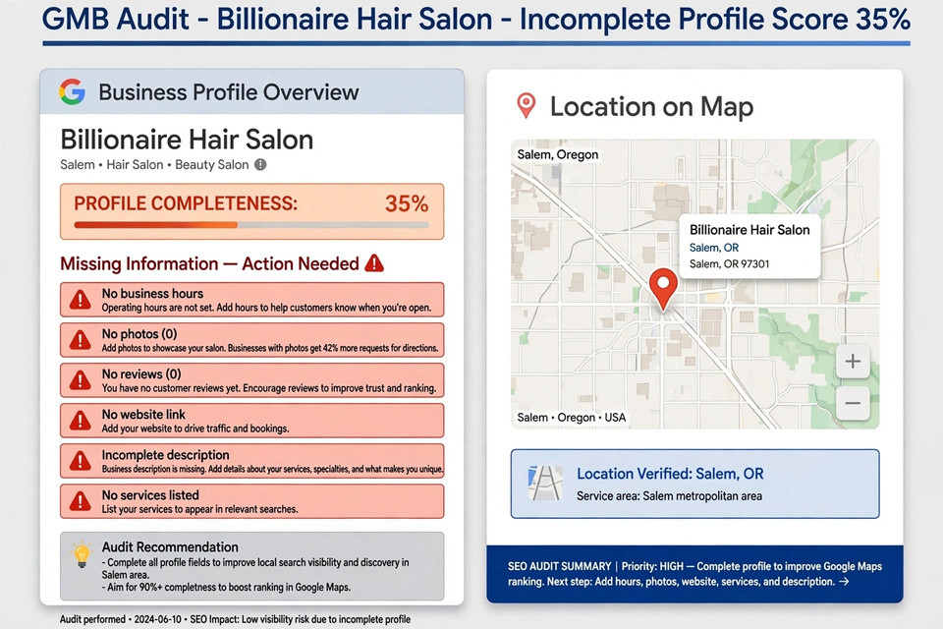
PAGE 16: GOOGLE MY BUSINESS (GMB) AUDIT
Profile Audit Status
Google BusinessProfileCompleteness: 35% ONLY
Missing Elements: Operating hours, store exterior/interior photos, customer reviews, direct website connection, and detailed structured service listings.
Immediate Action Required: Fill all core details, verify address, upload high-res gallery images, and set up booking options.

Slide 17
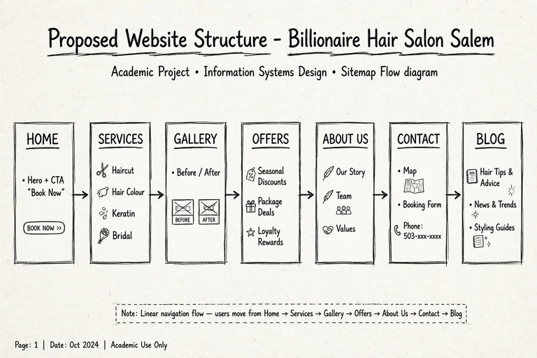
PAGE 17: WEBSITE WIREFRAME & RECOMMENDATIONS
Proposed Site Information Architecture
Home>Services(HairCare,BridalMakeup,BeautyTreatments) > Gallery > Offers > About Us > Contact Us > Blog
Conversion & Layout Recommendations
Integrate prominent sticky 'BookNow'Call-To-Action (CTA) buttons on top navigation and mobile footers. Implement direct WhatsApp chat integration for instant appointment requests.

Slide 18
PAGE 18: CONCLUSION & 6-MONTH ROADMAP
Strategic Execution Roadmap
• Month 1: Complete andoptimizeGoogleMy Business (GMB) profile.
• Month 2: Build and deploy a modern 1-page responsive custom website.
• Month 3: Execute full On-Page SEO optimization and structured metadata.
• Month 4: Publish 4 high-value localized blog articles targeting Salem search terms.
• Month 5: Acquire 20+ local business directory citations and backlinks.
• Month 6: Monitor keyword rankings, traffic conversions, and continuous iteration.
Projected Impact
Executionof this6-month roadmap will transition Billionaire Hair Salon from 0 online search presence to Top 5 organic rankings for 'hair salon Salem'.

