Slide 1
Multi-Agent Debate Framework using Evidence Disagreement Triggering and Conflict-Type Classification
Debate only when the evidence actually disagrees.
M. Reddy Sasi Kiran
Suhas Koheda
C R Suhas
23BAI1188
23BAI1148
23BAI1187
github.com/Suhas-Koheda/MAD
Notes:
Evidence-MAD. Three retrieval agents, an NLI evidence gate, and a typed debate. Repo is public; all numbers in this deck come from trace JSON files the system writes itself.

Slide 2
MOTIVATION
The problem, and what we add to Multi-Agent Debate
What goes wrong today
Our three contributions
1
Sources genuinely disagree
1
Evidence gate
“When was India’s NEP introduced?” → Wikipedia says 1986, web says 2020. Both are real answers to different questions.
Debate fires only when NLI measures a real contradiction between agents.
evidence/aggregator.py
2
A single LLM hides the conflict
2
Typed conflict strategies
It picks one version silently, with no source and no signal that anything was contested.
5 conflict types, each with its own debate prompt instead of one generic prompt.
conflict/classifier.py · debate/proposer.py
3
Standard MAD debates everything
3
Full audit trail
Prior work runs a full debate on every query — 6–8 extra LLM calls even when all three sources already agree.
Every query writes a JSON trace: claims, NLI scores, debate rounds, verdict, sources.
results/trace_<id>.json
Notes:
The gate is the contribution. Standard MAD always debates; we only debate on measured disagreement, and we classify the disagreement before debating it.

Slide 3
End-to-end pipeline — app.py · MADSystem.solve(query)
Stage 1 · Three independent agents, same query verbatim, run in parallel
Web Agent
Reference Agent
Scholarly Agent
DuckDuckGo HTML
Wikipedia API
Crossref API
WebAgent._duckduckgo_search()
ReferenceAgent._wikipedia_search()
ScholarlyAgent._crossref_search()
agents/search_agent.py · parallelised by agents/router.py → QueryRouter.execute() (ThreadPoolExecutor, 3 workers)
2
Normalize
Relevance filter drops off-topic hits, then one LLM call turns the surviving snippets into a single claim per agent, with date / version / scope extracted.
evidence/normalizer.py → _is_relevant(), _llm_normalize()
3
Gate
Pairwise NLI over all usable claims returns one of four states: AGREEMENT, DISAGREEMENT, UNCERTAIN, INSUFFICIENT. Only DISAGREEMENT opens the debate.
evidence/aggregator.py → EvidenceAggregator.decide()
4
Classify + Debate
Conflict is typed, then Propose → Critique → Revise runs up to 3 rounds and a Judge picks the stronger claim with a reason.
conflict/classifier.py · debate/manager.py, judge.py
5
Answer + Trace
Four different answer shapes, one per state — never a fabricated resolution. Full JSON trace written to disk.
output/generator.py → AnswerGenerator.generate()
Notes:
Independence matters: no agent gets a modified query, so any disagreement observed is real and not something we induced. Stage 3 is where our contribution sits.

Slide 4
TECHNICAL ACCURACY
The evidence gate: how we decide that two claims conflict
Decision rule — EvidenceAggregator.decide()
Why NLI, not cosine similarity
usable = [a for a in agents if a.is_usable]
if len(usable) <= 1 → INSUFFICIENT
if ANY pair contradiction >= 0.70 → DISAGREEMENT (gate opens)
elif ALL pairs entailment >= 0.70 → AGREEMENT (debate skipped)
else → UNCERTAIN (report both)
Cosine similarity measures topic overlap. “introduced in 2020” and “introduced in 1986” are about the same topic and score high — yet they contradict.
NLI scores entailment vs contradiction vs neutral directly, which is the question we actually need answered.
Why the rule is asymmetric
The NLI model
Disagreement needs only ONE contradicting pair — if Wikipedia says 1986 and the web says 2020, that conflict is real even if the third agent sides with one of them.
Agreement needs EVERY pair to entail. Two agents agreeing plus one neutral is UNCERTAIN, not agreement — the neutral agent may have found something the other two missed.
Net effect: the system is conservative. It would rather debate once too often than silently claim consensus.
NLI_MODE=transformers
ynie/roberta-large-snli_mnli_fever_anli_R1_R2_R3-nli — RoBERTa-large tuned on 5 NLI corpora. Run in both directions; the stronger contradiction score wins, since NLI is not symmetric.
NLI_MODE=mock
Deterministic pattern rules (year, version, scope, negation). Offline and instant — used for the demo and tests.
evidence/disagreement_detector.py → NLIDetector.predict(), MockNLIDetector._pattern_predict() · thresholds in config.py
Notes:
Thresholds live in config.py: DISAGREEMENT_THRESHOLD = 0.70, ENTAILMENT_THRESHOLD = 0.70. Mock mode is what --demo uses so results are reproducible without a download.

Slide 5
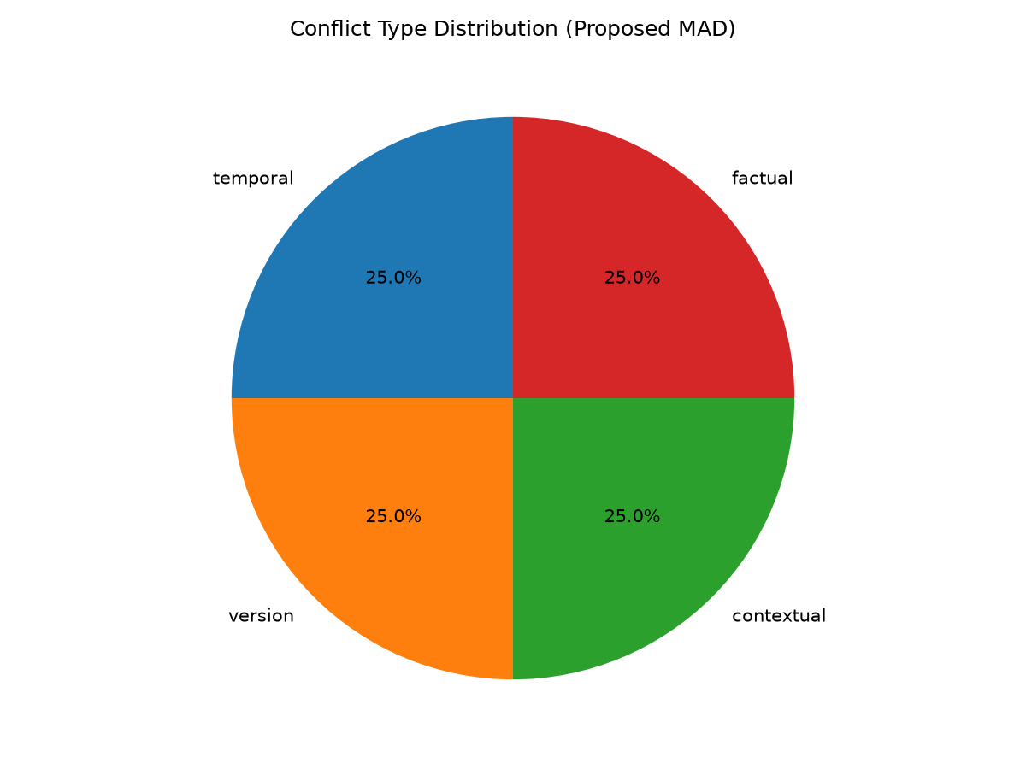
TECHNICAL ACCURACY
Typed conflicts, then a structured debate
TEMPORAL
Different dates
NEP: 1986 vs 2020
VERSION
Different releases
Python 3.13 vs 3.14
CONTEXTUAL
Different populations / scopes
Aspirin: adults vs children
SOURCE
Authority gap between sources
Peer review vs blog post
FACTUAL
Directly incompatible facts
Napoleon 5'2" vs 5'7"
Conflict mix in the evaluation run — the classifier is exercised across four of the five types, not one dominant case.
Each type selects a different system prompt from CONFLICT_STRATEGIES — a temporal conflict asks which date the query wanted; a contextual one first checks whether both claims are true under different scopes.
conflict/classifier.py → classify() · debate/proposer.py → CONFLICT_STRATEGIES
If the judge fails
The answer states “conflict unresolved, consult sources”. The system never invents a resolution it did not reach.
Propose
→
Critique ×2
→
Revise
→
Judge
debate/proposer.py
debate/critic.py
debate/reviser.py
debate/judge.py
Max 3 rounds · stops early on converged (95% Jaccard vs previous revision), no_objection, or stage_failure — debate/manager.py → run_debate()
Notes:
Judge is only called when debate status == completed. Stop reasons are recorded per run so we can report how often early stopping saved rounds.

Slide 6
IMPLEMENTATION STATUS
What is built, and how each piece is proven to matter
78
3
6
5
19
tests passing
retrieval agents
systems compared
conflict types
metrics computed
Ablation matrix — one feature removed per row
Two run modes
System | Gate | Typed strategy | Relevance filter
Single LLM (baseline) | ✗ | ✗ | ✗
Standard MAD (prior work) | ✗ | ✗ | ✓
Proposed MAD (ours) | ✓ | ✓ | ✓
No Gate | ✗ | ✓ | ✓
No Typed Strategy | ✓ | ✗ | ✓
No Relevance Filter | ✓ | ✓ | ✗
python3 app.py --demo
FIXTURE — 10 curated cases from data/fixtures.json. No network, no keys, identical output every run.
python3 app.py
LIVE — real retrieval and real LLM calls via llm_client.py.
Failures are recorded, not hidden
evaluation/systems/ → single_llm.py, standard_mad.py, proposed_mad.py (hosts all three ablations)
Agent timeout → RETRIEVAL_FAILED, other agents continue. Classifier LLM fails → pattern fallback tagged FALLBACK. Debate stage fails → stage_failure, judge skipped. Every LLM call is labelled by role in llm_client.call_report().
Reading it: if Proposed MAD beats No Gate, the gain came from the gate. If it beats No Typed Strategy, the typed prompts are earning their place. One row per claim we make.
Notes:
78 tests cover aggregator, conflict typing, debate, relevance filter, retrieval failure and LLM failure paths. Run: venv/bin/python -m pytest tests/ -q

Slide 7
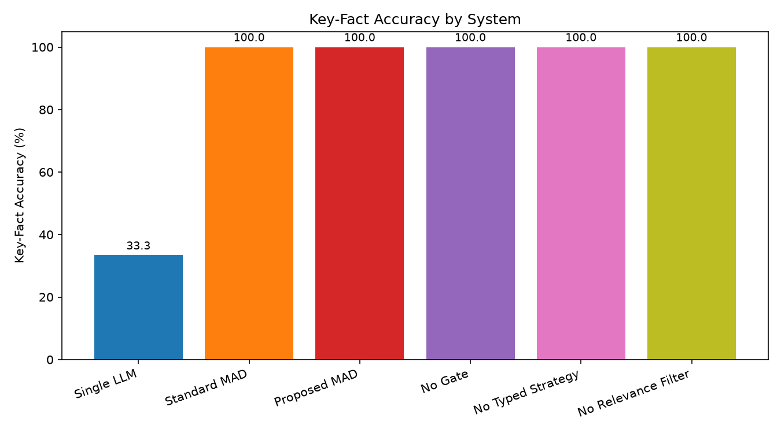
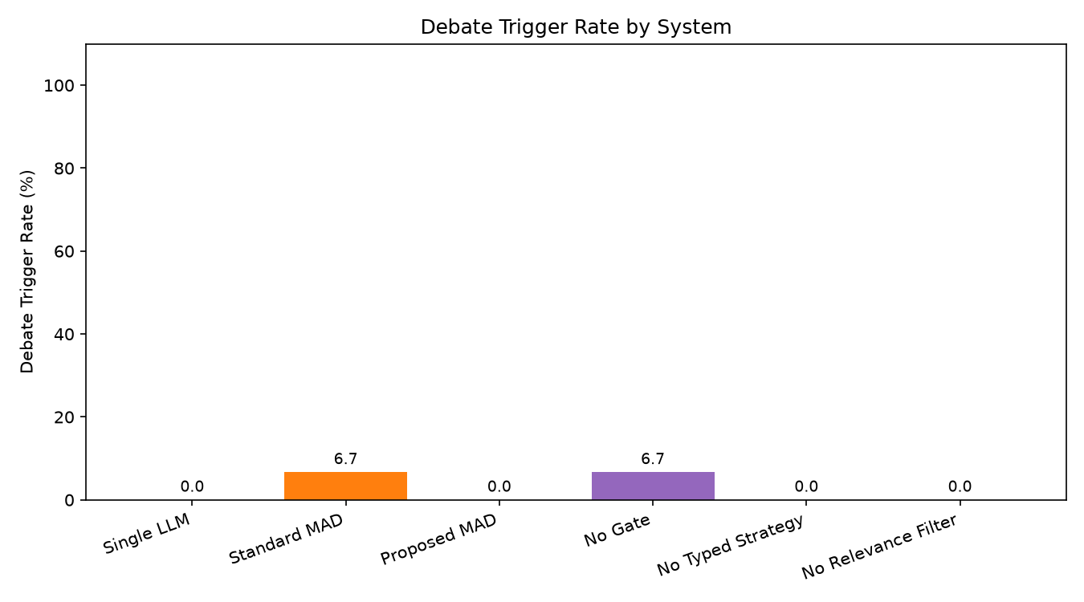
RESULTS SO FAR
Accuracy against a baseline, and selectivity of the gate
Key-fact accuracy
Debate trigger rate
Strict metric: the answer must contain every required fact and no forbidden fact — a verbose near-miss scores zero. Retrieval-backed systems reach 100% against 33.3% for the no-retrieval baseline, which is the evidence that grounding the answer in agent-retrieved sources is doing real work.
Standard MAD and No Gate debate on 6.7% of queries; Proposed MAD debates on 0% of this set — the gate found no contradiction worth paying for. Same accuracy, fewer debates. This is the efficiency claim stated in one chart.
Generated by: python3 -m evaluation.run_experiments --demo → figures/ · metrics in evaluation/metrics.py → MetricsCalculator
Notes:
Both charts are from the FIXTURE run so they are reproducible on demand in front of the panel.

Slide 8
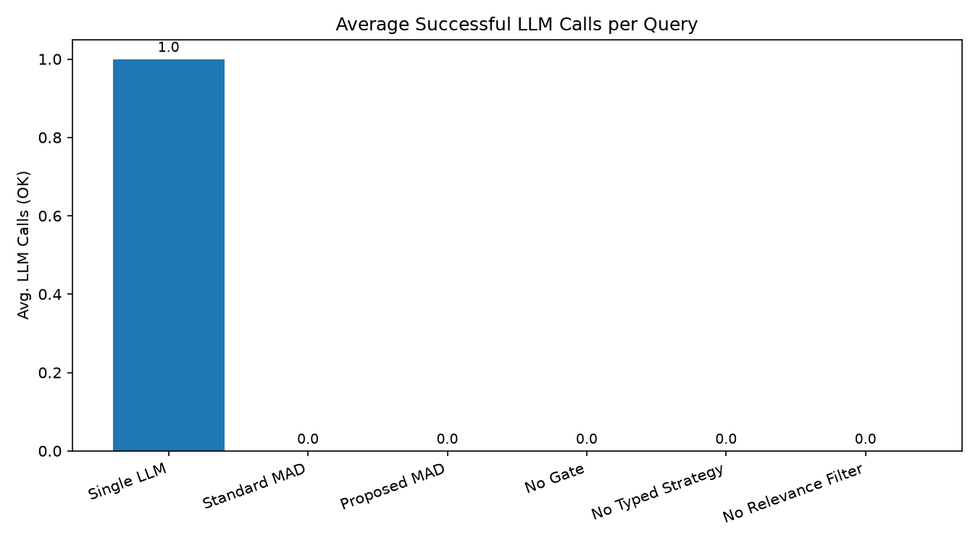
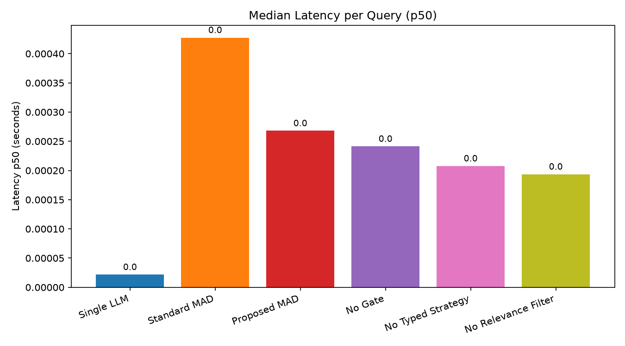
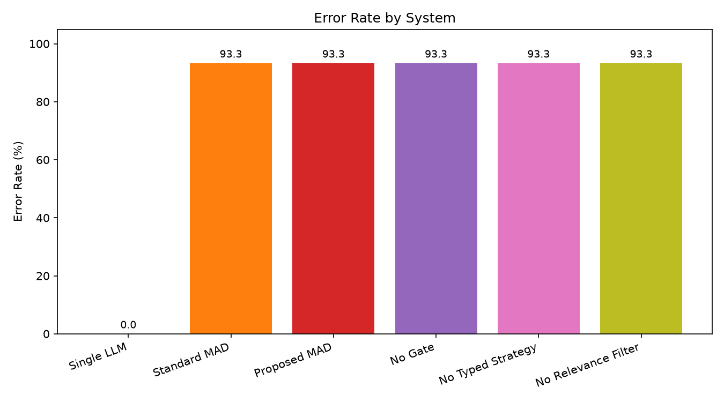
RESULTS SO FAR
Cost, latency, and an honest reading of the error rate
LLM calls per query
Median latency (p50)
Error rate
Single LLM spends 1 call. The MAD systems show 0 here because the fixture run answers from stored evidence, so no live LLM is invoked — cost comparison moves to the LIVE run.
Whole scale is sub-millisecond, so this measures orchestration overhead only. Standard MAD is the slowest because it debates unconditionally; Proposed MAD sits below it.
93.3% is a fixture-coverage gap, not a crash: the evaluation set holds 15 queries and data/fixtures.json currently holds 10 curated cases, so unmatched queries raise FixtureNotFoundError by design.
Full pipeline runs end to end, 78 tests green, six systems wired into one harness, and every number traceable to a results/trace_<id>.json file. Nothing in this deck is hardcoded.
Extend fixtures to the full 15-query set, rerun in LIVE mode with NLI_MODE=transformers for real cost and latency, and add per-conflict-type accuracy plus debate early-stop rate to evaluation/metrics.py.
Notes:
If asked about the 93.3%: it is fixture coverage, and the fix is adding cases to data/fixtures.json. The design choice to fail loudly rather than fall back silently is deliberate.

