Slide 1
Multi Agent Debate Framework Using Evidence Disagreement Triggering and Conflict Type Classification
FINAL PROJECT REVIEW • OCTOBER 2026
Evidence-MAD | VIT Chennai
Faculty guide: Dr M. Marimuthu
Students: M. Reddy Sasi Kiran (23BAI1188) • Suhas Koheda (23BAI1148) • C. R. Suhas (23BAI1187)

Slide 2
Project overview
Project status
Built a multi-agent QA pipeline with retrieval, claim normalization, an NLI gate, conflict classification, debate, and JSON traces.
Run summary
96 questions were evaluated across six configurations.
Evidence-MAD triggered debate on 22 (22.9%).
Standard MAD triggered debate on 50 (52.1%).
Interpretation
The saved traces have no gold answer labels. These results describe routing and runtime behaviour, not answer accuracy.

Slide 3
Related work and research gap
Debate and adaptive collaboration
Multi-agent debate studies role-based critique, revision, and consensus [2–4].
Adaptive debate asks when collaboration is needed [5].
Evidence-MAD tests an evidence-state trigger before debate.
Retrieval and conflicting evidence
RAG grounds generation in retrieved passages [1].
Multi-agent retrieval systems filter or select evidence [6, 7].
Conflict work studies disagreement in search results [8, 9].
The current run describes behavior; it does not establish a performance advantage.

Slide 4
Evidence retrieval and NLI gate
Sources observed in trace decisions
Web agent (DuckDuckGo)
Reference agent (Wikipedia)
Wikidata agent
Independent LLM answer candidate
Trace audit
Crossref, OpenAlex, arXiv, and Europe PMC appear in the configured-source signature but were not selected in these runs.
Evidence preparation and gate
Filter snippets for query relevance; normalize them into claims.
Compare claim pairs in both directions with NLI.
States: AGREEMENT, DISAGREEMENT, UNCERTAIN, INSUFFICIENT.
Disagreement routes to conflict classification and debate.
Uncertain or insufficient evidence remains qualified.

Slide 5
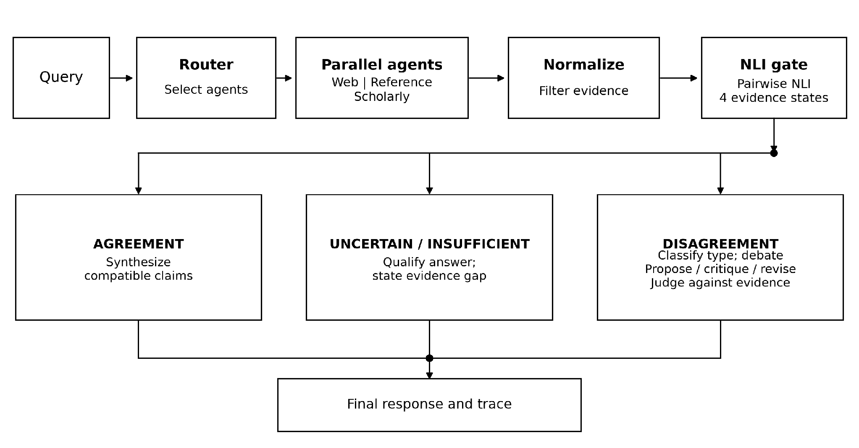
System architecture

Slide 6
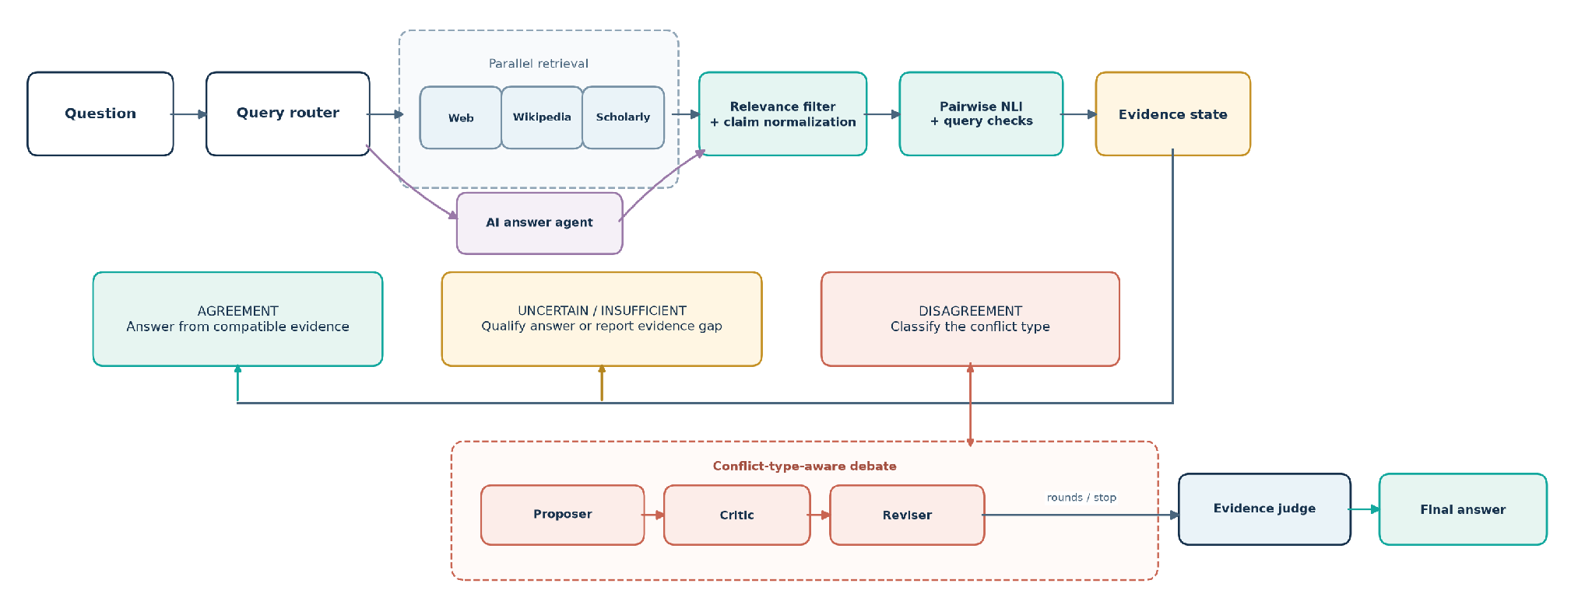
Evidence gate and debate architecture

Slide 7
NLI gate and query aware checks
Pairwise NLI
RoBERTa large fine tuned on SNLI, MultiNLI, FEVER-NLI, and ANLI.
Run in both premise directions.
Contradiction threshold: 0.70.
Entailment threshold: 0.70 for agreement.
Query aware guards
Entity substitution.
Explicit epistemic challenge.
Target resolution mismatch.
These checks address cases where generic sentence pair inference can miss the query’s target.

Slide 8
Conflict resolution and application
Five conflict types
FACTUAL — incompatible propositions or values.
TEMPORAL — different dates or periods.
VERSION — different releases or documents.
CONTEXTUAL — different populations or conditions.
SOURCE — different source authority.
Type-specific prompts direct the debate toward the relevant distinction.
Debate lifecycle and application
Proposer presents an evidence led position.
Critic identifies unsupported claims.
Reviser responds; Judge prioritizes evidence.
Early stopping and a maximum-round limit are supported.
FastAPI backend, browser UI, and JSON traces.

Slide 9
Evaluation design and limitations
Matched run
Same 96 questions across six configurations.
One live run; model identifiers vary by system.
No gold answer labels in this trace bundle.
Accuracy and conflict precision/recall are not scored.
Interpretation
A lower debate rate does not prove that skipped debates were unnecessary.
Operational caveats
Some debates were partial or failed.
Evidence states are system outputs, not gold labels.
Retrieval and model services can change between runs.
Long latency tails occur in the live traces.
Next evaluation
Add answer and claim-pair labels; pin the model and evidence snapshot; repeat the comparison.

Slide 10
Results and trace analysis

Slide 11
Evaluation workflow
Use 96 questions
Read saved traces
State limits clearly
Dataset
Execution
Trace audit
Analysis
Reporting
Run six configurations
Compare routing and runtime

Slide 12
Debate activation by configuration
Compared systems
Ablations
Single LLM
0%
No Gate
50%
Standard MAD
50%
No Typed Strategy
23%
Evidence-MAD
22%
No Relevance Filter
18%
Values are percentages of 96 traces. Lower activation is a routing observation, not evidence that the system skipped only unnecessary debates.

Slide 13
Latency by configuration (seconds)
Median (p50)
95th percentile (p95)
Single LLM
16.8
Single LLM
26.5
Standard MAD
55.0
Standard MAD
211.5
Evidence-MAD
50.0
Evidence-MAD
232.7
No Gate
50.0
No Gate
200.2
No Typed
55.0
No Typed
238.6
No Relevance
55.0
No Relevance
205.4
Evidence-MAD p50/p95 = 49.99/232.65 s; Standard MAD = 54.99/211.47 s.

Slide 14
Evidence states and debate outcomes
Evidence-MAD state counts (n = 96)
Insufficient: 47
Uncertain: 26
Disagreement: 22
Agreement: 1
Debate outcomes: 16 completed, 1 partial, 5 failed.
Standard MAD state counts (n = 96)
Insufficient: 46
Uncertain: 29
Disagreement: 16
Agreement: 5
Debate outcomes: 29 completed, 21 failed.

Slide 15
Model calls and usable retrieval agents
Mean model calls / question
Evidence-MAD: 1.85 successful; 0.39 failed.
Standard MAD: 1.42 successful; 0.49 failed.
No Typed Strategy: 1.90 successful; 0.49 failed.
Call counts include roles outside debate, such as normalization.
Usable retrieval agents / question
Evidence-MAD: 1.31.
Standard MAD: 1.24.
Retrieval configurations: 1.24–1.31 on average.
The configured source list is not the same as the number of agents that returned usable evidence.

Slide 16
Results
Debate activation
Evidence-MAD: 22/96 (22.9%). Standard MAD: 50/96 (52.1%).
Latency
Evidence-MAD median / p95: 49.99 / 232.65 s. Standard MAD: 54.99 / 211.47 s.
What follows from this
Evidence-MAD debated less often in this run. Without labels, we cannot tell whether it selected the right cases.

Slide 17
Project links
PROJECT LINKS
Code base: MAD 2
Evaluation traces
Literature review
Architecture diagrams

Slide 18
References
[1] P. Lewis et al., “Retrieval-Augmented Generation for Knowledge-Intensive NLP Tasks,” NeurIPS, 2020.
[2] Y. Du et al., “Improving Factuality and Reasoning in Language Models Through Multiagent Debate,” ICML, 2024.
[3] J. C.-Y. Chen et al., “ReConcile: Round-Table Conference Improves Reasoning via Consensus among Diverse LLMs,” ACL, 2024.
[4] C.-M. Chan et al., “ChatEval: Towards Better LLM-Based Evaluators through Multi-Agent Debate,” ICLR, 2024.
[5] S. Eo et al., “Debate Only When Necessary: Adaptive Multiagent Collaboration for Efficient LLM Reasoning,” arXiv, 2025.
[6] C.-Y. Chang et al., “MAIN-RAG: Multi-Agent Filtering Retrieval-Augmented Generation,” ACL, 2025.

Slide 19
References
[7] H. Wang et al., “Retrieval-Augmented Generation with Conflicting Evidence,” COLM, 2025.
[8] A. Cattan et al., “DRAGged into Conflicts: Detecting and Addressing Conflicting Sources in Search-Augmented LLMs,” arXiv, 2025.
[9] R. Xu et al., “Knowledge Conflicts for LLMs: A Survey,” EMNLP, 2024.
[10] A. Williams, N. Nangia, and S. R. Bowman, “A Broad-Coverage Challenge Corpus for Sentence Understanding through Inference,” NAACL-HLT, 2018.
[11] H. Wang et al., “Learning to Break: Knowledge-Enhanced Reasoning in Multi-Agent Debate System,” Neurocomputing, 2025.
[12] S. Jeong et al., “Tool-MAD: A Multi-Agent Debate Framework for Fact Verification with Diverse Tool Augmentation and Adaptive Retrieval,” arXiv, 2026.

