Slide 1


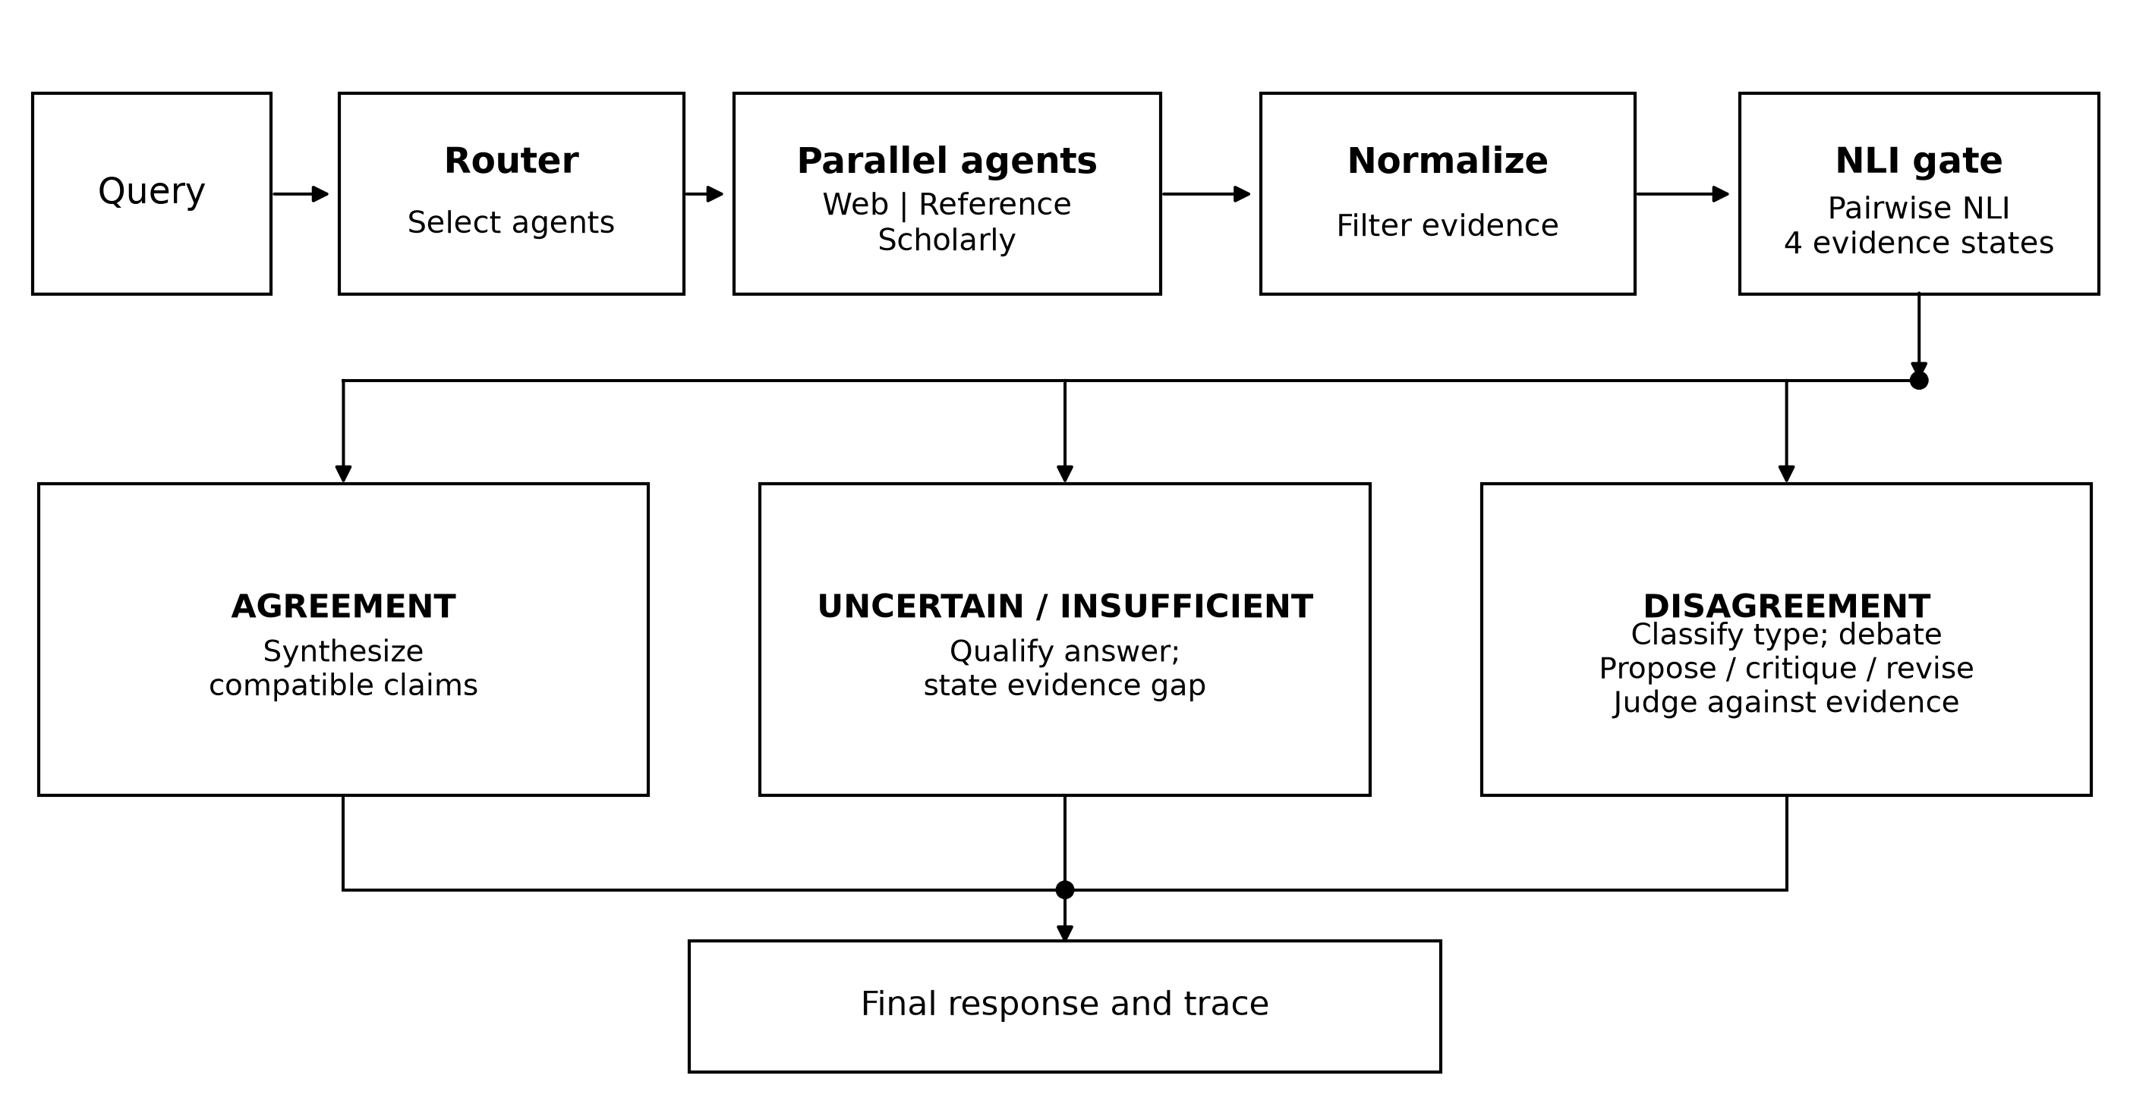
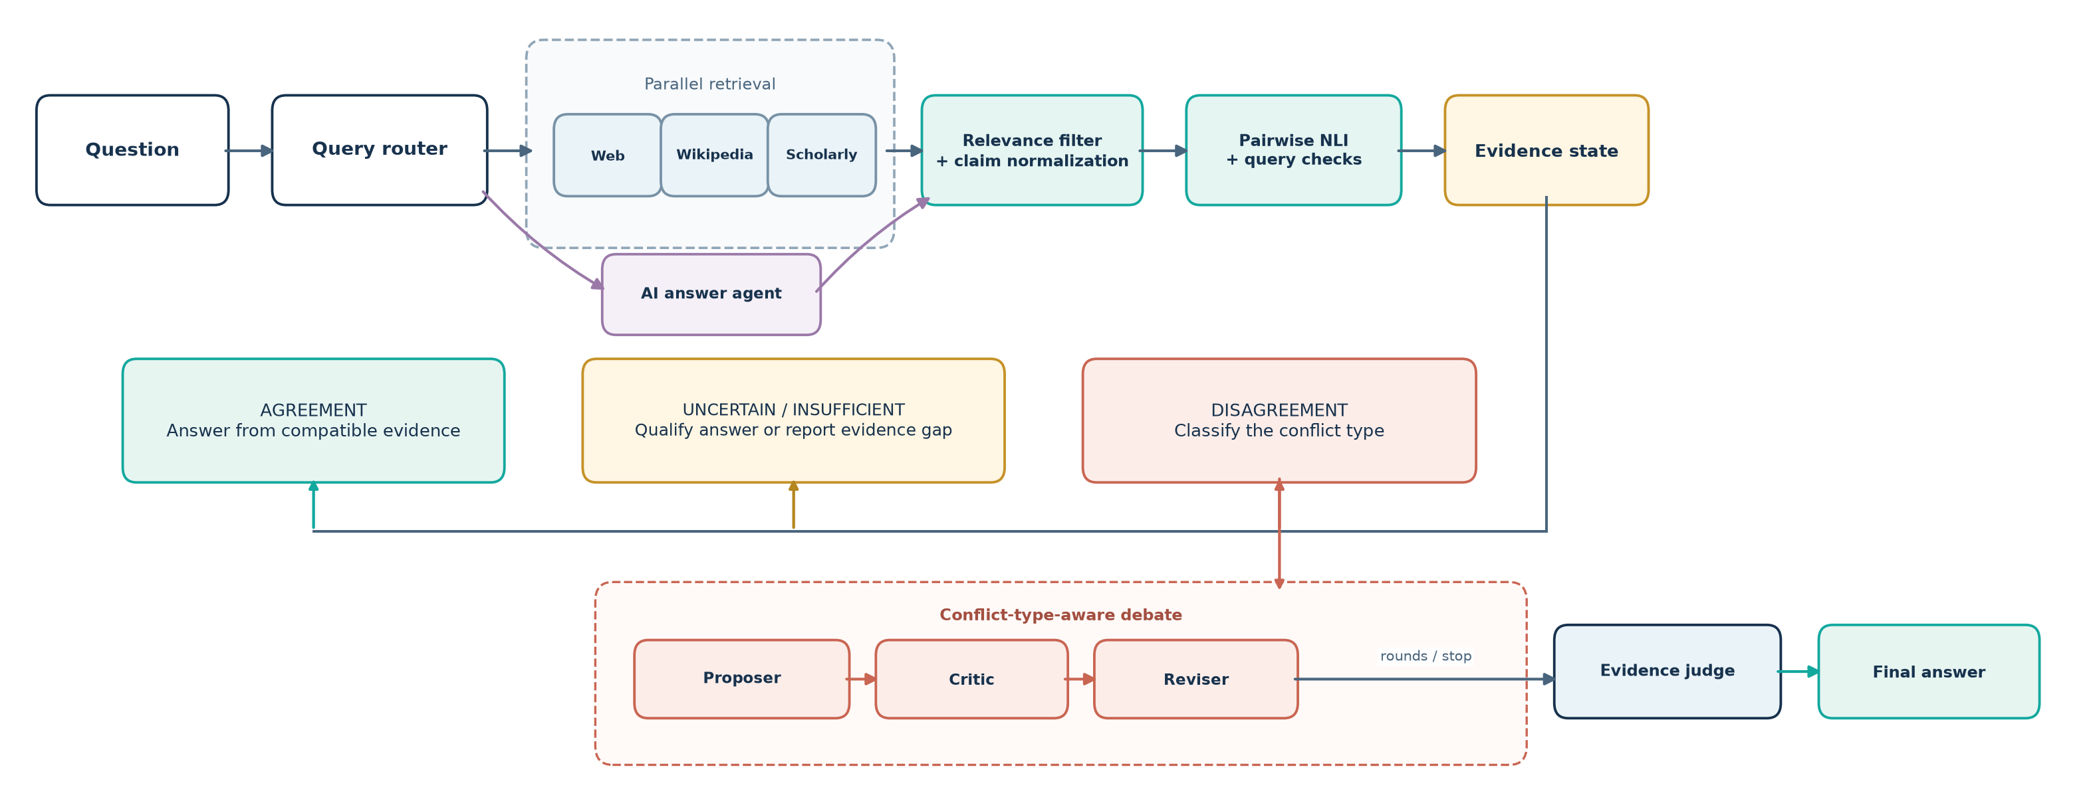
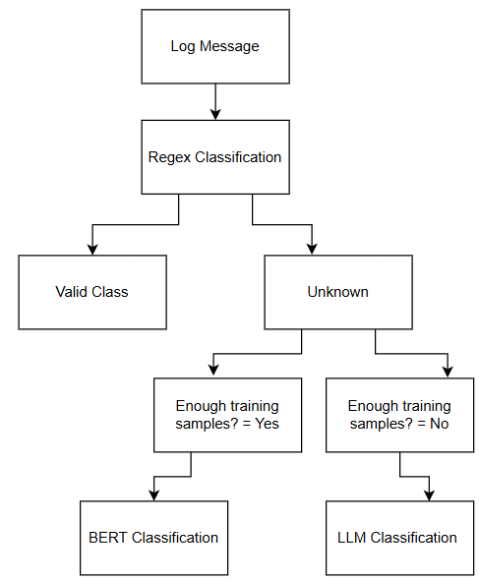
Multi Agent Debate Framework Using Evidence Disagreement Triggering and Conflict Type Classification
M. Marimuthu | Faculty
M. Reddy Sasi Kiran • Suhas Koheda • C. R. Suhas
School of Computer Science and Engineering | VIT Chennai
MOTIVATION / INTRODUCTION
Multiple sources can return different answers because they refer to different dates, versions, populations, or definitions.
A multi-agent debate can help examine disagreement, but running it for every question adds model calls and delay.
Evidence-MAD checks the relations among retrieved claims before opening the debate path.
OBJECTIVES
Compare normalized claims with a bidirectional natural-language-inference (NLI) model.
Route agreement, disagreement, uncertainty, and insufficient evidence separately.
Use factual, temporal, version, contextual, and source conflict labels to guide debate.
Keep retrieved evidence, decisions, debate stages, and outcomes in JSON traces.
SCOPE OF THE PROJECT
This poster reports one live comparison of six system configurations on 96 questions. The saved set has no gold answer labels, so it supports an operational analysis of routing and runtime—not an answer-accuracy claim.
METHODOLOGY
The router sends questions to web, Wikipedia reference, and Wikidata agents; an LLM answer agent supplies another candidate.
A relevance filter removes off-topic snippets. A normalizer turns the remaining material into claims with source details.
A RoBERTa-large NLI model compares claim pairs in both directions. The gate returns one of four evidence states.
When the state is DISAGREEMENT, the system classifies the conflict and runs Proposer, Critic, Reviser, and Judge stages.
ARCHITECTURE
The figures below show the intended architecture. In the matched-run traces, web, Wikipedia, and Wikidata were selected; Crossref, OpenAlex, arXiv, and Europe PMC were not called.
RESULTS
CONCLUSION
Evidence-MAD triggered debate on 22 of 96 questions (22.9%), compared with 50 (52.1%) for Standard MAD. Median latency was 49.99 s versus 54.99 s; p95 was 232.65 s versus 211.47 s. The set has no gold labels, so these results describe routing and runtime, not answer accuracy.
PROJECT MATERIALS (click to open)
Code base: MAD-2
Matched evaluation traces
Final literature review
Architecture diagrams
REFERENCES
[1] Y. Du et al., “Improving Factuality and Reasoning in Language Models Through Multiagent Debate,” ICML, 2024. [2] P. Lewis et al., “Retrieval-Augmented Generation for Knowledge-Intensive NLP Tasks,” NeurIPS, 2020. [3] A. Williams et al., “A Broad-Coverage Challenge Corpus for Sentence Understanding through Inference,” NAACL-HLT, 2018. [4] A. Cattan et al., “DRAGged into Conflicts,” 2025.
System | Debates | p50 / p95 (s)
Single LLM | 0/96 (0.0%) | 16.79 / 26.51
Standard MAD | 50/96 (52.1%) | 54.99 / 211.47
Evidence-MAD | 22/96 (22.9%) | 49.99 / 232.65
No Gate | 50/96 (52.1%) | 49.99 / 200.21
No Typed Strategy | 23/96 (24.0%) | 54.99 / 238.55
No Relevance Filter | 18/96 (18.8%) | 54.96 / 205.42

