Slide 1
Ebooks recommendation system using reviewer ratings & Feedback
STUDENT DETAILS
K.Sasi Kiran
2019202049
GUIDE DETAILS
Ms.S.Kanimozhi,
Teaching Fellow

Slide 2
MOTIVATION & OBJECTIVE
MOTIVATION :
The major reason for such a recommendation system is to provide user interaction utilizing utmost with the system.
Also it provides intersection of software engineering, machine learning, and statistics.
OBJECTIVE :
The objective of recommender systems is to provide recommendations based on recorded information on the users' reviews and ratings.
There will be 2 cases, where the user will be able to search the books by keywords and recommendation is made and displayed based on ratings. The other case will be to search a sentence which displays the recommended books based on the positivity rate.

Slide 3
INTRODUCTION
Recommender systems aim to predict users' interests and recommend product items that quite likely are interesting for them.
They are among the most powerful machine learning systems that online retailers implement in order to drive sales.
The impact is very huge which helps in marketing the products worldwide.
Recommender systems are beneficial to both service providers and users

Slide 4
LITERATURE REVIEW
Data Preprocessing
Namrata Chaudhary proposed the general Sources of Errors and Data Cleaning Strategies in which python jupyter is used in order to perform data cleaning using pandas library.
Word Mapping
Keywords are words that come to you naturally, or that may be part of a specific discipline vocabulary (e.g. terms used only by midwives), or that you brainstorm when planning your search.
Filtering User Feedback
This approach is nothing but to get the positive, neutral and negative of the user feedback and to filter them based on their matter of behaviours.

Slide 5
DATASET DETAILS
Books.csv (https://www.kaggle.com/datasets/arashnic/book-recommendation-dataset)
Columns : 'ISBN', 'bookTitle', 'bookAuthor', 'yearOfPublication', 'publisher', 'imageUrlS', 'imageUrlM', 'imageUrlL‘
Size : 2,71,379
Users.csv
Columns : 'userID', 'Location', 'Age‘
Size : 2,78,858
Ratings.csv
Columns : 'userID', 'ISBN', 'bookRating‘
Size : 11,49,780

Slide 6
IMPLEMENTATION PLATFORM / FRAMEWORK
Dataset Pre-processing is done in python jupyter platform.
For Data visualization, Pandas, numpy and matplotLib is used.
For user interaction and algorithm java netbeans is used and for database, mysql is used.

Slide 7
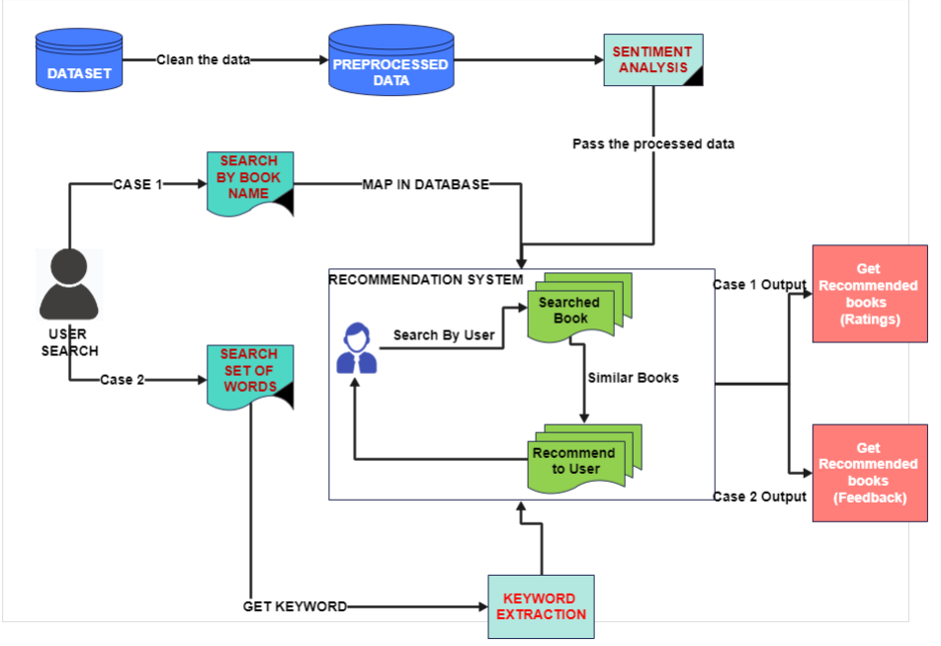
OVERALL ARCHITECTURE

Slide 8
LIST OF MODULES
Data Preprocessing :
Input : All three (Books, Users, Ratings) CSV files.
Process the data, manipulate it, clean it using Pandas, Numpy in jupyter platform.
Output : Cleaned and processed Data which is loaded into another CSV file
Sentiment Analysis:
Input : The preprocessed csv file.
Import nltk sentiment vader library and loop the column for which the polarity needs to be given to. The polarity is found for positivity, neutral and negativity for the feedback column and combined with the csv file with respect to the User-ID.
Output : The polarities for each column is found and they’re included in the dataset, i.e. compound, positive, neutral and negative columns

Slide 9
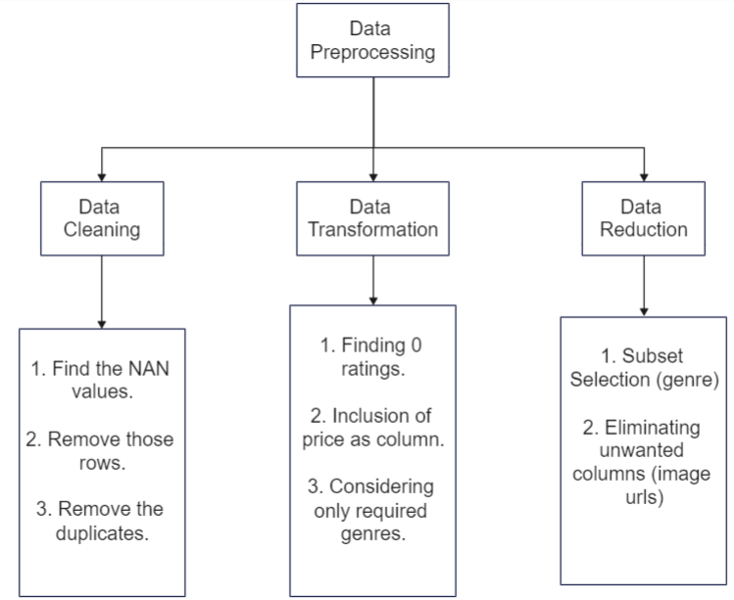
design of Data preprocessing module
Description :
Data Cleaning ->
The CSV files will have more null values, so they must be eliminated.
Remove the duplicates (rows and columns)
Data Transformation ->
Find the zero ratings data and include a separate column as price.
Genre column has multi label genres, so they must be eliminated.
Data Reduction ->
For any data study to make, the unwanted rows/columns must be deleted.
Also the subset values must be eliminated.

Slide 10
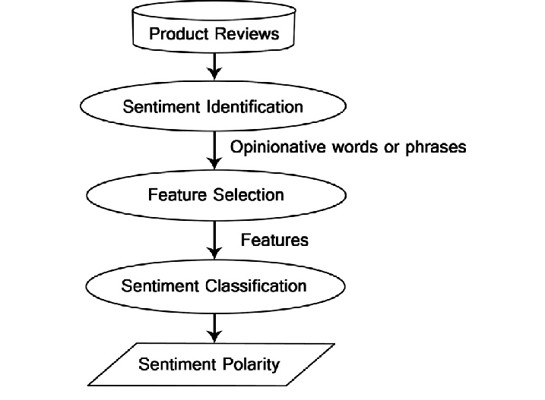
SENTIMENT ANALYSIS MODULE
Description :
Sentiment Analysis identifies the sentiment expressed in a text then analyzes it.
Therefore, the target of SA is to find opinions, identify the sentiments they express, and then classify their polarity.
The data sets used in SA are an important issue in this field.
These reviews are important to the business holders as they can take business decisions according to the analysis results of users’ opinions about their products.
The reviews sources are mainly review sites. SA is not only applied on product reviews but can also be applied on stock markets, news articles, political debates.

Slide 11
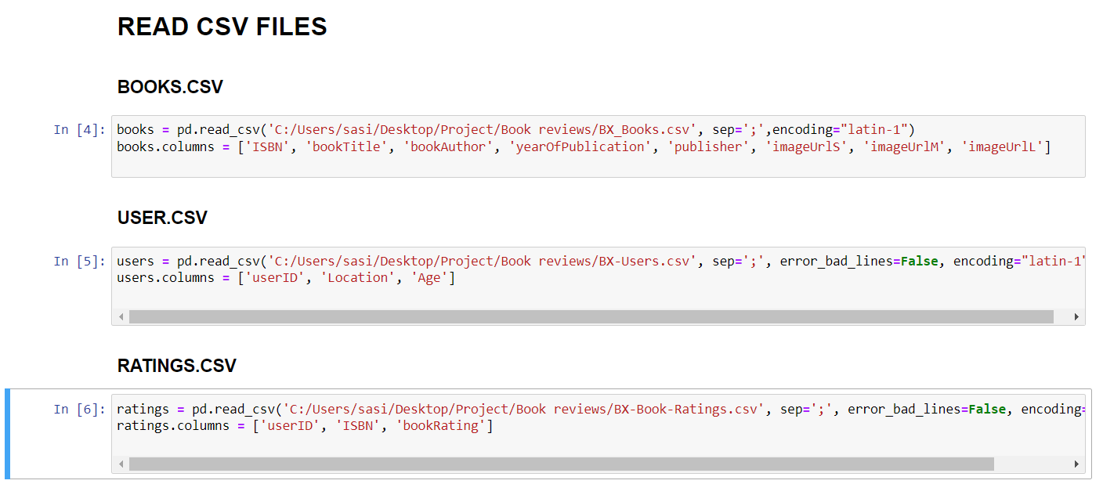
Data preprocessing outputs

Slide 12
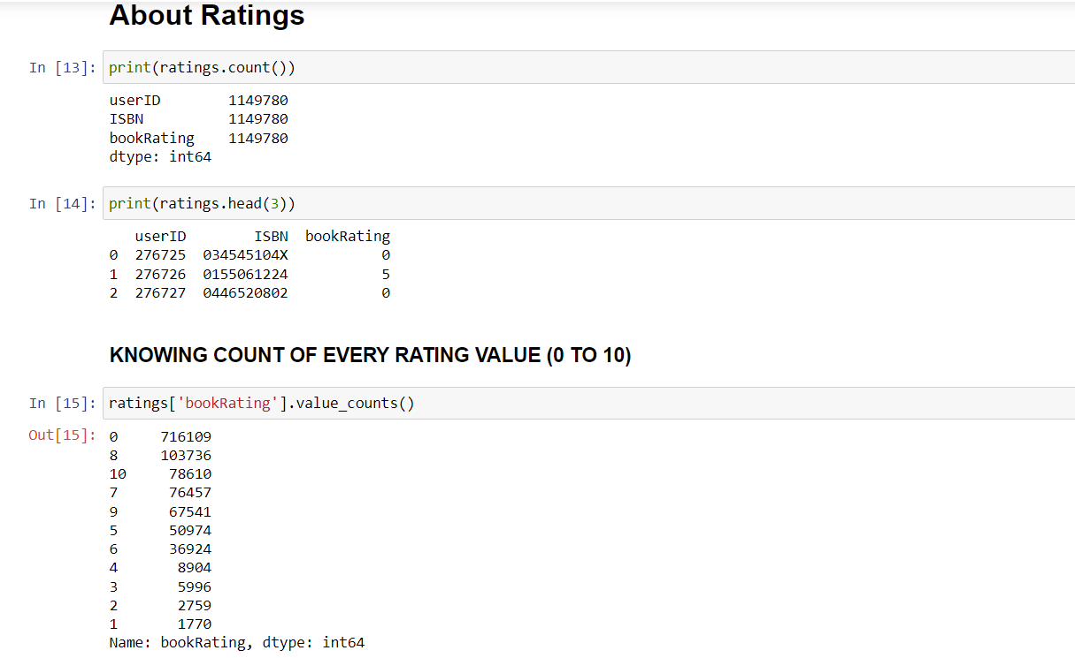

Slide 13
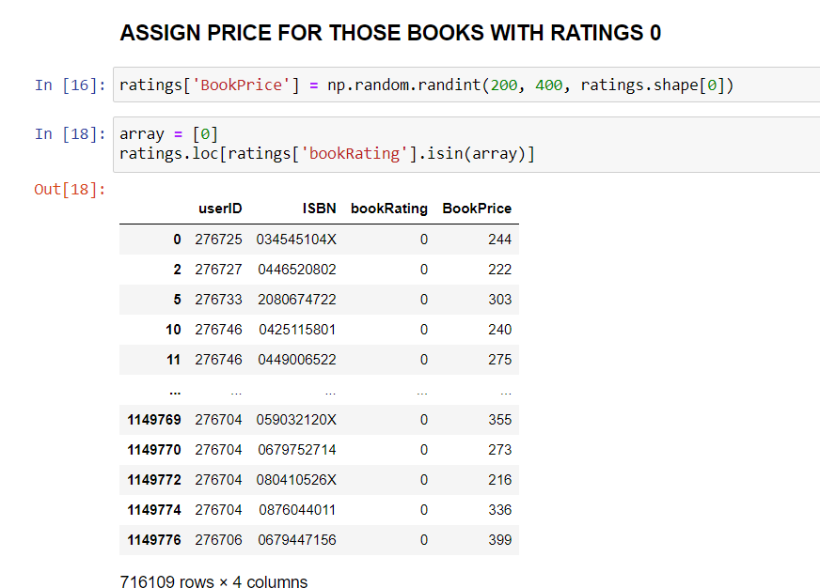

Slide 14
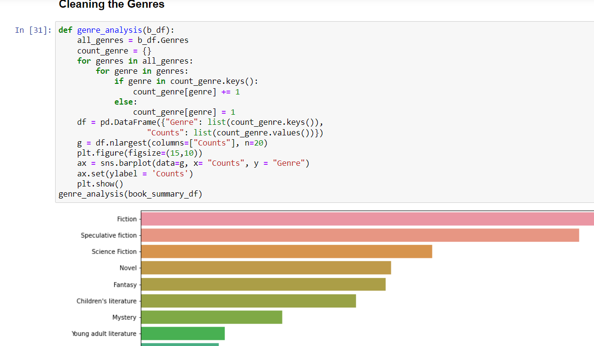

Slide 15
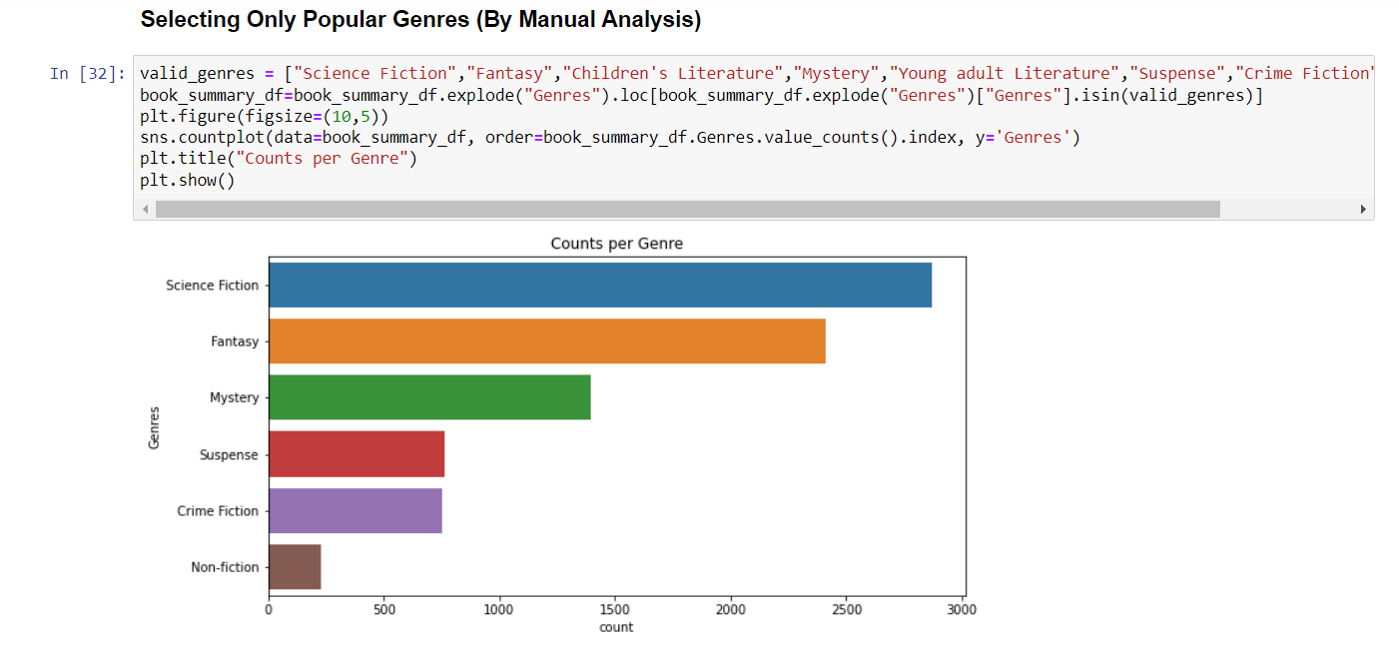

Slide 16
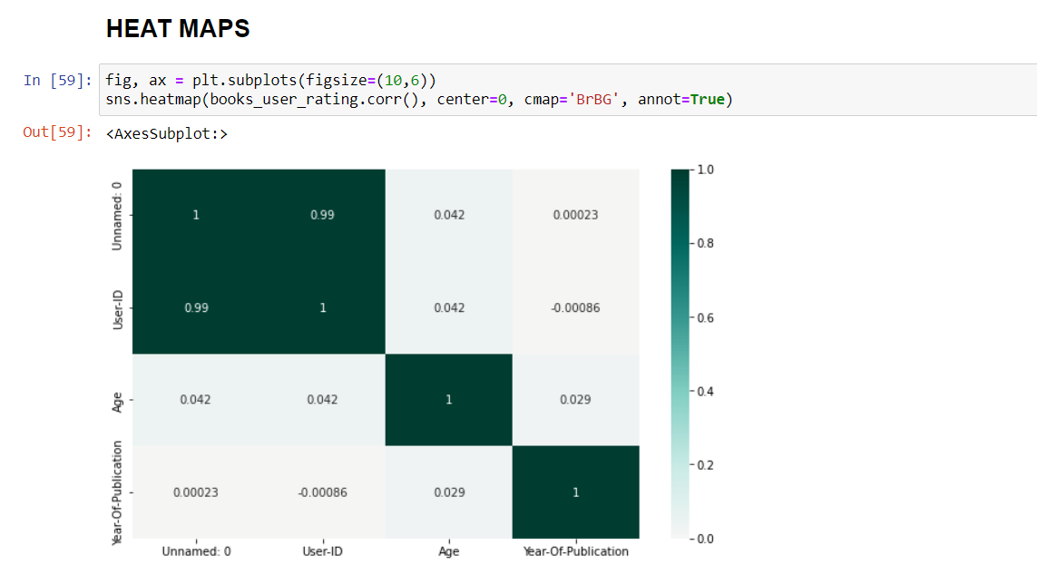

Slide 17
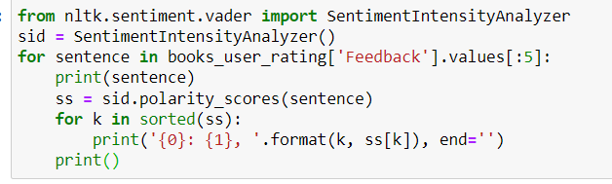
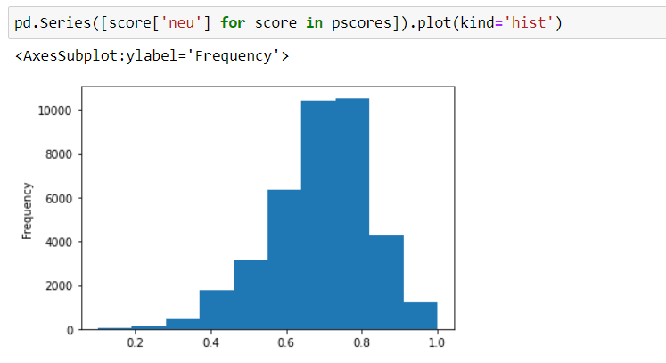
Sentiment Analysis :
Importing the nltk and required sentiment libraries for the analysis
Neutral Score:

Slide 18
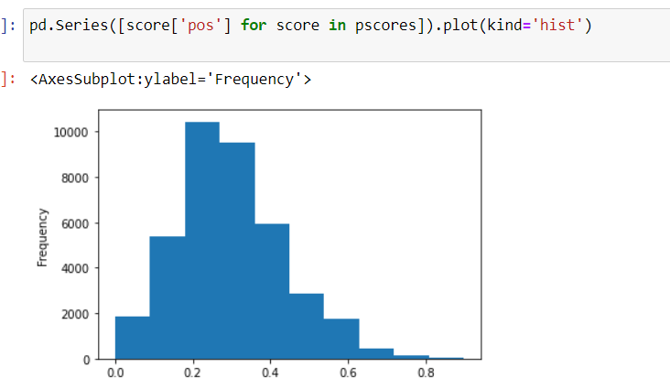
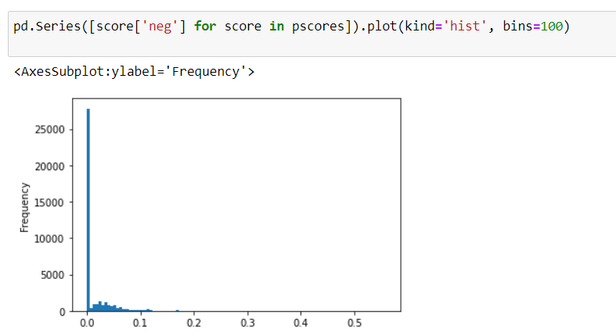
Positive Score:
Negative Score:

Slide 19
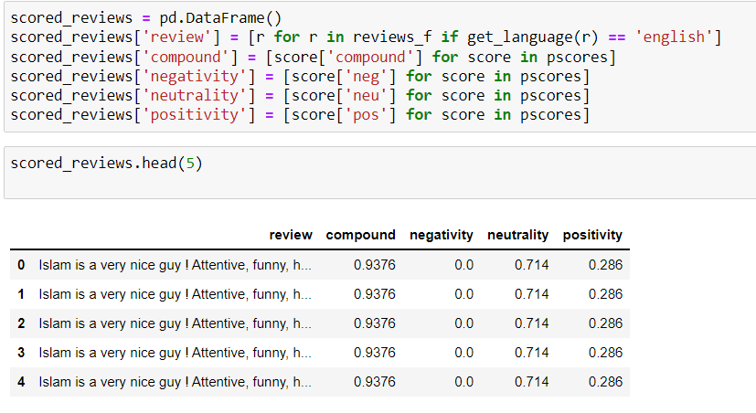
Getting the polarity columns:

Slide 20
REFERENCES
https://data-science-blog.com/en/blog/2018/11/04/sentiment-analysis-using-python/
https://arxiv.org/ftp/arxiv/papers/1403/1403.3185.pdf
https://link.springer.com/chapter/10.1007/978-3-540-72079-9_10
https://ieeexplore.ieee.org/abstract/document/6965073?casa_token=smrJx4qFy1wAAAAA:H4oCy03htAEqXuLqlV3lumBMTYGQjBjC4OHi5MVq44jo1ozKGklwmk63lQ9AAvLtuNxfWZvggg
https://libguides.library.cqu.edu.au/c.php?g=760913&p=5456502
https://www.kaggle.com/datasets/arashnic/book-recommendation-dataset
https://www.kaggle.com/code/sercanyesiloz/book-recommendation-system#Preprocessing
https://journalofbigdata.springeropen.com/articles/10.1186/s40537-015-0015-2
https://www.mdpi.com/2076-3417/11/9/3986
https://www.researchgate.net/profile/Haque-Nawaz-Lashari-2/publication/332731286_Student_Feedback_Sentiment_Analysis_Model_Using_Various_Machine_Learning_Schemes_A_Review/links/5d961d2c299bf1c363f5759a/Student-Feedback-Sentiment-Analysis-Model-Using-Various-Machine-Learning-Schemes-A-Review.pdf

Slide 21
THANK YOU

