Slide 1
Snowflake

Slide 2
Snowflake Connect
Why Do I have To Learn Snowflake?
Industry Gravitating from Big Data to Cloud Data warehousing Technologies
Early entry helps Career Progress and Monetary Benefits
Change your Roles if interested – QA / Analyst /
Cutting Edge Technology – Will be there for more time – Can Plan Career On This
Easy Learning Curve
Lot of Job Opportunities

Slide 3
Snowflake
Developed in 2012 by Benoit Dageville, Thierry Cruanes and Marcin Zukowski,
Snowflake is a data platform built on cloud designed to overcome all the challenges of maintaining a traditional data warehouses along with some powerful in-built features for storing, managing and analyzing your huge amounts of data.
What is Snowflake?
Snowflake is an analytic data warehouse provided as Software-as-a-Service (SaaS).
Snowflake provides a data warehouse that is faster, easier to use, and far more flexible than traditional data warehouse offerings.
Snowflake provides a single cloud data platform for Data Warehousing, Data Lakes, Data Engineering, Data Science, Data application development, and secure sharing and consumption of real-time / shared data.

Slide 4
Where Snowflake Fits In..
OLTP
Application Oriented
Used to run business
Detailed data
Current up to date
Isolated Data
Clerical User
Few Records accessed at a time
(tens)
Read/Update Access
No data redundancy
Database Size 100MB -100 GB
Transaction throughput is the
performance metric
Thousands of users
Managed in entirety
Data Warehouse
Subject Oriented
Used to analyze business
Summarized and refined
Snapshot data
Integrated Data
Knowledge User (Manager)
Large volumes accessed at a time (millions)
Mostly Read (Batch Update)
Redundancy present
Database Size 100 GB - few terabytes
Query throughput is the performance metric
Hundreds of users
Managed by subsets
Madrona, Altimeter, RedPoint

Slide 5
Where Do I Fit In ?
Ingestion
ETL Tools - Informatica, Talend, Matillion
Java, Python , Spark
Transformation
Snow SQL, Procedures, Functions, Materialized Views
Visualization
Tableau, Looker, SAP BO, Power BI
Administration
Security, Roles, Encryption
Sharing : data share

Slide 6
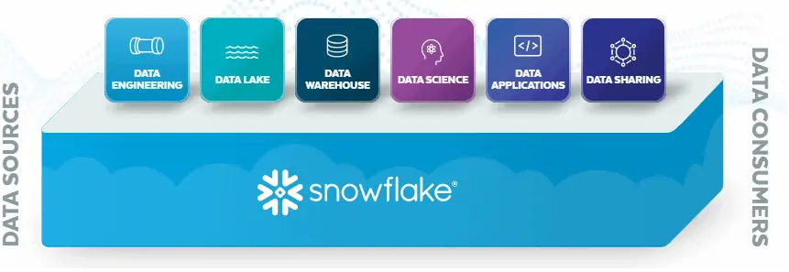
Snowflake Consumers
Snowflake provides a single cloud data platform for Data Warehousing, Data Lakes, Data Engineering, Data Science, Data application development, and secure sharing and consumption of real-time / shared data.

Slide 7
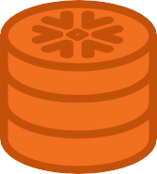



What Customers like about Snowflake
Performance
200x
Concurrency
Simplicity
“We can now run an entire set of monthly reports that used to take 2-3 days in just 45 minutes.”
Ken Wood, Data Team Manager
“Consistency of performance and
concurrency has been a huge win for us.”
Erika Bakse, BI Solution Architect
“That we don’t need to do
any configuration or tuning is great –
we can focus on analyzing data instead of
managing and tuning a data warehouse.”
Craig Lancaster, CTO

Slide 8
















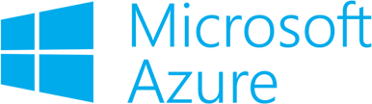









Cloud Data Ecosystem
Data Integration
Business Intelligence | Analytics and Machine Learning
Innovative Technologies | Development Tools
Cloud Platform

Slide 9









































Proven by Over 3000 Customers
7

Slide 10
How Snowflake is different?
Snowflake is built on top of the leading cloud computing platforms (AWS,Azure,GCP). It means it runs completely on cloud infrastructure.
There is absolutely no hardware or software to select, install, configure, or manage.
All the ongoing maintenance, management, upgrades, and tuning are handled by Snowflake.
What sets Snowflake apart is its architecture and data sharing capabilities.
The Snowflake architecture allows storage and compute to scale independently, so customers can use and pay for storage and computation separately.
And the sharing functionality makes it easy for organizations to quickly share governed and secure data in real time.
Snowflake cannot run on a private cloud infrastructure, either on-premises or hosted.

Slide 11
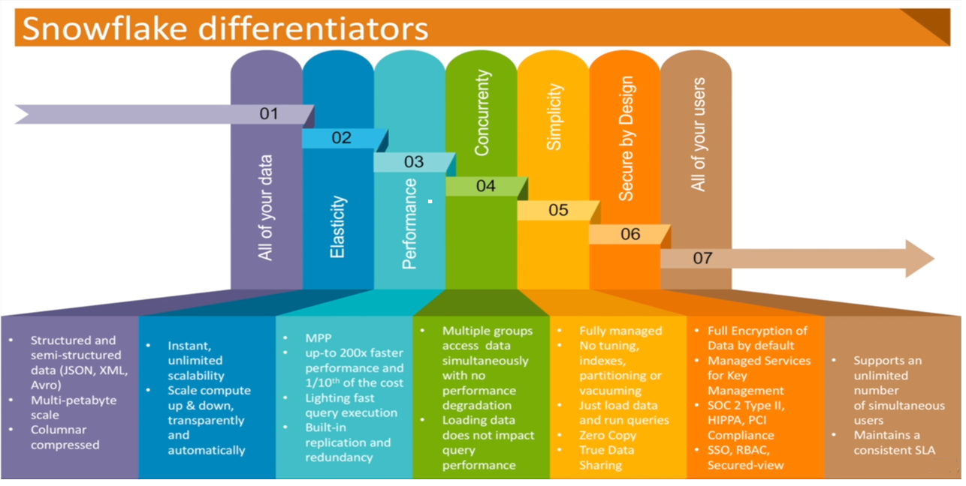
How Snowflake is different?

Slide 12
Key Features and Benefits of Snowflake
Snowflake is built specifically for the cloud designed to support fault isolation, performance isolation and elasticity of cloud.
Effortless Usability: As a Snowflake user, you simply signup, choose your cloud provider, load your data into database tables and start querying.
Performance and Speed: allows you to scale up the compute resources as required instantly to make the data loads and querying faster and scale down afterwards or even shut down when not in use.
Storage and support for structured and semi-structured data: provides unlimited scalability in terms of storage and you only pay for what you are using. It also supports both structured and semi-structured non-relational data
Data Sharing and replication capabilities: Snowflake makes it easy to replicate your data across multiple regions and clouds. Snowflake provides secure data sharing and replication options that make this easy to achieve.
High Availability: Data in Snowflake is distributed across availability zones of the platform on which it runs AWS , Azure or GCP.
Third-party data integrations: Snowflake customers to extend workflows with data services and third-party applications. An integration platform as a service (iPaaS) like Informatica Cloud pre-built Snowflake connectors make it easy for anyone to create data pipelines to automate workflows across the enterprise.
Cost Effective: Snowflake offers a flexible pricing model where you pay only for the compute and cloud storage that you actually use. The Snowflake interface cuts off idle time of resources and only considers the usage time.

Slide 13
Snowflake on GCP
Snowflake Concepts & Architecture
What is Snowflake
Snowflake is an analytic data warehouse provided as Software-as-a-Service (SaaS). Snowflake provides a data warehouse that is faster, easier to use, and far more flexible than traditional data warehouse offerings.
Data Warehouse as a Cloud Service
There is no hardware (virtual or physical) for you to select, install, configure, or manage.
There is no software for you to install, configure, or manage.
Ongoing maintenance, management, and tuning is handled by Snowflake
Snowflake runs completely on cloud infrastructure
Snowflake manages all aspects of software installation and updates.

Slide 14
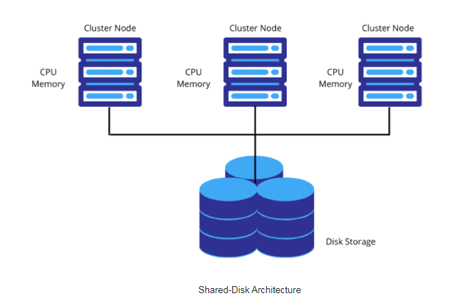
Traditional Architecture: Shared-Disk Architecture
Shared-Disk architecture is an architecture in which the cluster nodes share same storage device but each node has its own CPU and Memory.
Any machine can read or write any portion of data into central data storage.
Scalability and performance are limitations.
One storage layer accessible by all cluster nodes.

Slide 15
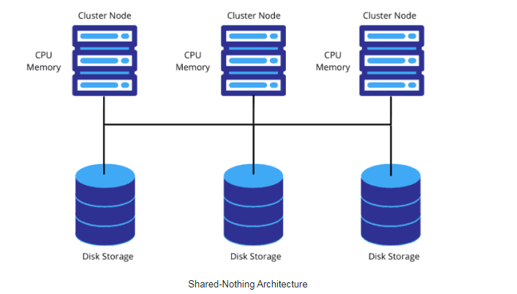
Traditional Architecture: Shared-Nothing Architecture
Contrary to Shared-Disk architecture, Shared-Nothing architecture has distributed cluster nodes with their own CPU, Memory along with Disk storage.
In this architecture the data is partitioned and stored across these compute nodes locally as each node has its own disk storage.
This model might lead to data loss if the copies of partitioned data is not maintained as backup in another cluster nodes, as there is no redundancy.
Each node in the cluster stores a portion of the entire data set locally which enables Massive Parallel Processing.

Slide 16
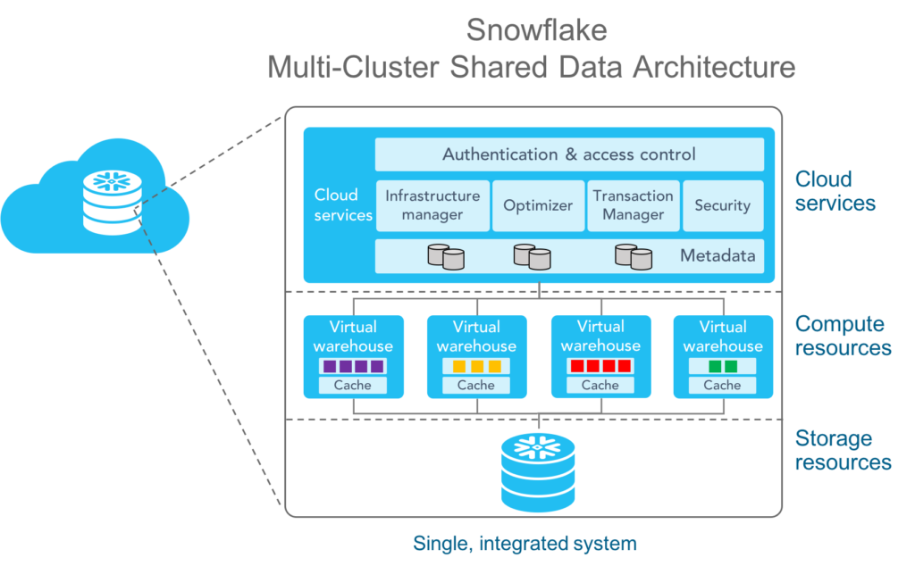
Snowflake Architecture
Snowflake’s architecture is a hybrid of traditional Shared-Disk and Shared-Nothing database architectures
With the hybrid Shared Data model, Snowflake has the data management simplicity of a Shared-Disk( central data repository) architecture with the performance benefits of a Shared-Nothing(MPP) architecture.
Snowflake’s architecture consists of 3 layers:
1)Database Storage
2)Query Processing
3)Cloud Services

Slide 17
Snowflake Architecture: Database Storage Layer
Database Storage Layer:
Snowflake uses highly secure cloud storage to maintain all your data.
Snowflake stores all data in databases. A database is a logical grouping of objects consisting primarily of tables and views organized into one or more schemas.
Snowflake supports both structured data using standard SQL data types and semi-structured non-relational data like JSON, Parquet, Avro etc. through Variant data type.
Snowflake supports querying data through ANSI Standard SQL.
As data is loaded into tables, snowflake converts it into an optimized columnar compressed format and encrypts it using AES-256 strong encryption.
Data objects in Snowflake are only accessible via SQL queries through the Compute layer and are hidden to users.

Slide 18
Snowflake Architecture: Query Processing Layer
Query execution is performed in the compute layer which is the ‘Muscle’ of the system.
A compute layer is where queries are executed using resources provisioned from a cloud provider.
snowflake allows you to create multiple independent compute clusters called Virtual Warehouses that all access the same data storage layer without contention or performance degradation.
Each virtual warehouse is an independent compute cluster made up of multiple compute nodes that does not share compute resources with other virtual warehouses. As a result, each virtual warehouse has no impact on the performance of other virtual warehouses.
Advantages with Warehouse:
A Virtual Warehouse can be scaled up or down at any time without any downtime or disruption.
Virtual Warehouses can also be set to auto-suspend or auto-resume so that warehouses are suspended after a specific period of inactive time and resumed when a query is submitted.
Since virtual warehouses access the same data storage layer, any updates or inserts become immediately available to all other warehouses.

Slide 19
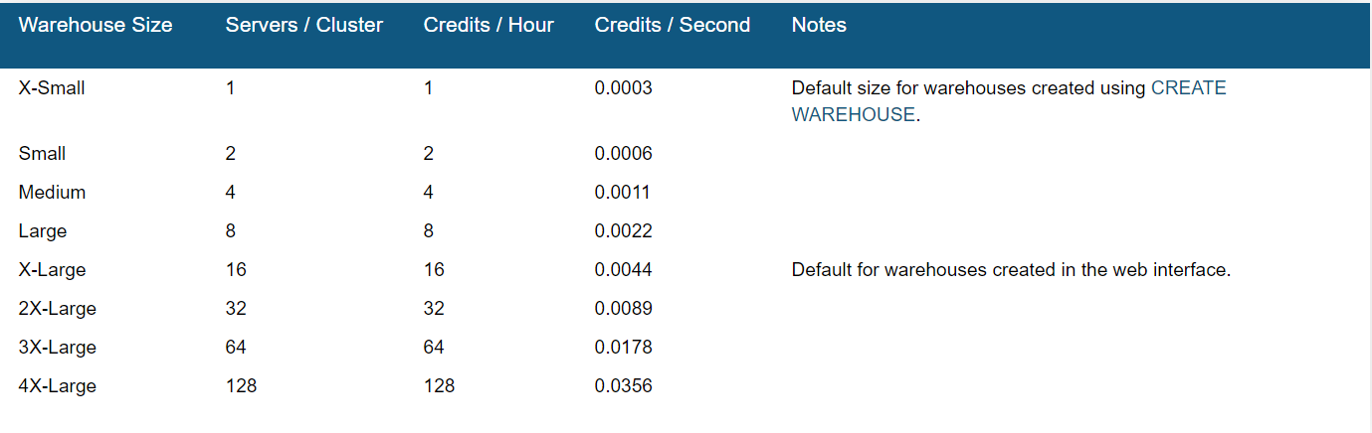
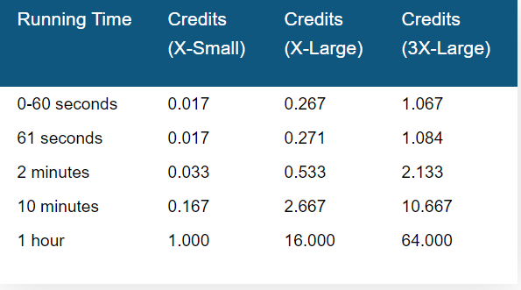
Virtual Warehouse Sizes

Slide 20
Snowflake Architecture: Cloud Services Layer
The Snowflake Cloud Services layer is the ‘Brain’ of the system which coordinates and manages the entire system.
The cloud services layer is fully maintained by snowflake and runs on compute instances provisioned by Snowflake from the cloud provider.
Services layer is responsible for
Authentication of users.
Manages sessions, secures data and performs query compilation and optimization.
Infrastructure Management by managing virtual warehouses and storage.
Coordinating data storage updates and access control so that the same version of the data is available to all warehouses with no impact on availability or performance.
A key component of the services layer is the Metadata Store of tables and micro partitions which powers a number of unique snowflake features including zero copy cloning, time travel and data sharing.

Slide 21
Connecting to Snowflake
Connecting to Snowflake
Web UI – Web Interface
CLI – SnowSQL – Command Line Utility
ODBC – JDBC
Native Connectors – Java, Python
Third Party Connectors – ETL Tools – Informatica, Talend, Matallion

Slide 22
Snowflake Platforms
Supported Cloud Platforms
AWS
Azure
GCP
Each platform provides one or more regions where the account is provisioned
The cloud platform you choose for each Snowflake account is completely independent from your other Snowflake accounts

Slide 23
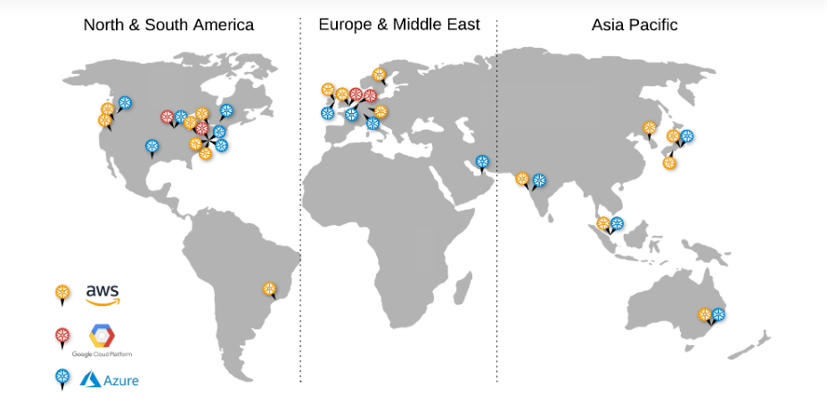
Snowflake Regions
Regions let your organization choose where your data is geographically stored across your regional, national, and international operations.
Each Snowflake account is hosted in a single region. If you wish to use Snowflake across multiple regions, you must maintain a Snowflake account in each of the desired regions.

Slide 24
Snowflake editions
Standard Edition : Standard Edition is our introductory level offering, providing full, unlimited access to all of Snowflake’s standard features. It provides a strong balance between features, level of support, and cost.
Enterprise Edition: Enterprise Edition provides all the features and services of Standard Edition, with additional features designed specifically for the needs of large-scale enterprises and organizations.
Business Critical Edition: Business Critical Edition, formerly known as Enterprise for Sensitive Data (ESD), offers even higher levels of data protection to support the needs of organizations with extremely sensitive data, particularly PHI data that must comply with HIPAA and HITRUST CSF regulations.
Virtual Private Snowflake (VPS):Virtual Private Snowflake offers our highest level of security for organizations that have the strictest requirements, such as financial institutions and any other large enterprises that collect, analyze, and share highly sensitive data.
EDITIONS:https://docs.snowflake.com/en/user-guide/intro-editions.html#release-management

Slide 25
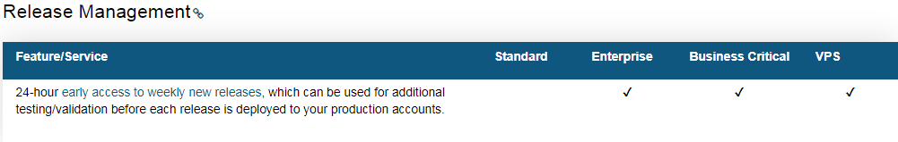
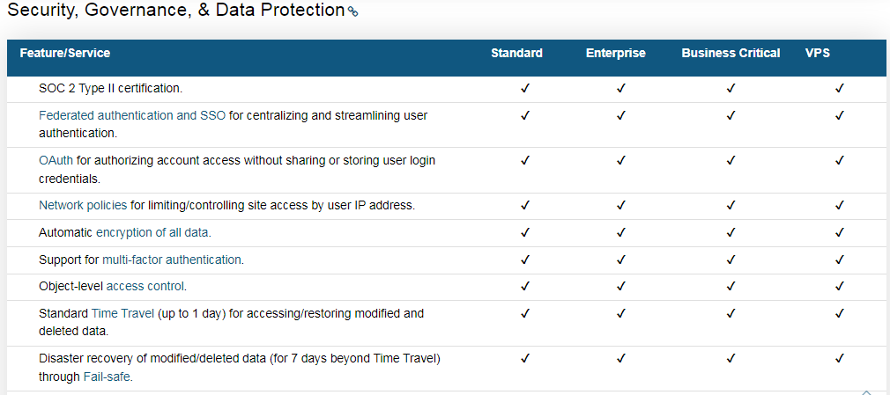
Snowflake Editions Comparison

Slide 26
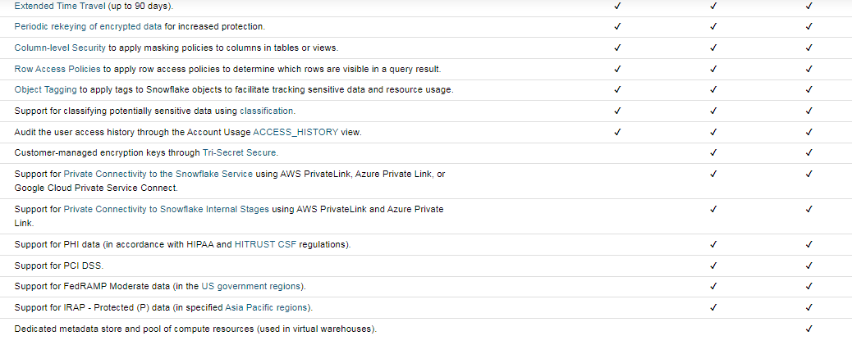
Snowflake Editions Comparison

Slide 27
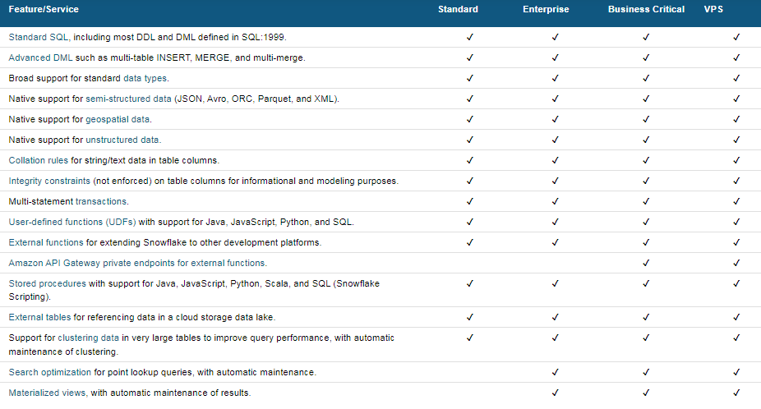
Snowflake Editions Comparison

Slide 28
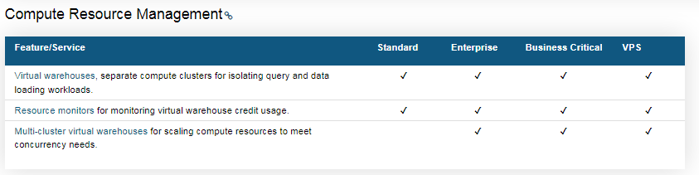
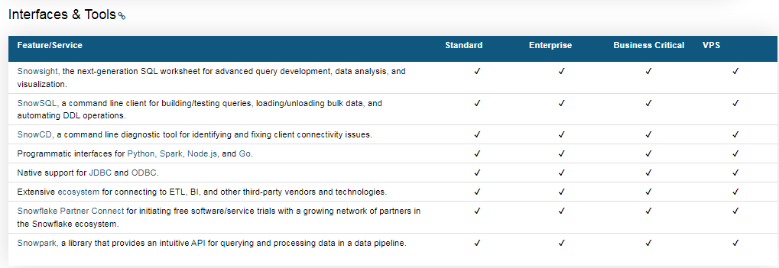
Snowflake Editions Comparison

Slide 29
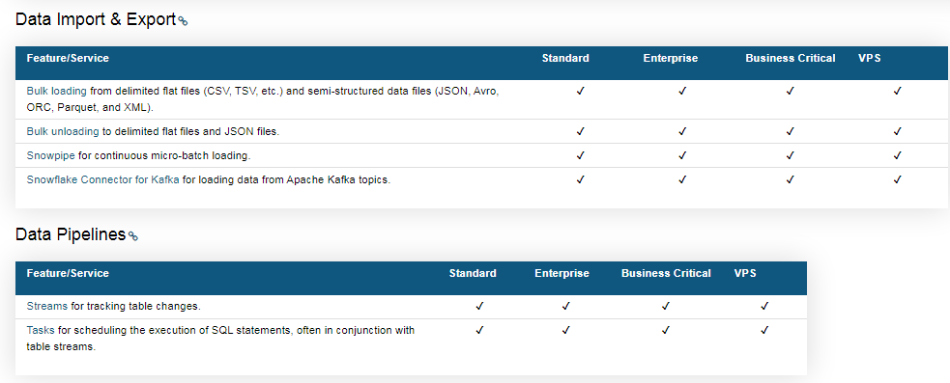
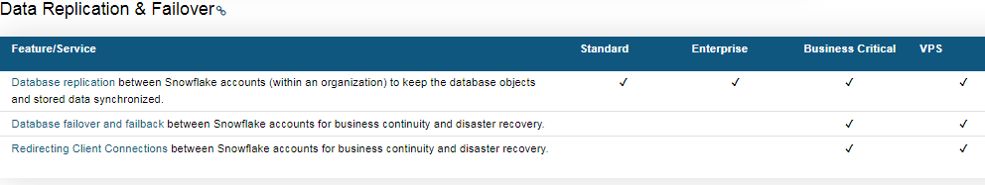
Snowflake Editions Comparison

Slide 30
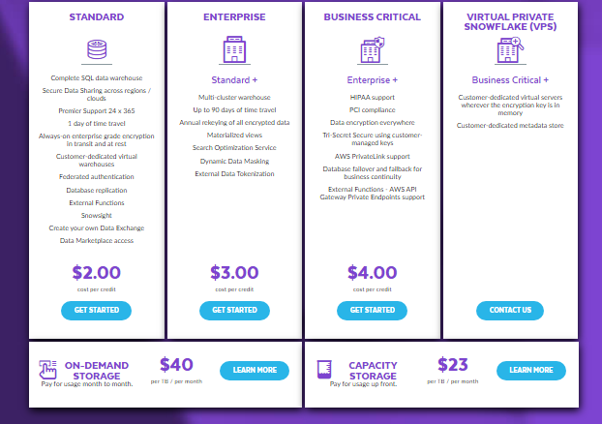
Pricing
Differences in unit costs for credits calculated by based on region and cloud platform and edition.
Storage cost also varry from one platform to another and on-demand and capacity storage

Slide 31
Snowflake URL
A hostname for a Snowflake account starts with an account name (provided by Snowflake) and ends with the Snowflake domain
<account_name>.snowflakecomputing.com
Ex:: https://en74892.europe-west4.gcp.snowflakecomputing.com accountname = en74892.europe-west4.gcp
user: en74892 region: europe-west4
cloud platform: gcp

Slide 32
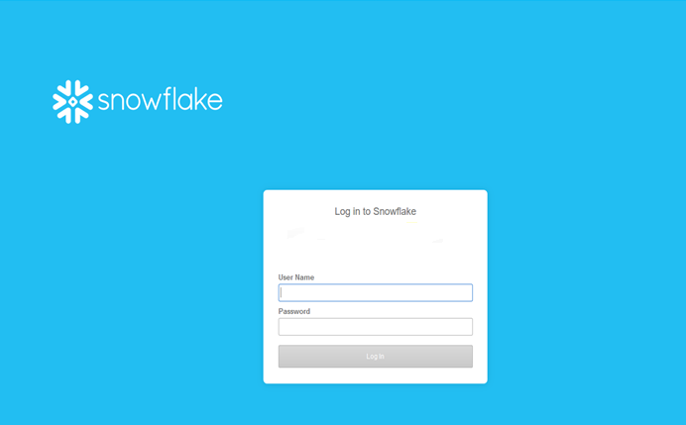
Snowflake Web UI
Account creation in the Snowflake: Please enter / click on the Url that you have received in your email for the trial Snowflake Account you have requested.
Log Into the Snowflake Account: Enter your User Name And Password

Slide 33
Snowflake Web UI
Snowflake web-based graphical interface, you can create and manage all Snowflake objects
Databases
Virtual Warehouses
All Database Objects (Schemas, Tables, Stages etc..)
Load Limited Amount of Data into Tables
Execute Queries, DDL and DML Operations
Based on the Role (Privileges) you have you can perform admin actions like Creating and Managing Users
Logging into the Snowflake
Please enter / click on the Url that you have received in your email for the trial Snowflake Account you have requested

Slide 34
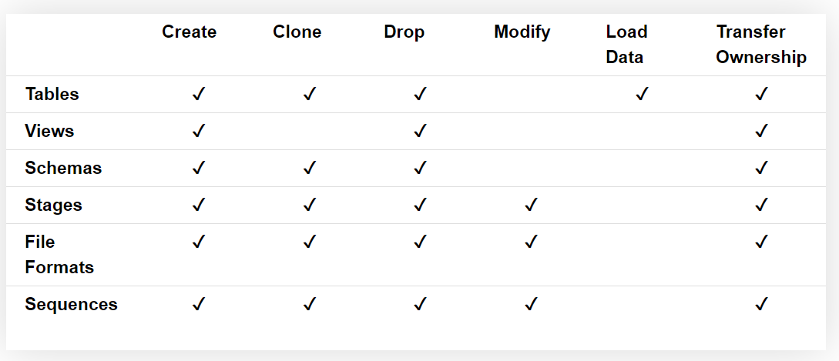
Snowflake Web UI
Databases Page
Shows information about the Databases that you have created or access to.
You can create , clone ,transfer ownership or drop a database
You can also access or navigate to the below objects in database

Slide 35
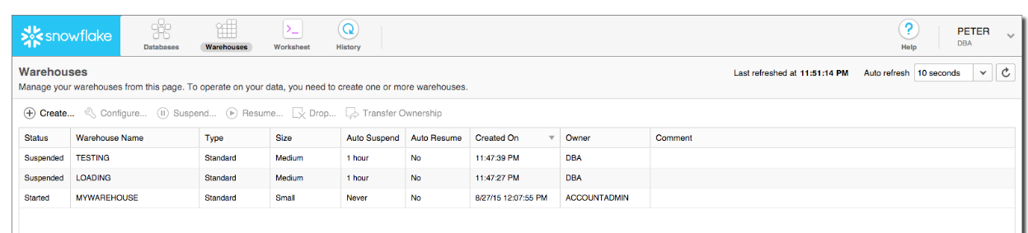
Snowflake Web UI
Warehouses Page
You can view Virtual Warehouses that you have created or access to
You can do the below actions in Warehouses Page
Create or drop a warehouse.
Suspend or resume a warehouse.
Configure a warehouse.
Transfer ownership of a warehouse to a different role.

Slide 36
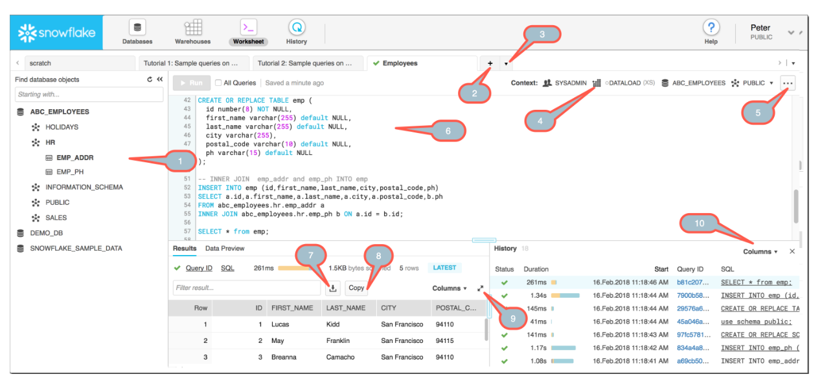
Snowflake Web UI
Worksheet Page
This page helps us to run our SQLs, Create Procedures, Load Tables.
We can create up to 16 Worksheets and each work sheet can connect to different database with different roles as well
All the worksheets are saved by default and when you connect back the next time to Snowflake all the Worksheets are intact.

Slide 37
Snowflake Web UI
Worksheet Page – Notes Details
1 – Database Navigator
2 – Create New Worksheet
3 – Open Existing Worksheet
4 – Context Sensitive Menu – Virtual Warehouse
5 – Load a Script, Delete a Worksheet, Highlight Code
6 – Queries or SQL text that can be executed or run
7 – Download the SQL Query Result Set
8 – Copy the SQL Query Result Set
9 – Expand the columns with Result set
10 – Select the columns in the History Details for viewing

