Slide 1
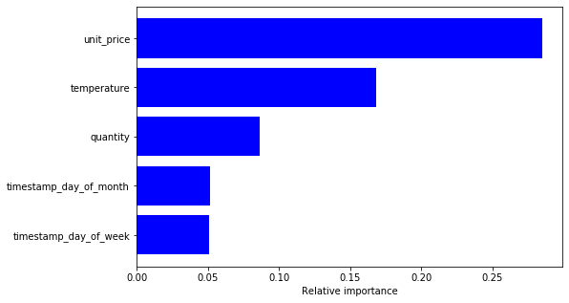
Findings:
1.More data is required
Model is performing with 50 % accuracy . Inorder to test this model in production large samples are required
2.Price is important
Price was an important feature in the model but category was not. Are there more features about the products to include in the model
3. Build on IOT
Temperature was also a significant feature in the model. With more iot or sensor data we believe that the accuracy of the model will improve. It also open up the potential to use open source weather data.

