Slide 1
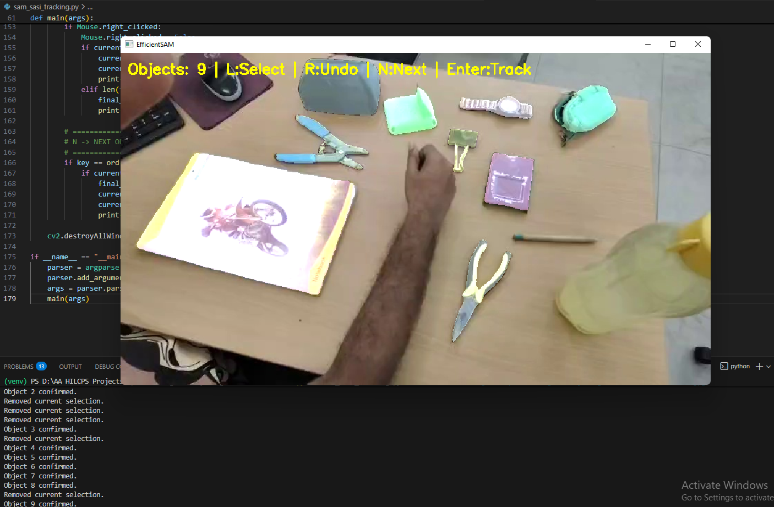
SAM image segmentation

Slide 2
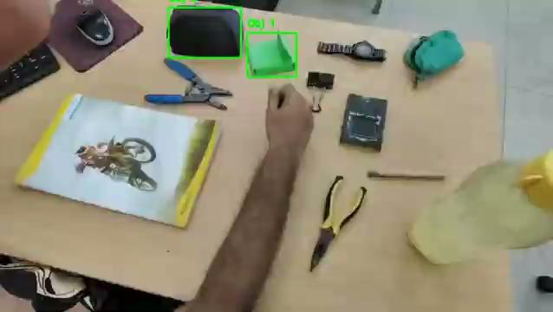
SAM video segmentation (Testing)
We are able to put bounding boxes for the segmented objects
We are able to move use segmentation and convert to csrt
TESTING SUCCESS

Slide 3
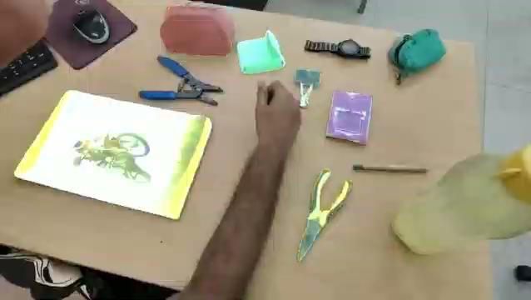
SAM video segmentation
Detection and tracking of the segmented objects
Works for rare and unusual objects
Drawbacks: Takes too long to process without GPU

Slide 4
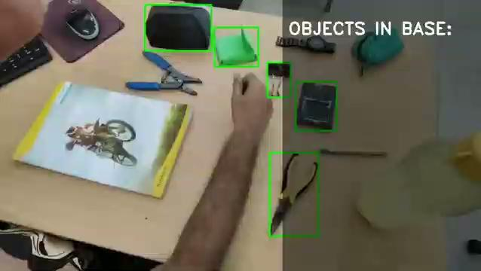
SAM video segmentation (Order of objects in base)
The notebook is selected as the BASE. The other segmented objects is drawn bounding boxes and gets their names assigned by the user.
It displays when the segmented objects are placed inside the BASE with their order.
Detection and tracking of the segmented objects with bounding box. Works for rare and unusual objects
Drawbacks: Takes too long to process without GPU

Slide 5
SAM
PROS:
Very Accurate Detection and tracking
Works for unusual Objects
CONS:
Takes a lot of time to compute
Requires GPU for fast processing, but it is also computationally expensive and slow than traditional tracking.

