Slide 1
ScreeCo
Generates PCFs automatically

Slide 2
What is ScreeCo?
Creating Page Configuration Files (PCF) is one of the primary task of a configuration developer
In current scenario, a Configuration developer does the following tasks to develop PCFs
  Validates the FLS provided by BA
  Raises clarifications if there are any discrepancy before development
  Starts the PCF development
  Identifies new discrepancies during the development from FLS
  Raises further clarifications to BA
  Completes the PCF development
All the above tasks will be automatically carried out by ScreeCo
Creation of typelists will also be taken care by ScreeCo

Slide 3
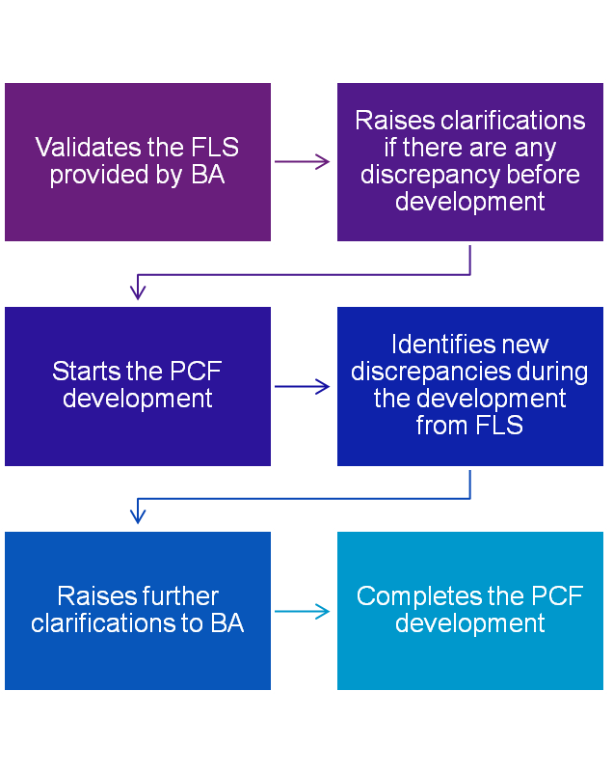
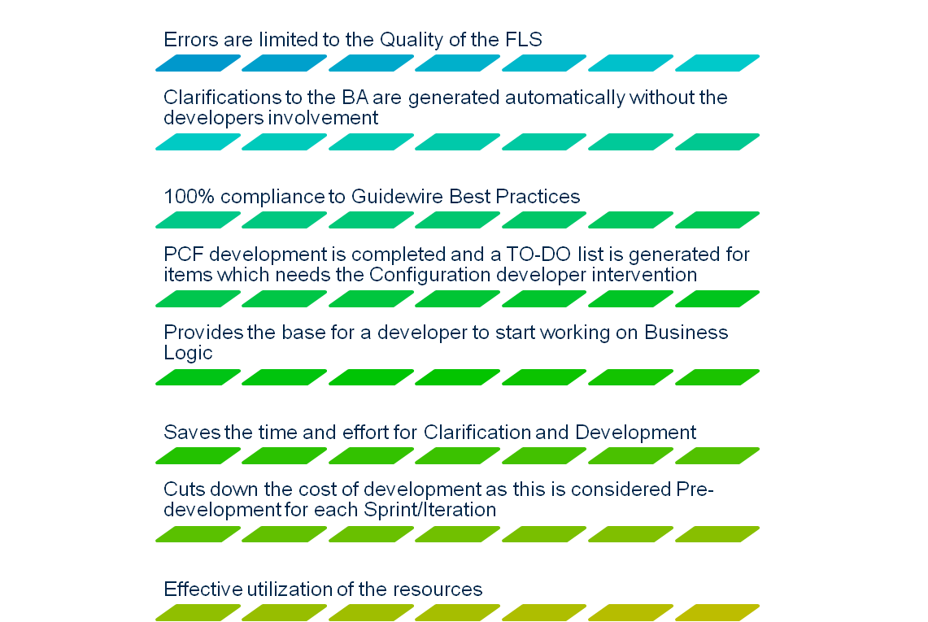
The Before and After of ScreeCo!

Slide 4
How to use ScreeCo?
Download and Install the PCF Generator
Place one or more FLS(s) in the following path
  PCFGEN\INPUT\FLS folder
Place the Typelist master in the following path
  PCFGEN\INPUT\TYPELIST
Run ScreeCo by following the on screen wizard

Slide 5
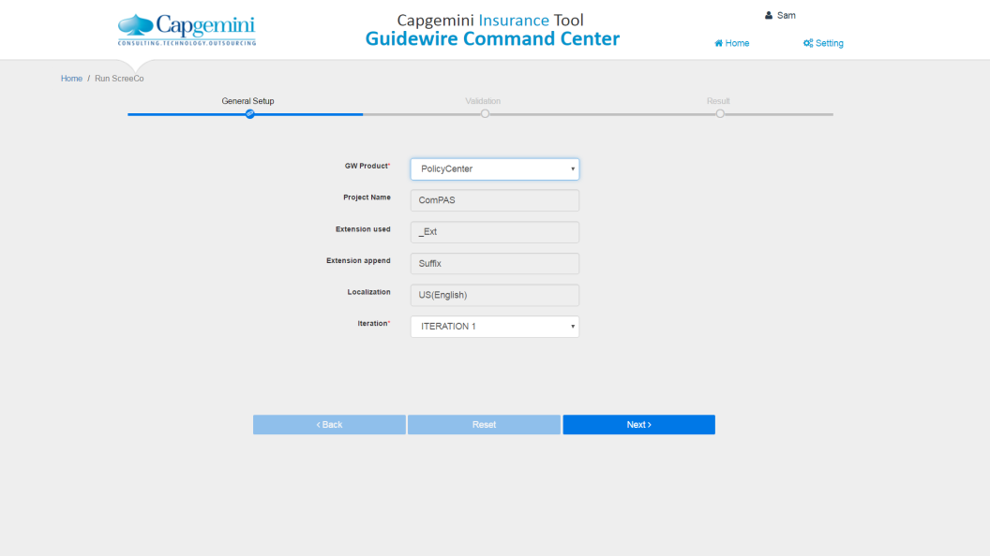
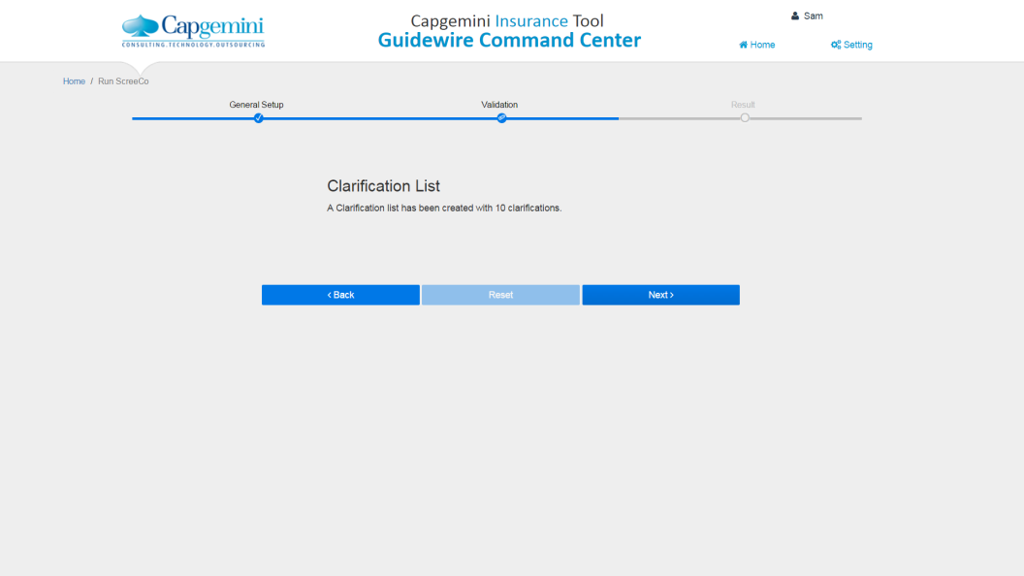
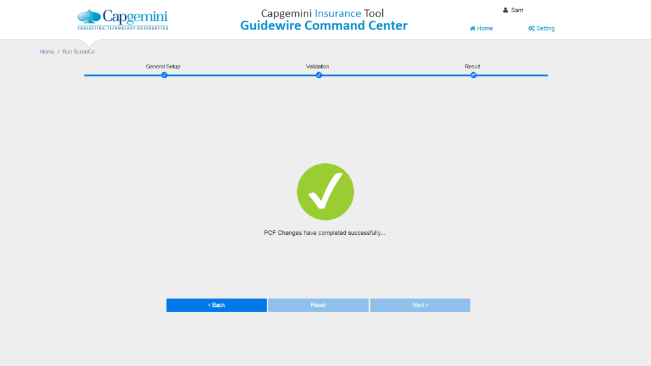
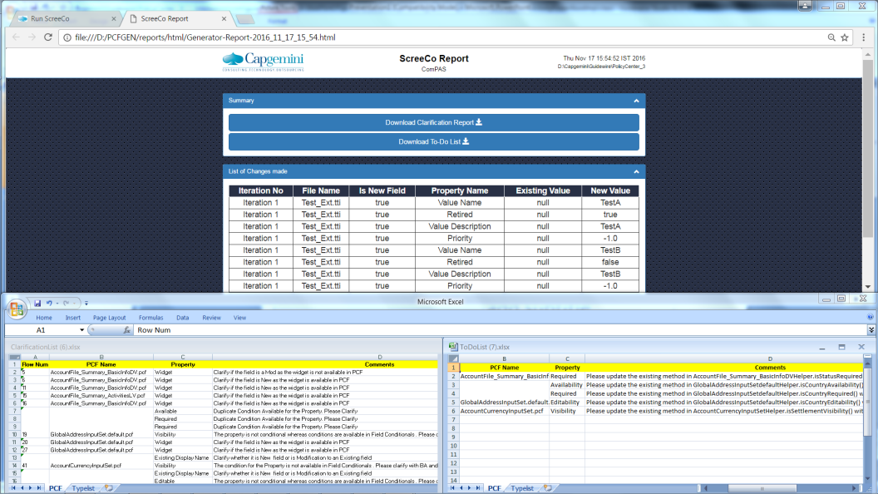
Flow of ScreeCo

