Slide 1
COMPUTER VISION AND PATTERN RECOGNITION (CEG-7550) MOTION DETECTION OF MULTIPLE OBJECTS
Professor: Dr. N. Bourbakis nikolaos.bourbakis@wright.edu
Presented by:
Team Number: 10 KOTA SASI PRIYA (kota.42@wright.edu) KOTHA LOKESH(kotha.56@wright.edu)

Slide 2
Introduction
Introduction to Moving Object Detection
Fundamental component in various applications: security, traffic monitoring, autonomous driving.
Key objective: Differentiate moving objects from static backgrounds in video sequences.
Enables further processing such as tracking, recognition, and behavior analysis.
Current Detection Methods
Optical Flow: Detailed motion estimation, but computationally heavy and noise-sensitive.
Frame Differencing: Fast and simple, but only effective under controlled frame timing; struggles with dynamic scene changes.
Background Subtraction: Balances simplicity and effectiveness; however, highly dependent on accurate background modeling.

Slide 3
Introduction (contd..)
Challenges in Traditional Background Subtraction
Sensitive to environmental changes like lighting and weather.
Pixel-based models often fail in dynamic scenes, causing false positives and missed detections.
Difficulty adapting to subtle background movements, impacting detection accuracy.
Innovative Approach: Block Updates
Introduces a block-based method for robust, efficient background subtraction.
Enhances noise resilience and computational efficiency by segmenting video frames into blocks.
Adapts more effectively to scene variations, improving detection in diverse conditions.

Slide 4
Objectives and Methodologies
Objectives:
Improve Accuracy: Enhance detection accuracy in dynamically changing environments.
Boost Efficiency: Reduce computational demands for real-time processing.
Increase Adaptability: Ensure robustness against environmental changes like lighting and weather.
Methodology:
Block-based Subtraction: Segment frames into blocks for efficient processing.
Dynamic Thresholding: Use adaptive thresholds for precise foreground detection.
Adaptive Background Update: Incrementally adjust the background model based on scene changes.
Performance Evaluation: Validate through comparative analysis with existing methods.

Slide 5
Problems Identified
System/Software Cost: Lack of clear cost details. potential high computational demands.
Operability: Missing specific details on system setup and technical requirements.
Usability: No information on the user interface or ease of use.
Multi-User Support: Does not explicitly address support for multiple users or concurrent access.
User-Friendliness: Absence of details on user-friendly features and system interaction.
Hardware Compatibility: Requires confirmation if it supports diverse hardware platforms, critical for scalability.
Software Compatibility: Needs verification on integration with various software environments, important for seamless deployment.

Slide 6
Improvements for identified problems
System/Software Cost: The cost associated could be high due to the use of specific libraries such as cv2 and multiprocessing. To reduce costs, you could explore using open-source or lower-cost libraries that offer similar functionalities.
Multi-User Support: If it does not support multiple users simultaneously, you could consider implementing a queuing system where image processing requests from different users are queued and processed in order.
Hardware/Software Compatibility: The complexity of the code could be reduced by modularizing the code into smaller, more manageable functions. This could make the code easier to understand, maintain, and debug. Additionally, adding comments to explain complex parts of the code could also help reduce its complexity.

Slide 7
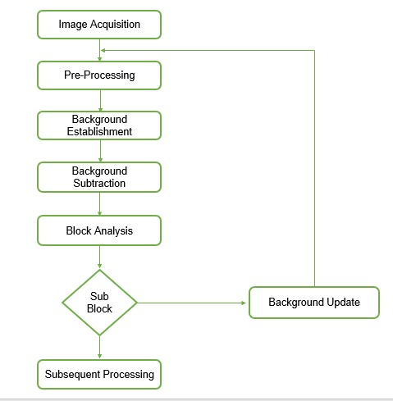
Developed Model
Proposed Model

Slide 8
Developed Model
Image Acquisition: Initial step for capturing video frames.
Pre-Processing: Newly added stage for noise reduction and video stabilization.
Advanced Background Modeling: Improved from "Background Establishment" with adaptive learning algorithms for more robust initial background modeling.
Enhanced Background Subtraction: Upgraded step that incorporates techniques to better handle dynamic backgrounds.
Block Analysis: Previously "Difference Image Block," now includes anomaly detection to differentiate between background noise and actual movement.
Decision Process for Movement: New decision-making step to evaluate if the detected movement is relevant or not (e.g., discard false positives like light flickers).
Sub-Block Classification: Enhanced from "sub-block in non-moving area," now with machine learning classification to improve the accuracy of detection.

Slide 9
Developed Model (contd..)
Background Update with Feedback Loop: Upgraded background update mechanism that takes feedback from classification results to refine the background model continuously.
Subsequent Processing: Post-processing step that can include object tracking, recognition, or other higher-level processing tasks.

Slide 10
Developed Code
1. The `initialize_background` function initializes the background model using the first frame of the video sequence.
2. The `update_background` function updates the background model using a running average approach.
3. The `apply_background_subtraction` function subtracts the background model from the current frame to detect moving objects.
4. In the `main` function:
- A video capture object is created using either the webcam (with `cv2.VideoCapture(0)`) or a video file.
- The initial background model is created using the first frame.
- In a loop, frames are captured from the video source.
- Background subtraction is applied to each frame to detect moving objects.

Slide 11
Developed code
The background model is updated with the current frame.
- The resulting binary image, which highlights moving objects, is displayed.
- Pressing 'q' quits the loop and closes the program.
This code can be useful for applications like motion detection or object tracking.

Slide 12

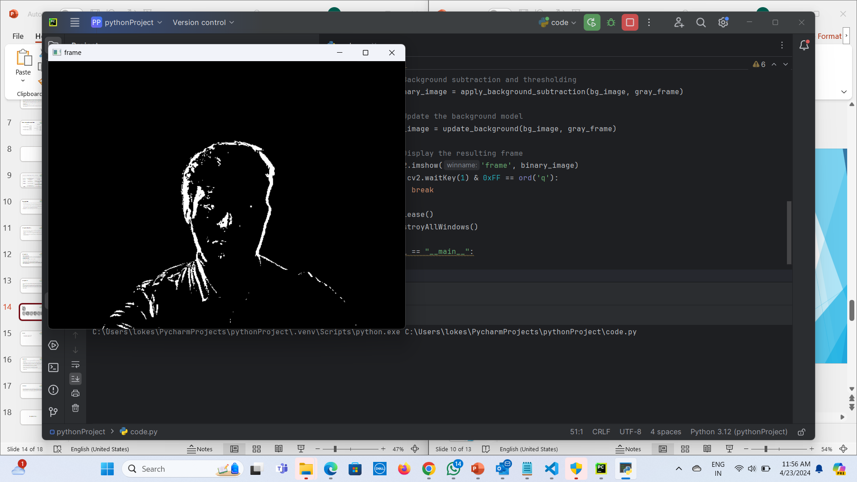
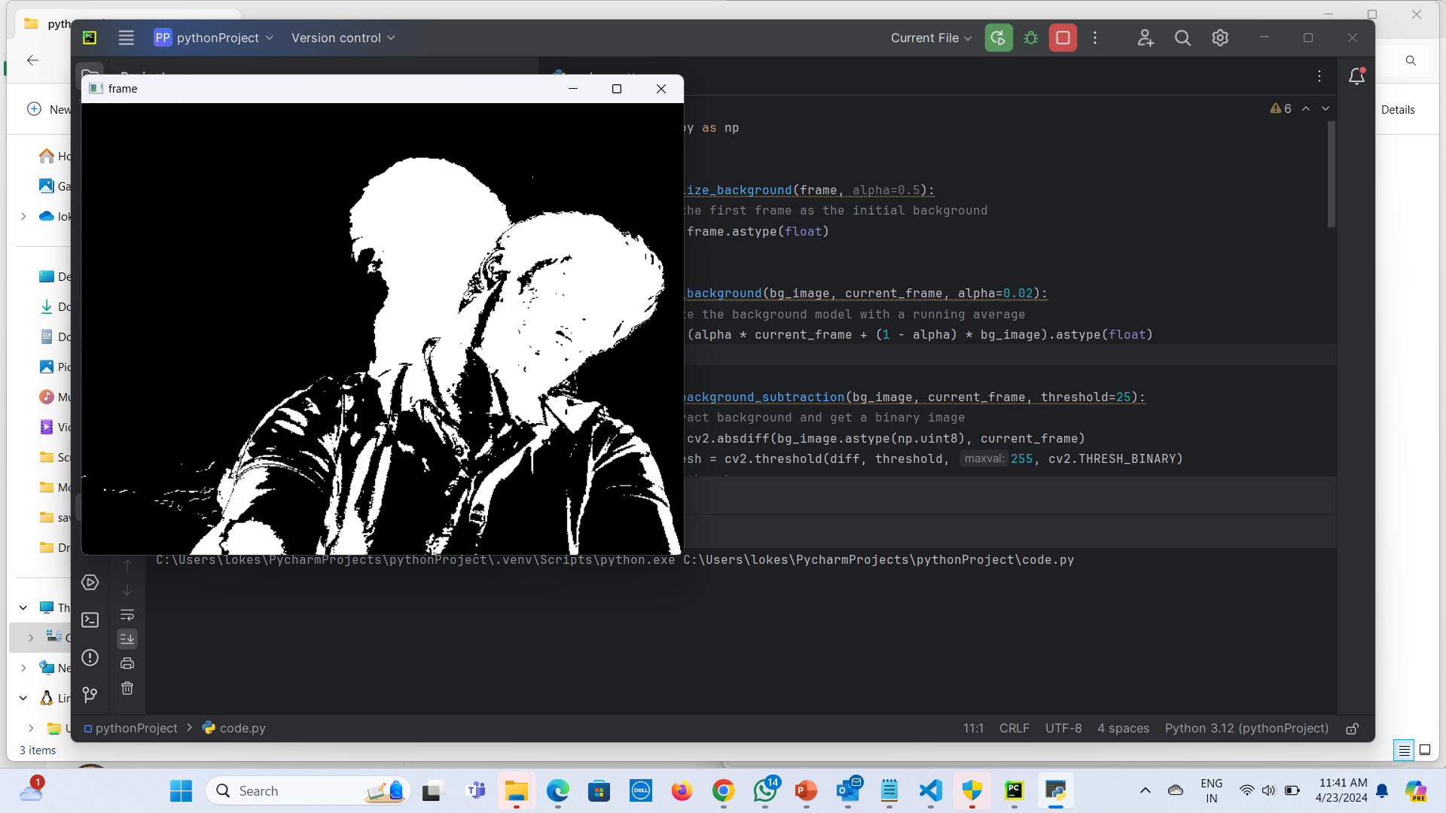
Results
Original image

Slide 13
Future Work
The paper presents a moving object detection method based on background subtraction of block updates. Future work could focus on improving this algorithm to increase its accuracy and efficiency. This could involve optimizing the block size or the weight factors used in the initial background model.
The paper mentions that the algorithm is not sensitive to light and background disturbances. Future research could focus on making the algorithm adaptable to a wider range of environments and lighting conditions.
The paper states that the algorithm meets the real-time requirement. However, there could be room for improvement in terms of processing speed, especially for high-resolution videos or complex scenes.
The paper compares the proposed method with other methods like Gauss method and three frame difference integrated with background subtraction method. Future work could explore the integration of these methods to leverage their respective strengths

Slide 14
Conclusion
The proposed moving object detection method, based on background subtraction with block updates, offers a robust, efficient, and real-time solution for computer vision tasks. It accurately separates moving objects from the background, even in challenging environments, and is adaptable to changing conditions. With its potential applications ranging from surveillance systems to autonomous navigation, this method represents a significant advancement in the field of computer vision.

Slide 15
Thankyou…

