Slide 1
Clinical Data-Managing, Analyzing, Submitting
Using Softwares (Oracle Clinical, Argus Safety & SAS)
Argus Safety
SAS Clinical
PV (PV CENTRES)
Regulatory Authorities
SAS ( Analysis & Reporting)
(ICH-GCP)
guidelines
CLINICAL RESEARCH
Drug development
Process + Preclinical
+Clinical Trials
Sponsor
CRO - CTT
Clinical Data Management
Oracle Clinical Software
Protocol
SOP
IB
IP
ETHICS
ICF

Slide 2
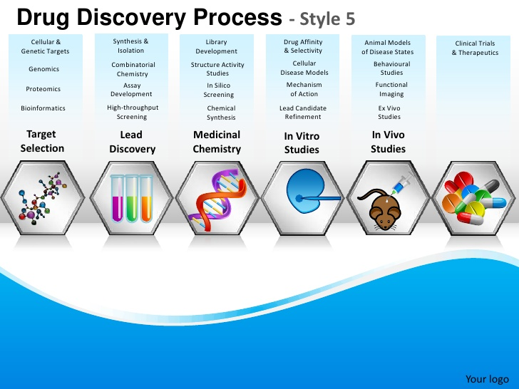
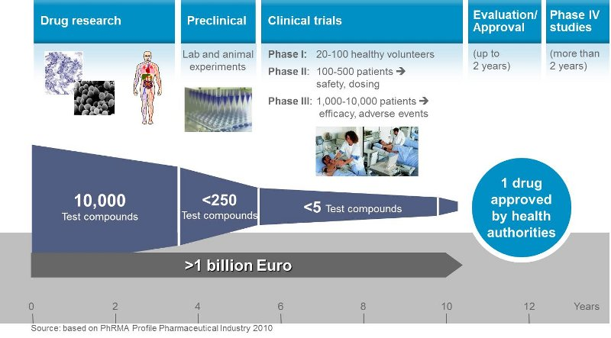

Slide 3
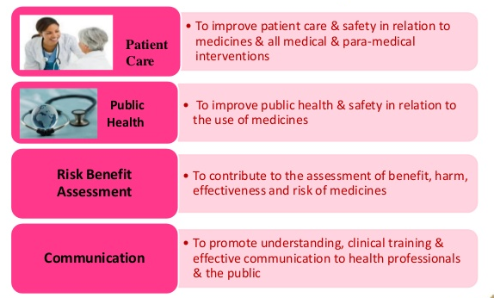
WHY PHARMACOVIGILANCE ?

Slide 4
Who reports about Adverse Events in Clinical trials and in PMS
Investigator
Clinical Trials
Sponsor
PMS
Clinical Trials
PMS
Consumers, Physicians, Health care Professionals
Health Authority

Slide 5
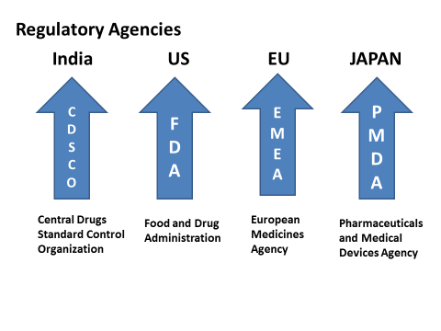
Drug Effects
Pharmacovigilance
Benefit Risk Analysis
Skeleton…
No drug which is pharmacologically effective is without hazard
Good
Benefit
Bad
Risk - AE
Suspected Adverse Reaction Forms:
Blue Card - Australia
Yellow Card – UK
Canada Vigilance Reporting Form - Canada
CIOMS (Council for International Organizations of Medical Sciences) Form - WHO
FDA MedWatch Form 3500 - USA
Suspected Adverse Reaction Form – CDSCO – India
(Central Drugs Standard Control Organization)
Expected
Unexpected
Individual Case Data flow
Signal Detection
Risk Management
ICSRs
Case Intake
Unblinding
Case Lock
Individual
Aggregate
Case Triage
Medical Review
Reporting
Expedited Reporting
PSUR
Data Entry
Quality Review
Case Archive

Slide 6
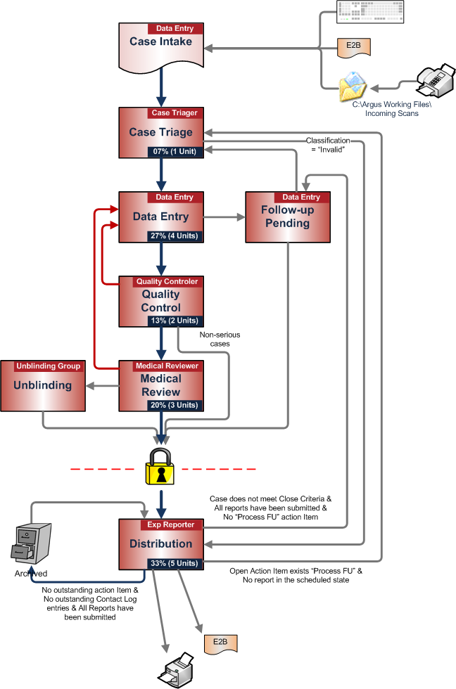

Slide 7
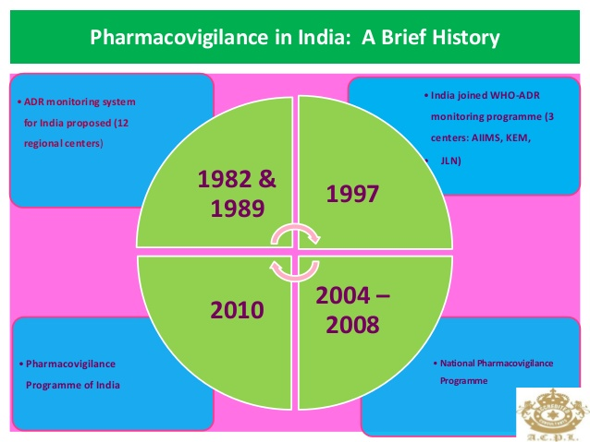

Slide 8
