Slide 1
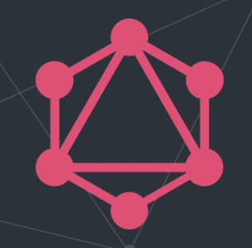
GraphQL
GraphQL is a query language (that's what the “QL” stands for) for APIs and a runtime for fulfilling those queries with your existing data
Notes:
GraphQL is a query language designed to build client application by providing an intuitive and flexible syntax for describing their data requirement. Yep, that is the most perfect definition and little bit jargon too. Let me explain that in better and easier syntax.Often endpoints without IDs just return everything and end points with ID returns full information about 1 resource. The biggest issue is you are either under fetching or over fetching information. Imagine you are over fetching 100s of IDs and making 100 API calls and then filtering just 5 values form it. It is expensive on servers. Servers like cricket information and Facebook.

Slide 2
Introduction to GraphQL
GraphQL is a query language for your API, and a server-side runtime for executing queries using a type system you define for your data. GraphQL isn't tied to any specific database or storage engine and is instead backed by your existing code and data.
A GraphQL service is created by defining types and fields on those types, then providing functions for each field on each type. For example, a GraphQL service that tells you who the logged in user is (me) as well as that user's name might look like this:

Slide 3
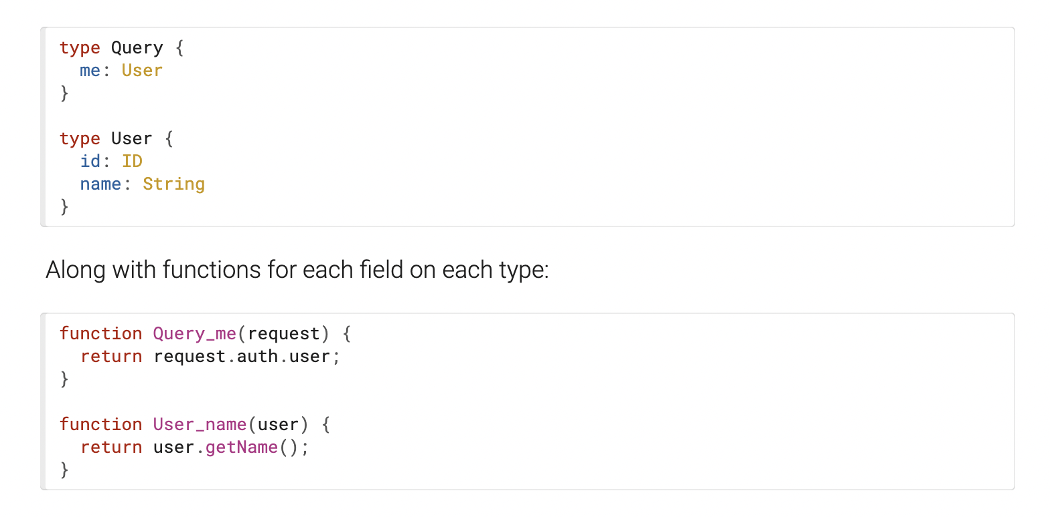

Slide 4
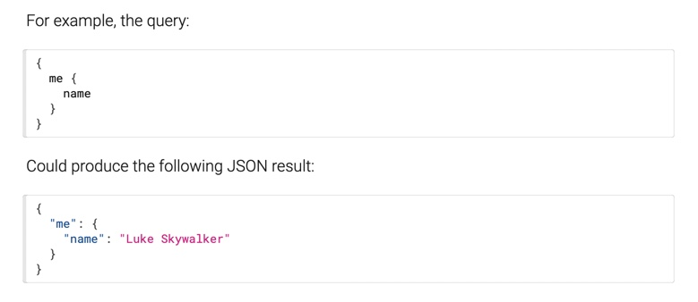
After a GraphQL service is running (typically at a URL on a web service),
it can receive GraphQL queries to validate and execute.
The service first checks a query to ensure it only refers to the types and fields defined,
and then runs the provided functions to produce a result.

Slide 5
What is GraphQL?
GraphQL is a query language and server-side runtime for application programming interfaces (APIs) that prioritizes giving clients exactly the data they request and no more.
GraphQL is designed to make APIs fast, flexible, and developer-friendly. It can even be deployed within an integrated development environment (IDE) known as GraphiQL. As an alternative to REST, GraphQL lets developers construct requests that pull data from multiple data sources in a single API call.
Additionally, GraphQL gives API maintainers the flexibility to add or deprecate fields without impacting existing queries. Developers can build APIs with whatever methods they prefer, and the GraphQL specification will ensure they function in predictable ways to clients.

Slide 6
GraphQL compared to REST Services
A REST API is an architectural concept for network-based software. GraphQL, on the other hand, is a query language, a specification, and a set of tools that operates over a single endpoint using HTTP. In addition, over the last few years, REST has been used to make new APIs, while the focus of GraphQL has been to optimize for performance and flexibility.

Slide 7
Where GraphQL Has the Upper Hand Over REST APIs
When using a REST API to fetch information, you’ll always get back a complete dataset. For example, if you wanted to request information from two objects, you’d need to perform two REST API requests. The advantage of REST APIs is its simplicity—you have one endpoint that does one task, so it’s easy to understand and manipulate. In other words, if you have X endpoint, it provides X data.
Conversely, if you wanted to gather some information from a specific endpoint, you couldn’t limit the fields that the REST API returns; you’ll always get a complete data set. This phenomenon is referred to as over fetching. GraphQL uses its query language to tailor the request to exactly what you need, from multiple objects down to specific fields within each entity. GraphQL would take X endpoint, and it can do a lot with that information, but you have to tell it what you want first.
In essence, GraphQL is extremely powerful, once you know how to use it. Because you are only fetching the data that you require, you limit the amount of processing required. As you begin to look at automation, these savings really start to add up.

Slide 8
Where REST APIs Beat Out GraphQL
REST has become the industry standard for companies deploying APIs. REST endpoints are mature and have been around for a while. Even “late-to-scene” OEMs have REST endpoints now, and if you have done any type of automation, you’re going to be familiar with REST.
Similarly, API analytics are easier to obtain for REST, due to the limited amount of tooling for GraphQL. There is a promise of more insights in the near future, once tools that support GraphQL are made more widely available.

Slide 9
Benefits of Graphql
Being less “talkative” than REST makes GraphQL way faster, as you can cut down on your request by picking only the fields you want to query. The following list shows other major advantages of using a GraphQL API in an application instead of a REST API.
Good fit for complex systems and microservices. By integrating multiple systems behind its API, GraphQL unifies them and hides their complexity. The GraphQL server is then responsible for fetching the data from the existing systems and packaging it up in the GraphQL response format. This is particularly relevant for legacy infrastructures or third-party APIs that have expanded over the years and now present a maintenance burden.

Slide 10
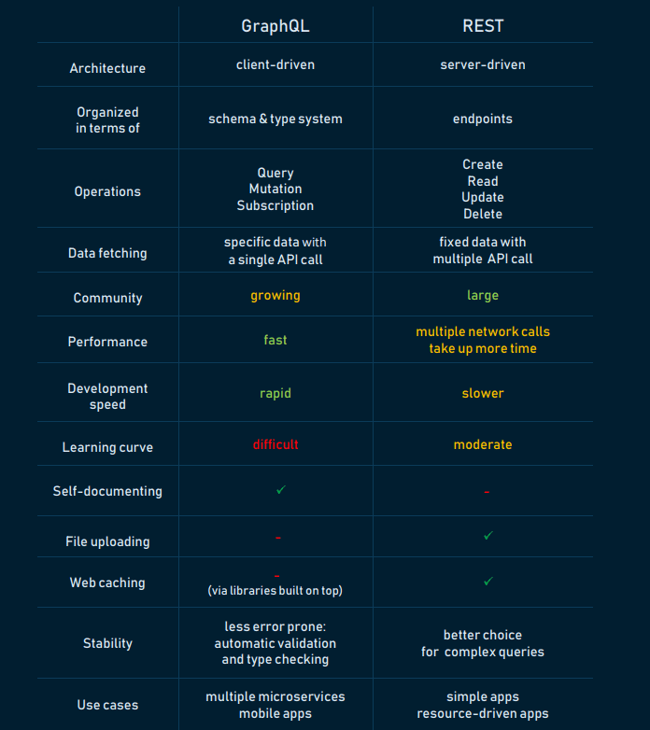
When migrating from a monolithic backend application to a microservice architecture, a GraphQL API can help handle communication between multiple microservices by merging them into one GraphQL schema. While each microservice defines its own GraphQL schema and has its own GraphQL endpoint, one GraphQL API gateway consolidates all schemas into one global schema.

Slide 11
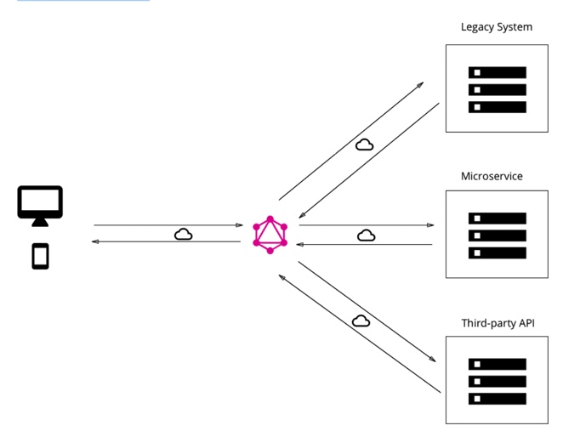
Fetching data with a single API call. The main difference between GraphQL and REST is that the latter is centered around individual endpoints, so to collect all needed data, a developer has to combine multiple endpoints. Whereas GraphQL focuses on the task itself, in this case, a developer can request the needed data with just one API call.
No over- and under-fetching problems. REST responses are known for either containing too much data or not enough of it, creating the need for another request. GraphQL solves this efficiency problem by fetching the exact data in a single request.
Caption

Slide 12
Apollo compared to Flux, Redux, and Relay
Apollo and Redux are primarily classified as "Platform as a Service" and "State Management Library" tools respectively.
Apollo vs Redux: What are the differences?
Developers describe Apollo as "GraphQL server for Express, Connect, Hapi, Koa and more". Build a universal GraphQL API on top of your existing REST APIs, so you can ship new application features fast without waiting on backend changes. On the other hand, Redux is detailed as "Predictable state container for JavaScript apps".
Redux helps you write applications that behave consistently, run in different environments (client, server, and native), and are easy to test. On top of that, it provides a great developer experience, such as live code editing combined with a time traveling debugger.

Slide 13
Apollo compared to Flux, Redux, and Relay
When developing modern React applications, at some point you need to solve the problem of managing your client-side state. Modern applications can’t afford to wait for the server to react, can’t always refetch when changing pages – they need to be reactive and feel as if everything is happening as fast as possible.
The state management layer of your application is responsible for this. You can also call it your caching layer or a model layer.
Redux and Relay are libraries for implementing this layer in your application.
Instagram, Intuit, and OpenGov are some of the popular companies that use Redux, whereas Apollo is used by CircleCI, Swat.io, and Flexport. Redux has a broader approval, being mentioned in 1036 company stacks & 836 developers stacks; compared to Apollo, which is listed in 131 company stacks and 127 developer stacks.

Slide 14
What is Redux?
It helps you write applications that behave consistently, run in different environments (client, server, and native), and are easy to test. t provides a great experience, such as live code editing combined with a time traveling debugger.

Slide 15
Benefits of GraphQL
GraphQL advantages
Good fit for complex systems and microservices. ...
Fetching data with a single API call. ...
No over- and under-fetching problems. ...
Tailoring requests to your needs. ...
Validation and type checking out-of-the-box. ...
Autogenerating API documentation. ...
API evolution without versioning. ...
Code-sharing.

Slide 16
Renaming a field with aliasing.
When working with a GraphQL API, you may want to rename a field to something other than what the API has to offer. Aliases exist as part of the GraphQL spec to solve this exact problem.
Aliases allow you to rename a single field to whatever you want it to be. They are defined client-side, so you don’t need to update your API to use them.
Imagine requesting data using the following query from an API:
You will get the following JSON response:
query GetEntries {
entries {
id
updated_at
}
}
{
"entries": [
{
"id": "4fe43afe",
"updated_at": "2020-07-05T22:56:15.012Z"
}
]
}

Slide 17
The id here is fine, but the updated_at doesn’t quite conform to the camel case convention in JavaScript. Let’s change it by using an alias.
query GetEntries {
entries {
id
updatedAt: updated_at
}
}
Which yields the following:
{
"entries": [
{
"id": "4fe43afe",
"updatedAt": "2020-07-05T22:56:15.012Z"
}
]
}

Slide 18
Creating an alias in GraphQL is easy. Simply add a colon and new name next to the field you want to rename.
Aliasing fields with arguments
The examples above only cover fields that don’t have any arguments. When creating an alias on a field that contains arguments, the syntax is slightly different. Instead of the alias appearing right to the field, it’s placed on the left.
Take a look at the following example. It contains the updated_atfield, but again, we want to rename.
query GetEntries {
entries {
id
updated_at(format: “MM dd, YYYY”)
}
}

Slide 19
Now with an alias:
query GetEntries {
entries {
id
updatedAt: updated_at(format: “MM dd, YYYY”)
}
}
And the result:
{
"entries": [
{
"id": "4fe43afe",
"updatedAt": "July 5, 2020"
}
]
}

Slide 20
Requesting a single field more than once
What’s great about aliases is you can request the same field several times, but yield different results. Take a look at this example:
query GetEntries {
entries {
id
updated_at
updated_at(format: “MM dd, YYYY”)
}
}
Running this query would yield an error because two of the field names are the same. You can use an alias to here to mitigate the error.
query GetEntries {
entries {
id
updated_at: updatedAt
updatedAtHumanized: updated_at(format: “MM dd, YYYY”)
}}

Slide 21
Running the updated query would give us the results we’re expecting.
{
"entries": [
{
"id": "4fe43afe",
"updatedAt": "2020-07-05T22:56:15.012Z",
"updatedAtHumanized": "July 5, 2020"
}
]
}

Slide 22
Breaking a large query into fragments.
By default, Apollo Client doesn't require any knowledge of the GraphQL schema, which means it's very easy to set up and works with any server and supports even the largest schemas. However, as your usage of Apollo and GraphQL becomes more sophisticated, you may start using fragments on interfaces or unions. Here's an example of a query that uses fragments on an interface:
query {
all_people {
... on Character {
name
}
... on Jedi {
side
}
... on Droid {
model
}
}
}

Slide 23
In the query above, all_people returns a result of type Character[]. Both Jedi and Droid are possible concrete types of Character, but on the client there is no way to know that without having some information about the schema.
By default, Apollo Client's cache will use a heuristic fragment matcher, which assumes that a fragment matched if the result included all the fields in its selection set, and didn't match when any field was missing.
This works in most cases, but it also means that Apollo Client cannot check the server response for you, and it cannot tell you when you're manually writing invalid data into the store using update, updateQuery, writeQuery, etc.
Also, the heuristic fragment matcher will not work accurately when using fragments with unions or interfaces.
Apollo Client will let you know this with a console warning (in development), if it attempts to use the default heuristic fragment matcher with unions/interfaces.
The IntrospectionFragmentMatcher is the solution for working with unions/interfaces.

Slide 24
To support result validation and accurate fragment matching on unions and interfaces, a special fragment matcher called the IntrospectionFragmentMatcher can be used. If there are any changes related to union or interface types in your schema, you will have to update the fragment matcher accordingly.
Setting up a build step that extracts the necessary information from the schema into a JSON file, where it can be imported from when constructing the fragment matcher. To set it up, follow the three steps below:
Query your server / schema to obtain the necessary information about unions and interfaces and write it to a file.
You can automate this or set this as a script to run at build time.
If you want to auto-generate the introspection result, there's a tool called GraphQL Code Generator that does it. Define where your GraphQL Schema is available and where to write the file:
# codegen.yml
schema: YOUR_API
overwrite: true
generates:
./fragmentTypes.json:
plugins:
- fragment-matcher

Slide 25
With all of that, you simply run:
gql-gen
In order to introspect the server manually, set this as a script to run at build time.
const fetch = require('node-fetch');
const fs = require('fs');
fetch(`${YOUR_API_HOST}/graphql`, {
method: 'POST',
headers: { 'Content-Type': 'application/json' },
body: JSON.stringify({
variables: {},
query: `
{
__schema {
types {
kind
name
possibleTypes {
name
}
}
}
}
`,
}),
})
.then(result => result.json())
.then(result => {
// here we're filtering out any type information unrelated to unions or interfaces
const filteredData = result.data.__schema.types.filter(
type => type.possibleTypes !== null,
);
result.data.__schema.types = filteredData;
fs.writeFile('./fragmentTypes.json', JSON.stringify(result.data), err => {
if (err) {
console.error('Error writing fragmentTypes file', err);
} else {
console.log('Fragment types successfully extracted!');
}
});
});

Slide 26
2. Create a new IntrospectionFragment matcher by passing in the fragmentTypes.json file you just created. You'll want to do this in the same file where you initialize the cache for Apollo Client.
3. Pass in the newly created IntrospectionFragmentMatcher to configure your cache during construction. Then, you pass your newly configured cache to ApolloClient to complete the process.
import { IntrospectionFragmentMatcher
} from 'apollo-cache-inmemory’;
import introspectionQueryResultData from './fragmentTypes.json’;
const fragmentMatcher = new IntrospectionFragmentMatcher
({ introspectionQueryResultData })
;
import ApolloClient from 'apollo-client';
import { InMemoryCache } from 'apollo-cache-inmemory';
import { HttpLink } from 'apollo-link-http';
// add fragmentMatcher code from step 2 here
const cache = new InMemoryCache({ fragmentMatcher });
const client = new ApolloClient({
cache,
link: new HttpLink(),
});

Slide 27
Developer tools
Improve your developer experience with these services and extensions
Apollo Studio
Apollo Studio (formerly Graph Manager) is a cloud app that provides a single, consolidated place for you to collaborate on the evolution of your graph.
It provides the following features to all Apollo users for free:
A query window that connects to all your environments and provides ergonomic ways to author and manage queries.
A GraphQL schema registry that tracks the evolution of your graph across your environments.Key insights into which parts of your schema are being actively used, and by whom.Team collaboration via organizations.Advanced features are available with a subscription to an Apollo Team or Enterprise plan.

Slide 28
Apollo Client Devtools
The Apollo Client Devtools are available as an extension for Chrome and Firefox.
Features
The Apollo Client Devtools appear as an "Apollo" tab in your web browser's Inspector panel, alongside default tabs like "Console" and "Network". The devtools currently have four main features:
GraphiQL: Send queries to your server through your web application's configured Apollo Client instance, or query the Apollo Client cache to see what data is loaded.
Watched query inspector: View active queries, variables, and cached results, and re-run individual queries.
Mutation inspector: View active mutations and their variables, and re-run individual mutations.
Cache inspector: Visualize the Apollo Client cache and search it by field name and/or value.

Slide 29
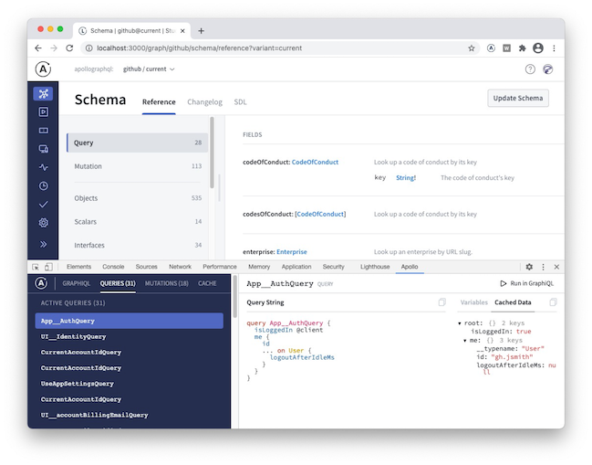

Slide 30
While your app is in dev mode, the Apollo Client Devtools will appear as an "Apollo" tab in your web browser inspector.
To enable the devtools in your app in production, pass connectToDevTools: true to the ApolloClient constructor in your app. Pass connectToDevTools: false if want to manually disable this functionality.
Apollo Codegen
Apollo Codegen is a tool to generate API code or type annotations based on a GraphQL schema and query documents.
It currently generates Swift code, TypeScript annotations, Flow annotations, and Scala code, we hope to add support for other targets in the future.
See Apollo iOS for details on the mapping from GraphQL results to Swift types, as well as runtime support for executing queries and mutations. For Scala, see React Apollo Scala.js for details on how to use generated Scala code in a Scala.js app with Apollo Client.

Slide 31
Usage
If you want to use apollo-codegen, you can install it command globally:
npm install -g apollo-codegen
introspect-schema
The purpose of this command is to create a JSON introspection dump file for a given graphql schema. The input schema can be fetched from a remote graphql server or from a local file. The resulting JSON introspection dump file is needed as input to the generate command.
To download a GraphQL schema by sending an introspection query to a server:
apollo-codegen introspect-schema http://localhost:8080/graphql --output schema.json

Slide 32
You can use the header option to add additional HTTP headers to the request. For example, to include an authentication token, use --header "Authorization: Bearer <token>".
You can use the insecure option to ignore any SSL errors (for example if the server is running with self-signed certificate).
To generate a GraphQL schema introspection JSON from a local GraphQL schema:
apollo-codegen introspect-schema schema.graphql --output schema.json
generate
The purpose of this command is to generate types for query and mutation operations made against the schema (it will not generate types for the schema itself).
This tool will generate Swift code by default from a set of query definitions in .graphql files:
apollo-codegen generate **/*.graphql --schema schema.json --output API.swift
You can also generate type annotations for TypeScript, Flow, or Scala using the --target option:
# TypeScript
apollo-codegen generate **/*.graphql --schema schema.json --target typescript --output operation-result-types.ts
# Flow
apollo-codegen generate **/*.graphql --schema schema.json --target flow --output operation-result-types.flow.js
# Scala
apollo-codegen generate **/*.graphql --schema schema.json --target scala --output operation-result-types.scala

Slide 33
gql template support
If the source file for generation is a javascript or typescript file, the codegen will try to extrapolate the queries inside the gql tag templates.
The tag name is configurable using the CLI --tag-name option.
.graphqlconfig support
Instead of using the --schema option to point out your GraphQL schema, you can specify it in a .graphqlconfig file.
In case you specify multiple schemas in your .graphqlconfig file, choose which one to pick by using the --project-name option.
Typescript and Flow
When using apollo-codegen with Typescript or Flow, make sure to add the __typename introspection field to every selection set within your graphql operations.
If you're using a client like @apollo/client that does this automatically for your GraphQL operations, pass in the --addTypename option to apollo-codegen to make sure the generated Typescript and Flow types have the __typename field as well. This is required to ensure proper type generation support for GraphQLUnionType and GraphQLInterfaceType fields.

Slide 34
Why is the __typename field required?
Using the type information from the GraphQL schema, we can infer the possible types for fields. However, in the case of a GraphQLUnionType or GraphQLInterfaceType, there are multiple types that are possible for that field. This is best modeled using a disjoint union with the __typename as the discriminant.
For example, given a schema:
interface Character {
name: String!
}
type Human implements Character {
homePlanet: String
}
type Droid implements Character {
primaryFunction: String
}

Slide 35
Apollo Codegen will generate a union type for Character.
export type CharactersQuery = {
characters: Array<{
__typename: 'Human',
name: string,
homePlanet: ?string
} | {
__typename: 'Droid',
name: string,
primaryFunction: ?string
}>
}
This type can then be used as follows to ensure that all possible types are handled:
function CharacterFigures({ characters }: CharactersQuery) {
return characters.map(character => {
switch(character.__typename) {
case "Human":
return <HumanFigure homePlanet={character.homePlanet} name={character.name} />
case "Droid":
return <DroidFigure primaryFunction={character.primaryFunction} name={character.name} />
}
});
}
Whenever a field of type Character is encountered, it could be either a Human or Droid. Human and Droid objects will have a different set of fields. Within your application code, when interacting with a Character you'll want to make sure to handle both of these cases.
Given this query:
query Characters {
characters(episode: NEW_HOPE) {
name
... on Human {
homePlanet
}
... on Droid {
primaryFunction
}
}
}

Slide 36
Inline Fragments
Like many other type systems, GraphQL schemas include the ability to define interfaces and union types. Learn about them in the schema guide.
If you are querying a field that returns an interface or a union type, you will need to use inline fragments to access data on the underlying concrete type. It's easiest to see with an example:
query HeroForEpisode($ep: Episode!) {
hero(episode: $ep) {
name
... on Droid {
primaryFunction
}
... on Human {
height
}
}
}
{
"data": {
"hero": {
"name": "R2-D2",
"primaryFunction": "Astromech"
}
}
}
{
"ep": "JEDI"
}

Slide 37
In this query, the hero field returns the type Character, which might be either a Human or a Droid depending on the episode argument. In the direct selection, you can only ask for fields that exist on the Character interface, such as name.
To ask for a field on the concrete type, you need to use an inline fragment with a type condition. Because the first fragment is labeled as ... on Droid, the primaryFunction field will only be executed if the Character returned from hero is of the Droid type. Similarly for the height field for the Human type.
Named fragments can also be used in the same way, since a named fragment always has a type attached.

Slide 38
Directives
Configure GraphQL types, fields, and arguments
A directive decorates part of a GraphQL schema or operation with additional configuration. Tools like Apollo Server (and Apollo Client) can read a GraphQL document's directives and perform custom logic as appropriate.
Directives are preceded by the @ character, like so:
schema.graphql
type ExampleType {
oldField: String @deprecated(reason: "Use `newField`.")
newField: String
}
This example shows the @deprecated directive, which is a default directive (i.e., it's part of the GraphQL specification). It demonstrates the following about directives:
Directives can take arguments of their own (reason in this case).
Directives appear after the declaration of what they decorate (the oldField field in this case)

Slide 39
Valid locations
Each directive can only appear in certain locations within a GraphQL schema or operation. These locations are listed in the directive's definition.
For example, here's the GraphQL spec's definition of the @deprecated directive:
directive @deprecated(
reason: String = "No longer supported"
) on FIELD_DEFINITION | ENUM_VALUE
This indicates that @deprecated can decorate either a schema FIELD_DEFINITION (as shown at the top of the article) or a schema ENUM_VALUE definition (as shown here):
The GraphQL specification defines the following default directives:
DIRECTIVE | DESCRIPTION
@deprecated(reason: String) | Marks the schema definition of a field or enum value as deprecated with an optional reason.
@skip(if: Boolean!) | If true, the decorated field or fragment in an operation is not resolved by the GraphQL server.
@include(if: Boolean!) | If false, the decorated field or fragment in an operation is not resolved by the GraphQL server.

Slide 40
To use a custom directive:
Make sure the directive is defined in your schema with all valid locations listed.
If the directive uses a SchemaDirectiveVisitor subclass to perform custom logic, provide it to the ApolloServer constructor via the schemaDirectives object.
The schemaDirectives object maps the name of a directive (e.g., upper) to the subclass that implements its behavior (e.g., UpperCaseDirective).
The following example defines an UpperCaseDirective subclass for use with the @upper custom directive. Because it's decorated with @upper, the Query.hello field returns HELLO WORLD! instead of Hello world!.

Slide 41
type Query {
hello: String @upper
}
`;
// Resolvers
const resolvers = {
Query: {
hello: (parent, args, context) => {
return 'Hello world!';
},
},
};
// Add directive to the ApolloServer constructor
const server = new ApolloServer({
typeDefs,
resolvers,
schemaDirectives: { upper: UpperCaseDirective, }
});
server.listen().then(({ url }) => {
console.log(`🚀 Server ready at ${url}`)
});
const { ApolloServer, gql, SchemaDirectiveVisitor } = require('apollo-server');
const { defaultFieldResolver } = require('graphql');
// Subclass definition for @upper directive logic
class UpperCaseDirective extends SchemaDirectiveVisitor {
visitFieldDefinition(field) {
const { resolve = defaultFieldResolver } = field;
field.resolve = async function (...args) {
const result = await resolve.apply(this, args);
if (typeof result === 'string') {
return result.toUpperCase();
}
return result;
};
}
}
// Schema definition (including custom directive)
const typeDefs = gql`
directive @upper on FIELD_DEFINITION

Slide 42
Introspection
It's often useful to ask a GraphQL schema for information about what queries it supports. GraphQL allows us to do so using the introspection system!
For our Star Wars example, the file starWarsIntrospection-test.ts contains a number of queries demonstrating the introspection system, and is a test file that can be run to exercise the reference implementation's introspection system.
We designed the type system, so we know what types are available, but if we didn't, we can ask GraphQL, by querying the __schema field, always available on the root type of a Query. Let's do so now, and ask what types are available.
{
__schema {
types {
name
}
}
}
Notes:
{
"data": {
"__schema": {
"types": [
{
"name": "Query"
},
{
"name": "String"
},
{
"name": "ID"
},
{
"name": "Mutation"
},
{
"name": "Episode"
},
{
"name": "Character"
},
{
"name": "Int"
},
{
"name": "LengthUnit"
},
{
"name": "Human"
},
{
"name": "Float"
},
{
"name": "Droid"
},
{
"name": "FriendsConnection"
},
{
"name": "FriendsEdge"
},
{
"name": "PageInfo"
},
{
"name": "Boolean"
},
{
"name": "Review"
},
{
"name": "ReviewInput"
},
{
"name": "Starship"
},
{
"name": "SearchResult"
},
{
"name": "__Schema"
},
{
"name": "__Type"
},
{
"name": "__TypeKind"
},
{
"name": "__Field"
},
{
"name": "__InputValue"
},
{
"name": "__EnumValue"
},
{
"name": "__Directive"
},
{
"name": "__DirectiveLocation"
}
]
}
}
}

Slide 43
Query, Character, Human, Episode, Droid - These are the ones that we defined in our type system.
String, Boolean - These are built-in scalars that the type system provided.
__Schema, __Type, __TypeKind, __Field, __InputValue, __EnumValue, __Directive - These all are preceded with a double underscore, indicating that they are part of the introspection system.

Slide 44
Prefetching data
Prefetching is one of the easiest ways to make your application's UI feel a lot faster with Apollo Client. Prefetching simply means loading data into the cache before it needs to be rendered on the screen. Essentially, we want to load all data required for a view as soon as we can guess that a user will navigate to it.
We can accomplish this in only a few lines of code by calling client.query whenever the user hovers over a link.
function Feed() { const { loading, error, data, client } = useQuery(GET_DOGS); let content; if (loading) { content = <Fetching />; } else if (error) { content = <Error />; } else { content = ( <DogList data={data.dogs} renderRow={(type, data) => ( <Link to={{ pathname: `/${data.breed}/${data.id}`, state: { id: data.id } }} onMouseOver={() => client.query({ query: GET_DOG, variables: { breed: data.breed } }) } style={{ textDecoration: "none" }} > <Dog {...data} url={data.displayImage} /> </Link> )} /> ); } return ( <View style={styles.container}> <Header /> {content} </View> ); }

Slide 45
All we have to do is access the client in the render prop function and call client.query when the user hovers over the link. Once the user clicks on the link, the data will already be available in the Apollo cache, so the user won't see a loading state.
There are a lot of different ways to anticipate that the user will end up needing some data in the UI. In addition to using the hover state, here are some other places you can preload data:
The next step of a multi-step wizard immediately
The route of a call-to-action button
All of the data for a sub-area of the application, to make navigating within that area instant

Slide 46
Subscriptions
Get real-time updates from your GraphQL server
In addition to queries and mutations, GraphQL supports a third operation type: subscriptions.
Like queries, subscriptions enable you to fetch data. Unlike queries, subscriptions are long-lasting operations that can change their result over time. They can maintain an active connection to your GraphQL server (most commonly via WebSocket), enabling the server to push updates to the subscription's result.
Subscriptions are useful for notifying your client in real time about changes to back-end data, such as the creation of a new object or updates to an important field.

Slide 47
When to use subscriptions
In the majority of cases, your client should not use subscriptions to stay up to date with your backend. Instead, you should poll intermittently with queries, or re-execute queries on demand when a user performs a relevant action (such as clicking a button).
You should use subscriptions for the following:
Small, incremental changes to large objects. Repeatedly polling for a large object is expensive, especially when most of the object's fields rarely change. Instead, you can fetch the object's initial state with a query, and your server can proactively push updates to individual fields as they occur.
Low-latency, real-time updates. For example, a chat application's client wants to receive new messages as soon as they're available.

Slide 48
Defining a subscription
You define a subscription on both the server side and the client side, just like you do for queries and mutations.
Server side
You define available subscriptions in your GraphQL schema as fields of the Subscription type. The following commentAdded subscription notifies a subscribing client whenever a new comment is added to a particular blog post (specified by postID):
type Subscription {
commentAdded(postID: ID!): Comment
}
For more information on implementing support for subscriptions on the server side, see the Apollo Server documentation for subscriptions.
Client side
In your application's client, you define the shape of each subscription you want Apollo Client to execute, like so:
const COMMENTS_SUBSCRIPTION = gql`
subscription OnCommentAdded($postID: ID!) {
commentAdded(postID: $postID) {
id
content
}
}
`;

Slide 49
When Apollo Client executes the onCommentAdded subscription, it establishes a connection to your GraphQL server and listens for response data. Unlike with a query, there is no expectation that the server will immediately process and return a response. Instead, your server only pushes data to your client when a particular event occurs on your backend.
Whenever your GraphQL server does push data to a subscribing client, that data conforms to the structure of the executed subscription, just like it does for a query:

Slide 50
GraphQL Clients
Since a GraphQL API has more underlying structure than a REST API, there are more powerful clients like Relay which can automatically handle batching, caching, and other features. But you don't need a complex client to call a GraphQL server. With express-graphql, you can just send an HTTP POST request to the endpoint you mounted your GraphQL server on, passing the GraphQL query as the query field in a JSON payload.
For example, let's say we mounted a GraphQL server on http://localhost:4000/graphql as in the example code for running an Express GraphQL server, and we want to send the GraphQL query { hello }. We can do this from the command line with curl. If you paste this into a terminal:
curl -X POST \
-H "Content-Type: application/json" \
-d '{"query": "{ hello }"}' \
http://localhost:4000/graphql
You should see the output returned as JSON:
{"data":{"hello":"Hello world!"}}

Slide 51
If you prefer to use a graphical user interface to send a test query, you can use clients such as GraphiQL and Insomnia.
It's also simple to send GraphQL from the browser. Open up http://localhost:4000/graphql, open a developer console, and paste in:
fetch('/graphql', {
method: 'POST',
headers: {
'Content-Type': 'application/json',
'Accept': 'application/json',
},
body: JSON.stringify({query: "{ hello }"})
})
.then(r => r.json())
.then(data => console.log('data returned:', data));
You should see the data returned, logged in the console:
data returned: Object { hello: "Hello world!" }

Slide 52
As your application becomes more complex, and you add GraphQL endpoints that take arguments as described in Passing Arguments, you will want to construct GraphQL queries using variables in client code. You can do this by including a keyword prefixed with a dollar sign in the query, and passing an extra variables field on the payload.
For example, let's say you're running the example server from Passing Arguments that has a schema of
type Query {
rollDice(numDice: Int!, numSides: Int): [Int]
}
You could access this from JavaScript with the code:
var dice = 3;
var sides = 6;
var query = `query RollDice($dice: Int!, $sides: Int) {
rollDice(numDice: $dice, numSides: $sides)
}`;
fetch('/graphql', {
method: 'POST',
headers: {

Slide 53
'Content-Type': 'application/json',
'Accept': 'application/json',
},
body: JSON.stringify({
query,
variables: { dice, sides },
})
})
.then(r => r.json())
.then(data => console.log('data returned:', data));
Using this syntax for variables is a good idea because it automatically prevents bugs due to escaping, and it makes it easier to monitor your server.

Slide 54
