Slide 1
Predicting Device Failure
By: Bilal Farooq

Slide 2
Topics
Problem statement
Sample
Variable exploration and Modification
Modeling – predicting failure
Final Model Selection & Next Steps

Slide 3
Problem Statement & Data Set
The task is to built a predictive model using machine learning to predict the probability of a device failure. When building the model, need to make sure to minimize false positives and false negatives.
Actual Data Set
Modified Data Set
Values | Counts | Percent %
1 | 106 | 0.09%
0 | 124,388 | 99.9%
Values | Counts | Percent %
1 | 106 | 9.1%
0 | 1,063 | 90.9%
The dataset has just 106 failures vs 124k non failures.
0.1% of devices fail.
There were several rows of data per device id, hence decided to combine all the rows of information per device and added row data as columns.
Once moved the data from row to column got approximately 9% of devices failing.

Slide 4
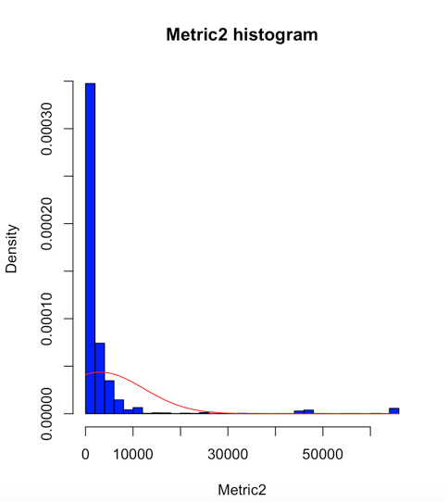
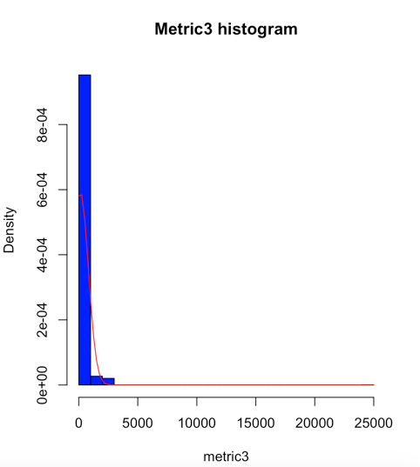
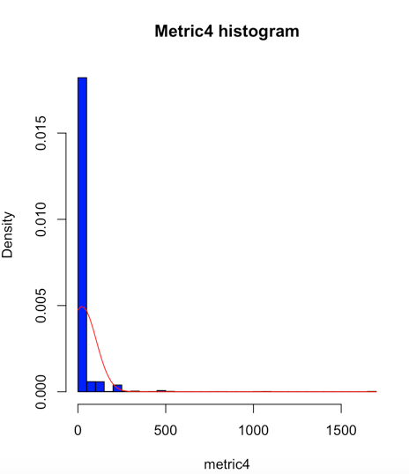
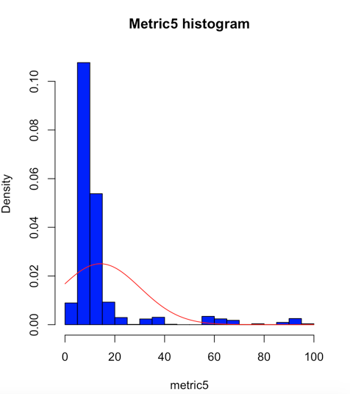
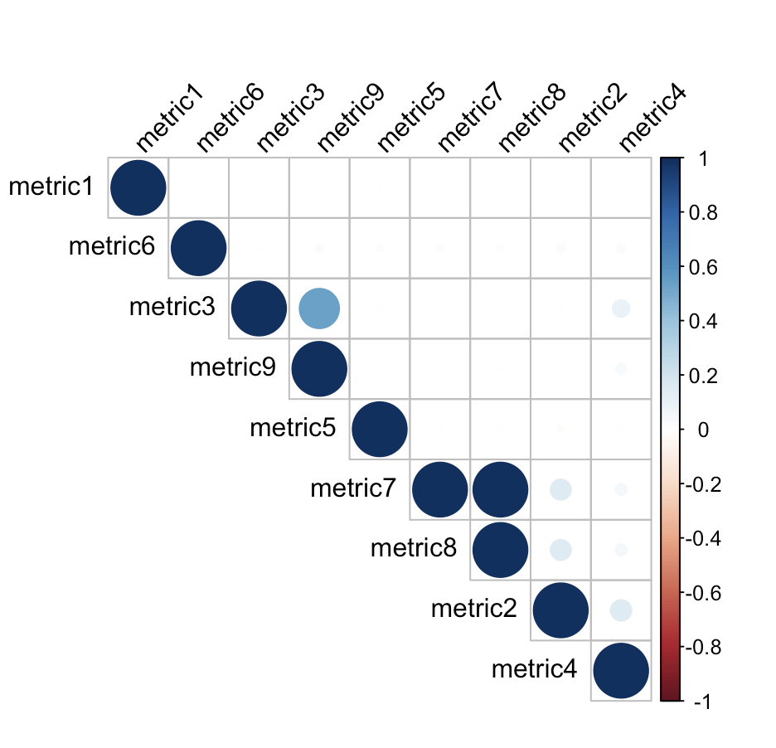
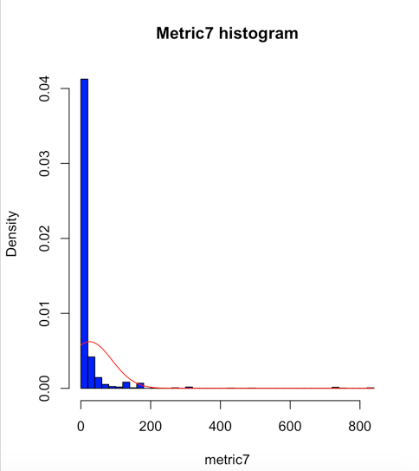
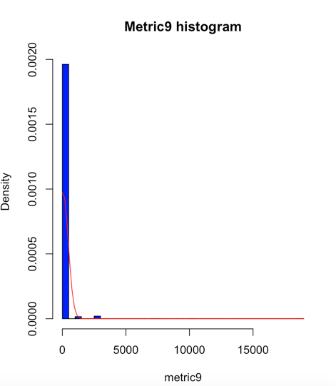
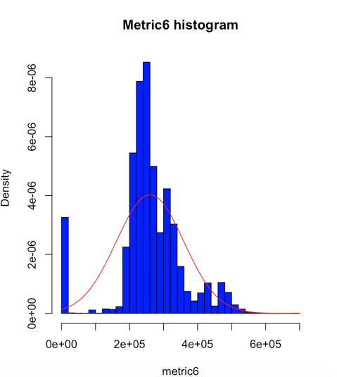
Variable Exploration and Modification
Correlation Analysis
Correlation | Value | Next Steps
Metric3 vs Metric9 | 0.53 | Continue to use both
Metric7 vs Metric 8 | 1.00 | Remove Metric8
Skewed distribution hence created dummy variables.
Normally distributed

Slide 5
Variable Exploration and Modification – continued
Created Ratio Variables -
Ratio variable between Metric 6 and Metric 5.
Created Dummy Variables:
As distributions for several metrics were skewed we have created dummy variables to seek if we can get any signals from them.
Extracted Value out of ID:
Created dummy variables out of ID, e.g. when ID = S1Fxxxx will create dummy variable S1F_dummy = 1 else 0. Similar for other ID’s.
Extracted value out of Date variable:
Based on the month of the year, associated risk of failure.
Based on the day of the month, associated risk of failure.
Calculated “Tenure” which is the number of days between max(date) and min(date).
Scaled continuous variables:
Scaled the continuous variables between 0 and 1.
Additional variables:
Added variables e.g. mean, median, min and max for the continues variables.

Slide 6
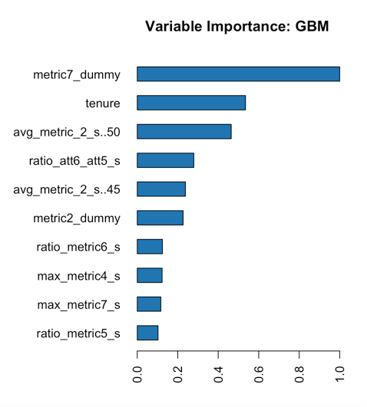
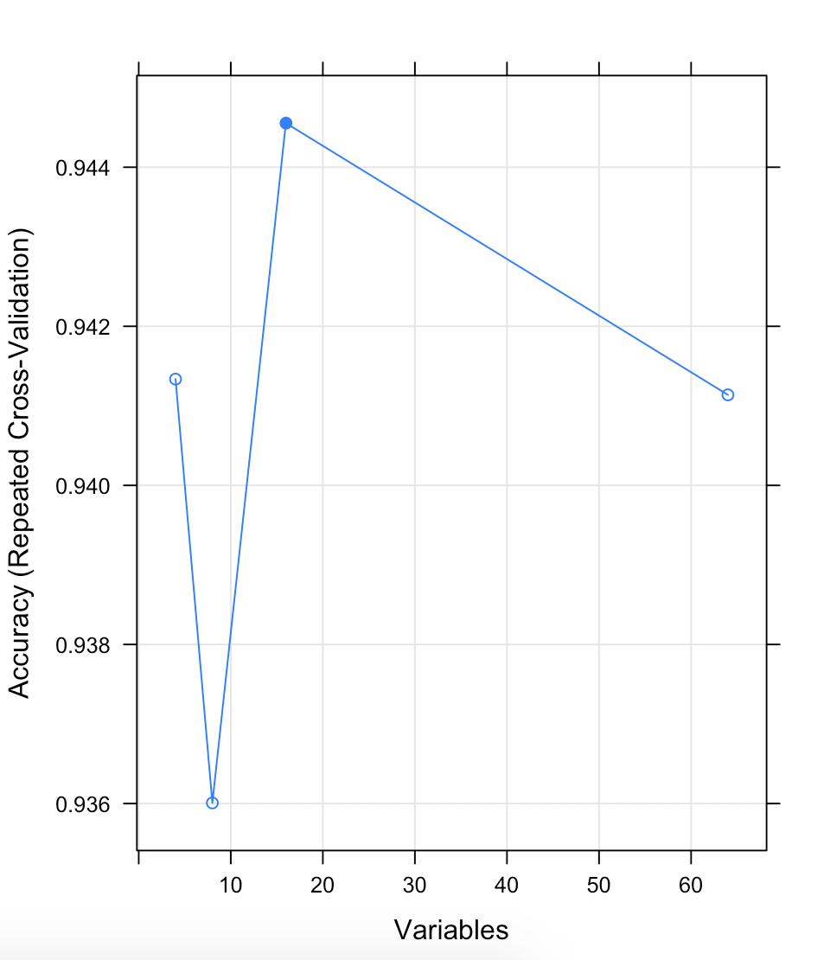
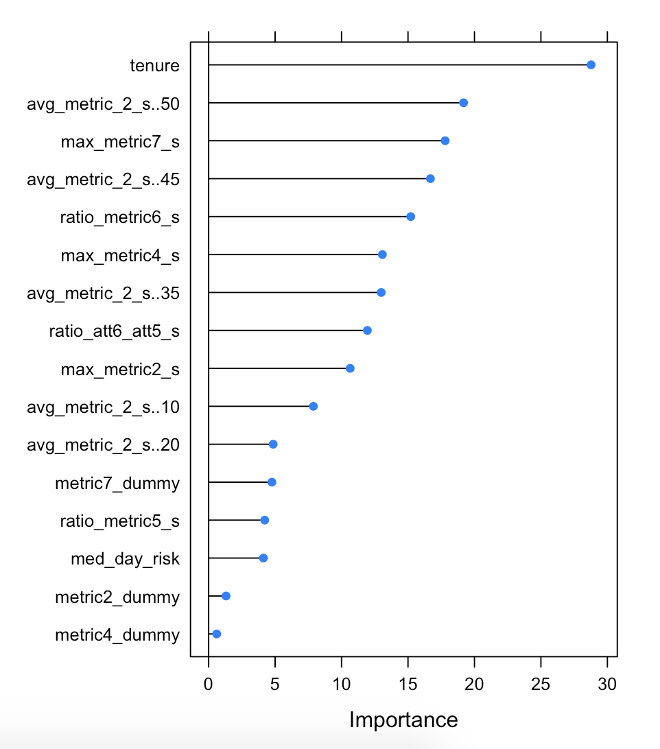
Modeling – predicting failure
Library | Algorithms
H2O | AutoML (XGBoost, DL, AdaBoost, RF…)
Caret | GBM, Random Forest, …
Leveraged two popular libraries available in R : Caret & H2O
Feature Selection:
Utilized Caret’s feature selection called recursive feature elimination and random forest.
The top 5 variables are:
tenure, max_metric7_s, max_metric4_s, avg_metric_2_s..35, max_metric2_s
If there are more than 16 variables the model performance becomes less accurate.
H2O – Variable Imp
RFE
RF – Variable Imp

Slide 7
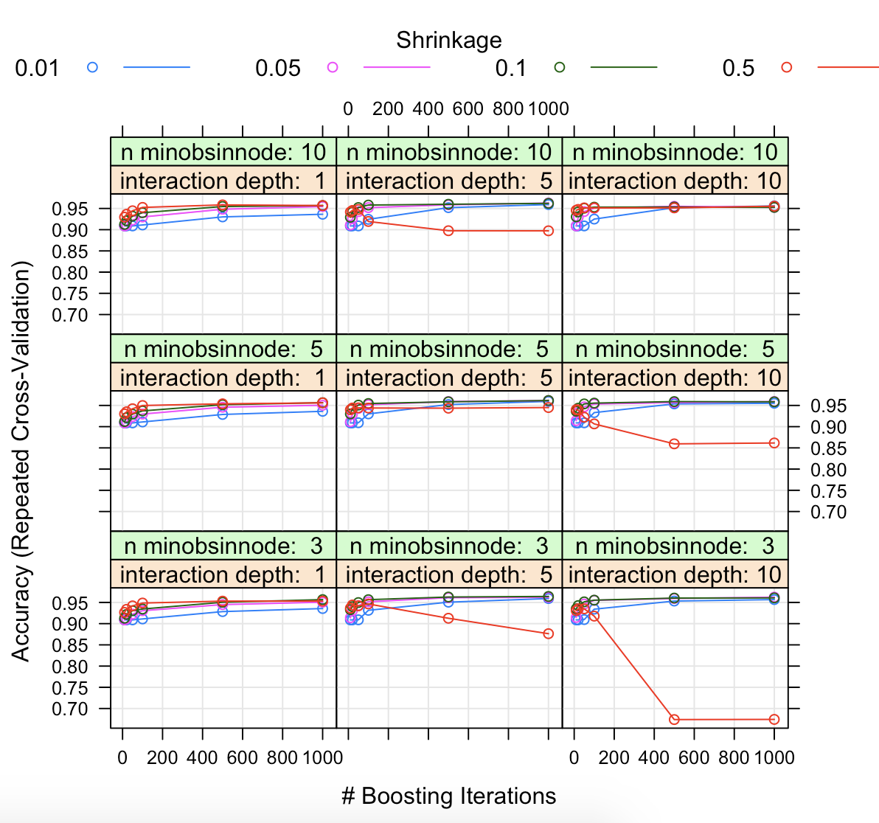
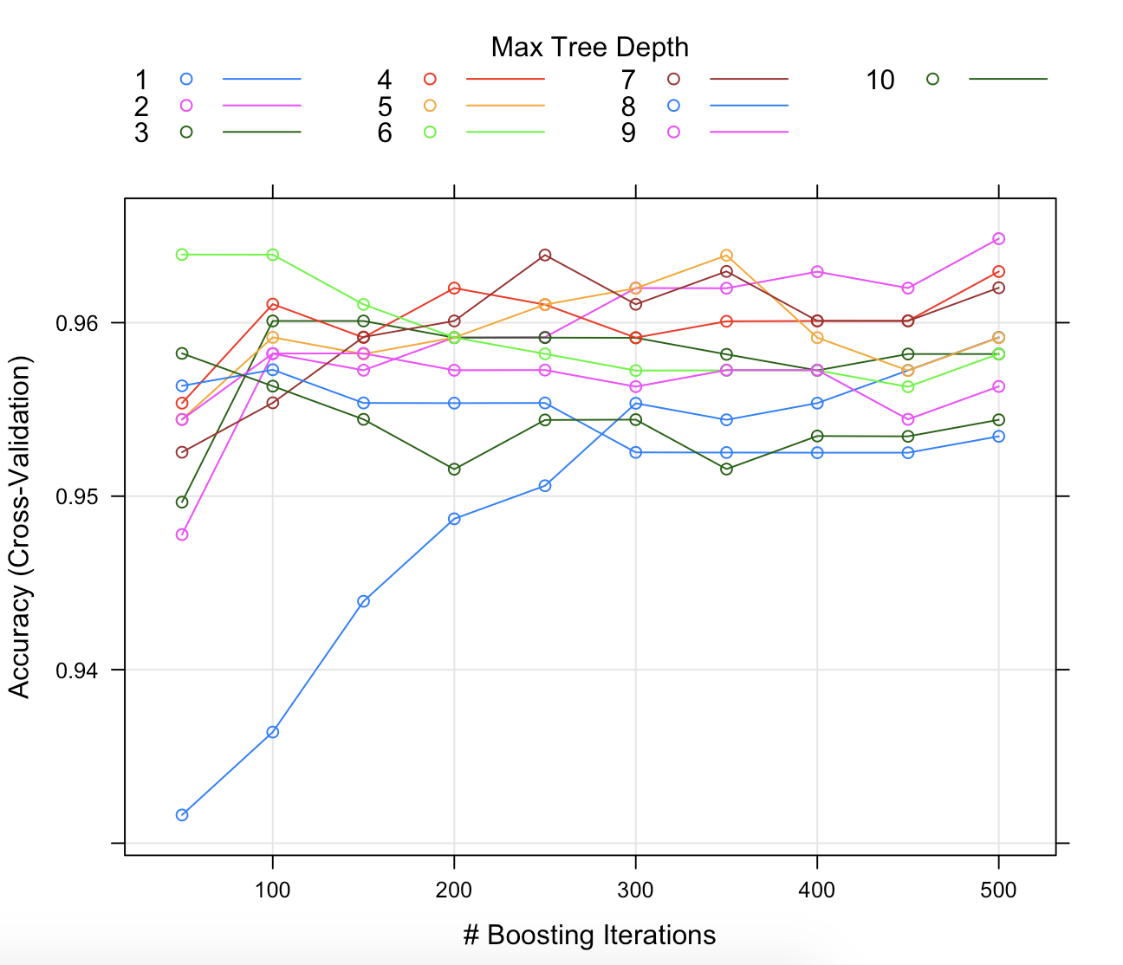
Modeling – predicting failure - GBM
Grid Search
Steps to build GBM Model:
The resampling technique used for evaluating the performance of the model using a set of parameters was set to 5-Fold cross validation, repeated 5 times.
Parameters including number of trees, interaction depth, shrinkage, min obs in a node were input via tuneGrid to ensure we can get best models.
The final values used for the model were # trees = 200, interaction depth = 5, shrinkage = 0.1 and n.minobsinnode = 10.
Accuracy was used to select the optimal model using the largest value.
Confusion Matrix calculation was performed on the test dataset and resulting Accuracy was : 0.9569
Tune Length
Confusion Matrix |  | Reference
Prediction |  | 0 | 1
 | 0 | 104 | 3
 | 1 | 2 | 7

Slide 8
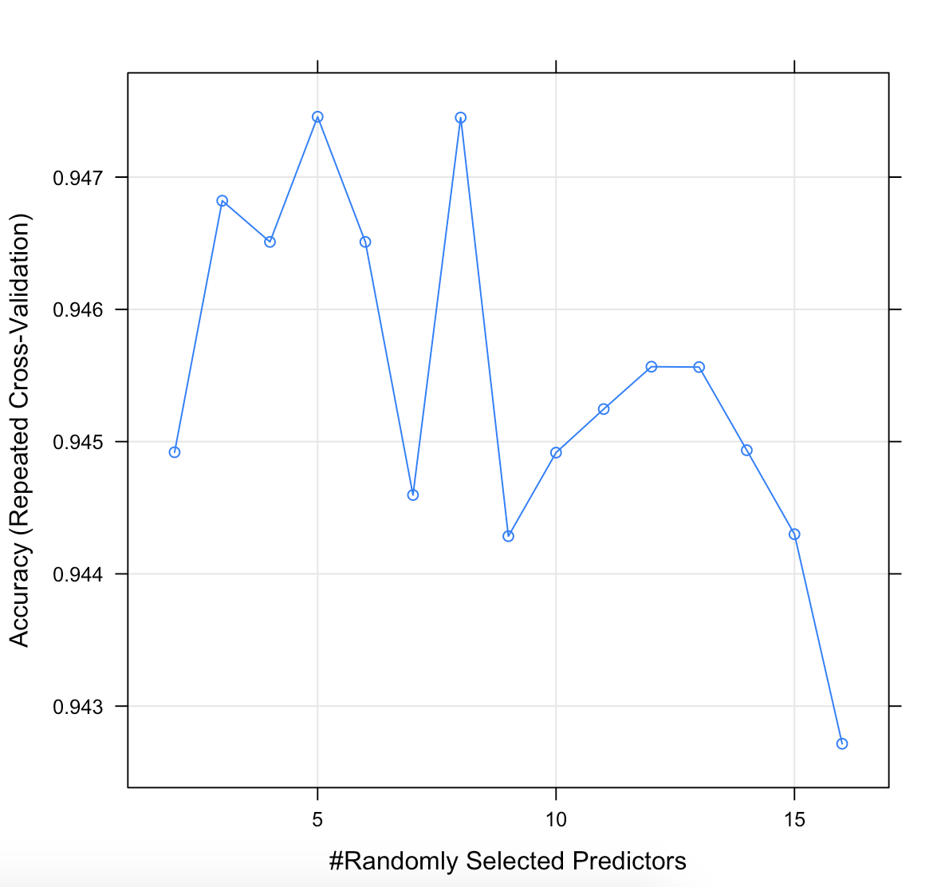
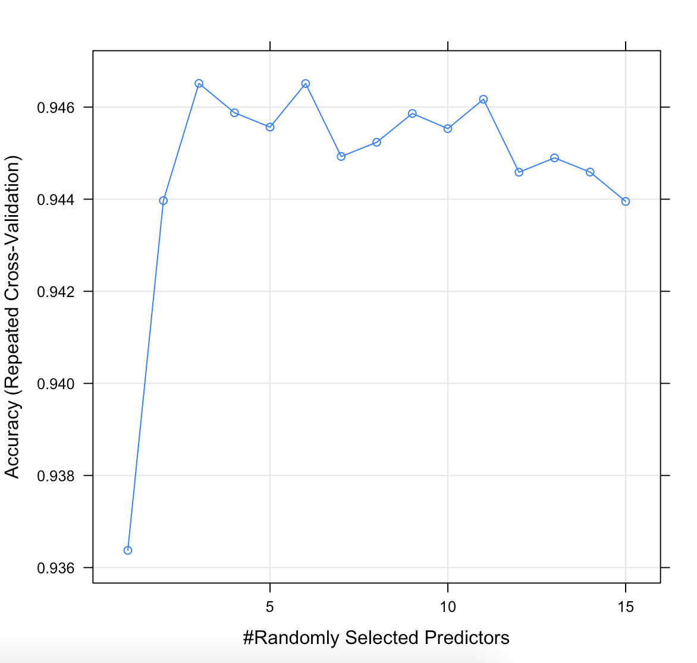
Modeling – predicting failure - RF
Random Search
Steps to build RF Model:
The resampling technique used for evaluating the performance of the model using a set of parameters was set to 10-Fold cross validation, repeated 3 times.
Parameters we testing are number of trees (ntree) and # of variables for each split (mtry).
Started with random search for mtry. Accuracy: 0.947with mtry: 5.
Next started with a gridSearch, Accuracy: 0.946 with mtry: 3.
Accuracy was used to select the optimal model using the largest value.
Final model selected with mtry 5 and accuracy is 0.947.
Grid Search
Confusion Matrix |  | Reference
Prediction |  | 0 | 1
 | 0 | 103 | 4
 | 1 | 3 | 6

Slide 9
Modeling – predicting failure - AUTOML
Library | Algorithms
H2O | AutoML (XGBoost, DL, AdaBoost, RF…)
Caret | GBM, Random Forest, …
Steps to build AutoML Model:
Automl executes various combination of models and selects the best performing models,
Automl combines best performing models via ensemble.
The results do indicate over fitting.
AUTOML Top Models | AUC
GBM_grid_1_AutoML_20190818_165146_model_4 | 0.997
XGBoost_grid_1_AutoML_20190818_163814_model_2 | 0.995
XGBoost_3_AutoML_20190817_135047 | 0.994
XGBoost_grid_1_AutoML_20190818_165146_model_2 | 0.993
XGBoost_3_AutoML_20190817_134302 | 0.993
GBM_1_AutoML_20190818_165146 | 0.993
Confusion Matrix |  | Reference
Prediction |  | 0 | 1
 | 0 | 98 | 9
 | 1 | 1 | 10

Slide 10
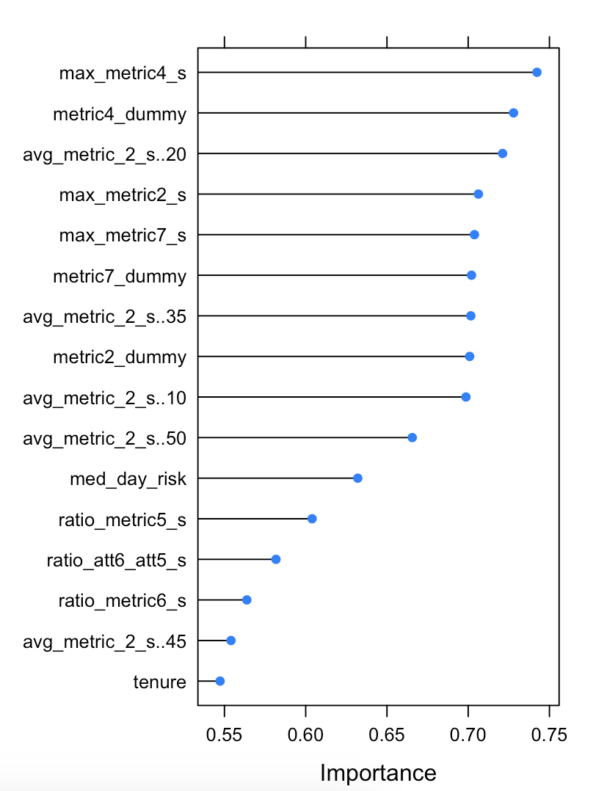
Modeling – predicting failure - Adaboost
Important Variables
Steps to build Adaboost Model:
The resampling technique used for evaluating the performance of the model using a set of parameters was set to 10-Fold cross validation, repeated 3 times.
Accuracy : 0.972
nIter | Method | Accuracy
50 | Adaboost.M1 | 0.970
50 | Real_adaboost | 0.964
100 | Adaboost.M1 | 0.972
100 | Real_adaboost | 0.965
150 | Adaboost.M1 | 0.972
150 | Real_adaboost | 0.965
Confusion Matrix |  | Reference
Prediction |  | 0 | 1
 | 0 | 103 | 1
 | 1 | 3 | 9

Slide 11
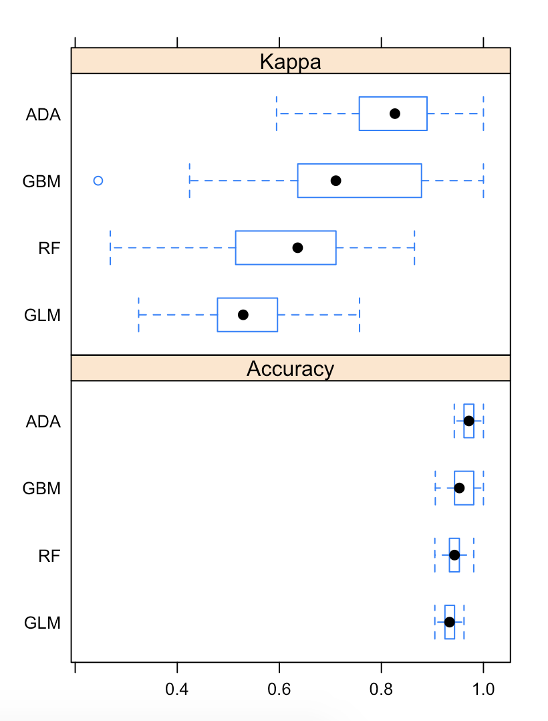
Final Model Selection
Model Performance
Final models were selected based on accuracy of the outcome.
Adaboost and GBM performed well.
Our final model selection is Adaboost.
Variable Tenure has come as an important predictor in all the models. Gives us an idea on when to service / replace the device prior to failing in combination with other metrics.

Slide 12
LSTM : short term memory
Steps to build Adaboost Model:
The resampling technique used for evaluating the performance of the model using a set of parameters was set to 10-Fold cross validation, repeated 3 times.
Accuracy : 0.972

