Slide 1
Customer Churn Analysis
With SHAP Explainability and Segmentation

Slide 2
Overview
• Predict customer churn using Random Forest
• Interpret with SHAP
• Visualize feature impact
• Assign business segments to customers

Slide 3
Data Preprocessing
• Converted TotalCharges to numeric
• Dropped missing values
• Encoded categorical columns

Slide 4
Model Training
• Random Forest Classifier
• Train-test split (80/20)
• Used probability predictions for SHAP & Segmentation

Slide 5
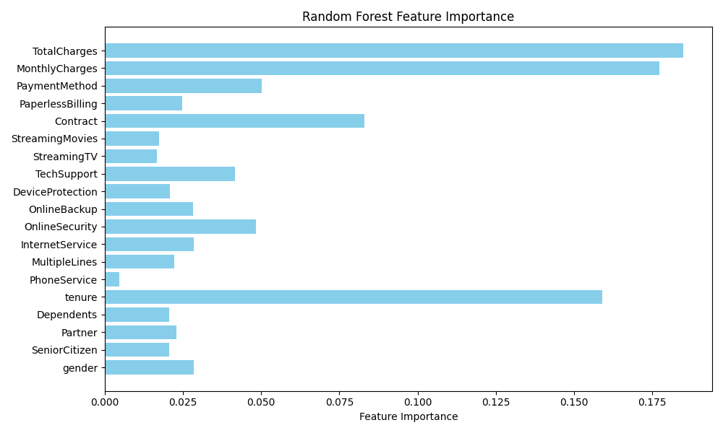
Feature Importance

Slide 6
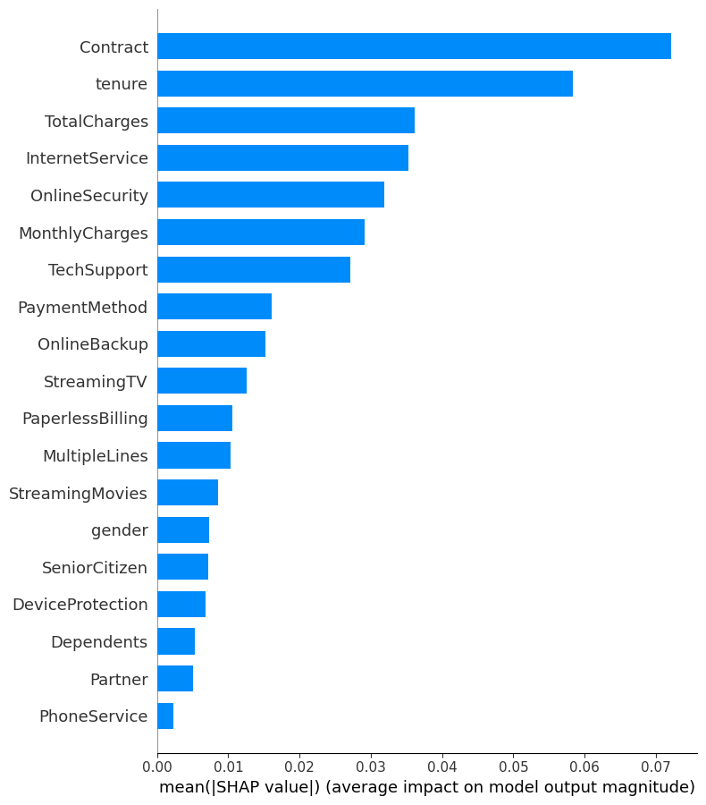
SHAP Summary Plot

Slide 7
Segmentation Rules
• At Risk: churn_prob > 0.6
• Loyal: tenure > 24 & no churn
• Dormant: MonthlyCharges < 40
• General: All others

Slide 8
Sample Customer Segments
customerID | churn_prob | segment
7590-VHVEG | 0.2000 | Dormant
5575-GNVDE | 0.0100 | Loyal
3668-QPYBK | 0.8000 | At Risk
7795-CFOCW | 0.0000 | Loyal
9237-HQITU | 0.7600 | At Risk

