Slide 1
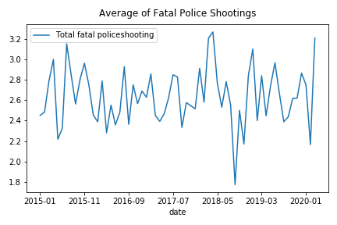
Fatal Police Shootings

Slide 2
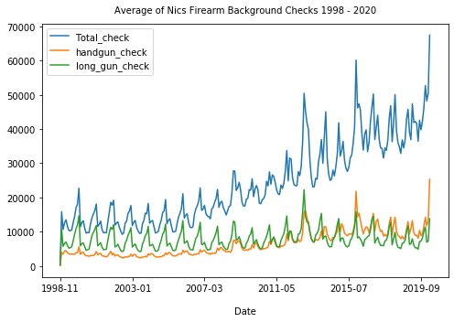
Police Shooting & NICS Firearm Background Checks

Slide 3
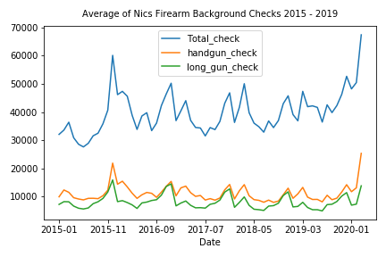
Police Shooting & NICS Firearm Background Checks

Slide 4
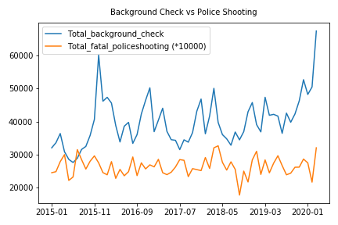
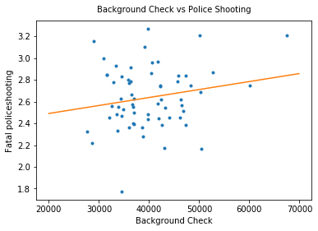
Police Shooting & NICS Firearm Background Checks
pvalue=0.13
R Value = 0.19
p-value = 0.13

Slide 5
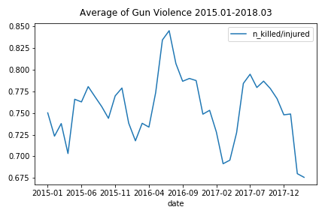
Police Shooting & Gun Violence

Slide 6
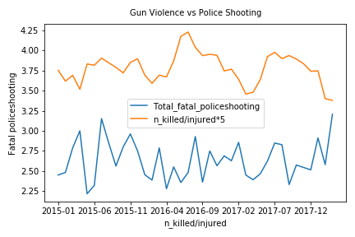
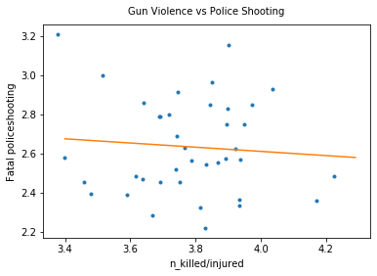
Police Shooting & Gun Violence
R Value = -0.0836
p-value = 0.6128

