Slide 1







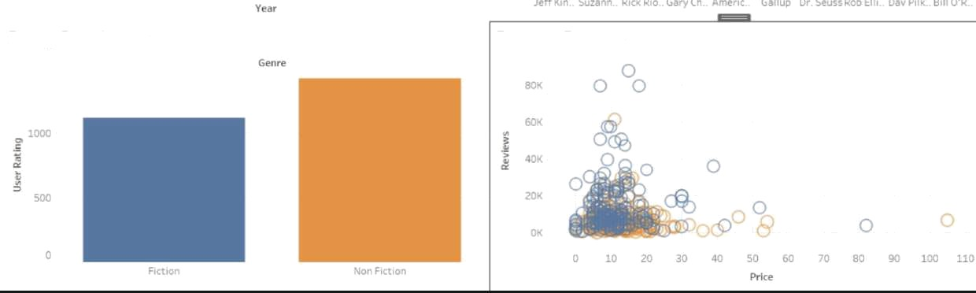
Bestseller Trends Over the Years
Top 10 Bestselling Authors
Rating Distribution
Price vs. Reviews

Slide 2
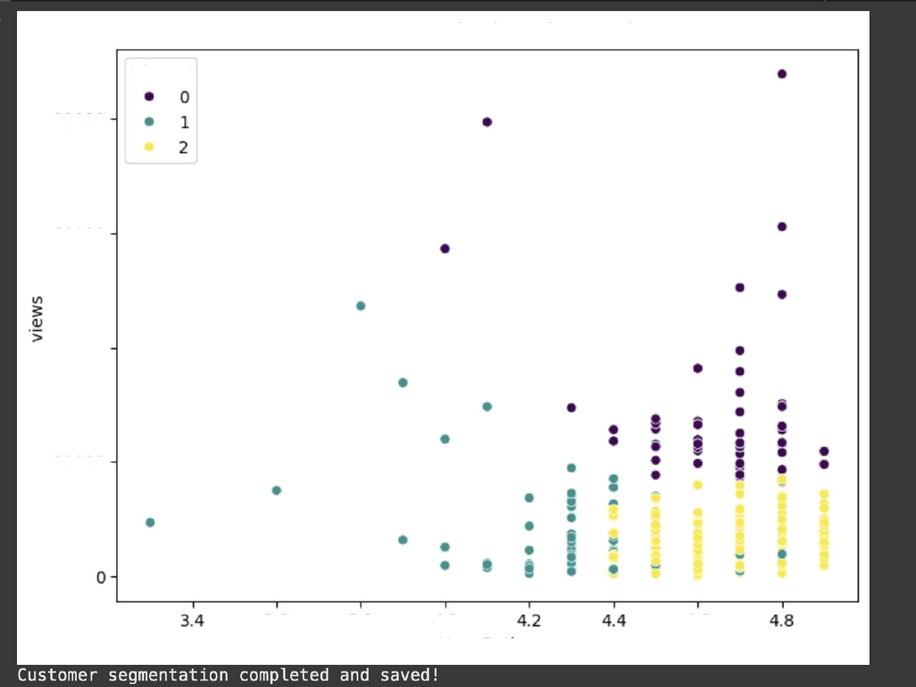
Customer Segmentation based on Book Features
Cluster
80000
60000
ÿ 40000
20000
3.6
3.8
4.0
User Rating
4.6

Slide 3
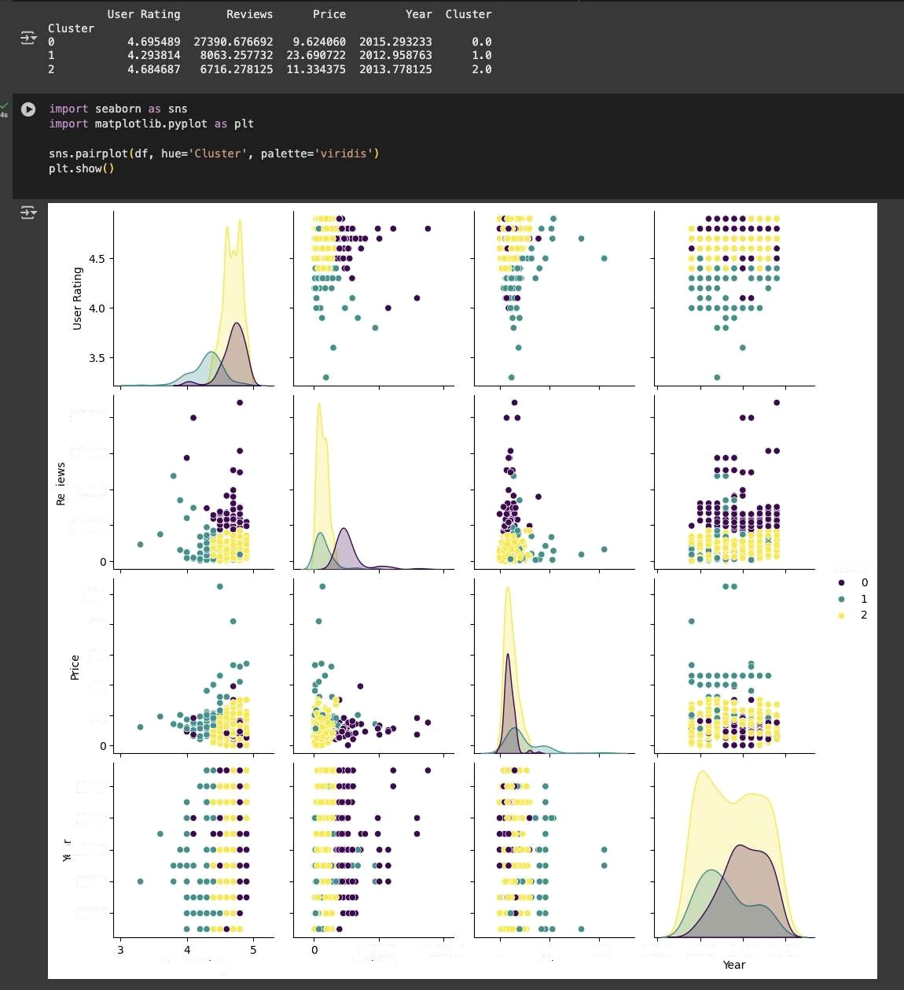
80000
60000
Ü 40000
2 0000
Cluster
100
60
20
2018
2016
'°, 2 014
2012
2010
User Rating
30000
Reviews
IOOOOO
0
50
100
2 00 5 2 010 2 015 2 020

Slide 4
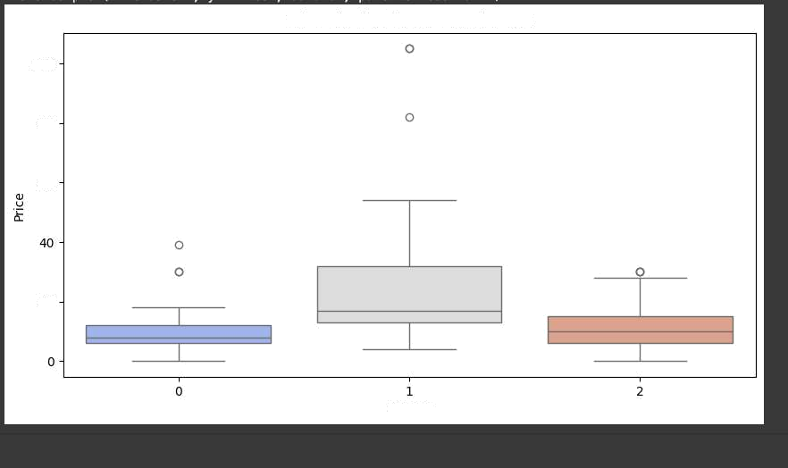
Price Distribution Across Clusters
100
80
60
20
Cluster

